Slide 1
Lecture 01
Bill Perry

Slide 2
Lecture 1: Syllabus
Please look over the syllabus as it has all the details of the class and how it will run.

Slide 3

Lecture 1: Who am I?
Bill Perry
Office is in SSB 13
Phone 218-726-8145
Email is wlperry_at_d.umn.edu

Slide 4
Lecture 1: My goals
How do we make observations and hypotheses?
How do we design an experiment
How do we collect data?
How do we organize, clean, summarize, and view the data?
How do we use statistics to test our hypotheses
  what tests to use
  what are the assumptions
  what are the interpretations

Slide 5
Lecture 1: My expectations
Communication
Practice
Failure
Learn to correct and troubleshoot

Slide 6
Lecture 1: Science
Way to acquire knowledge, organize it and apply it back to the real world
Make predictions and testing these predictions using a falsifiable approach - statistics
Explanations that cannot be falsified are not science

Slide 7

What is Statistics?
Zar (1999) - “analysis and interpretation of data with view towards objective evaluation of conclusions based on the data”

Slide 8
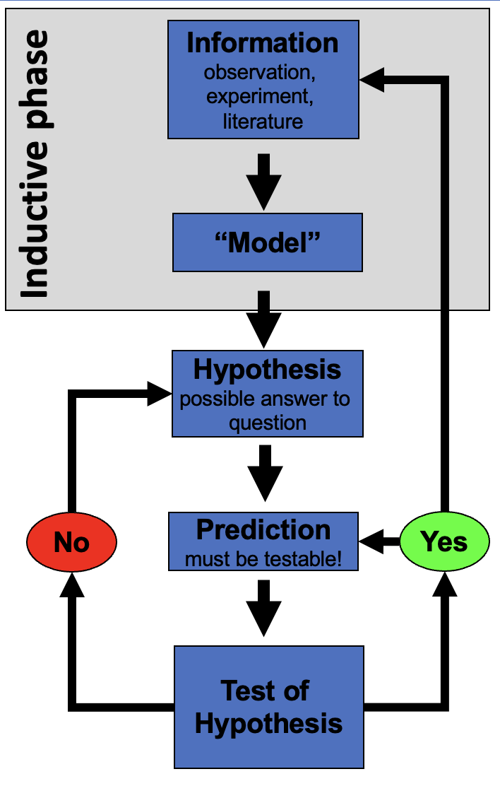
Lecture 1: Inductive reasoning (Specific → General)
Inductive Reasoning (Specific → General)
Inductive reasoning involves observing specific cases and using them to form a general conclusion.
Example:
Measure 10 pine needles from a tree - average length is 75 mm.
Measure 10 more needles from the same tree and gets similar results.
Measures needles from second tree - average length is 120 mm .
You generalize pine needles from different trees vary in length, but each tree tends to have a characteristic range.
Conclusion (Induction): “Pine needle length varies by tree, but each tree seems to have a typical range of lengths.
Potential Issue: Conclusion is not guaranteed to be true - based on patterns observed in a sample, and there could be exceptions.

Slide 9
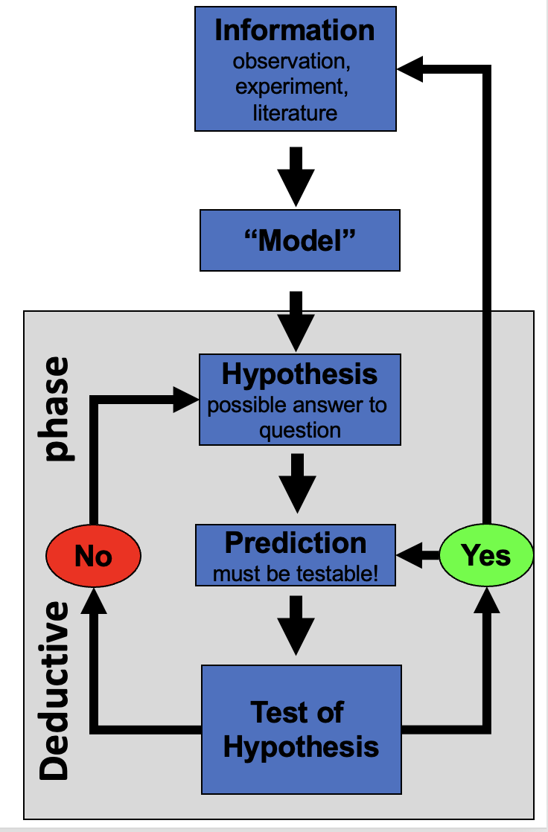
Lecture 1: Deductive reasoning (General → Specific)
Deductive Reasoning (General → Specific)
Deductive reasoning starts with a general principle and applies it to a specific case.
Example:
General Principle: Pine needles from a species of pine tree have a predictable length range (e.g., 70–80 mm).
Specific Case: Collect sample of pine needles and measure them.
Prediction: Since its the species the needle lengths should fall within 70–80 mm.
Measurement: Check the data and confirm needles fall within this expected range.
Conclusion (Deduction): “This tree belongs the species with a needle length range of 70–80 mm, we expect its needle lengths to fall in this range.”
Stronger than induction because it’s based on a general rule—but if the assumption (length range) is incorrect, conclusion could still be wrong.

Slide 10
Lecture 1: Reality of reasoning
In reality we are doing both of these processes

Slide 11
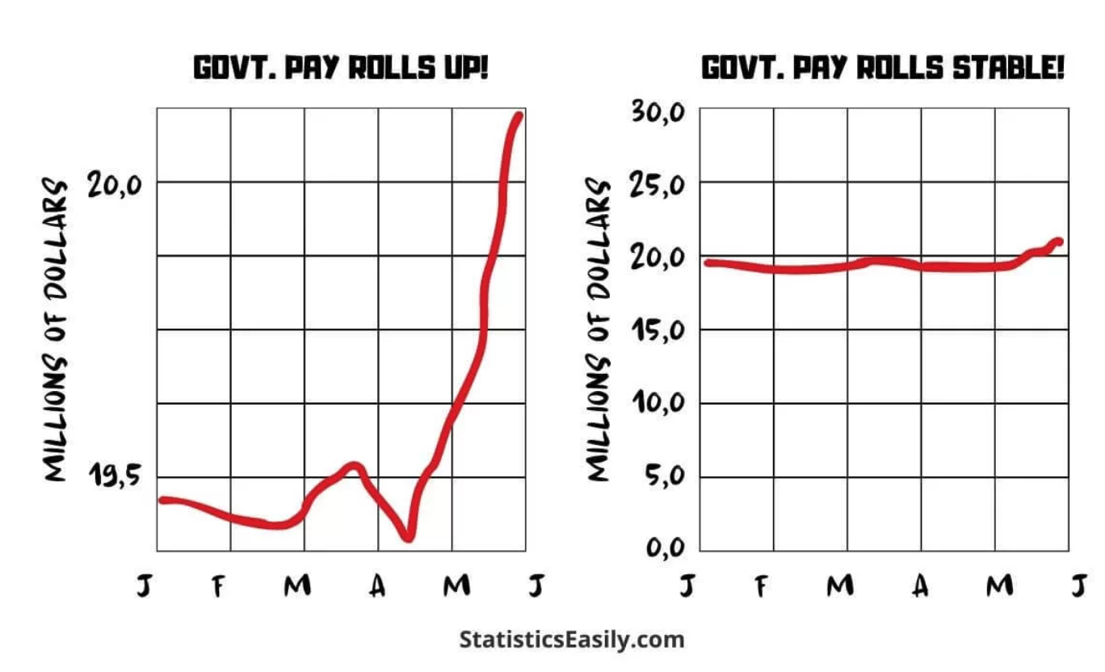
How do we test hypotheses
Statistics
Design good experiments
Design good tests
Summarize patterns/data
Use to make probabilistic determinations to see if differences are “real”

Slide 12
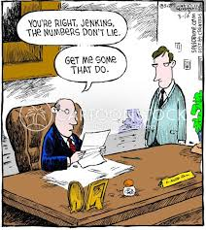
Data Types
Continuous
  numeric
Discrete
  integer or numerical
Categorical
  nominal – up, down, right, left…
  ordinal – order - a, b, c, d or morning, afternoon, evening

Slide 13
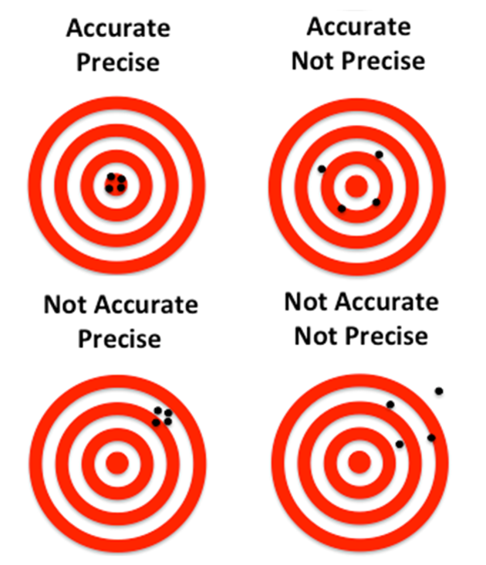
Measurements
Data is obtained through measurement
The world is a messy place and how you measure matters
Our measures depend on
accuracy - how close we are to the real value
precision - how close all our measurements are but may not be precise

