Slide 1
Lecture 02
Bill Perry

Slide 2
Review of Lecture 1
Covered
Inductive vs deductive reasoning
Formulating research questions
Accuracy vs precision
Data types and classifications
Setting up R projects
Installing and loading libraries
Reading files into R
Creating basic graphs

Slide 3

Lecture 2: Project Design & Data Visualization
The objectives:
Design a well-organized project
Implement good naming conventions
  Controlled vocabulary
  Including units in names
Create and use metadata effectively
Build tidy, well-structured spreadsheets
Understand data repositories
Create effective visualizations with ggplot2

Slide 4
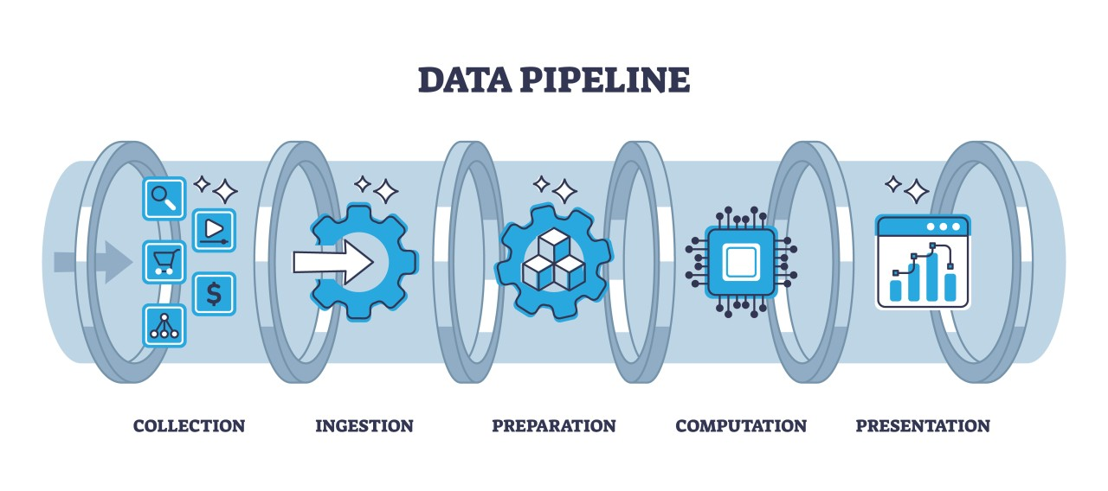
Project Design: Step 1
Data: the raw material of science
Wide variety of formats, sizes, complexity
Data management and curation often under emphasized
Good data management: owe it to our funding agencies, colleagues, supervisors, and study systems

Slide 5
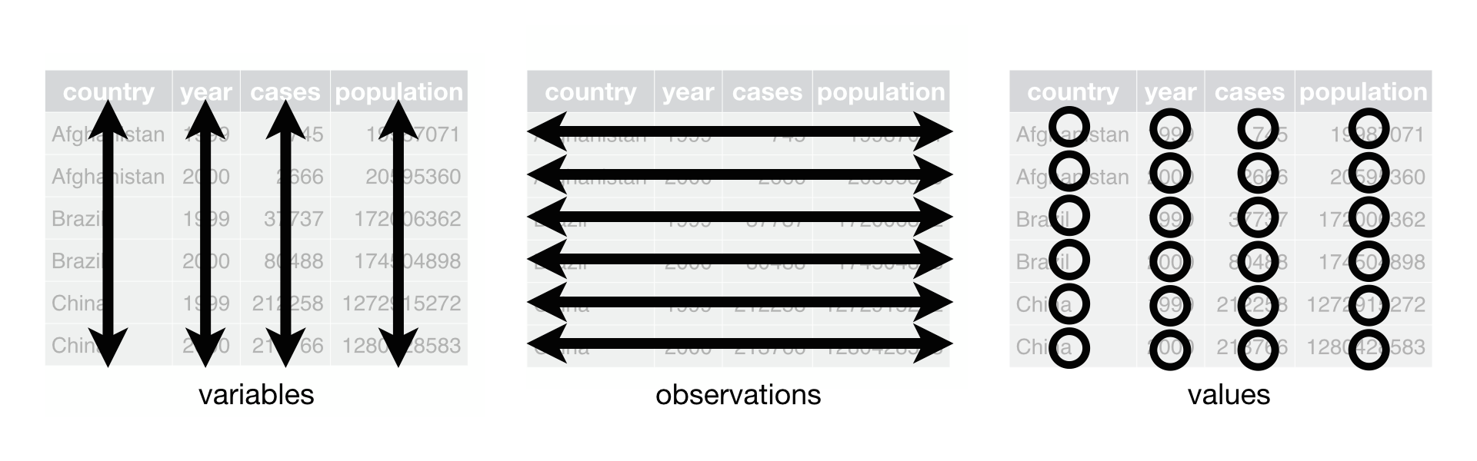
Lecture 2: Project Design: Step 1
Determine data types you’ll collect
Establish controlled vocabulary
  Example: do_mgl for dissolved oxygen in mg/L
  Example: drp_ugl for dissolved reactive phosphorus in μg/L
Plan your data flow from collection to analysis
Organize your project structure (folders, files)
Enter data promptly after collection
Save in multiple formats (Excel and CSV)
Ensure tidy data principles from the start
Note
See Hadley Wickham’s Tidy Data principles for best practices

Slide 6
Project Design: Step 2
Create a Metadata Sheet that includes:
Variable descriptions
Units of measurement
Collection methods
Instrument details
Dates and locations
Any other relevant contextual information

Slide 7
Practice Exercise 1: Pine Data Organization
Practice Exercise 1: Pine Data Organization
Let’s examine our pine needle data:
- What naming conventions did you choose?
- How did you organize the data?
- How can you verify data formats (numeric vs categorical)?
- What’s your plan for organizing outputs and figures?
# A tibble: 48 × 6
date group n_s wind tree_no length_mm
<chr> <chr> <chr> <chr> <dbl> <dbl>
1 3/20/25 cephalopods n lee 1 20
2 3/20/25 cephalopods n lee 1 21
3 3/20/25 cephalopods n lee 1 23
4 3/20/25 cephalopods n lee 1 25
5 3/20/25 cephalopods n lee 1 21
6 3/20/25 cephalopods n lee 1 16
7 3/20/25 cephalopods s wind 1 15
8 3/20/25 cephalopods s wind 1 16
9 3/20/25 cephalopods s wind 1 14
10 3/20/25 cephalopods s wind 1 17
# ℹ 38 more rows

Slide 8

Lecture 2: Data Management: Step 3
Storage and Backup Strategy:
Store raw data and metadata securely
  Save in both Excel and CSV formats
  Consider write-protecting raw data files
Implement the 3-2-1 backup rule:
  3 total copies of data
  2 different storage media
  1 offsite location (cloud storage)
Establish a regular backup schedule

Slide 9
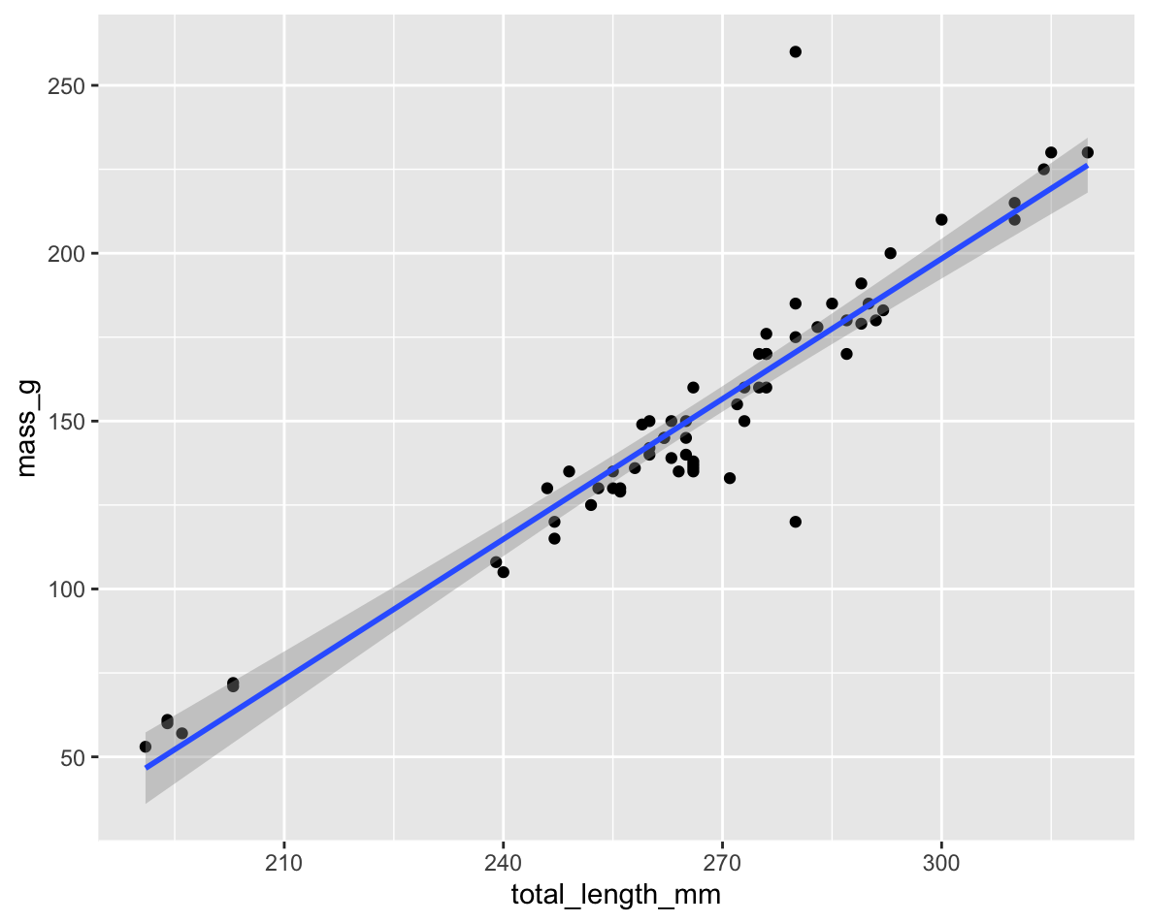
Lecture 2: Data Management: Step 4
Initial Data Inspection:
Examine data in the Environment tab
Run summary() and glimpse() functions
Create exploratory visualizations
Check for outliers, errors, and missing data
# Specify how to handle missing values during import
pine_df <- read_csv("data/pine_needles.csv",
na = c("", "NA", "N/A", "missing", "null"))
# Get a quick summary
summary(pine_df)

Slide 10
Practice Exercise 2: Try plotting a histogram
Practice Exercise 2: Try plotting a histogram of your data
Create a histogram of pine needle lengths to check the distribution:

Slide 11
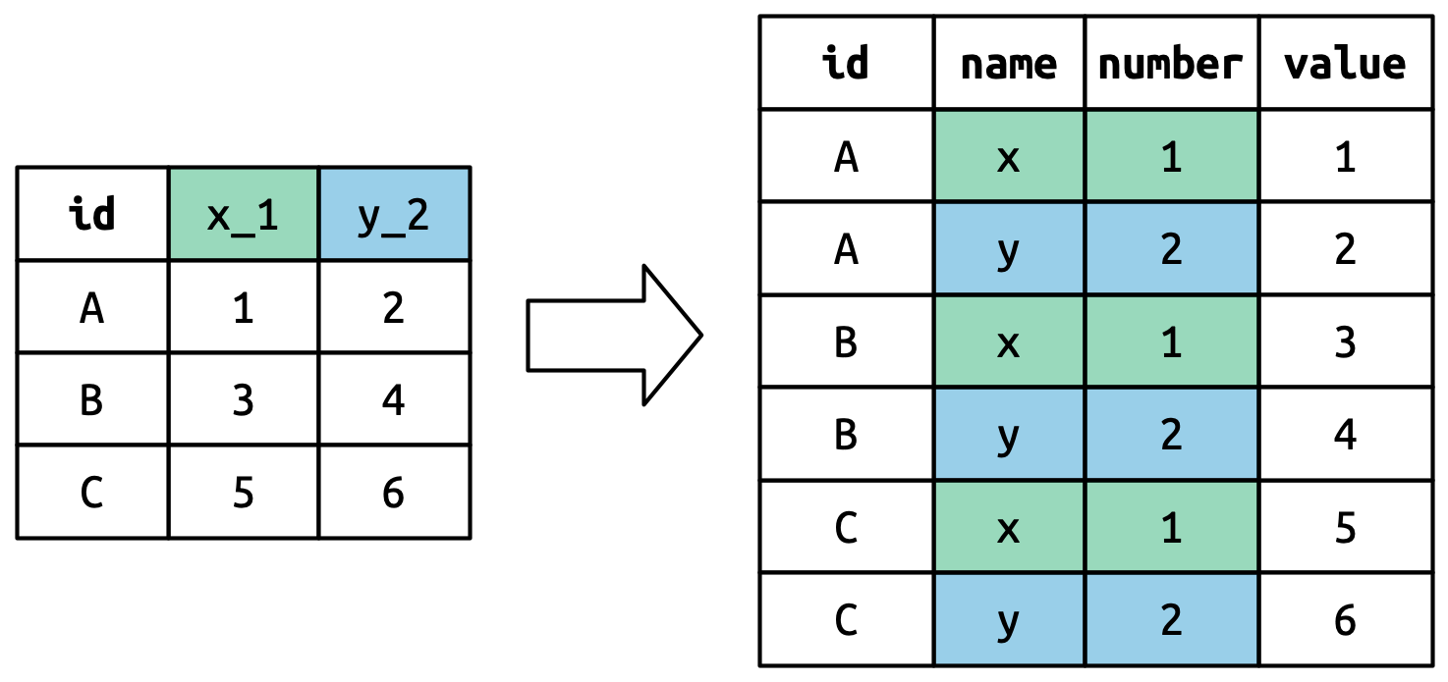
Lecture 2: Data Management: Step 5
Data Cleaning:
Correct errors and inconsistencies
Replace missing values with proper NA codes
Document all changes made to raw data
Save a clean, master version (consider making read-only)
Keep notes on data cleaning procedures

Slide 12
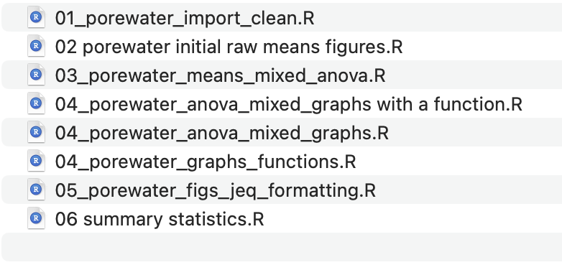
Lecture 2: Data Management: Step 6
Analysis and Visualization Workflow:
Create exploratory visualizations
Summarize and transform data as needed
Document all analysis steps
Save outputs systematically
A useful way to organize script files is number them in the order they get run.

Slide 13
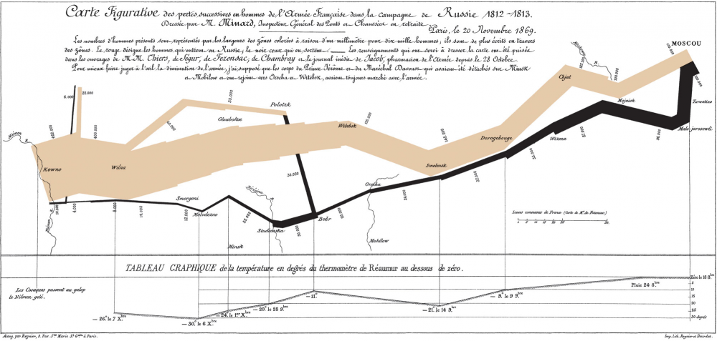
Lecture 2: Effective Data Visualization
Why make plots?
Get in a group and discuss
What is the purpose of a data visualization?
What elements are essential in an effective plot?
What characteristics define a “good” plot?
What common mistakes make plots ineffective?
Napoleon’s Disastrous Invasion of Russia Detailed in an 1869 Data Visualization: It’s Been Called “the Best Statistical Graphic Ever Drawn”

Slide 14
Lecture 2: Tables vs. Visualizations
How readable are tables?
We will get to what these number mean and how to make them in the next lecture.
Tables
  are they useful in a presentation?
wind | n | mean_mm | sd_mm | min_mms | max_mm
lee | 24 | 20 | 2.45 | 16 | 25
wind | 24 | 15 | 1.91 | 12 | 19

Slide 15
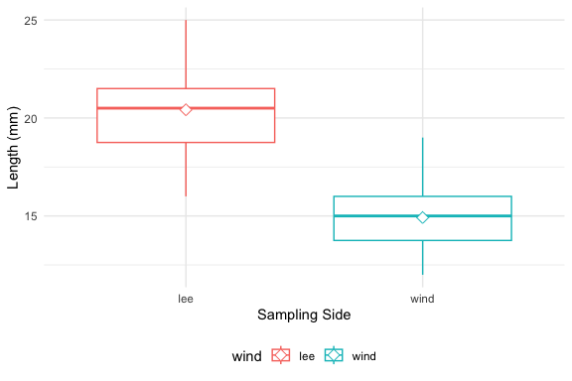
Lecture 2: Displaying data
how does a table compare to a plot?
Does this help?
What is this plot?
  if you don’t explain does the audience know?

Slide 16
Lecture 2: Principles of Effective Graphics
According to Tufte (2001), good scientific graphics:
Show the data without distortion
Maximize data-ink ratio (minimize non-data elements)
Make large datasets coherent and understandable
Encourage comparison between elements
Reveal multiple layers of information
Serve a clear purpose in telling your story
Integrate with statistical methods appropriately
# A tibble: 4 × 7
group mean_mm sd_mm n se_mm conf_low conf_high
<chr> <dbl> <dbl> <int> <dbl> <dbl> <dbl>
1 cephalopods 18 3.86 12 1.11 15.5 20.5
2 crayfish 18 3.86 12 1.11 15.5 20.5
3 salmon 16.3 3.94 12 1.14 13.8 18.8
4 snail 18.3 2.27 12 0.655 16.9 19.8

Slide 17
Lecture 2: Creating Effective Graphics
According to Tufte (2001), good scientific graphics:
To implement these principles:
  Focus on the data, not decorative elements
  Ensure proportional representation of numbers
  Provide clear and informative labels
  Remove unnecessary elements (“chart junk”)
  Revise and refine visualizations iteratively

Slide 18
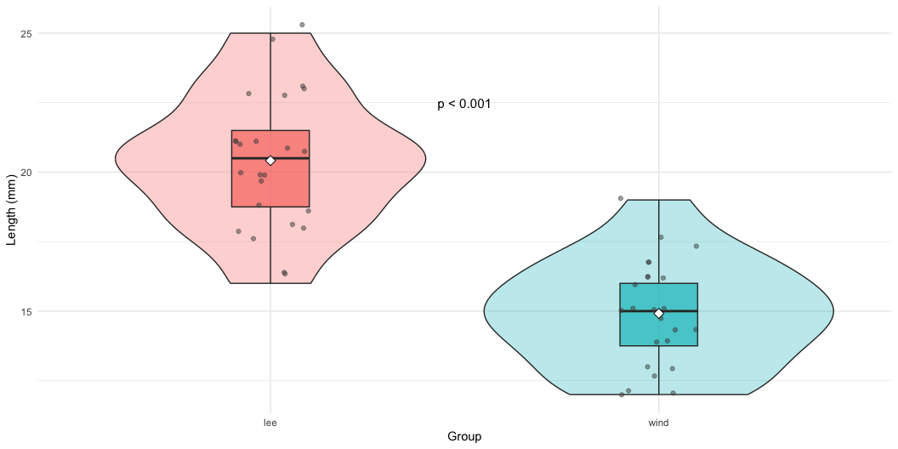
Lecture 2: Displaying data - Good Graphics
To make good graphics:
Above all, focus on data
Do not distort data
Graphical representation of numbers → directly proportional to numbers
Strive for clarity through labeling
Maximize data-ink ratio
  Remove non-data ink
  Reduce redundant data ink
Revise and redraw

Slide 19
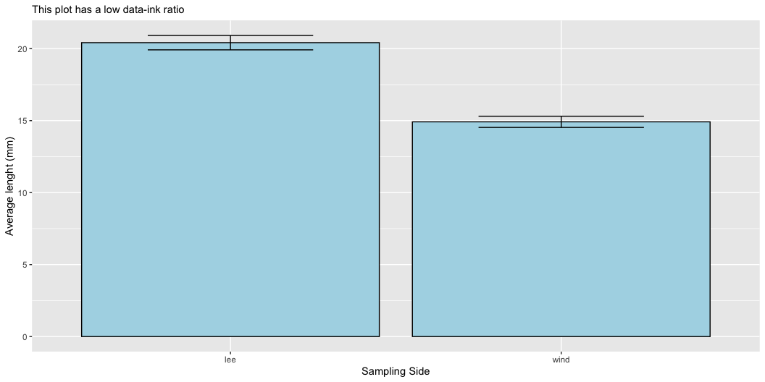
Lecture 2: Displaying data - Poor Example
What do you think?
Does this -
Focus on data
Distort data
Is it directly proportional to numbers
Is labeling clear
Maximize data-ink ratio
  Remove non-data ink
  Reduce redundant data ink
Revise and redraw

Slide 20
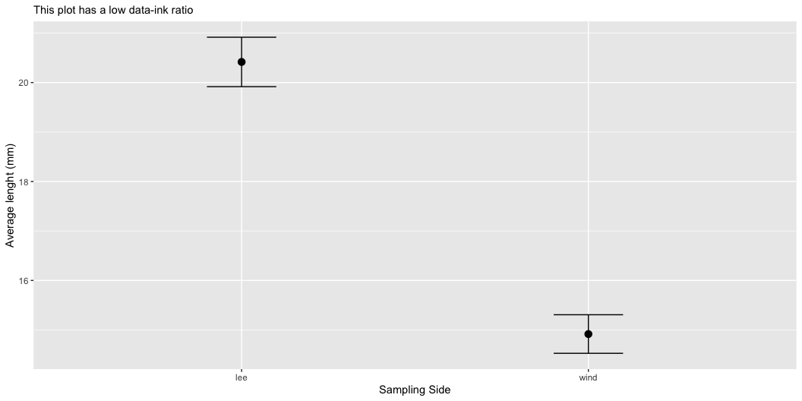
Lecture 2: Displaying data - Better Example
What do you think?
Does this -
Focus on data
Distort data
Is it directly proportional to numbers
Is labeling clear
Maximize data-ink ratio
  Remove non-data ink
  Reduce redundant data ink
Revise and redraw
What is one of the most common plots you make all the time?

Slide 21
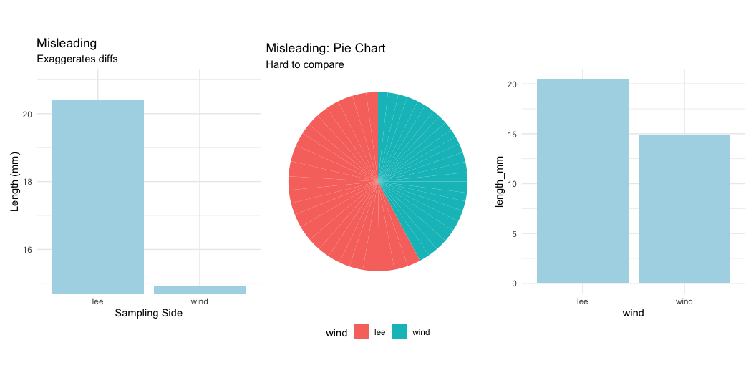
Lecture 2: Displaying data - Common Problems
Common Visualization Problems
Data distortion:
  Non-zero baselines on bar charts
  3D effects that skew perspective
  Inappropriate scales
Excessive “chart junk”:
  Too many grid lines
  Unnecessary decorative elements
  Redundant information
Poor color choices:
  Too many colors
  Non-colorblind-friendly palettes
  Colors that don’t print well in grayscale
Misleading representations:
  Pie charts with too many categories
  Dual y-axes with different scales
  Truncated axes without clear indication

Slide 22
Practice Exercise 3: Basic Plots with Pine Data
Practice Exercise 3: Lets try some plots with pine data first
Lets try to make some basic plots
# Write your code here to make a dot plot or X y plot
# How do you examine the data - what are the ways you think and lets try it!
# what is missing - hwo do you tell the effect of wind?

Slide 23
Practice Exercise 4: Colors, Shapes, and Fills
Practice Exercise 4: OK we are closer but what about colors or shape or fills
Lets try to make some more basic plots
This is free time - we will free code this….
Below are some examples of code you will need for the future
# Write your code here to make a dot plot or X y plot
# How do you examine the data - what are the ways you think and lets try it!
# what is missing - hwo do you tell the effect of wind?

Slide 24
Lecture 2: Introduction to the Grammar of Graphics - ggPLOT
We will learn the anatomy of a GGplot is layers
ggplot2 uses a layered grammar of graphics approach:
  Data: The dataset you’re visualizing
  Aesthetics: Mapping variables to visual properties
  Geometries: The visual elements representing data
  Facets: Splitting visualization into subplots
  Statistics: Statistical transformations of the data
  Coordinates: The space in which data is plotted
  Themes: Overall visual style of the plotWe have aesthetics

Slide 25
Lecture 2: Building a ggplot Visualization
Key Components:
Aesthetics (aes) map variables to visual properties:
  x and y positions
  color, fill, shape, size, alpha
  group, linetype
**Geometries (geom_*)** determine how data is displayed:
  geom_point(): Scatter plots
  geom_line(): Line graphs
  geom_boxplot(): Box-and-whisker plots
  geom_violin(): Violin plots
  geom_histogram(): Histograms
  geom_bar(): Bar charts
Position adjustments control how elements are arranged:
  position_dodge(): Side-by-side elements
  position_jitter(): Add random noise to points
  position_stack(): Stack elements on top of each other
Labels and annotations provide context:
  labs(): Title, subtitle, caption, axis labels
  annotate(): Add text, shapes, etc.

Slide 26
Lecture 2: Fine-tuning your visualizations
Colors, fills, and shapes:
  scale_color_manual(
  values = c("wind" = "darkblue", "lee" = "darkred"),
  labels = c("wind" = "Windward", "lee" = "Leeward")
  )
Coordinate systems:
  coord_cartesian(ylim = c(10, 30)) # Zoom in without dropping data
Themes:
  theme_minimal() +
  theme(
  axis.title = element_text(size = 14),
  legend.position = "bottom"
  )
Combining plots with patchwork:
  plot1 + plot2 + plot_layout(ncol = 2)

Slide 27
Practice Exercise 5: Publication-Quality Plot
Practice Exercise 4: Creating a Publication-Quality Plot
Create a fully customized plot that would be suitable for publication:
# Create a publication-quality plot
pine_df %>%
ggplot(aes(x = wind, y = length_mm, fill = wind)) +
geom_violin(alpha = 0.4) +
geom_boxplot(width = 0.2, alpha = 0.7, outlier.shape = NA) +
geom_jitter(width = 0.1, alpha = 0.5, color = "gray30", size = 2) +
stat_summary(fun = mean, geom = "point", shape = 23, size = 3, fill = "white") +
labs(
title = "Pine Needle Length Varies with Wind Exposure",
subtitle = "Needles on the leeward side tend to be longer",
x = "Tree Side",
y = "Needle Length (mm)",
caption = "Data collected Spring 2023") +
scale_fill_manual(
values = c("wind" = "#1b9e77", "lee" = "#d95f02"),
labels = c("wind" = "Windward", "lee" = "Leeward")) +
theme_minimal() +
theme(
plot.title = element_text(face = "bold", size = 16),
plot.subtitle = element_text(size = 12, color = "gray30"),
axis.title = element_text(face = "bold"),
legend.title = element_blank(),
legend.position = "bottom")

Slide 28
Key Takeaways
Plan your data management from the beginning
  Consistent naming conventions
  Good organization
  Regular backups
Make your data tidy from the start
  One observation per row
  One variable per column
  One value per cell
Create effective visualizations by:
  Focusing on data, not decoration
  Using appropriate plot types
  Following good design principles
  Customizing for clear communication
Master the grammar of graphics to:
  Build plots layer by layer
  Communicate patterns clearly
  Tell compelling stories with data

Slide 29
Next Steps
Practice creating different types of plots
Learn to combine multiple plots effectively
Explore statistical transformations in ggplot2
Develop a consistent visualization style

