Slide 1
Lecture 05: Probability and Statistical Inference
Bill Perry

Slide 2
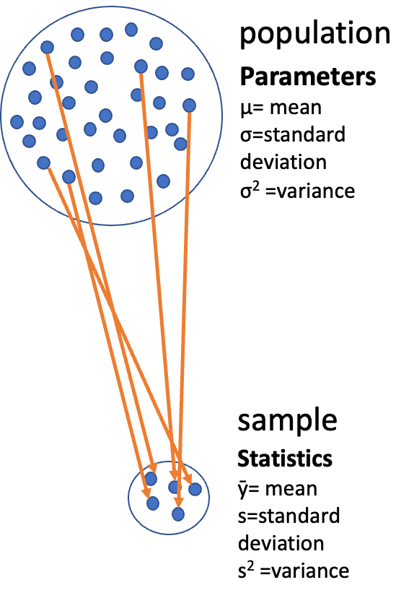
Lecture 4: Review
Introduction to histograms or frequency distributions
Probability Distribution Functions (PDF)
  Z scores and T scores
Tests of means using T-Tests
  one sample
  two sample

Slide 3
Tests of means using T-Tests
  one sample - is the sample mean different from a hypothesized mean?
  two sample - are the sample means from two samples the same or different?
for Two sample T-tests the df = n1+ n2 -2 = 8+8-2=14
# A tibble: 2 × 5
side mean_length sd_length se_length count
<chr> <dbl> <dbl> <dbl> <int>
1 shady 17.6 2.51 0.886 8
2 sunny 16.2 2.64 0.934 8

Slide 4
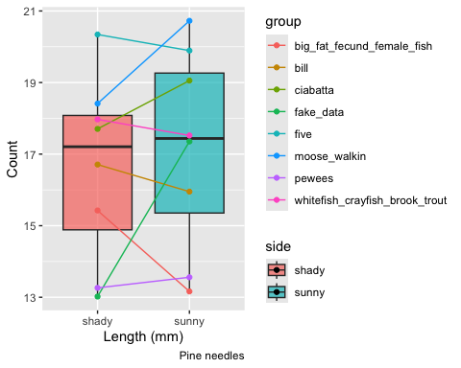
Lecture 5: Probability and Statistical Inference
The goals for today
Statistical inference fundamentals
Hypothesis testing principles
T Distributions
One sample T Test
Two sample T Test
Paired T Test
Assumption tests

Slide 5
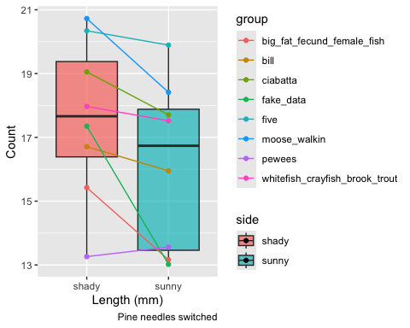
Lecture 5: Probability and Statistical Inference
The goals for today
Statistical inference fundamentals
Hypothesis testing principles
T Distributions
One sample T Test
Two sample T Test
Paired T Test

Slide 6
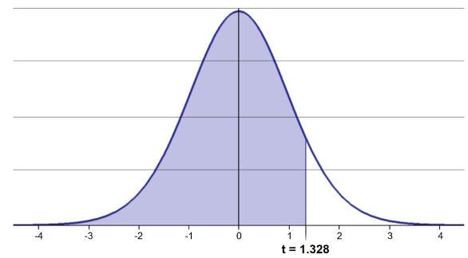
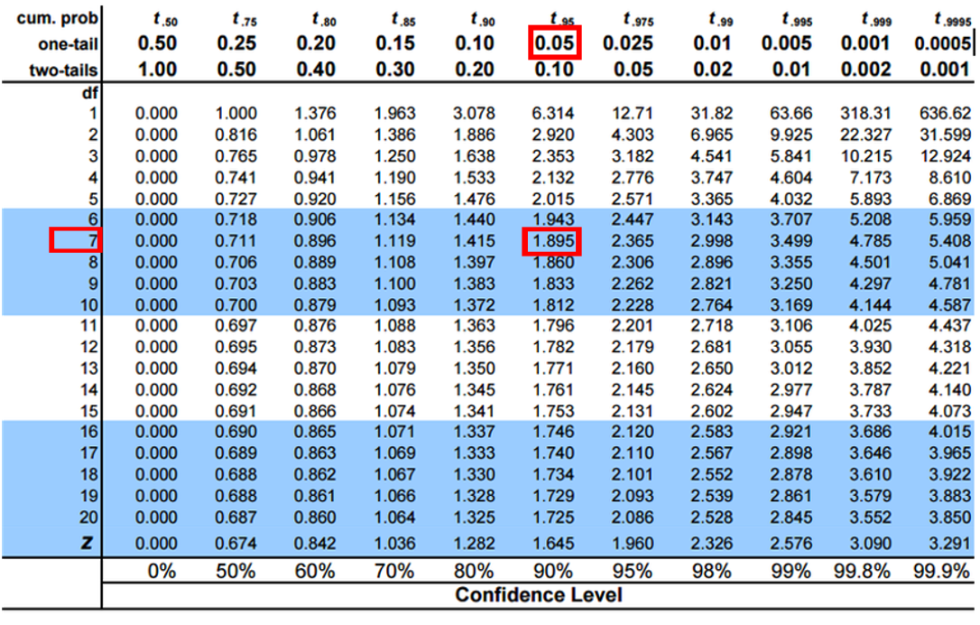
Lecture 5: One-tailed Questions
One-tailed questions: area of distribution left or (right) of a certain value for a one sample test
n=8 (df=7) - 95% of the observations found left
t= 1.895 (5% are outside)

Slide 7
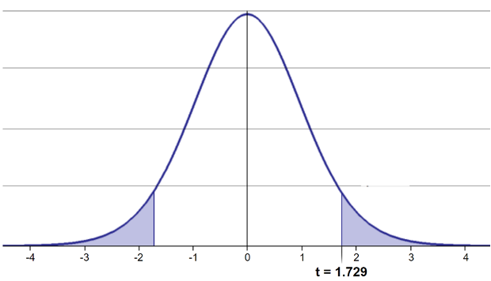
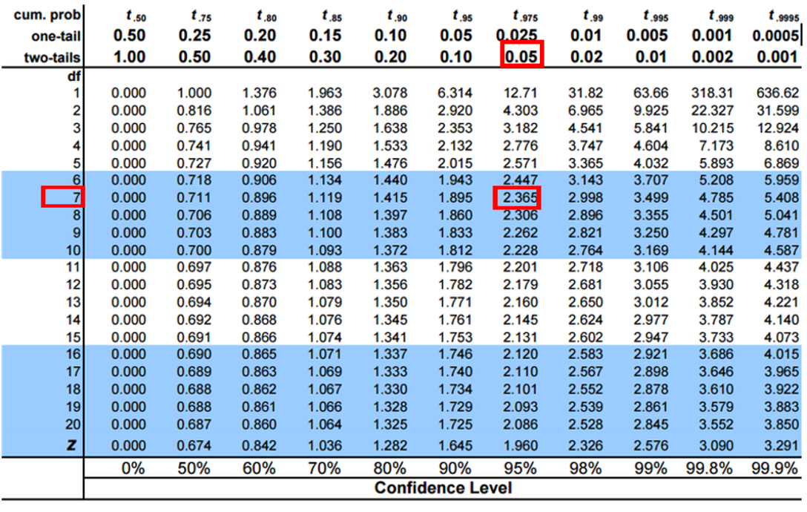
Lecture 5: Two-tailed Questions
Two-tailed questions refer to area between certain values
n= 8 (df=7), 95% of the observations are between
t=-2.365 and t=2.365 (2.5% are outside on each side)
One tailed was t= 1.895 (5% are outside)

Slide 8
Lecture 5: Calculating CI Example
Let’s calculate CIs again:
Use two-sided test
$\text{CI}=\overset{‾}{y}±t⋅\frac{s}{\sqrt{n}}$
95% CI Sample A: = 17.6 ± 2.365 * (2.51/(8^0.5)) = +/- 2.098746
The 95% CI is between 15.50 and 19.70
“The 95% CI for the population mean from sample A is 17.6 ± 2.1

Slide 9
Lecture 5: Applications of t-distribution
So:
Can assess confidence that population mean is within a certain range
Can use t distribution to ask questions like:
  “What is probability of getting sample with mean = ȳ
  from population with mean = µ?” (1 sample t-test)
  “What is the probability that two samples came from
  the same population?” (2 sample t-test)

Slide 10
Lecture 5: One Sample T-Test
We want to test if the mean needle length on one side differs from 15mm.
Activity: Define hypotheses and identify assumptions
H₀: μ = 15 (The mean needle length on shade side is 15mm)
H₁: μ ≠ 15 (The mean needle length on shade side is not 240mm)
Assumptions for t-test:
Data is normally distributed
Observations are independent
No significant outliers

Slide 11
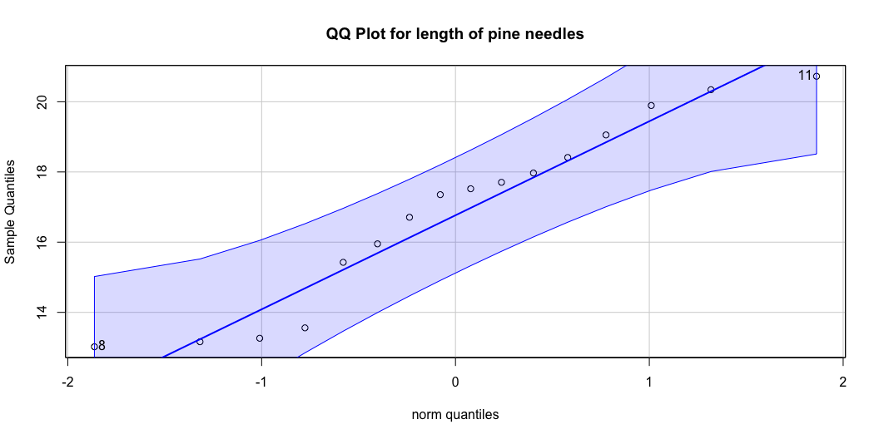
Assumptions in R - qqplots from car

Slide 12
[1] 8 11

Slide 13
Statistical Test of Normality
Shapiro-Wilk test
Shapiro-Wilk normality test
data: ps_df$length_mm
W = 0.92754, p-value = 0.2228

Slide 14
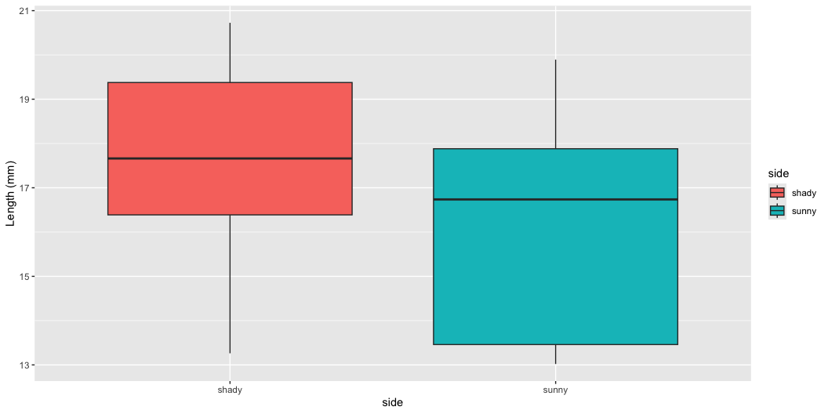
Checking for Outliers

Slide 15
Practice Exercise 1: One-Sample t-Test
Practice Exercise 1: One-Sample t-Test
Let’s perform a one-sample t-test to determine if the mean needle length on the shady side differs from 15 mm:
Mean: 17.6 mm
One Sample t-test
data: ps_shady_df$length_mm
t = 2.9414, df = 7, p-value = 0.02167
alternative hypothesis: true mean is not equal to 15
95 percent confidence interval:
15.51092 19.70030
sample estimates:
mean of x
17.60561
Interpret this test result by answering these questions:
What was the null hypothesis?
What was the alternative hypothesis?
What does the p-value tell us?
Should we reject or fail to reject the null hypothesis at α = 0.05?
What is the practical interpretation of this result for botanists?

Slide 16
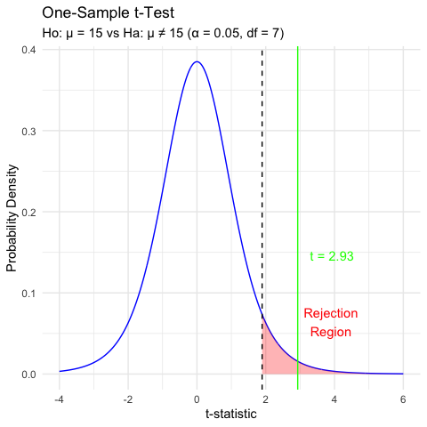
Lecture 5: Hypothesis Testing Framework
Hypothesis testing is a systematic way to evaluate research questions using data.
Key components:
Null hypothesis (Ho): Typically assumes “no effect” or “no difference”
Alternative hypothesis (Ha): The claim we’re trying to support
Statistical test: Method for evaluating evidence against H₀
P-value: Probability of observing our results (or more extreme) if H₀ is true
Significance level (α): Threshold for rejecting H₀, typically 0.05
Decision rule: Reject Ho if p-value less than α or shorthand p < 0.05

Slide 17
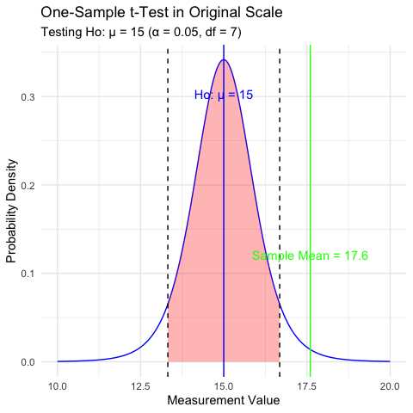
Lecture 5: Hypothesis Testing
Hypothesis testing is a systematic way to evaluate research questions using data.
Key components:
Null hypothesis (H₀): Typically assumes “no effect” or “no difference”
Alternative hypothesis (Hₐ): The claim we’re trying to support
Statistical test: Method for evaluating evidence against H₀
P-value: Probability of observing our results (or more extreme) if H₀ is true
Significance level (α): Threshold for rejecting H₀, typically 0.05
Decision rule: Reject H₀ if p-value < α

Slide 18
Lecture 5: Interpreting One-Sample T-Test Results
Activity: Interpret the t-test results
What does the p-value tell us?
Should we reject or fail to reject the null hypothesis?
How to report this result in a scientific paper:
“A one-sample t-test at α=0.05 showed that the mean needle length (… mm, SD = …) [was/was not] significantly different from the expected 15 mm, t(…) = …, p = …”

Slide 19
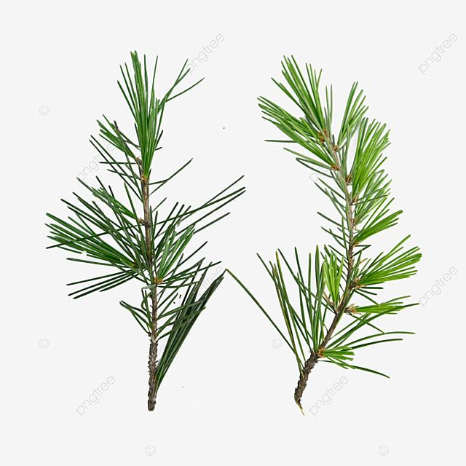
Lecture 5: Two Sample T-Tests Introduction
For example
what is probability that population X is the same as population Y?
How would you assess this question using what we learned?
This is what we will do with the needle length again…

Slide 20
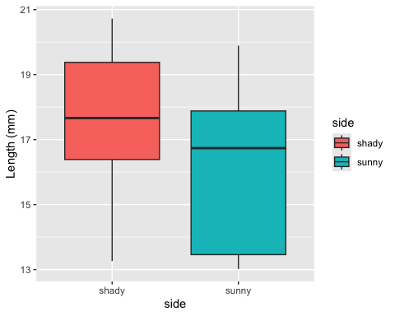
Lecture 5: Comparing Two Samples
For example
what is probability that population X is the same as population Y?
How would you assess this question using what we learned?

Slide 21
Practice Exercise 2: Formulating Hypotheses
Practice Exercise 2: Formulating Hypotheses
For the following research questions about needle lengths write the null and alternative hypotheses:
Are needle lengths on shady and sunny sides different?
What are the hypotheses?
Ho =
Ha =

Slide 22
Lecture 5: Two-Sample T-Test Framework
Now, let’s compare needles lengths from the two sides
Question: Is there a significant difference in needle length between the sides?
This requires a two-sample t-test.
Two-sample t-test compares means from two independent groups.
$t=\frac{{\overset{‾}{x}}_{1}−{\overset{‾}{x}}_{2}}{S_{p}\sqrt{\frac{1}{n_{1}}+\frac{1}{n_{2}}}}$
where:
x̄₁ and x̄₂: These represent the sample means of the two groups you’re comparing
s²ₚ: This is the pooled variance, calculated as: s²ₚ = [(n₁ - 1)s₁² + (n₂ - 1)s₂²] / (n₁ + n₂ - 2), where s₁² and s₂² are the sample variances of the two groups.
n₁ and n₂: These are the sample sizes of the two groups.
√(1/n₁ + 1/n₂): This represents the pooled standard error.
$t=\frac{SIGNAL}{NOISE}$

Slide 23
Practice Exercise 3: Summary Statistics
Practice Exercise 3: Calculate summary statistics grouped by lake
Before conducting the test, we need to understand the data for each group.
You need this and the graph to see what is going on ….
  # A tibble: 2 × 5
  side mean_length sd_length n se_length
  <chr> <dbl> <dbl> <int> <dbl>
  1 shady 17.6 2.51 8 0.886
  2 sunny 16.2 2.64 8 0.934

Slide 24
Practice Exercise 4: Effect Size
Practice Exercise 4: Effect size
We could also look at the difference in means… some cool code here
# A tibble: 1 × 1
difference
<dbl>
1 1.45

Slide 25
Practice Exercise 5: ggplot Summary Statistics
Practice Exercise 5: Using GGPLOT to get summary plot
GGplot also has code to make the mean and standard error plots we are interested in along with a lot of others

Slide 26
Lecture 5: Testing Assumptions for Two-Sample T-Test
For a two-sample t-test, we need to check:
Normality within each group
Equal variances between groups (for standard t-test)
Independent observations
If assumptions are violated:
Welch’s t-test (unequal variances)
Non-parametric alternatives (Mann-Whitney U test)

Slide 27
Practice Exercise 6: Separate Group Data
Practice Exercise 7: Test normality of sunny pine needle lengths
Note you need to test each groups separately…
# A tibble: 6 × 5
# Groups: group, tree_no, tree_char [6]
group tree_no tree_char side length_mm
<chr> <dbl> <chr> <chr> <dbl>
1 big_fat_fecund_female_fish 2 tree_2 shady 15.4
2 bill 3 tree_3 shady 16.7
3 ciabatta 5 tree_5 shady 19.1
4 fake_data 8 tree_8 shady 17.4
5 five 1 tree_1 shady 20.3
6 moose_walkin 7 tree_7 shady 20.7
# A tibble: 6 × 5
# Groups: group, tree_no, tree_char [6]
group tree_no tree_char side length_mm
<chr> <dbl> <chr> <chr> <dbl>
1 big_fat_fecund_female_fish 2 tree_2 sunny 13.2
2 bill 3 tree_3 sunny 16.0
3 ciabatta 5 tree_5 sunny 17.7
4 fake_data 8 tree_8 sunny 13.0
5 five 1 tree_1 sunny 19.9
6 moose_walkin 7 tree_7 sunny 18.4

Slide 28
Practice Exercise 8: Combined Normality Test
Practice Exercise 8: Test Normality at one time
There are always a lot of ways to do this in R
# A tibble: 2 × 4
side shapiro_stat shapiro_p_value normal_distribution
<chr> <dbl> <dbl> <chr>
1 shady 0.966 0.868 Normal
2 sunny 0.900 0.289 Normal

Slide 29
Practice Exercise 13: Test Equal Variances
Practice Exercise 13: Test equal variances
Levenes test can be done on the original dataframe
Note: the Levenes Test should be NOT SIGNIFICANT - What is the null hypothesis
[1] "Levene's Test for Homogeneity of Variance:"
Levene's Test for Homogeneity of Variance (center = median)
Df F value Pr(>F)
group 1 0.2062 0.6567
14

Slide 30
Lecture 5: Conducting the Two-Sample T-Test
Now we can compare the mean needle lengths between shady and sunny sides.
Ho: μ₁ = μ₂ (The needle lengths do not differ)
Ha: μ₁ ≠ μ₂ (The mean needle lengths differ - direction is not specified)
Calculate t-statistic manually (optional) - YOUR CODE HERE:
t = (mean1 - mean2) / sqrt((s1^2/n1) + (s2^2/n2))
Deciding between:
Standard t-test (equal variances)
Welch’s t-test (unequal variances)
[1] "Standard two-sample t-test:"
Two Sample t-test
data: length_mm by side
t = 1.1279, df = 14, p-value = 0.2783
alternative hypothesis: true difference in means between group shady and group sunny is not equal to 0
95 percent confidence interval:
-1.309330 4.214005
sample estimates:
mean in group shady mean in group sunny
17.60561 16.15328

Slide 31
Lecture 5: Conducting the Two-Sample T-Test
Now we can compare the mean needle lengths between shady and sunny sides.
Ho: μ₁ = μ₂ (The needle lengths do not differ)
Ha: μ₁ ≠ μ₂ (The mean needle lengths differ - direction is not specified)
Calculate t-statistic manually (optional) - YOUR CODE HERE:
t = (mean1 - mean2) / sqrt((s1^2/n1) + (s2^2/n2))
Deciding between:
Standard t-test (equal variances)
Welches t-test (unequal variances)
[1] "Welches two-sample t-test:"
Welch Two Sample t-test
data: length_mm by side
t = 1.1279, df = 13.96, p-value = 0.2784
alternative hypothesis: true difference in means between group shady and group sunny is not equal to 0
95 percent confidence interval:
-1.310069 4.214743
sample estimates:
mean in group shady mean in group sunny
17.60561 16.15328

Slide 32
Lecture 5: Difference between a Two-Sample T and Welch’s T Test
Standard t-test (Student’s t-test)
Assumes equal variances between the two groups being compared
Uses a pooled variance estimate that combines data from both group
Has higher statistical power when the equal variance assumption is met
Degrees of freedom = n₁ + n₂ - 2
Welch’s t-test
Does not assume equal variances between groups (also called the “unequal variances t-test”)
Uses separate variance estimates for each group
More robust when group variances are different
Uses a more complex degrees of freedom calculation (Welch-Satterthwaite equation) and decimal!!!
Degrees of freedom are typically non-integer and usually smaller than the standard t-test

Slide 33
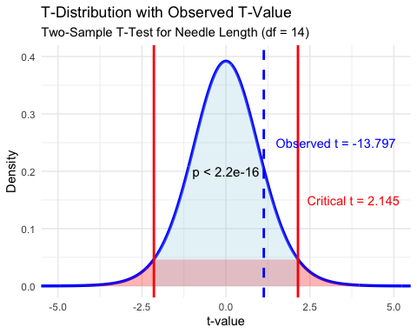
Lecture 5: Interpreting Two-Sample T-Test Results
Interpret the results of the two-sample t-test
What can we conclude about the needle lengths on sunny vs shady sides?
How to report this result in a scientific paper:
“A two-tailed, two-sample t-test at α=0.05 showed [a significant/no significant] difference in needle length between sunny (M = …, SD = …) and shady (M = …, SD = …) sides of pine trees, t(…) = …, p = ….”

Slide 34
Lecture 5: Now what does a paired T test tell us
Paired t-test:
Compares two measurements from the same subjects or matched pairs Tests whether the mean difference between paired observations equals zero Examples: before/after measurements on the same people, left vs right measurements, matched case-control studies Uses the differences between pairs as the data points Generally more powerful because it controls for individual variation
[1] "Standard two-sample t-test:"
Paired t-test
data: ps_wide_df$sunny and ps_wide_df$shady
t = -2.7818, df = 7, p-value = 0.02723
alternative hypothesis: true mean difference is not equal to 0
95 percent confidence interval:
-2.6868652 -0.2178092
sample estimates:
mean difference
-1.452337

Slide 35
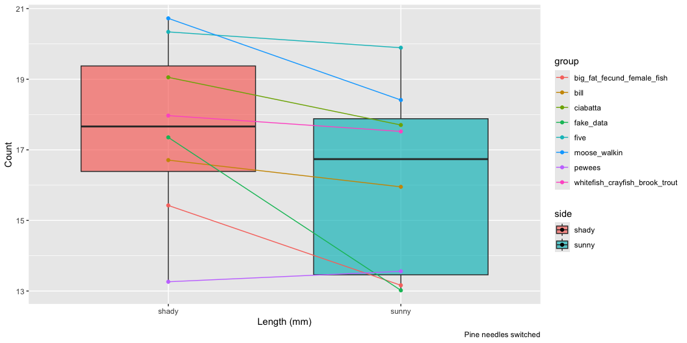
Lecture 5: What is going on??
Note that thee is a lot of variation within trees but the trend is the same

Slide 36
Lecture 5: Assumptions of Parametric Tests
Common assumptions for t-tests:
Normality: Data comes from normally distributed populations
Equal variances (for two-sample tests)
Independence: Observations are independent
No outliers: Extreme values can influence results
What can we do if our data violates these assumptions?
Alternatives when assumptions are violated:
Data transformation (log, square root, etc.)
Non-parametric tests
Robust statistical methods

Slide 37
Lecture 5: Summary and Conclusions
In this activity, we’ve:
Formulated hypotheses about pine needle length
Tested assumptions for parametric tests
Conducted one-sample and two-sample t-tests
Visualized data using appropriate methods
Learned how to interpret and report t-test results
Key takeaways:
Always check assumptions before conducting tests
Visualize your data to understand patterns
Report results comprehensively
Consider alternatives when assumptions are violated - non parametric tests…

