Slide 1
Lecture 07
Bill Perry

Slide 2

Lecture 6 - A Brief review
Hypotheses
1- and 2-sided T tests
Power - what is it and why talk about it.
Assumptions of parametric tests
What next — WHEN ASSUMPTIONS FAIL!
  we will always cover parametric tests
  then we will cover non parametric approaches
  later on we will explore other approaches to use the appropriate underlying distribution that is not normal but Poisson or other

Slide 3

Lecture 7 overview
What we will cover today:
What are the assumptions again and how do you assess them
What to do when assumptions fail
  Robust tests
  Rank-based tests
  Permutation tests
Lets work with the Lake Trout data as the weights are pretty cool and the assumptions may or may not hold
This is easily translated into any of the other dataframes you might want to use
lake trout

Slide 4
Setting Up Our Analysis

Slide 5
Loading Lake Trout Data
# A tibble: 6 × 5
sampling_site species length_mm mass_g lake
<chr> <chr> <dbl> <dbl> <chr>
1 I8 lake trout 515 1400 I8
2 I8 lake trout 468 1100 I8
3 I8 lake trout 527 1550 I8
4 I8 lake trout 525 1350 I8
5 I8 lake trout 517 1300 I8
6 I8 lake trout 607 2100 I8
# A tibble: 6 × 2
# Groups: lake [6]
lake mode_mass
<chr> <dbl>
1 I8 1000
2 Island Lake 2200
3 N 01 1000
4 NE 12 90
5 NE 14 1150
6 Toolik 340

Slide 6
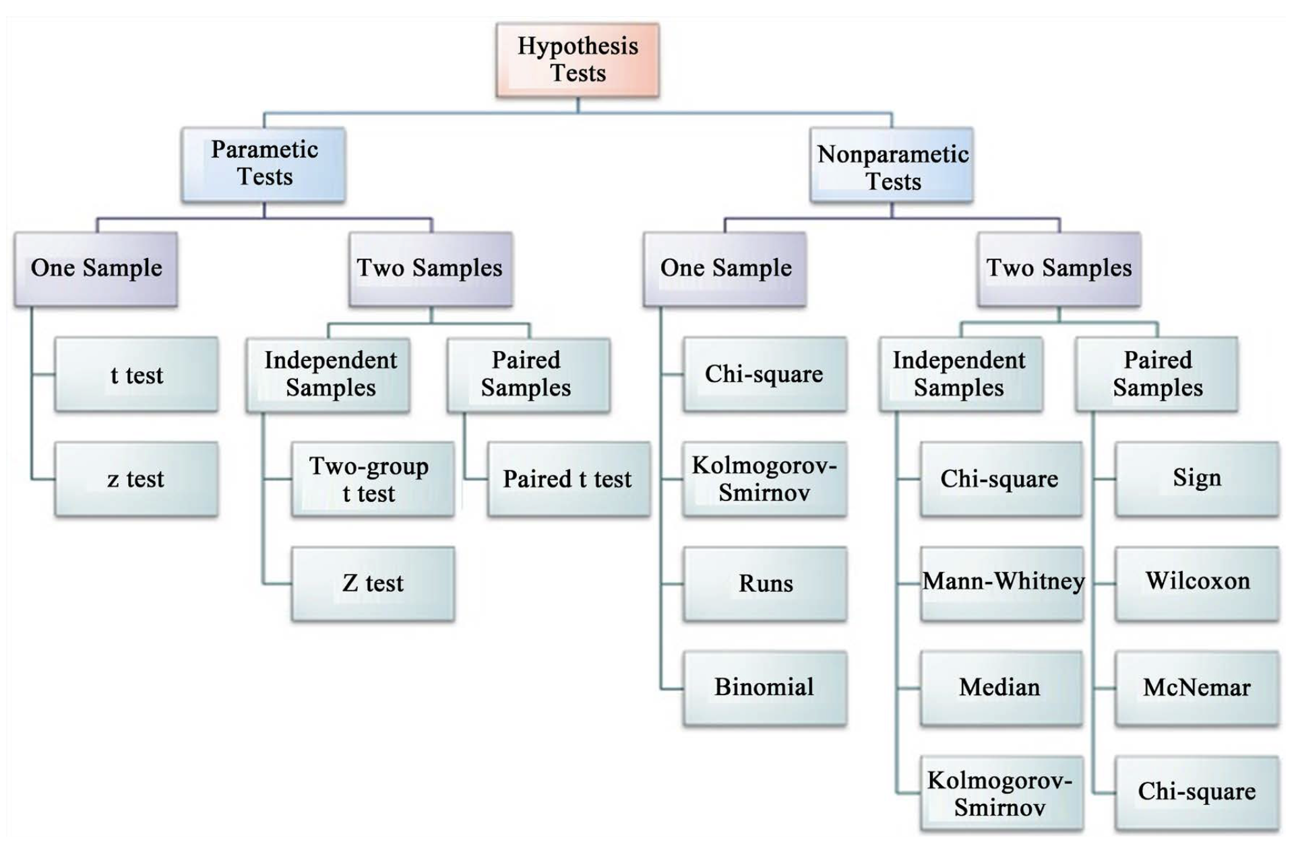
Parametric versus non-parametric tests
T-tests are parametric tests
Parametric tests:
  specify/assume probability distribution from which parameters came
  Basic assumptions of parametric t-tests:
    Random sampling
    Normality
    Equal variance (or Welches T Test)
    No outliers
Non-parametric tests: no assumption about probability distribution/normality
  Mukasa et al 2021 DOI: 10.4236/ojbm.2021.93081

Slide 7
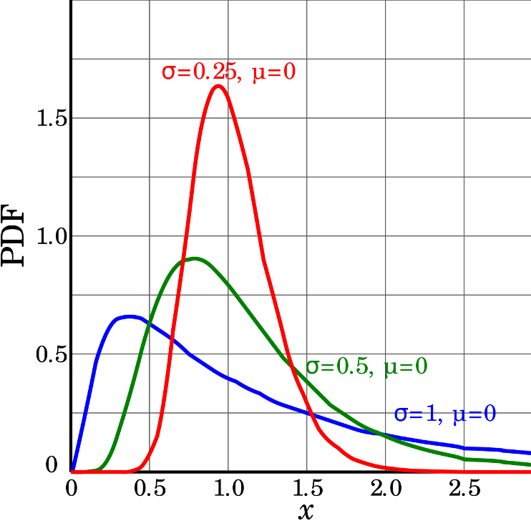
Assumptions of parametric tests - Overview
If assumptions of parametric test violated, test becomes unreliable
This is because test statistic may no longer follow distribution
Most parametric tests robust to mild/moderate violations of normality assumptions

Slide 8
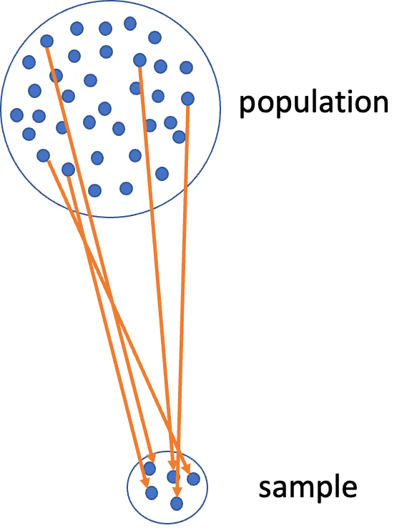
Assumptions of parametric tests - Random Sampling
Basic assumptions of parametric t-tests:
  Random sampling
  Normality
  Equal variance
  No outliers
Random sampling:
  samples are randomly collected from populations; part of experimental design
  Necessary for sample -> population inference

Slide 9
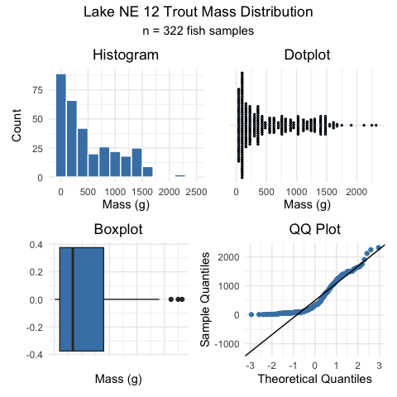
Assumptions of parametric tests - Normality Testing
Basic assumptions of parametric t-tests:
Normality
equal variance
random sampling
no outliers
Lets do the above for one lake - NE 12 as if we were going to do a one sample T Test
  we need to make a new dataframe with NE 12 data only called ne12_data
  how do you do this?
Normality: Samples from normally distributed population
  Graphical tests: histograms, dotplots, boxplots, qq-plots
  “Formal” tests: Shapiro-Wilk test - sometimes not useful

Slide 10
Shapiro-Wilk Test for Normality
Basic assumptions of parametric t-tests:
Normality
equal variance
random sampling
no outliers
Lets do the above for one lake - NE 12 as if we were going to do a one sample T Test
  we need to make a new dataframe with NE 12 data only called ne12_data
  how do you do this?
Normality: Samples from normally distributed population
  Graphical tests: histograms, dotplots, boxplots, qq-plots
  “Formal” tests: Shapiro-Wilk test - sometimes not useful
“Null hypothesis is that data is normally distributed”
Shapiro-Wilk normality test
data: ne12_data$length_mm
W = 0.94528, p-value = 1.56e-09

Slide 11
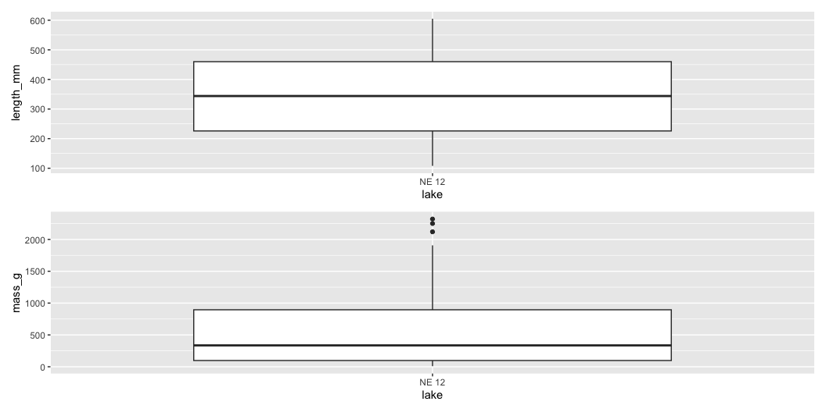
Testing Equal Variance Assumption
Basic assumptions of parametric t-tests:
Normality
equal variance
random sampling
no outliers
Equal variance: samples are from populations with similar degree of variability
Graphical tests: boxplots
“Formal” tests: F-ratio test
When samples sizes equal
  Parametric tests most robust to violations of normality
  Less so for equal variation assumptions

Slide 12
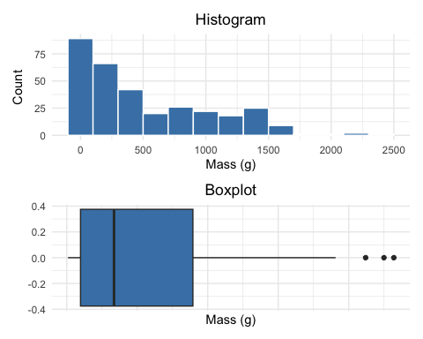
Testing for Outliers
Basic assumptions of parametric t-tests:
  Normality
  equal variance
  random sampling
  no outliers
No outliers: no “extreme” values that are very different from rest of sample
  Graphical tests: boxplots, histograms
  “Formal tests”: Grubb’s test - no one really does this
  Note: outliers a problem for non-parametric tests as well

Slide 13
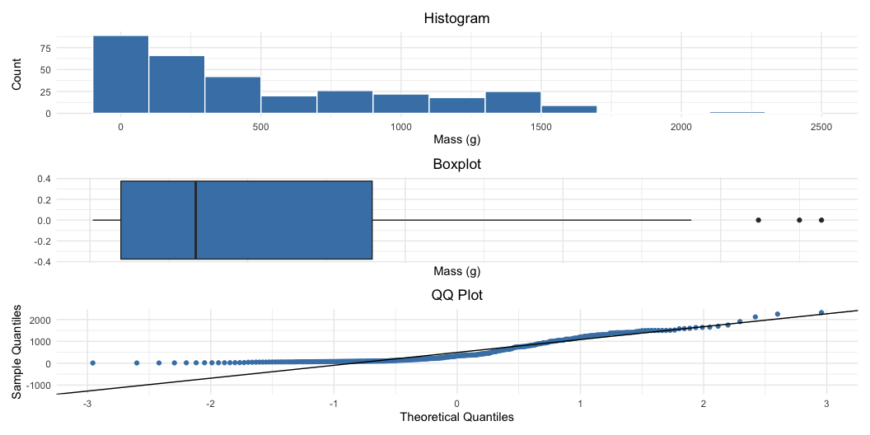
Alternative Tests When Assumptions Fail
What if T Test assumptions fail?
Alternative tests, with more relaxed assumptions, are available
In which case would you use the following tests?
  Welch’s t-test: when distribution normal but variance unequal
  Mann-Whitney-Wilcoxon test: when distribution not normal and/or outliers are present (but both groups should still have similar distributions and ~equal variance)
  Permutation test for two samples: when distribution not normal (but both groups should still have similar distributions and ~equal variance)

Slide 14
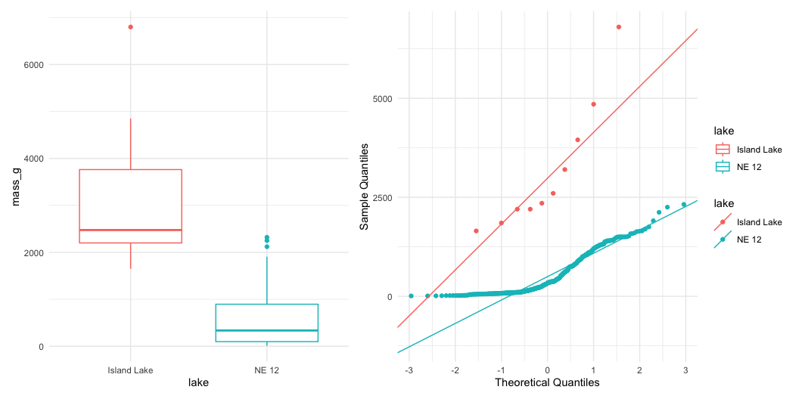
Understanding QQ-Plots
QQ-plots: tool for assessing normality
On x- theoretical quantiles from SND
On y- ordered sample values
Deviation from normal can be detected as deviation from straight line

Slide 15
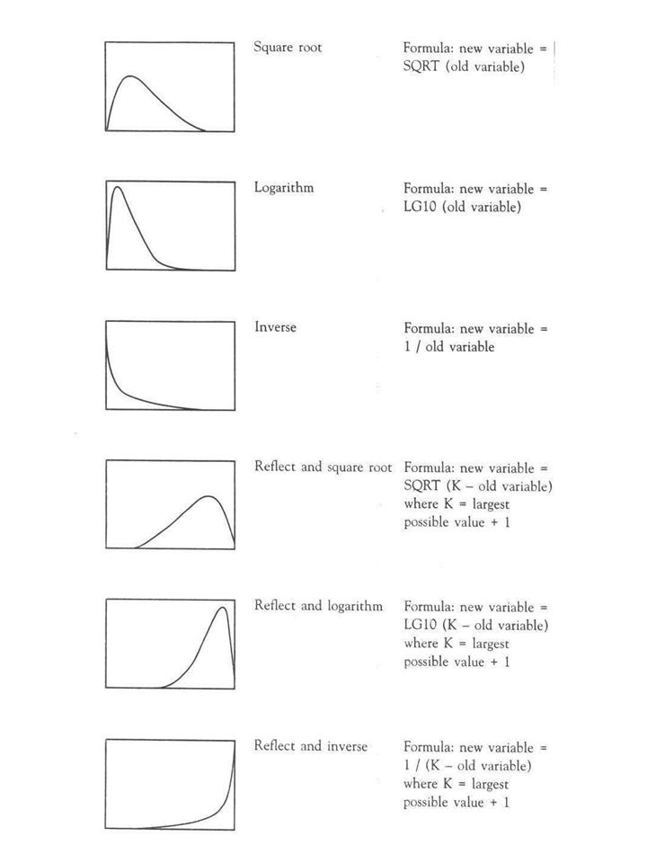
Data Transformations
In some cases, data can be mathematically “transformed” to meet assumptions of parametric tests
this can be done in r and usually involves
  log10 transformations
  square root transformations
  and many others… I will have a description soon

Slide 16
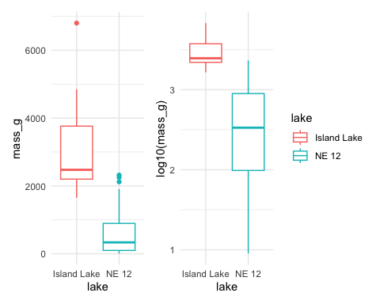
Robust tests - Welch’s T-Test
Welch’s t-test
  common “robust” test for means of two populations
  Robust to violation of equal variance assumption, deals better with unequal sample size
  Parametric test (assumes normal distribution)
  Calculates a t statistic but recalculates df based on samples sizes and s

Slide 17
Comparing Standard T-Test vs Welch’s T-Test
Lets compare a parametric T-Test to a Welch’s t-test
  T-Test is:
    t.test(y1, y2, var.equal = TRUE, paired = FALSE)
  Welch’s T-Test is:
    t.test(y1, y2, var.equal = FALSE, paired = FALSE)
[1] "Standard t-test results for mass_g:"
Two Sample t-test
data: mass_g by lake
t = 14.181, df = 330, p-value < 2.2e-16
alternative hypothesis: true difference in means between group Island Lake and group NE 12 is not equal to 0
95 percent confidence interval:
2266.304 2996.360
sample estimates:
mean in group Island Lake mean in group NE 12
3165.0000 533.6677
[1] "Welch's t-test results for mass_g:"
Welch Two Sample t-test
data: mass_g by lake
t = 5.1368, df = 9.0578, p-value = 0.0006016
alternative hypothesis: true difference in means between group Island Lake and group NE 12 is not equal to 0
95 percent confidence interval:
1473.676 3788.989
sample estimates:
mean in group Island Lake mean in group NE 12
3165.0000 533.6677

Slide 18
Rank-Based Tests
Rank-based tests: no assumptions about distribution (non-parametric)
Ranks of data: observations assigned ranks, sums (and signs for paired tests) of ranks for groups compared
Mann-Whitney U test common alternative to independent samples t-test
Wilcoxon signed-rank test is alternative to paired t-test
Assumptions: similar distributions for groups, equal variance
Less power than parametric tests
Best when normality assumption can not be met by transformation (weird distribution) or large outliers

Slide 19
Mann-Whitney U Test Results
[1] "Mann-Whitney U test results mass_g:"
Wilcoxon rank sum test with continuity correction
data: mass_g by lake
W = 3205.5, p-value = 9.506e-08
alternative hypothesis: true location shift is not equal to 0

Slide 20
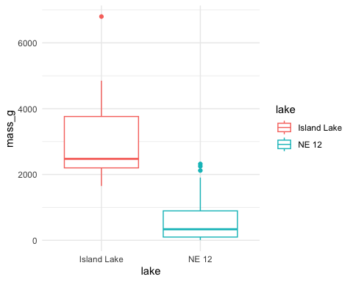
Permutation Tests - Concept
Permutation tests based on resampling: reshuffling of original data
Resampling allows parameter estimation when distribution unknown, including SEs and CIs of statistics (means, medians)
Common approach is bootstrap: resample sample with replacement many times, recalculate sample stats
Use the perm package
Ho: µ_{A} = µ_{B}
Ha: µ_{A} ≠µ_{B}
Calculates the difference ∆ in means between two groups

Slide 21
Permutation Tests - Method
Randomly reshuffle observations between groups (keeping n~NE 12~=323 and n_{Island}=10), calculate ∆
Repeat >1,000 times
Record proportion of the different means i
This is equivalent to p-value and can be used in “traditional” H test framework
For a graphical explanation:
  Graphical Explanation

Slide 22
Permutation Test Implementation
In R (using ‘perm’ package):
Assumptions: both groups have similar distribution; equal variance
Exact Permutation Test Estimated by Monte Carlo
data: GROUP 1 and GROUP 2
p-value = 2e-04
alternative hypothesis: true mean GROUP 1 - mean GROUP 2 is not equal to 0
sample estimates:
mean GROUP 1 - mean GROUP 2
-333.08
p-value estimated from 10000 Monte Carlo replications
99 percent confidence interval on p-value:
0.000000000 0.001059383

Slide 23
Summary - Testing Assumptions
Testing Assumptions of Parametric Tests
Key Assumptions
Random sampling: Samples are randomly collected from populations
Normality: Data follows a normal distribution
Equal variance: Samples come from populations with similar variability
No outliers: No extreme values that can skew results
Assessing Assumptions
Key to do every time
Should acknowledge in manuscript

Slide 24
Summary - Data Transformations
Data Transformations
When assumptions aren’t met, transformations may help normalize data:
Log transformation: log10(x) - Useful for right-skewed data, multiplicative effects
Square root: sqrt(x) - Useful for count data, moderately right-skewed distributions
Box-Cox: More flexible family of power transformations
More specialized transformations especially for percentages or proportions

Slide 25
Summary - Parametric Test Options
1. Standard T-Test
Strengths:
  High statistical power when assumptions are met
  - Well understood and widely accepted
Weaknesses:
  - Sensitive to violations of normality, equal variance
  - Heavily influenced by outliers
2. Welch’s T-Test
Strengths:
  - Robust to violations of equal variance assumption
  - Handles unequal sample sizes well
  - Still parametric (assumes normality)
Weaknesses:
  - Slightly less powerful than standard t-test when variances are equal
  - Still assumes normal distribution

Slide 26
Summary - Non-Parametric Options
3. Mann-Whitney-Wilcoxon Test
Strengths:
  - Non-parametric: doesn’t assume normal distribution
  - Robust against outliers
  - Works with ordinal data
Weaknesses:
  - Less statistical power than parametric tests
  - Still assumes similar distributions and approximate equal variance
  - Tests median differences rather than mean differences
4. Permutation Tests
Strengths:
  - Distribution-free: doesn’t assume a specific distribution
  - Can be applied to many types of test statistics
  - Handles small sample sizes well
  - Directly estimates p-values through resampling
Weaknesses:
  - Computationally intensive
  - Assumes exchangeability under the null hypothesis
  - Requires similar distributions and equal variance

Slide 27
Key Takeaway
Statistical tests have different strengths and assumptions. The choice should be guided by your data characteristics, not just convenience. Always visualize your data before deciding on the appropriate test.

