Slide 1
Lecture 09 Correlation and Regression
Bill Perry

Slide 2
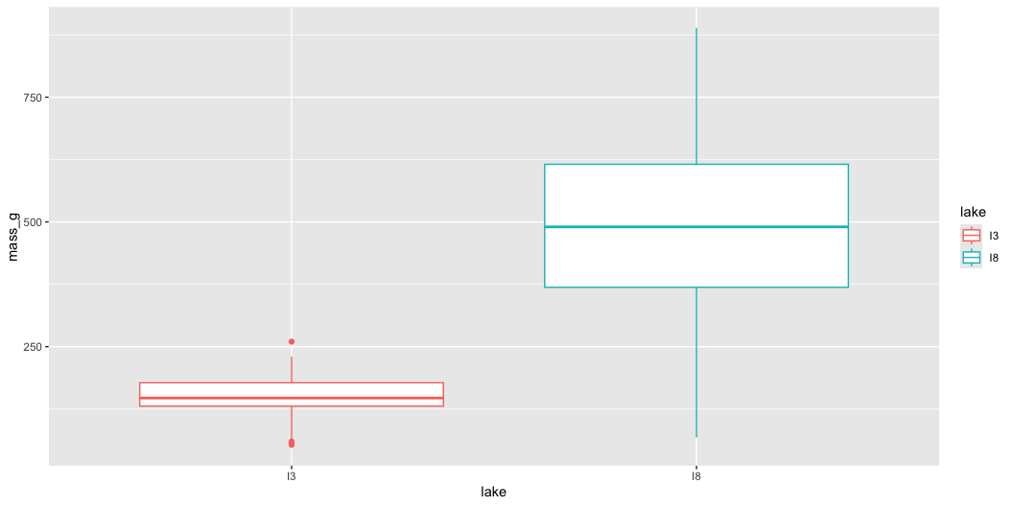
Lecture 8: Review
Covered
Study design
Causality in ecology
Experimental design:
  Replication, controls, randomization, independence
Sampling in field studies
Power analysis: a priori and post hoc
Study design and analysis

Slide 3
Lecture 9: Overview
The objectives:
This lecture covers two fundamental statistical techniques in biology: correlation and regression analysis. Based on Chapters 16-17 from Whitlock & Schluter’s The Analysis of Biological Data (3rd edition), we’ll explore:
Correlation analysis: measuring relationships between variables
The distinction between correlation and regression
Simple linear regression: predicting one variable from another
Estimating and interpreting regression parameters
Testing assumptions and handling violations
Analysis of variance in regression
Model selection and comparison

Slide 4
Lecture 9: Correlation vs. Regression:
What’s the Difference?

Slide 5
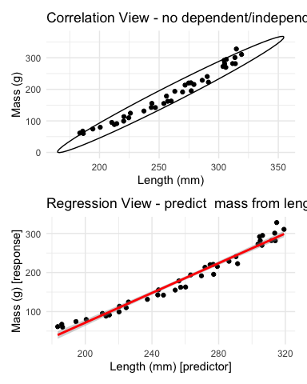
Correlation Analysis:
Measures the strength and direction of a relationship between two numerical variables
Both X and Y are random variables (both measured, neither manipulated)
Variables are typically on equal footing (either could be X or Y)
No cause-effect relationship implied
Quantifies the degree to which variables are related
Expressed as a correlation coefficient (r) from -1 to +1
Regression Analysis:
Predicts one variable (Y) from another (X)
X is often fixed or controlled (manipulated)
Y is the response variable of interest
Often implies a cause-effect relationship
Produces an equation for prediction with slope and intercept parameters

Slide 6
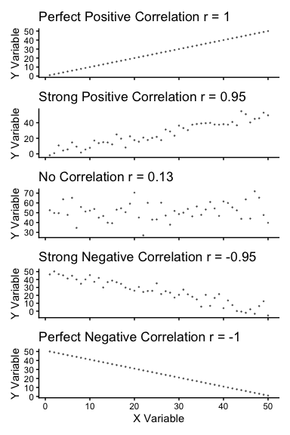
Lecture 9: Correlation Analysis
What Is Correlation?
Correlation analysis measures the strength and direction of a relationship between two numerical variables:
Ranges from -1 to +1
+1 indicates perfect positive correlation
0 indicates no correlation
-1 indicates perfect negative correlation
The Pearson correlation coefficient (r) is defined as:
r=i​(Xi−X)(Yi−Y)i​(Xi−X)2i​(Yi−Y)2
This can be simplified as:
$$r=\frac{\text{Covariance}(X,Y)}{s_{X}⋅s_{Y}}$$
Where $s_{X}$ and $s_{Y}$ are the standard deviations of X and Y.

Slide 7
Lecture 9: Correlation Analysis
Example 16.1: Flipping the Bird
Nazca boobies (Sula granti) - Do aggressive behaviors as a chick predict future aggressive behavior as an adult?
correlation is r = 0.534 - moderate positive relationship
p-value = 0.007 correlation is statistically significant.
For a Pearson correlation coefficient (r) of 0.53372:
This is r (not rho as Spearman nonparametric below), as indicated by “cor” in your output
To determine the amount of variation explained, you square this value: r² = 0.53372² = 0.2849 (or approximately 28.49%)
means about 28.49% of the variance in one variable can be explained by the other variable
Note that it is tested by a t test: $\text{t}=\frac{r}{SE_{r}}$
Pearson's product-moment correlation
data: booby_data$visits_as_nestling and booby_data$future_aggression
t = 2.9603, df = 22, p-value = 0.007229
alternative hypothesis: true correlation is not equal to 0
95 percent confidence interval:
0.1660840 0.7710999
sample estimates:
cor
0.5337225

Slide 8
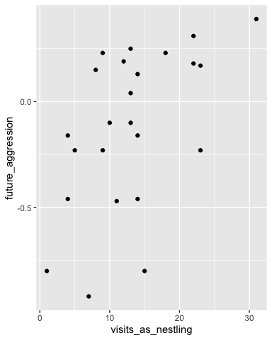
Lecture 9: Correlation Analysis
Example 16.1: Flipping the Bird
Interpretation: The correlation coefficient of r = 0.534 suggests that Nazca boobies who experienced more visits from non-parent adults as nestlings tend to display more aggressive behavior as adults. This supports the hypothesis that early experiences influence adult behavior patterns in this species.
Standard Error:
${\text{SE}}_{r}=\sqrt{\frac{1−r^{2}}{n−2}}$
SE = 0.180
Need to be sure relationship is not curved - note below

Slide 9
Lecture 9: Correlation Analysis
Testing Assumptions for Correlation
As described in Section 16.3, correlation analysis has key assumptions:
Random sampling: Observations should be a random sample from the population
Bivariate normality: Both variables follow a normal distribution, and their joint distribution is bivariate normal
Linear relationship: The relationship between variables is linear, not curved
Let’s check these assumptions booby data:
Shapiro-Wilk normality test
data: booby_data$visits_as_nestling
W = 0.95783, p-value = 0.3965
Shapiro-Wilk normality test
data: booby_data$future_aggression
W = 0.91575, p-value = 0.04709

Slide 10
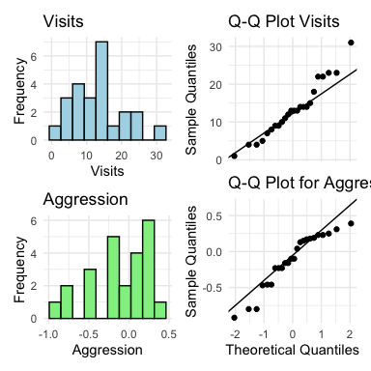
Lecture 9: Correlation Analysis
Testing Assumptions for Correlation
As described in Section 16.3, correlation analysis has key assumptions:
Random sampling: Observations should be a random sample from the population
Bivariate normality: Both variables follow a normal distribution, and their joint distribution is bivariate normal
Linear relationship: The relationship between variables is linear, not curved
Let’s check these assumptions using the booby data

Slide 11
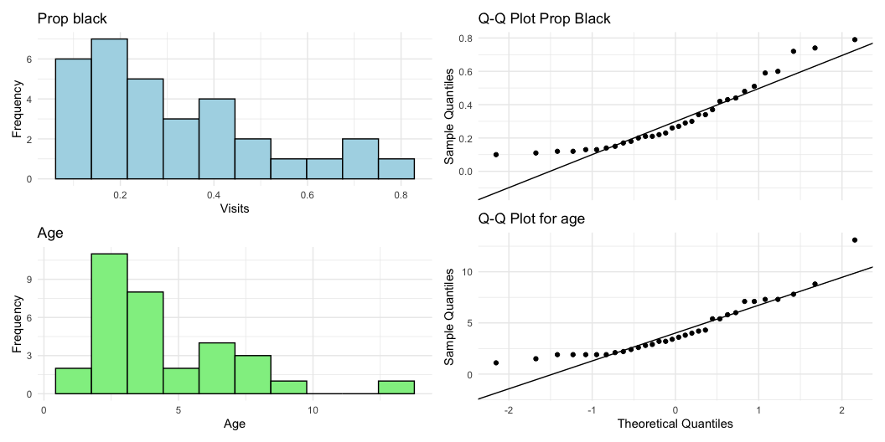
Lecture 9: Correlation Analysis
What to do if assumptions are violated:
Transform one or both variables (log, square root, etc.)
Use non-parametric correlation (Spearman’s rank correlation) or Kendall’s tau 𝛕
Examine the data for outliers or influential points

Slide 12
Lecture 9: Correlation Analysis
To understand the amount of variation explained, you can square the non parametric Spearman’s rho value.
For your value of 0.74485:
ρ² = 0.74485² = 0.5548
This means approximately 55.48% of the variance in ranks of one variable can be explained by the ranks of the other variable. This is similar to how R² works in linear regression, but specifically for ranked data.
Spearman's rank correlation rho
data: lion_data$proportion_black and lion_data$age_years
S = 1392.1, p-value = 1.013e-06
alternative hypothesis: true rho is not equal to 0
sample estimates:
rho
0.7448561

Slide 13
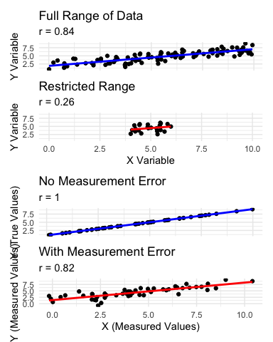
Lecture 9: Correlation Analysis
Correlation: Important Considerations
The correlation coefficient depends on the range
  Restricting range of values can reduce the correlation coefficient
  Comparing correlations between studies requires similar ranges of values
Measurement error affects correlation
  Measurement error in X or Y tends to weaken observed correlation
  This bias is called attenuation
  True correlation typically stronger than observed correlation
Correlation vs. Causation
  Correlation does not imply causation
  Three possible explanations for correlation:
    X causes Y
    Y causes X
    Z (a third variable) causes both X and Y
Correlation significance test
  H₀: ρ = 0 (no correlation in population)
  H₁: ρ ≠ 0 (correlation exists in population)
  Test statistic: t = r / SE(r) with df = n-2

Slide 14
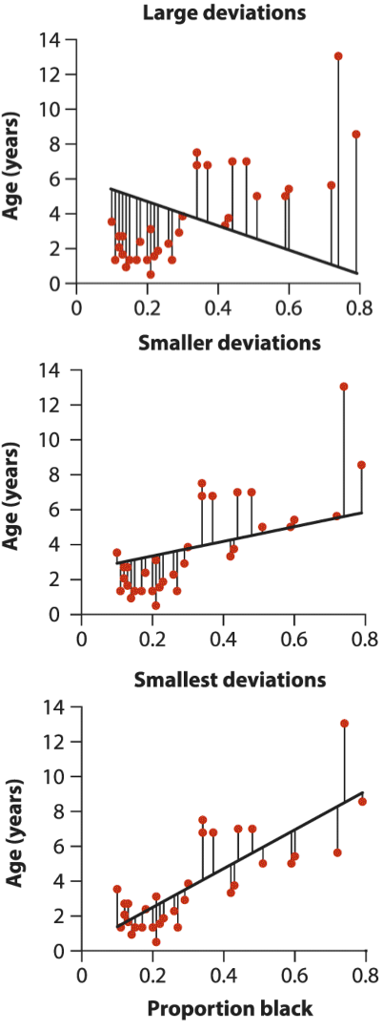
Lecture 9: Linear Regression
Simple Linear Regression Model
Simple linear regression models the relationship between a response variable (Y) and a predictor variable (X).
The population regression model $Y=α+βX+ε$
Where:
  Y is the response variable
  X is the predictor variable
  α (alpha) is the intercept (value of Y when X=0)
  β (beta) is the slope (change in Y per unit change in X)
  ε (epsilon) is the error term (random deviation from the line)
The sample regression equation is: $\hat{Y}=a+bX$
Where:
  $\hat{Y}$ is the predicted value of Y
  a is the estimate of α (intercept)
  b is the estimate of β (slope)
Method of Least Squares: The line is chosen to minimize the sum of squared vertical distances (residuals) between observed and predicted Y values.

Slide 15
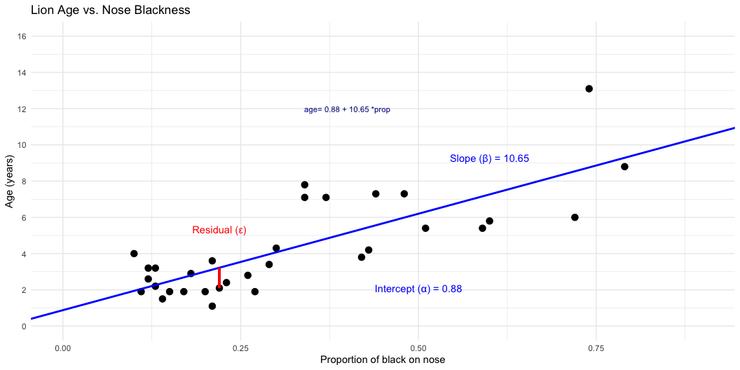
Lecture 9: Linear Regression
Simple Linear Regression Model
Simple linear regression models the relationship between a response variable (Y) and a predictor variable (X).
The population regression model is: $Y=α+βX+ε$
Where:
  Y is the response variable
  X is the predictor variable
  α (alpha) is the intercept (value of Y when X=0)
  β (beta) is the slope (change in Y per unit change in X)
  ε (epsilon) is the error term (random deviation from the line)
The sample regression equation is: $\hat{Y}=a+bX$
Where:
  $\hat{Y}$ is the predicted value of Y
  a is the estimate of α (intercept)
  b is the estimate of β (slope)
Method of Least Squares: The line is chosen to minimize the sum of squared vertical distances (residuals) between observed and predicted Y values.

Slide 16
Lecture 9: Linear Regression
From Example 17.1 in the textbook the regression line for the lion data is:
$\text{age}=0.88+10.65×{\text{proportion}}_{black}$
This means:
When a lion has no black on its nose (proportion = 0), its predicted age is 0.88 years
For each 0.1 increase in the proportion of black, age increases by 1.065 years
The slope (10.65) indicates that lions with more black on their noses tend to be older

Slide 17
Lecture 9: Linear Regression
Simple Linear Regression Model
male lions develop more black pigmentation on their noses as they age.
can be used to estimate the age of lions in the field.
Call:
lm(formula = age_years ~ proportion_black, data = lion_data)
Residuals:
Min 1Q Median 3Q Max
-2.5449 -1.1117 -0.5285 0.9635 4.3421
Coefficients:
Estimate Std. Error t value Pr(>|t|)
(Intercept) 0.8790 0.5688 1.545 0.133
proportion_black 10.6471 1.5095 7.053 7.68e-08 ***
---
Signif. codes: 0 '***' 0.001 '**' 0.01 '*' 0.05 '.' 0.1 ' ' 1
Residual standard error: 1.669 on 30 degrees of freedom
Multiple R-squared: 0.6238, Adjusted R-squared: 0.6113
F-statistic: 49.75 on 1 and 30 DF, p-value: 7.677e-08

Slide 18
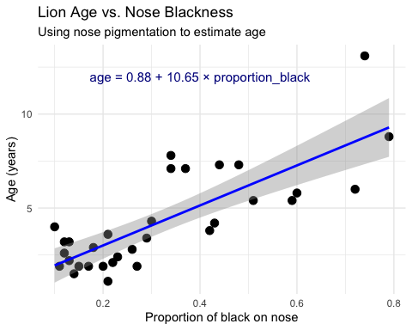
Lecture 9: Linear Regression
Simple Linear Regression Model
The calculation for slope (m) is:
m=i​(Xi−X)(Yi−Y)i​(Xi−X)2
Given:
  - $\overset{‾}{X}=0.3222$
  - $\overset{‾}{Y}=4.3094$
  - i​(Xi−X)2=1.2221
  - i​(Xi−X)(Yi−Y)=13.0123
b = 13.0123 / 1.2221 = 10.647
Intercept (b): $b=\overset{‾}{Y}−m\overset{‾}{X}=4.3094−10.647(0.3222)=0.879$

Slide 19
Lecture 9: Linear Regression
Simple Linear Regression Model
Making predictions:
To predict the age of a lion with 0.50 proportion of black on its nose:
$$\hat{Y}=0.88+10.65(0.50)=6.2\text{ years}$$
Confidence intervals vs. Prediction intervals:
Confidence interval: Range for the mean age of all lions with 0.50 black
Prediction interval: Range for an individual lion with 0.50 black
Both intervals are narrowest near $\overset{‾}{X}$ and widen as X moves away from the mean.

Slide 20
Lecture 9: Linear Regression
Example Prairie Home Companion
Does biodiversity affect ecosystem stability?
Tilman et al. (2006) investigated using experimental plots varying plant species
Call:
lm(formula = log_stability ~ species_number, data = prairie_data)
Residuals:
Min 1Q Median 3Q Max
-0.82774 -0.25344 -0.00426 0.27498 0.75240
Coefficients:
Estimate Std. Error t value Pr(>|t|)
(Intercept) 1.252629 0.041023 30.535 < 2e-16 ***
species_number 0.025984 0.004926 5.275 4.28e-07 ***
---
Signif. codes: 0 '***' 0.001 '**' 0.01 '*' 0.05 '.' 0.1 ' ' 1
Residual standard error: 0.3433 on 159 degrees of freedom
Multiple R-squared: 0.149, Adjusted R-squared: 0.1436
F-statistic: 27.83 on 1 and 159 DF, p-value: 4.276e-07
Analysis of Variance Table
Response: log_stability
Df Sum Sq Mean Sq F value Pr(>F)
species_number 1 3.2792 3.2792 27.829 4.276e-07 ***
Residuals 159 18.7358 0.1178
---
Signif. codes: 0 '***' 0.001 '**' 0.01 '*' 0.05 '.' 0.1 ' ' 1

Slide 21
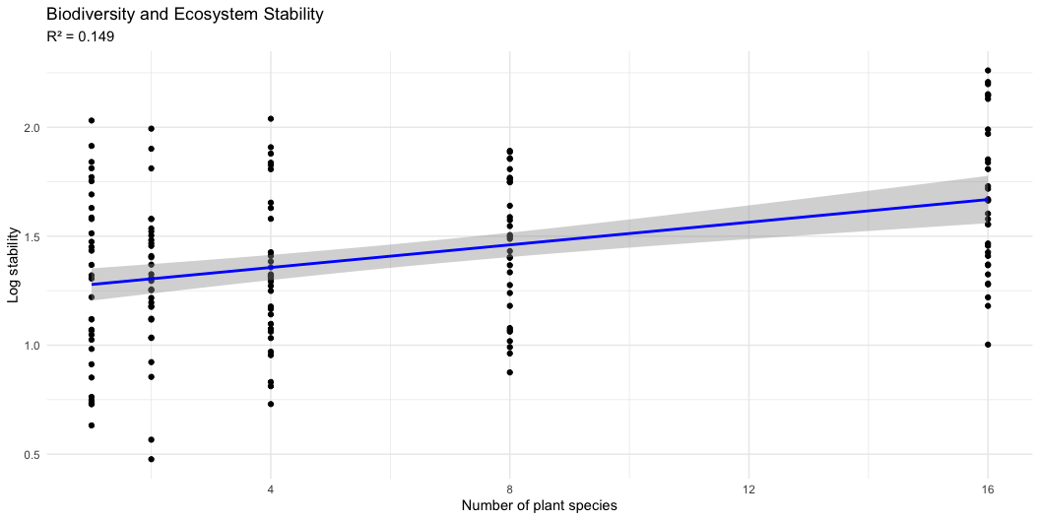
Lecture 9: Linear Regression
The hypothesis test asks whether the slope equals zero:
H₀: β = 0 (species number does not affect stability)
H₁: β ≠ 0 (species number does affect stability)
t = estimate/SE
Interpretation:
The slope estimate is 0.033, indicating that log stability increases by 0.033 units for each additional plant species in the plot.
The p-value is very small (2.73e-10), providing strong evidence to reject the null hypothesis that species number has no effect on ecosystem stability.
R² = 0.222, meaning that approximately 22.2% of the variation in log stability is explained by the number of plant species.
This supports the biodiversity-stability hypothesis: more diverse plant communities have more stable biomass production over time.

Slide 22
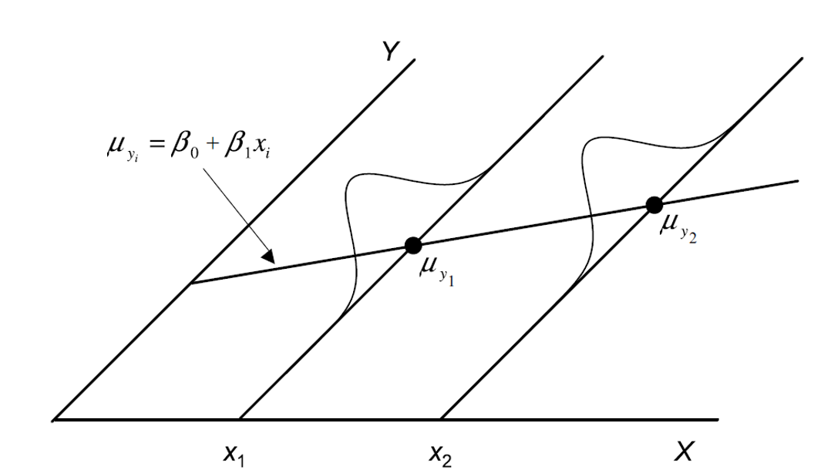
Lecture 9: Linear Regression
Testing Regression Assumptions
linear regression has four key assumptions:
Linearity: The relationship between X and Y is linear
Independence: Observations are independent
Homoscedasticity: Equal variance across all values of X
Normality: Residuals are normally distributed
Let’s check these assumptions for the lion regression model:
Assume that error 𝞮 is $e_{i}=y_{i}−{\hat{y}}_{i}$
normally distributed for each x_{i}
has the same variance
has a mean of 0 at each xi

Slide 23
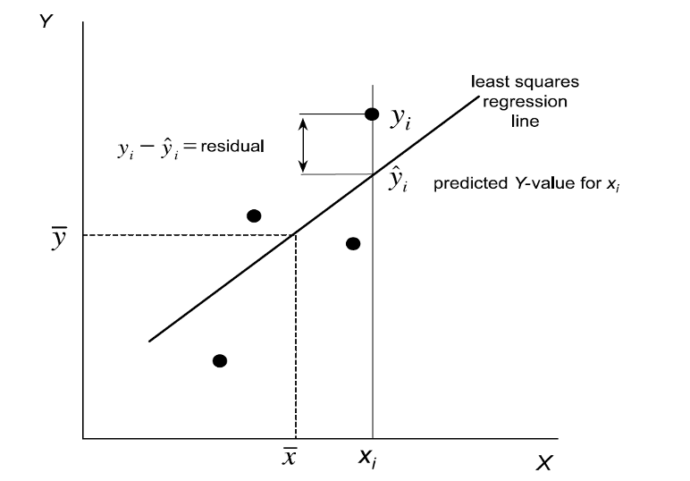
Lecture 9: Linear Regression
Testing Regression Assumptions
linear regression has four key assumptions:
Linearity: The relationship between X and Y is linear
Independence: Observations are independent
Homoscedasticity: Equal variance across all values of X
Normality: Residuals are normally distributed
Let’s check these assumptions for the lion regression model:
Assume that error 𝞮 is - estimated as the residuals: $e_{i}=y_{i}−{\hat{y}}_{i}$
ordinary lease square estimates a and b or slope and intercept to minimize the sum of the residuals squared as
$\sum_{i=1}^{n}{=}(y_{i}−{\hat{y}}_{i})^{2}$

Slide 24
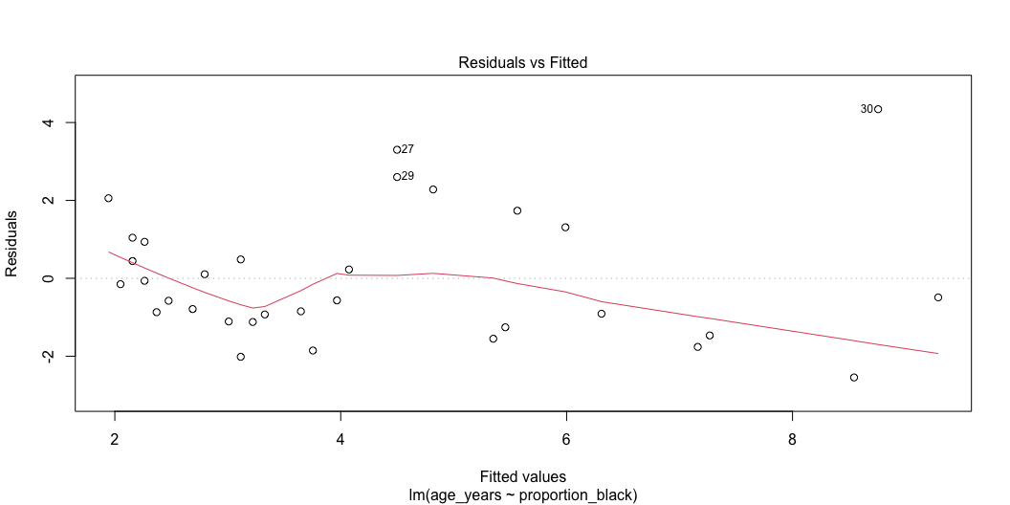
Lecture 9: Linear Regression
Testing Regression Assumptions
linear regression has four key assumptions:
Linearity: The relationship between X and Y is linear
Independence: Observations are independent
Homoscedasticity: Equal variance across all values of X
Normality: Residuals are normally distributed
Let’s check these assumptions for the lion regression model:
Linearity - how does this plot work

Slide 25
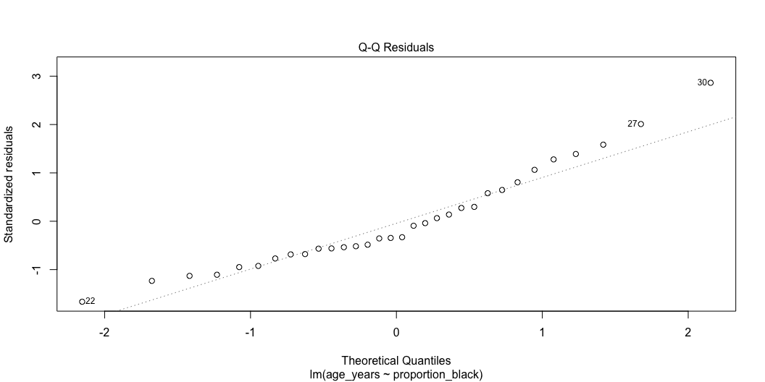
Lecture 9: Linear Regression
Testing Regression Assumptions
linear regression has four key assumptions:
Linearity: The relationship between X and Y is linear
Independence: Observations are independent
Homoscedasticity: Equal variance across all values of X
Normality: Residuals are normally distributed
Let’s check these assumptions for the lion regression model:

Slide 26
Lecture 9: Linear Regression
Testing Regression Assumptions
linear regression has four key assumptions:
Linearity: The relationship between X and Y is linear
Independence: Observations are independent
Homoscedasticity: Equal variance across all values of X
Normality: Residuals are normally distributed
Let’s check these assumptions for the lion regression model:
Shapiro-Wilk normality test
data: residuals(lion_model)
W = 0.93879, p-value = 0.0692

Slide 27
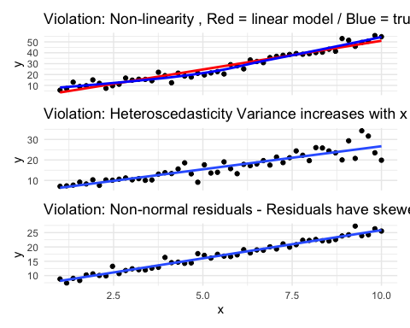
Lecture 9: Linear Regression
Simple Linear Regression Model
linear regression has four key assumptions:
Linearity: The relationship between X and Y is linear
Independence: Observations are independent
Homoscedasticity: Equal variance across all values of X
Normality: Residuals are normally distributed
If assumptions are violated: 1. Transform the data (Section 17.6) 2. Use weighted least squares for heteroscedasticity 3. Consider non-linear models (Section 17.8)

Slide 28
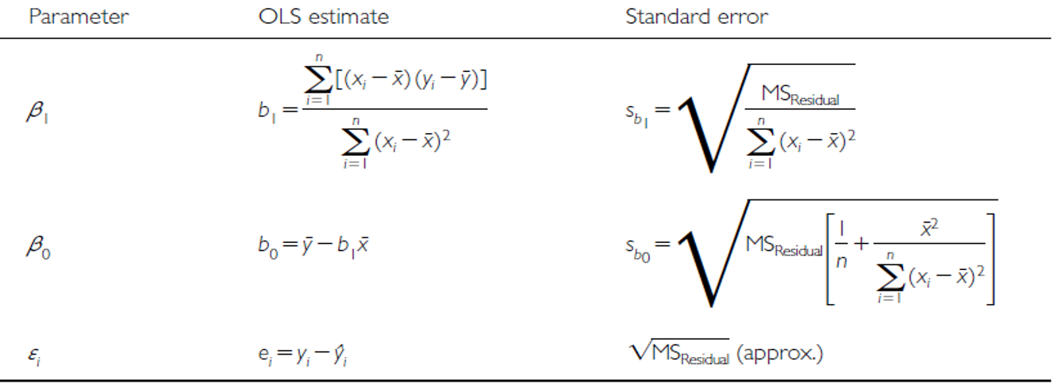
Lecture 9: Linear Regression - estimates of error and significance
Estimates of standard error and confidence intervals for slow and intercept to determine confidence bands
the 95% confidence band will contain the true population line 95/100 under repeated sampling
this is usually done in R

Slide 29
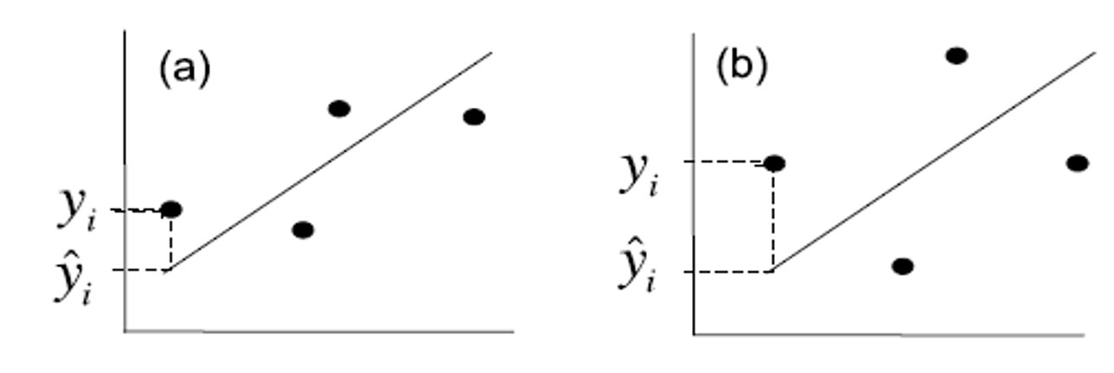
Lecture 9: Linear Regression - estimates of error and significance
In addition to getting estimates of population parameters (β0 , β1), want to test hypotheses about them
This is accomplished by analysis of variance
Partition variance in Y: due to variation in X, due to other things (error)

Slide 30
Lecture 9: Linear Regression - estimates of variance
Total variation in Y is “partitioned” into 3 components:
$SS_{regression}$: variation explained by regression
  difference between predicted values (ŷi ) and mean y (ȳ)
  dfs= 1 for simple linear (parameters-1)
$SS_{residual}$: variation not explained by regression
  difference between observed ($y_{i}$) and predicted (${\hat{y}}_{i}$) values
  dfs= n-2
$SS_{total}$: total variation
  sum of squared deviations of each observation ($y_{i}$) from mean ($\overset{‾}{y}$)
  dfs = n-1

Slide 31
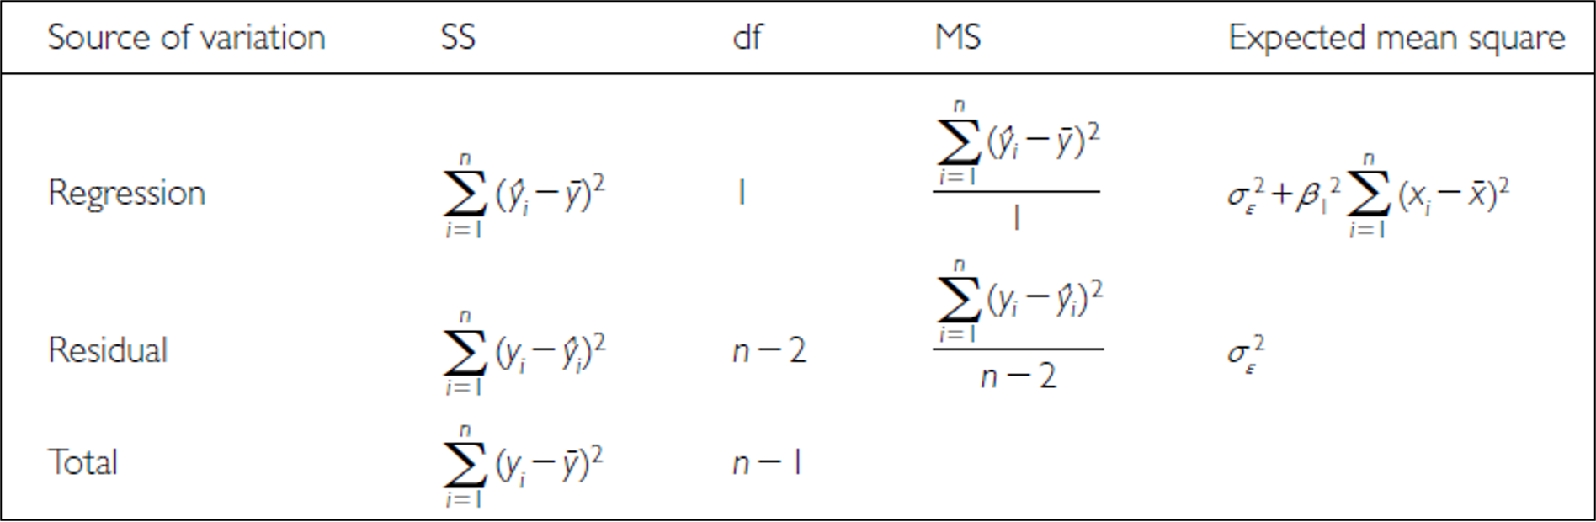
Lecture 9: Linear Regression - estimates of variance
Total variation in Y is “partitioned” into 3 components:
$SS_{regression}$: variation explained by regression
  difference between predicted values (ŷi ) and mean y (ȳ)
  dfs= 1 for simple linear (parameters-1)
$SS_{residual}$: variation not explained by regression
  difference between observed ($y_{i}$) and predicted (${\hat{y}}_{i}$) values
  dfs= n-2
$SS_{total}$: total variation
  sum of squared deviations of each observation ($y_{i}$) from mean ($\overset{‾}{y}$)
  dfs = n-1

Slide 32
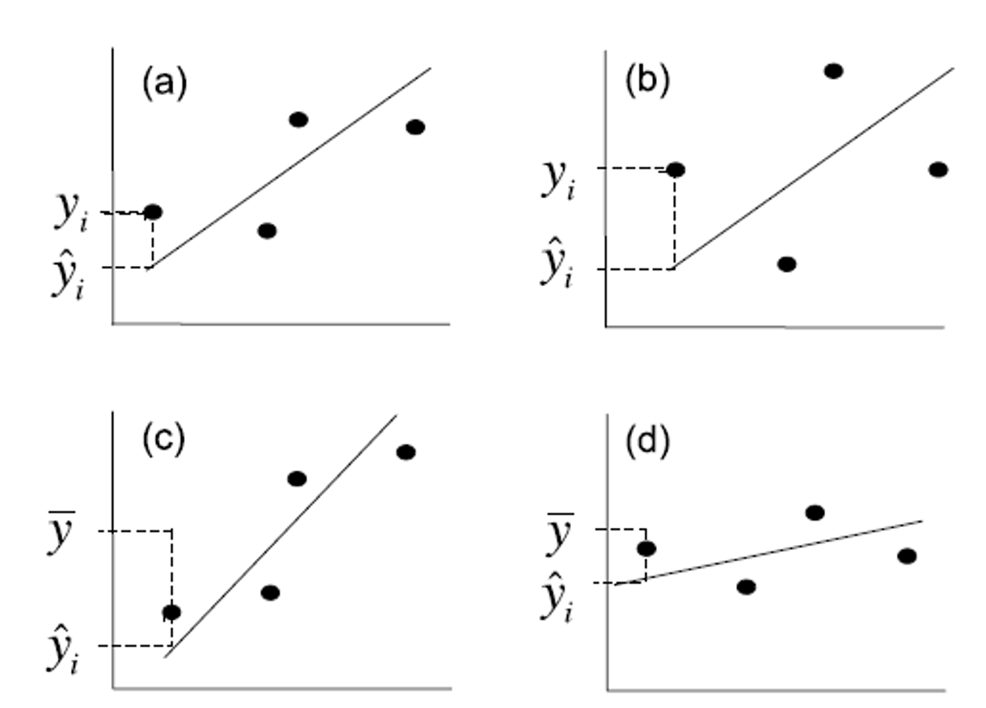
Lecture 9: Linear Regression - estimates of variance
Total variation in Y is “partitioned” into 3 components:
$SS_{regression}$: variation explained by regression
  GREATER IN C than D
$SS_{residual}$: variation not explained by regression
  GREATER IN B THAN A
$SS_{total}$: total variation

Slide 33
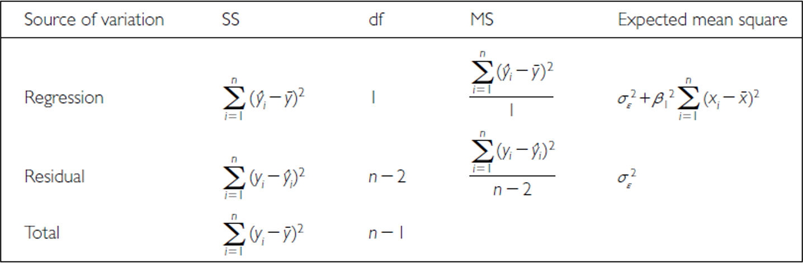
Lecture 9: Linear Regression - estimates of variance
Sums of Squares and degress of freedome are:
$SS_{regression}+SS_{residual}=SS_{total}$
$df_{regression}+df_{residual}=df_{total}$
Sums of Squares depends on n
We need a different estimate of variance

Slide 34
Lecture 9: Linear Regression - estimates of variance
Sums of Squares converted to Mean Squares
Sums of Squares divided by degrees of freedom - does not depend on n
$MS_{residual}$: estimate population variation
$MS_{regression}$: estimate pop variation and variation due to X-Y relationship
Mean Squares are not additive

