Slide 1
How an ANOVA IS A REGRESSION WIHT DUMMY VARIABLES
Bill Perry

Slide 2
Introduction
This document demonstrates how Analysis of Variance (ANOVA) is mathematically equivalent to a regression model with dummy variables using an example with R code and visualizations.

Slide 3
Setup and Data Creation
Let’s begin by loading necessary packages and creating a dataframe about plant heights with three different fertilizer treatments.

Slide 4
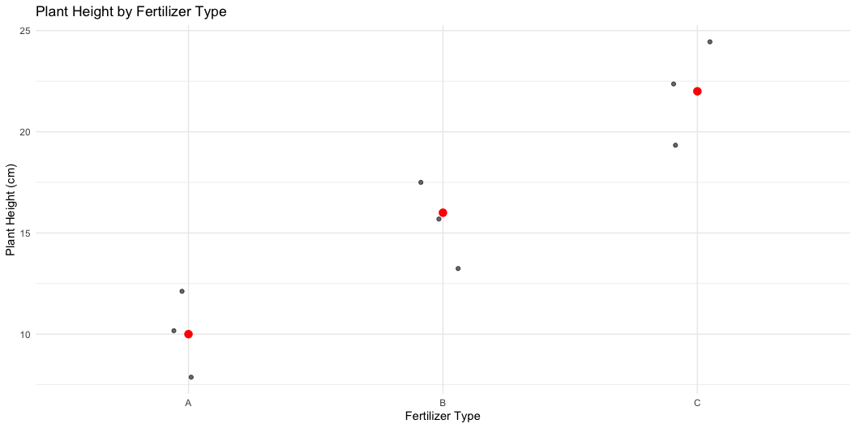
Calculating Group Means (ANOVA Approach)
In ANOVA, we calculate the mean of each group and compare variation between groups to variation within groups.
Let’s visualize the raw data and group means:
fertilizer | mean_height
A | 10
B | 16
C | 22

Slide 5
Running the ANOVA
Df Sum Sq Mean Sq F value Pr(>F)
fertilizer 2 216 108 27 0.001 **
Residuals 6 24 4
---
Signif. codes: 0 '***' 0.001 '**' 0.01 '*' 0.05 '.' 0.1 ' ' 1

Slide 6
Regression with Dummy Variables
For the regression approach, we’ll create dummy variables for fertilizer types, using fertilizer A as the reference level.
Call:
lm(formula = height ~ fertilizer, data = fertilizer_data)
Residuals:
Min 1Q Median 3Q Max
-2 -2 0 2 2
Coefficients:
Estimate Std. Error t value Pr(>|t|)
(Intercept) 10.000 1.155 8.660 0.000131 ***
fertilizerB 6.000 1.633 3.674 0.010402 *
fertilizerC 12.000 1.633 7.348 0.000325 ***
---
Signif. codes: 0 '***' 0.001 '**' 0.01 '*' 0.05 '.' 0.1 ' ' 1
Residual standard error: 2 on 6 degrees of freedom
Multiple R-squared: 0.9, Adjusted R-squared: 0.8667
F-statistic: 27 on 2 and 6 DF, p-value: 0.001

Slide 7
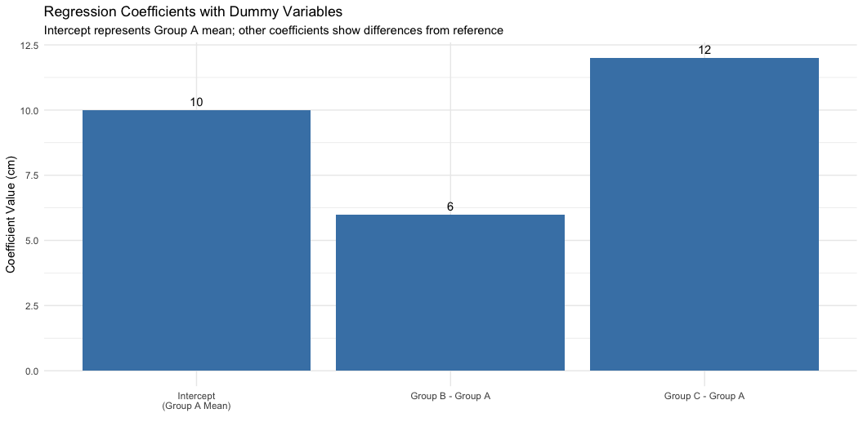
Understanding the Regression Coefficients
In our regression model:
The intercept (10) is equal to the mean of the reference group (A)
The coefficient for fertilizer B (6) is the difference between mean of group B and mean of group A
The coefficient for fertilizer C (12) is the difference between mean of group C and mean of group A
Let’s visualize these coefficients:
Term | Coefficient | Meaning | Mathematical_Expression | Numeric_Value
Intercept | 10.00 | Mean of Group A (reference group) | β₀ = μA | 10
fertilizerB | 6.00 | Difference between Group B and Group A means | β₁ = μB - μA | 16 - 10 = 6
fertilizerC | 12.00 | Difference between Group C and Group A means | β₂ = μC - μA | 22 - 10 = 12

Slide 8
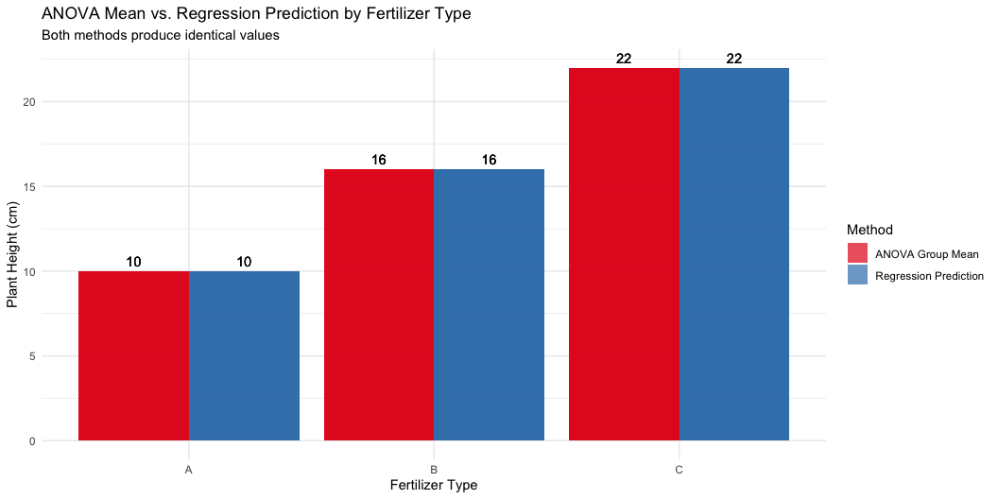
Demonstrating the Equivalence
Now, let’s prove that the regression model predictions are identical to the ANOVA group means:
Let’s visualize this equivalence:

Slide 9
Comparing Statistical Tests
Both ANOVA and regression provide an F-test. Let’s compare them:
Test | F-value | p-value
ANOVA F-test | 27.0000 | 0.0010
Regression F-test | 27.0000 | 0.0010

Slide 10
The Mathematical Relationship
For a one-way ANOVA with a categorical variable having k levels, we can express the relationship with regression as:
$$Y=β_{0}+β_{1}X_{1}+β_{2}X_{2}+...+β_{k−1}X_{k−1}+ϵ$$
Where: - $β_{0}$ is the mean of the reference group - $β_{1},β_{2},...,β_{k−1}$ are the differences between each group’s mean and the reference group mean - $X_{1},X_{2},...,X_{k−1}$ are dummy variables (0 or 1)
In our example: - $β_{0}=10$ (mean of group A) - $β_{1}=6$ (difference between B and A) - $β_{2}=12$ (difference between C and A)

Slide 11
Conclusion
This demonstration shows that one-way ANOVA is mathematically equivalent to regression with dummy variables. The key equivalences are:
ANOVA group means = Regression predictions for each group
F-statistic from ANOVA = F-statistic from regression
p-values are identical in both approaches
This confirms that both techniques are special cases of the General Linear Model, just expressed in different ways. For a categorical predictor with k levels, we need k-1 dummy variables in the regression approach, with one level serving as the reference category.

