Slide 1
Lecture 12 - Factorial ANOVA of Penguin Mass Balanced
Bill Perry

Slide 2
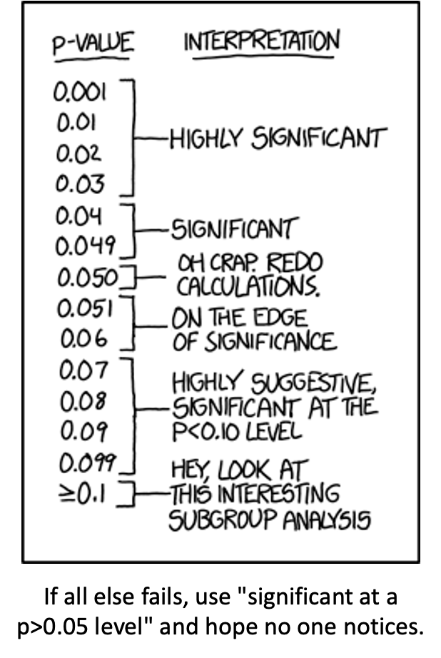
Lecture 11: Review
ANOVA
Analysis of variance: single and multi-factor designs
Examples: diatoms, circadian rhythms
Predictor variables: fixed vs. random
ANOVA model
Analysis and partitioning of variance
Null hypothesis
Assumptions and diagnostics
Post F Tests - Tukey and others
Reporting the results

Slide 3
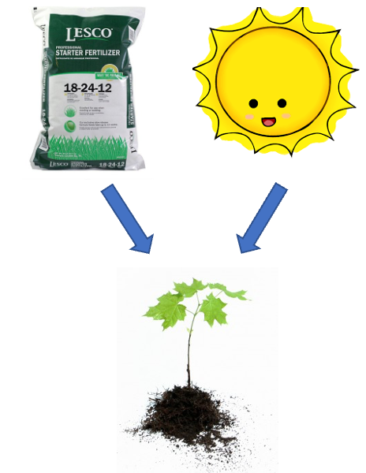
Lecture 12: Factorial ANOVA
2-factor designs (2-way ANOVA)
very common in ecology
can have more factors (e.g., 3-way ANOVA) but interpretation gets very challenging…
Most multifactor designs: are factorial or nested
We will cover a 2 Factor Anova - this could be fertilizer and sunlight for plant biomass produced…
  each can have an effect independently
  the effect of one factor may interact with the other factor
  in this example…
    a low light and high light treatment might affect biomass
    fertilizer also might affect plant biomass
    but when you have higher light the high fertilizer treatment may grow better than expected

Slide 4
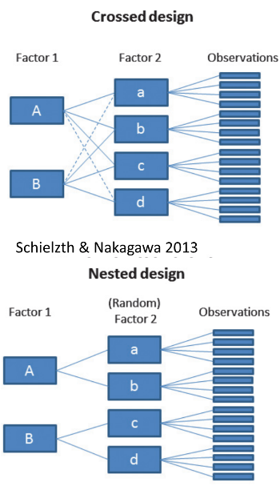
Factorial ANOVA: Design Structure
Consider two factors:
Factorial/crossed:
  every level of B in every level of A

Slide 5
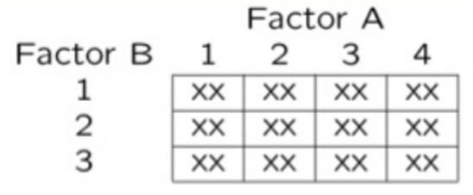
Factorial ANOVA: Effect Types
In factorial designs
look at two types of factor effects:
  Main effect of each factor (polling across other factor)
  Interaction effects; is there synergistic/ antagonistic effect of factors?

Slide 6
Introduction to Two-Way ANOVA
Factorial Designs
Two-way ANOVA examines:
Main effect of Factor A (Species)
Main effect of Factor B (Sex)
Interaction between A × B
Balanced design: equal sample sizes in all cells
Type III sums of squares for unbiased estimates - if balanced it does not matter
## # A tibble: 6 × 6
## species sex n mean_mass sd_mass se_mass
## <fct> <fct> <int> <dbl> <dbl> <dbl>
## 1 Adelie female 73 3369. 269. 31.5
## 2 Adelie male 73 4043. 347. 40.6
## 3 Chinstrap female 34 3527. 285. 48.9
## 4 Chinstrap male 34 3939. 362. 62.1
## 5 Gentoo female 58 4680. 282. 37.0
## 6 Gentoo male 61 5485. 313. 40.1

Slide 7
Data Preparation - Creating Balanced Design
Balancing the Penguin Data
The dataframe of penguins is unbalanced - there are unequal samples per cell
## # A tibble: 3 × 3
## species female male
## <fct> <int> <int>
## 1 Adelie 73 73
## 2 Chinstrap 34 34
## 3 Gentoo 58 61
## Minimum n = 34
## # A tibble: 3 × 3
## species female male
## <fct> <int> <int>
## 1 Adelie 34 34
## 2 Chinstrap 34 34
## 3 Gentoo 34 34
Statistical Mode $Y_{ijk}=μ+α_{i}+β_{j}+(αβ)_{ij}+ε_{ijk}$
Where:
$μ$ = grand mean
$α_{i}$ = effect of species i
$β_{j}$ = effect of sex j
$(αβ)_{ij}$ = interaction effect
$ε_{ijk}$ = random error

Slide 8
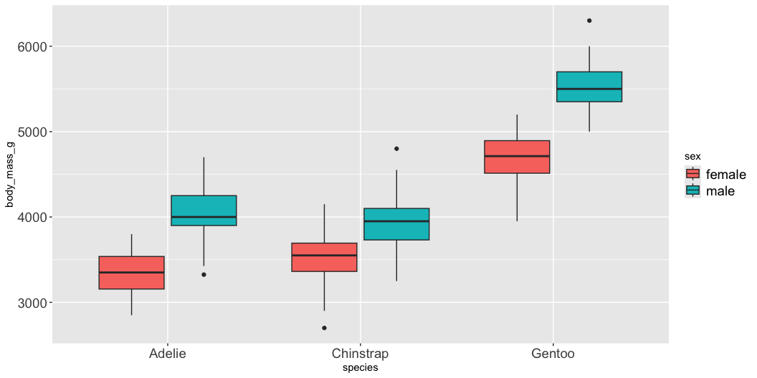
Descriptive Statistics
Summary Statistics by Groups
## # A tibble: 6 × 6
## species sex n mean_mass sd_mass se_mass
## <fct> <fct> <int> <dbl> <dbl> <dbl>
## 1 Adelie female 34 3335. 260. 44.5
## 2 Adelie male 34 4049. 318. 54.5
## 3 Chinstrap female 34 3527. 285. 48.9
## 4 Chinstrap male 34 3939. 362. 62.1
## 5 Gentoo female 34 4681. 309. 53.0
## 6 Gentoo male 34 5525 274. 47.0

Slide 9
Factorial ANOVA Models
Factorial designs can be of 3 types:
Model 1 - 2 fixed factors - the focus for today….
Model 2 - 2 random
Model 3 - 1 fixed, 1 random (mixed model) - often nested
Model 1 ANOVA:
$$y_{ijk}=μ+α_{i}+β_{j}+(αβ)_{ij}+ε_{ijk}$$

Slide 10
Model Components Explained
$$y_{ijk}=μ+α_{i}+β_{j}+(αβ)_{ij}+ε_{ijk}$$
$y_{ijk}$: value of the k_{th} observation from jth and ith combination of B and A (sex m of species y)
µ: overall mean (overall mass)
αi: effect of the ith level of A, pooling across all levels of B: µi- µ (difference between average mass in all “males” for species x and overall mean)

Slide 11
Interaction Effects
$$y_{ijk}=μ+α_{i}+β_{j}+(αβ)_{ij}+ε_{ijk}$$
Βj: effect of jth level of B, pooling across all levels of A: µj- µ (difference between average mass in all males treatments and overall mean)
(αβ)ij: effect of interaction of ith level of A and jth level of B (µij - µi - µj + µ).
  Does effect of B depend on level of A? (is effect of sex different in the 3 species?)

Slide 12
Model Types and Interpretation
$$y_{ijk}=μ+α_{i}+β_{j}+(αβ)_{ij}+ε_{ijk}$$
Model 2 ANOVA rare in ecology
Model 3 interpretation is different:
  βj: random variable measuring variance in y across all possible levels of B, pooling across all levels of A
  (αβ)ij is random variable measuring variance of interaction between A and B across all possible levels of B (“is effect of A consistent across all possible levels of B that could have been chosen?”)

Slide 13
Estimated Marginal Means
Before we go further we need to define what estimated marginal means are
Balanced data - it is just the means of the groups… easy
Unbalanced data - it is the mean of cells that represent the lowest average of the groups
## Combined table with means and counts:
## # A tibble: 3 × 5
## species female_mean male_mean female_n male_n
## <fct> <dbl> <dbl> <int> <int>
## 1 Adelie 3369. 4043. 73 73
## 2 Chinstrap 3527. 3939. 34 34
## 3 Gentoo 4680. 5485. 58 61
##
##
## Regular means (WRONG for marginal means):
## # A tibble: 3 × 3
## species total_n regular_mean
## <fct> <int> <dbl>
## 1 Adelie 146 3706.
## 2 Chinstrap 68 3733.
## 3 Gentoo 119 5092.
## Estimated Marginal Means for Species (CORRECT):
## # A tibble: 3 × 3
## species emm_mean calculation
## <fct> <dbl> <chr>
## 1 Adelie 3706. (3368.8 + 4043.5) / 2 = 3706.2
## 2 Chinstrap 3733. (3527.2 + 3939) / 2 = 3733.1
## 3 Gentoo 5082. (4679.7 + 5484.8) / 2 = 5082.3
##
##
## Comparison showing EMM calculation:
## # A tibble: 3 × 6
## species cell_mean_female cell_mean_male species_emm regular_mean difference
## <fct> <dbl> <dbl> <dbl> <dbl> <dbl>
## 1 Adelie 3369. 4043. 3706. 3706. 4.55e-13
## 2 Chinstrap 3527. 3939. 3733. 3733. 0
## 3 Gentoo 4680. 5485. 5082. 5092. -1.01e+ 1

Slide 14
Estimated Marginal Means
Before we go further we need to define what estimated marginal means are
Balanced data - it is just the means of the groups… easy
Unbalanced data - it is the mean of cells that represent the lowest average of the groups
## Combined table with means and counts:
## # A tibble: 3 × 5
## species female_mean male_mean female_n male_n
## <fct> <dbl> <dbl> <int> <int>
## 1 Adelie 3369. 4043. 73 73
## 2 Chinstrap 3527. 3939. 34 34
## 3 Gentoo 4680. 5485. 58 61
##
## Regular means sex (WRONG for marginal means):
## # A tibble: 2 × 3
## sex total_n regular_mean
## <fct> <int> <dbl>
## 1 female 165 3862.
## 2 male 168 4546.
##
##
## Estimated Marginal Means for Sex (CORRECT):
## # A tibble: 2 × 3
## sex emm_mean calculation
## <fct> <dbl> <chr>
## 1 female 3859. (3368.8 + 3527.2 + 4679.7) / 3 = 3858.6
## 2 male 4489. (4043.5 + 3939 + 5484.8) / 3 = 4489.1
## \n
## Comparison showing difference between regular and marginal means:
## # A tibble: 2 × 5
## sex total_n regular_mean emm_mean difference
## <fct> <int> <dbl> <dbl> <dbl>
## 1 female 165 3862. 3859. -3.68
## 2 male 168 4546. 4489. -56.6

Slide 15
ANOVA Table Structure
SStotal = SSA + SSB + SSAB + SSresidual
SStotal = (Y - Grand Mean Y)^2
SSresidual = (Y -Yhat)^2 or the difference between each observation and the appropriate cell mean, summed over all observations

Slide 16
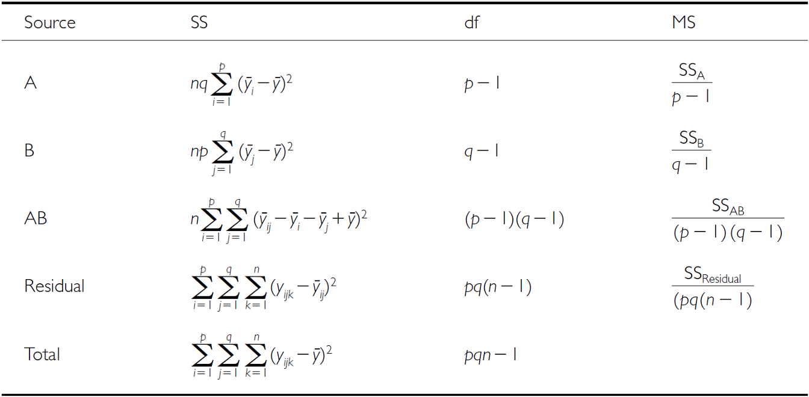
SSA: Factor A Effects
SSA is SS of differences between each marginal mean of A and overall mean
If A is species then get the emmeans for factor A down and subtract from overall mean

Slide 17
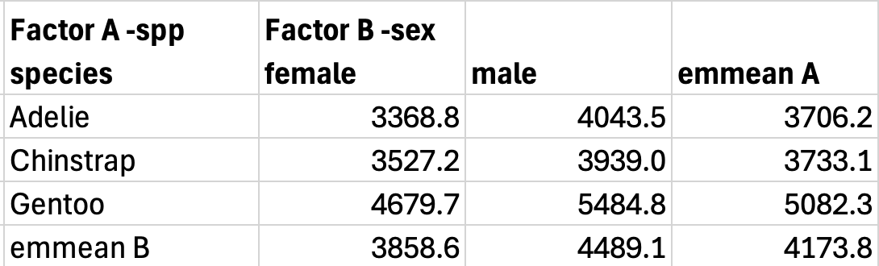

Slide 18
SSB: Factor B Effects
SSB is SS of differences between each marginal mean of B and overall mean
If B is sex then get the emmeans for factor B across and subtract from overall mean

Slide 20
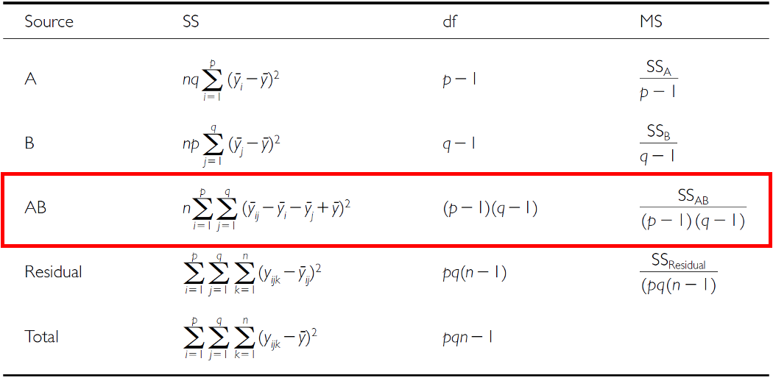
SSAB: Interaction Effects
SSAB is SS of cell means minus marginal means plus overall mean

Slide 22
F-ratio Calculations
SS converted to MS;
F-ratio calculations are different depending on whether factors are fixed, random or mixed

Slide 23
Hypotheses: Fixed Factors
3 hypotheses are tested in a two-way factorial ANOVA:
A, B, A*B Both factors fixed:
  Ho(A): µ1= µ2= µ3=…. µi= µp (no diff. in marginal means of A, pooling across all levels of B)
  Ho(B): µ1= µ2= µ3=…. µj= µq (no diff. in marginal means of B, pooling across all levels of A)
  Ho(AB): µij- µi - µj + µ = 0 (no effect of interaction)

Slide 24
Hypotheses: Mixed Model
3 hypotheses are tested in a two-way factorial ANOVA: A, B, A*B
One fixed, one random:
  Ho(A): µ1= µ2= µ3=…. µi= µp (no diff. in marginal means of A, pooling across all levels of B)
  Ho(B): σB2= 0 (no added variance due to levels of B that could have been used)
  Ho(AB): σAB2= 0 (no added variance due to interaction between all levels of A and B that could have been used)

Slide 25
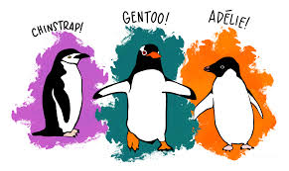
Example Study Details
So lets try the example with the penguin data that is in the package penguin
Effect of species and sex on body_mass_g
  3 species (factor A)
  2 sexes (factor B)
  34 replicates in each cell
  This analysis examines the effects of species and sex on the body mass of penguins.

Slide 26
Two-Way ANOVA with Type III Sums of Squares
Fitting the Model
##
## Call:
## lm(formula = body_mass_g ~ species * sex, data = balanced_df)
##
## Residuals:
## Min 1Q Median 3Q Max
## -827.21 -178.13 6.25 175.00 861.03
##
## Coefficients:
## Estimate Std. Error t value Pr(>|t|)
## (Intercept) 4175.86 21.23 196.727 < 2e-16 ***
## species1 -484.31 30.02 -16.134 < 2e-16 ***
## species2 -442.77 30.02 -14.750 < 2e-16 ***
## sex1 -328.31 21.23 -15.467 < 2e-16 ***
## species1:sex1 -28.68 30.02 -0.955 0.341
## species2:sex1 122.43 30.02 4.078 6.57e-05 ***
## ---
## Signif. codes: 0 '***' 0.001 '**' 0.01 '*' 0.05 '.' 0.1 ' ' 1
##
## Residual standard error: 303.2 on 198 degrees of freedom
## Multiple R-squared: 0.8596, Adjusted R-squared: 0.856
## F-statistic: 242.4 on 5 and 198 DF, p-value: < 2.2e-16
## Type III Sums of Squares ANOVA:
## Anova Table (Type III tests)
##
## Response: body_mass_g
## Sum Sq Df F value Pr(>F)
## (Intercept) 3557308900 1 38701.5271 < 2.2e-16 ***
## species 87725999 2 477.2049 < 2.2e-16 ***
## sex 21988483 1 239.2224 < 2.2e-16 ***
## species:sex 1672776 2 9.0994 0.0001657 ***
## Residuals 18199467 198
## ---
## Signif. codes: 0 '***' 0.001 '**' 0.01 '*' 0.05 '.' 0.1 ' ' 1

Slide 27
Understanding Type III SS
Type III sums of squares test each effect after adjusting for all other effects in the model:
Species effect: Tested after adjusting for sex and interaction
Sex effect: Tested after adjusting for species and interaction
Interaction: Tested after adjusting for both main effects
This is especially important for unbalanced designs, but we’re using it here for consistency with the next analysis.
## Effect Sizes (Eta-squared):
## Effect Eta_Squared
## 1 Species 0.67696748
## 2 Sex 0.16968160
## 3 Interaction 0.01290854

Slide 28
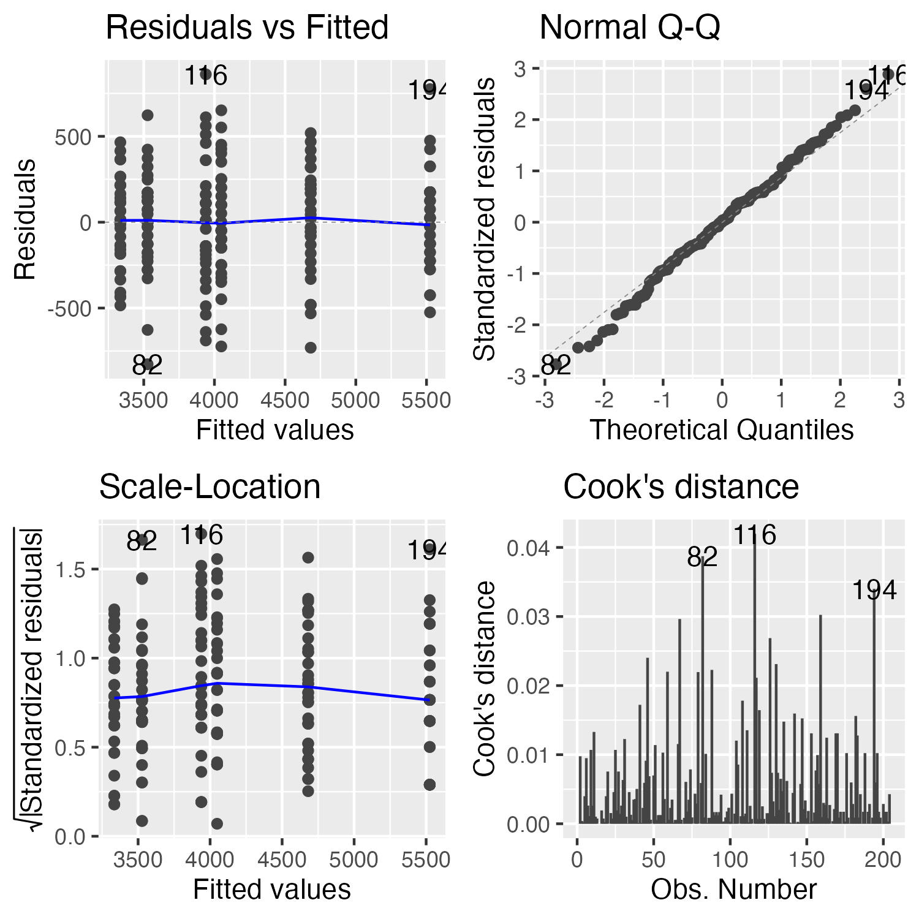
Checking Model Assumptions
Assumption Plots
should be the plot of the 4 assumption plots

Slide 29
Formal Tests
These are the formal tests of
  normality of residuals
  homogeneity of variances
## Shapiro-Wilk Normality Test:
##
## Shapiro-Wilk normality test
##
## data: residuals(anova_model)
## W = 0.99612, p-value = 0.8886
## Levene's Test for Homogeneity:
## Levene's Test for Homogeneity of Variance (center = median)
## Df F value Pr(>F)
## group 5 0.7841 0.5622
## 198
## Number of outliers (|z| > 3): 0

Slide 30
Estimated Marginal Means (EMMs)
Computing EMMs
## Species EMMs:
## species emmean SE df lower.CL upper.CL
## Adelie 3692 36.8 198 3619 3764
## Chinstrap 3733 36.8 198 3661 3806
## Gentoo 5103 36.8 198 5030 5175
##
## Results are averaged over the levels of: sex
## Confidence level used: 0.95
## Sex EMMs:
## sex emmean SE df lower.CL upper.CL
## female 3848 30 198 3788 3907
## male 4504 30 198 4445 4563
##
## Results are averaged over the levels of: species
## Confidence level used: 0.95
## Species by Sex EMMs:
## species sex emmean SE df lower.CL upper.CL
## Adelie female 3335 52 198 3232 3437
## Chinstrap female 3527 52 198 3425 3630
## Gentoo female 4681 52 198 4578 4783
## Adelie male 4049 52 198 3946 4151
## Chinstrap male 3939 52 198 3836 4042
## Gentoo male 5525 52 198 5422 5628
##
## Confidence level used: 0.95
Pairwise Comparisons
## [1] "Species pairwise comparisons:\n"
## contrast estimate SE df t.ratio p.value
## Adelie - Chinstrap -41.5 52 198 -0.799 0.7041
## Adelie - Gentoo -1411.4 52 198 -27.145 <0.0001
## Chinstrap - Gentoo -1369.9 52 198 -26.346 <0.0001
##
## Results are averaged over the levels of: sex
## P value adjustment: tukey method for comparing a family of 3 estimates
## [1] "Species comparisons within sex:"
## sex = female:
## contrast estimate SE df t.ratio p.value
## Adelie - Chinstrap -193 73.5 198 -2.620 0.0256
## Adelie - Gentoo -1346 73.5 198 -18.310 <0.0001
## Chinstrap - Gentoo -1154 73.5 198 -15.690 <0.0001
##
## sex = male:
## contrast estimate SE df t.ratio p.value
## Adelie - Chinstrap 110 73.5 198 1.490 0.2979
## Adelie - Gentoo -1476 73.5 198 -20.079 <0.0001
## Chinstrap - Gentoo -1586 73.5 198 -21.569 <0.0001
##
## P value adjustment: tukey method for comparing a family of 3 estimates

Slide 31
Post F Test of the interaction
What we need to do if the interaction is significant is to test the overall interaction and ignore the main effects!!!

Slide 32
Interaction tests continued
## species sex emmean SE df lower.CL upper.CL .group
## Adelie female 3334.559 51.99448 198 3196.378 3472.740 a
## Adelie male 4048.529 51.99448 198 3910.349 4186.710 b
## Chinstrap female 3527.206 51.99448 198 3389.025 3665.387 a
## Chinstrap male 3938.971 51.99448 198 3800.790 4077.151 b
## Gentoo female 4680.882 51.99448 198 4542.702 4819.063 c
## Gentoo male 5525.000 51.99448 198 5386.819 5663.181 d
##
## Confidence level used: 0.95
## Conf-level adjustment: sidak method for 6 estimates
## P value adjustment: sidak method for 15 tests
## significance level used: alpha = 0.05
## NOTE: If two or more means share the same grouping symbol,
## then we cannot show them to be different.
## But we also did not show them to be the same.

Slide 33
interaction plot

Slide 34
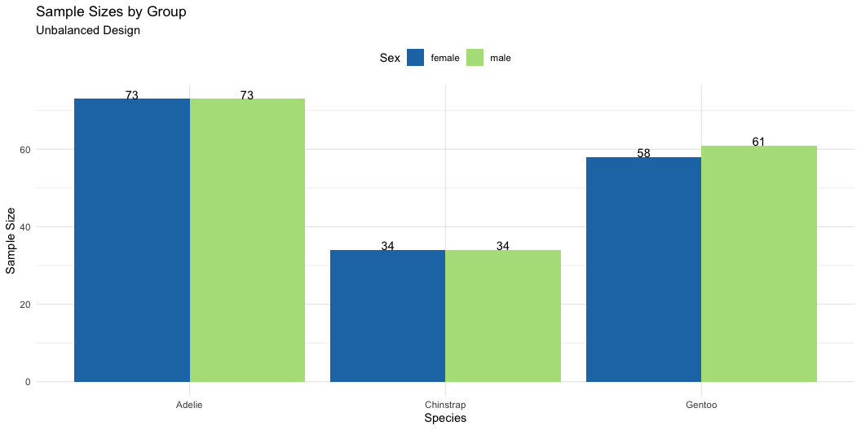
Introduction to Unbalanced Designs
The Challenge of Unbalanced Data
Real-world data is often unbalanced:
  Unequal sample sizes across groups
  Missing data patterns
  Natural variation in sampling
Key Issues:
  Type I, II, and III SS give different results
  Order of terms matters for Type I SS
  Marginal means ≠ Simple averages Interpretation becomes complex
Statistical Model (same as balanced):
$$Y_{ijk}=μ+α_{i}+β_{j}+(αβ)_{ij}+ε_{ijk}$$
But parameter estimation differs!
Data Preparation - Using Natural Unbalanced Data
## [1] "Unbalanced sample sizes:"
## # A tibble: 6 × 3
## species sex n
## <fct> <fct> <int>
## 1 Adelie female 73
## 2 Adelie male 73
## 3 Chinstrap female 34
## 4 Chinstrap male 34
## 5 Gentoo female 58
## 6 Gentoo male 61
## [1] "Total N = 333"
## [1] "Imbalance ratio = 2.15"
Visualizing Imbalance

Slide 35
Understanding Sums of Squares Types
Type I (Sequential) SS
## Type I SS (Species → Sex → Interaction):
## Analysis of Variance Table
##
## Response: body_mass_g
## Df Sum Sq Mean Sq F value Pr(>F)
## species 2 145190219 72595110 758.358 < 2.2e-16 ***
## sex 1 37090262 37090262 387.460 < 2.2e-16 ***
## species:sex 2 1676557 838278 8.757 0.0001973 ***
## Residuals 327 31302628 95727
## ---
## Signif. codes: 0 '***' 0.001 '**' 0.01 '*' 0.05 '.' 0.1 ' ' 1
##
##
## Type I SS (Sex → Species → Interaction):
## Analysis of Variance Table
##
## Response: body_mass_g
## Df Sum Sq Mean Sq F value Pr(>F)
## sex 1 38878897 38878897 406.145 < 2.2e-16 ***
## species 2 143401584 71700792 749.016 < 2.2e-16 ***
## sex:species 2 1676557 838278 8.757 0.0001973 ***
## Residuals 327 31302628 95727
## ---
## Signif. codes: 0 '***' 0.001 '**' 0.01 '*' 0.05 '.' 0.1 ' ' 1
##
##
## Type I SS depends on order:
## Effect Order1_SS Order2_SS
## 1 Species 145190219 143401584
## 2 Sex 37090262 38878897
How Type I SS Works
Sequential decomposition:
First term gets all SS it can explain
Second term gets SS after removing first
Third term gets SS after removing first two
Example calculation:
  SS(Species) = reduction in SS from null to species-only model
  SS(Sex|Species) = additional reduction adding sex
  SS(Interaction|Species,Sex) = additional reduction adding interaction
Problems with unbalanced data:
  Order dependency
  Biased if factors are correlated
  Not invariant to coding

Slide 36
Type III Sums of Squares
Type III (Marginal) SS
## [1] "Type III Sums of Squares:"
## Anova Table (Type III tests)
##
## Response: body_mass_g
## Sum Sq Df F value Pr(>F)
## (Intercept) 5232595969 1 54661.828 < 2.2e-16 ***
## species 143001222 2 746.924 < 2.2e-16 ***
## sex 29851220 1 311.838 < 2.2e-16 ***
## species:sex 1676557 2 8.757 0.0001973 ***
## Residuals 31302628 327
## ---
## Signif. codes: 0 '***' 0.001 '**' 0.01 '*' 0.05 '.' 0.1 ' ' 1
## [1] "Comparison of F-values:"
## Effect Type_I_F Type_III_F
## 1 Species 758.36 746.92
## 2 Sex 387.46 311.84
## 3 Interaction 8.76 8.76
How Type III SS Works
Marginal decomposition:
  Each effect tested after adjusting for all others:
    SS(Species|Sex,Interaction)
    SS(Sex|Species,Interaction)
    SS(Interaction|Species,Sex)
Advantages:
  Order invariant
  Tests hypotheses about unweighted means
  Standard in most software
Disadvantages:
  Lower power with missing cells
  Tests may not be orthogonal
  Requires careful interpretation
## [1] "Effect Sizes (Type III):"
## Effect Eta_Squared
## 1 Species 0.6947
## 2 Sex 0.1450
## 3 Interaction 0.0081

Slide 37
Manual SS Calculation Demonstration
Computing SS Step-by-Step
## [1] "Grand mean: 4207.1"
## [1] "Total SS: 215259666"
## [1] "Between-groups SS: 183957038"
## [1] "Within-groups SS: 31302628"
## [1] "Check: Between + Within = 215259666"
Decomposing Between-Group SS
## SS(Species alone): 145190219
## SS(Sex alone): 38878897
##
##
## Sum of main effects: 184069116
## Actual between SS: 183957038
##
##
## Difference (due to correlation): -112078

Slide 38
Estimated Marginal Means - Unbalanced Data
Computing EMMs
## Species EMMs (model-based):
## species emmean SE df lower.CL upper.CL
## Adelie 3706 25.6 327 3656 3757
## Chinstrap 3733 37.5 327 3659 3807
## Gentoo 5082 28.4 327 5026 5138
##
## Results are averaged over the levels of: sex
## Confidence level used: 0.95
##
##
## Sex EMMs (model-based):
## sex emmean SE df lower.CL upper.CL
## female 3859 25.3 327 3809 3908
## male 4489 25.2 327 4440 4539
##
## Results are averaged over the levels of: species
## Confidence level used: 0.95
## contrast estimate SE df t.ratio p.value
## Adelie female - Chinstrap female -193 73.5 198 -2.620 0.0973
## Adelie female - Gentoo female -1346 73.5 198 -18.310 <0.0001
## Adelie female - Adelie male -714 73.5 198 -9.710 <0.0001
## Adelie female - Chinstrap male -604 73.5 198 -8.220 <0.0001
## Adelie female - Gentoo male -2190 73.5 198 -29.789 <0.0001
## Chinstrap female - Gentoo female -1154 73.5 198 -15.690 <0.0001
## Chinstrap female - Adelie male -521 73.5 198 -7.090 <0.0001
## Chinstrap female - Chinstrap male -412 73.5 198 -5.600 <0.0001
## Chinstrap female - Gentoo male -1998 73.5 198 -27.169 <0.0001
## Gentoo female - Adelie male 632 73.5 198 8.600 <0.0001
## Gentoo female - Chinstrap male 742 73.5 198 10.090 <0.0001
## Gentoo female - Gentoo male -844 73.5 198 -11.480 <0.0001
## Adelie male - Chinstrap male 110 73.5 198 1.490 0.6711
## Adelie male - Gentoo male -1476 73.5 198 -20.079 <0.0001
## Chinstrap male - Gentoo male -1586 73.5 198 -21.569 <0.0001
##
## P value adjustment: tukey method for comparing a family of 6 estimates

Slide 39
Interaction tests continued
## species sex emmean SE df lower.CL upper.CL .group
## Adelie female 3368.836 36.21222 327 3272.980 3464.692 a
## Adelie male 4043.493 36.21222 327 3947.637 4139.349 b
## Chinstrap female 3527.206 53.06120 327 3386.749 3667.662 a
## Chinstrap male 3938.971 53.06120 327 3798.514 4079.427 b
## Gentoo female 4679.741 40.62586 327 4572.202 4787.281 c
## Gentoo male 5484.836 39.61427 327 5379.975 5589.698 d
##
## Confidence level used: 0.95
## Conf-level adjustment: sidak method for 6 estimates
## P value adjustment: sidak method for 15 tests
## significance level used: alpha = 0.05
## NOTE: If two or more means share the same grouping symbol,
## then we cannot show them to be different.
## But we also did not show them to be the same.

Slide 40
Pairwise Comparisons
Tukey HSD Comparisons
## Species pairwise comparisons (Tukey):
## contrast estimate SE df t.ratio p.value
## Adelie - Chinstrap -26.9 45.4 327 -0.593 0.8241
## Adelie - Gentoo -1376.1 38.2 327 -36.007 <0.0001
## Chinstrap - Gentoo -1349.2 47.0 327 -28.682 <0.0001
##
## Results are averaged over the levels of: sex
## P value adjustment: tukey method for comparing a family of 3 estimates
##
##
## Sex effect within each species:
## species = Adelie:
## contrast estimate SE df t.ratio p.value
## female - male -675 51.2 327 -13.174 <0.0001
##
## species = Chinstrap:
## contrast estimate SE df t.ratio p.value
## female - male -412 75.0 327 -5.487 <0.0001
##
## species = Gentoo:
## contrast estimate SE df t.ratio p.value
## female - male -805 56.7 327 -14.188 <0.0001
Interaction Contrasts
## Sex effect (Male - Female) by species:
## Species Sex_Effect
## 1 Adelie -675
## 2 Chinstrap -412
## 3 Gentoo -805
##
##
## Interaction interpretation:
## [1] "Sex effects differ across species"

Slide 41
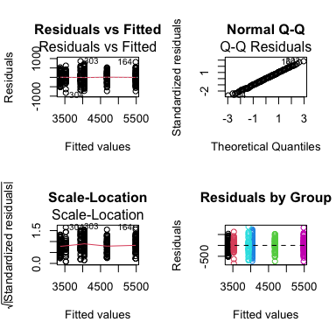
Diagnostic Plots - Unbalanced Design
Model Diagnostics
Assumption Tests
## [1] "Shapiro-Wilk test:"
##
## Shapiro-Wilk normality test
##
## data: residuals(model_u)
## W = 0.99776, p-value = 0.9367
## [1] "\nLevene's test:"
## Levene's Test for Homogeneity of Variance (center = median)
## Df F value Pr(>F)
## group 5 1.3908 0.2272
## 327
## [1] "\nResidual SD by group:"
## # A tibble: 6 × 3
## species sex sd_resid
## <fct> <fct> <dbl>
## 1 Adelie female 269.
## 2 Adelie male 347.
## 3 Chinstrap female 285.
## 4 Chinstrap male 362.
## 5 Gentoo female 282.
## 6 Gentoo male 313.

Slide 42
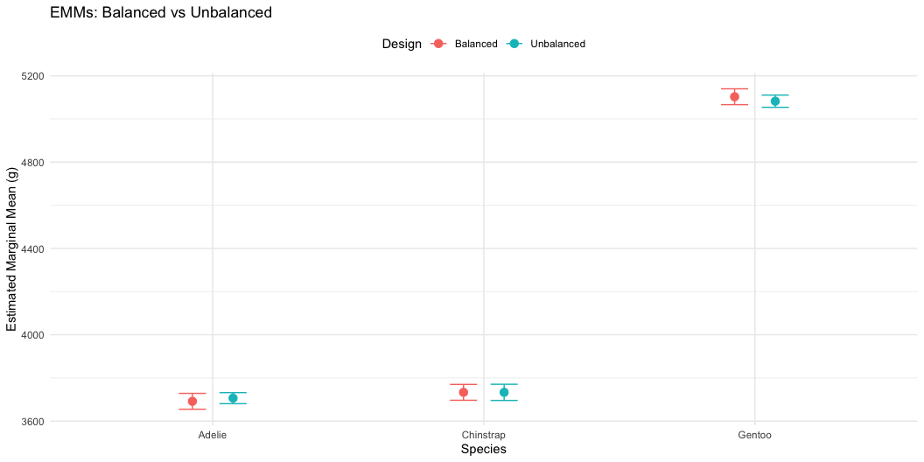
Comparing Balanced vs Unbalanced Results
Side-by-Side Comparison
## Balanced vs Unbalanced Results:
## Effect Balanced_F Balanced_p Unbalanced_F Unbalanced_p
## 1 Species 477.20 0e+00 746.92 0e+00
## 2 Sex 239.22 0e+00 311.84 0e+00
## 3 Interaction 9.10 2e-04 8.76 2e-04
##
##
## Sample sizes:
## Balanced total N: 204
## Unbalanced total N: 333
## Data discarded: 129 observations
Visual Comparison

Slide 43
Summary and Best Practices
Key Takeaways
Unbalanced Designs:
Challenges: - Type I SS depends on order - Simple means ≠ EMMs - Reduced power for interactions - Complex interpretation
Solutions: - Use Type III SS for main effects - Report EMMs, not simple means - Check assumptions carefully - Consider impact of imbalance
Recommendations:
Always report:
  Sample sizes per cell
  Type of SS used
  EMMs with CIs
Visualization:
  Show actual data points
  Include error bars
  Note unequal sample sizes
Interpretation:
  Focus on effect sizes
  Consider practical significance
  Acknowledge limitations

Slide 44
Final Recommendations
For Experimental Studies: - Design for balance when possible - Randomize allocation - Plan for attrition
For Observational Studies: - Accept imbalance as reality - Use Type III SS - Report EMMs - Consider covariates (ANCOVA)
Statistical Software Defaults: - R: Type I (sequential) - SAS: Type III (marginal) - SPSS: Type III (marginal)
Always specify which type you’re using!

