Slide 1
Principal Component Analysis (PCA)
Understanding Multivariate Data with Darlingtonia californica
Bill Perry

Slide 2
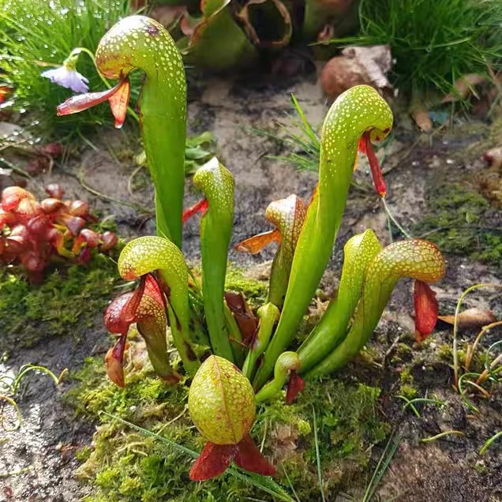
Introduction to Multivariate Analysis
Why Study Multivariate Data?
In ecology, often measure many variables on the same organisms:
  Plant morphology: height, width, leaf size, flower size
  Environmental conditions: temperature, pH, nutrients
  Species composition: presence/absence, abundance
Challenge: How do we make sense of all these variables at once?
PCA helps by:
  Reducing many correlated variables to a few key dimensions
  Visualizing patterns in high-dimensional data
  Identifying the most important sources of variation
Darlingtonia californica (Cobra Lily)
image of a cobra lily Darlingtonia californica

Slide 3
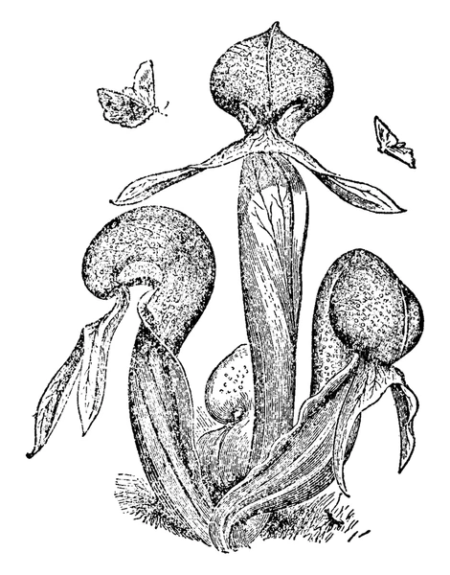
Our Study System: Darlingtonia
The Cobra Lily Dataset
Analyze morphological measurements from 89 individual Darlingtonia californica plants collected from 4 sites in the Siskiyou Mountains of Oregon.
Variables measured (10 total):
  Morphological measurements (mm):
    height - Height of pitcher
    mouth_diam - Mouth diameter
    tube_diam - Tube diameter
    keel_diam - Keel diameter
    wing1_length, wing2_length
    Wing lengths (2 measurements)
    wingsprea - Wing spread
  Biomass measurements (g):
    hoodmass_g - Hood mass
    tubemass_g - Tube mass
    wingmass_g - Wing mass
![Darlingtonia pitcher structure showing measured features\]
**Sites**:
TJH: T.J. Howell’s Fen
DG: Day’s Gulch
LEH: L.E. Hunter’s Fen
HD: High Divide

Slide 4
Loading the Data
Step 1: Import and Prepare the Data
# Load the data
darlingtonia <- read_csv("darlingtonia.csv")
# View the structure
head(darlingtonia)
## # A tibble: 6 × 11
## site height mouth_diam tube_diam keel_diam wing1_length wing2_length
## <chr> <dbl> <dbl> <dbl> <dbl> <dbl> <dbl>
## 1 TJH 654 38.4 16.6 6.4 85 76
## 2 TJH 413 22.2 17.2 5.9 55 26
## 3 TJH 610 31.2 19.9 6.7 62 60
## 4 TJH 546 34.4 20.8 6.3 84 79
## 5 TJH 665 30.5 20.4 6.6 60 51
## 6 TJH 665 33.6 19.5 6.6 84 66
## # ℹ 4 more variables: wingsprea <dbl>, hoodmass_g <dbl>, tubemass_g <dbl>,
## # wingmass_g <dbl>
darlingtonia %>%
count(site, name = "n_plants")
## # A tibble: 4 × 2
## site n_plants
## <chr> <int>
## 1 DG 25
## 2 HD 12
## 3 LEH 25
## 4 TJH 25

Slide 5
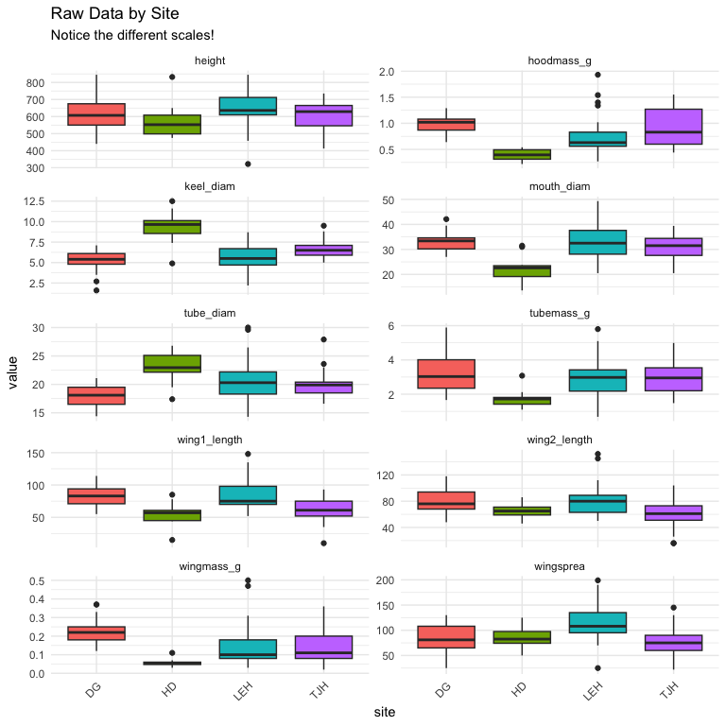
Exploring the Raw Data
Initial Data Exploration
Before any analysis, we should always look at our data:
Check for outliers
Examine distributions
Look for patterns by site
Understand variable scales
Key observations:
Variables measured in different units (mm vs. g)
Different ranges: height (hundreds) vs. biomass (fractions)
Need to standardize before PCA!

Slide 6
The Problem of Different Scales
Why Standardization Matters
Without standardization:
  Variables with larger values (like height in mm) would dominate the analysis over variables with smaller values (like biomass in g).
Example from data:
  Height: mean ≈ 600 mm, range 322-845 mm -
  Wing mass: mean ≈ 0.16 g, range 0.02-5.00 g
calculated distances without standardizing, height would have 1000× more influence than wing mass!
Solution: Z-score standardization
  $Z=\frac{(Y_{i}−\overset{‾}{Y})}{s}$
transforms each variable to:
  Mean = 0
  Standard deviation = 1
  Units: “standard deviations from the mean”
Before standardization: - Height dominates (larger scale)
After standardization:
  All variables contribute equally
  Measured in “standard deviations”
# Example: standardize height
darlingtonia %>%
summarize(
mean_height = mean(height),
sd_height = sd(height),
mean_wingmass = mean(wingmass_g),
sd_wingmass = sd(wingmass_g)
)
## # A tibble: 1 × 4
## mean_height sd_height mean_wingmass sd_wingmass
## <dbl> <dbl> <dbl> <dbl>
## 1 616. 101. 0.154 0.102
# After standardization, both will have:
# mean = 0, sd = 1

Slide 7
Measuring Multivariate Distance
Euclidean Distance Between Individuals
How different are two plants?
  For two plants measured on multiple variables, calculate Euclidean distance:
    For 2 variables (height and spread):
      $d_{i,j}=\sqrt{(y_{i,1}−y_{j,1})^{2}+(y_{i,2}−y_{j,2})^{2}}$
    For n variables:
      $d_{i,j}=\sqrt{\sum_{k=1}^{n}{(}y_{i,k}−y_{j,k})^{2}}$
    Pythagorean theorem extended to many dimensions!
    Key point: Distance should use standardized values so all variables contribute equally
##
## Distance between plants 1 and 2 (standardized):
## 3.53 standard deviations
##
##
## Note: Standardization uses mean and SD from ALL plants,
## not just these two plants!

Slide 8
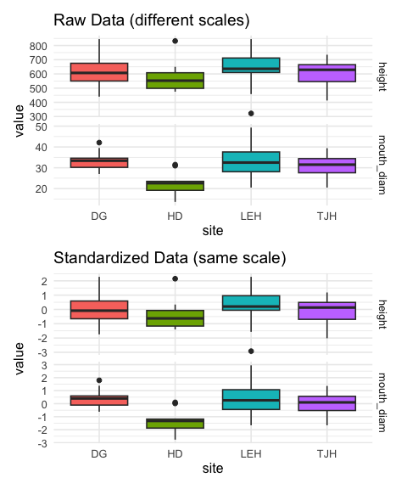
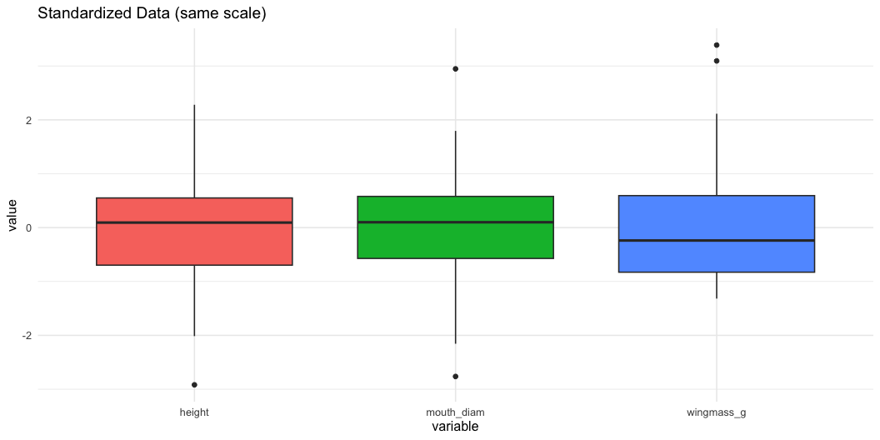
Standardizing the Data
Step 2: Z-score Transformation
Visualizing Standardized Data

Slide 9
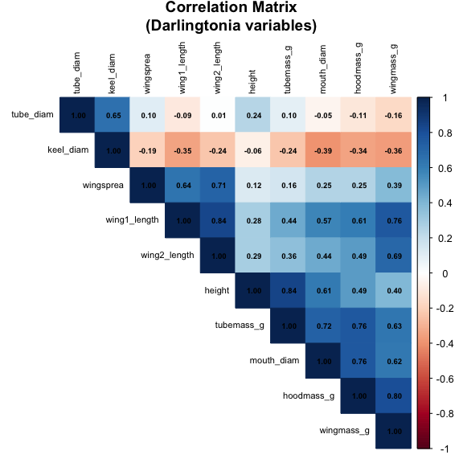
Understanding Correlations
Why Correlations Matter for PCA
PCA works best when variables are correlated:
  If variables are uncorrelated → PCA provides no benefit
  If variables are highly correlated → PCA can reduce dimensions effectively
In data, expect correlations because:
  Larger plants have larger measurements overall
  Wing dimensions likely correlate with each other
  Mass measurements correlate with size measurements
The correlation matrix shows relationships between all pairs of variables.
Strong correlations (positive or negative) suggest PCA will be useful!
Strong positive correlations (dark blue) suggest variables measure similar aspects of plant size/shape.

Slide 10
Correlation Matrix Details
Examining Variable Relationships
## height mouth_diam tube_diam keel_diam wing1_length wing2_length
## height 1.00 0.61 0.24 -0.06 0.28 0.29
## mouth_diam 0.61 1.00 -0.05 -0.39 0.57 0.44
## tube_diam 0.24 -0.05 1.00 0.65 -0.09 0.01
## keel_diam -0.06 -0.39 0.65 1.00 -0.35 -0.24
## wing1_length 0.28 0.57 -0.09 -0.35 1.00 0.84
## wing2_length 0.29 0.44 0.01 -0.24 0.84 1.00
## wingsprea 0.12 0.25 0.10 -0.19 0.64 0.71
## hoodmass_g 0.49 0.76 -0.11 -0.34 0.61 0.49
## tubemass_g 0.84 0.72 0.10 -0.24 0.44 0.36
## wingmass_g 0.40 0.62 -0.16 -0.36 0.76 0.69
## wingsprea hoodmass_g tubemass_g wingmass_g
## height 0.12 0.49 0.84 0.40
## mouth_diam 0.25 0.76 0.72 0.62
## tube_diam 0.10 -0.11 0.10 -0.16
## keel_diam -0.19 -0.34 -0.24 -0.36
## wing1_length 0.64 0.61 0.44 0.76
## wing2_length 0.71 0.49 0.36 0.69
## wingsprea 1.00 0.25 0.16 0.39
## hoodmass_g 0.25 1.00 0.76 0.80
## tubemass_g 0.16 0.76 1.00 0.63
## wingmass_g 0.39 0.80 0.63 1.00

Slide 11
Key Observations
Highly correlated variables:
  Height with tube area (r=0.89)
    Wing lengths with each other (r=0.80)
    Wing area with wing spread (r=0.81)
These correlations indicate redundancy
multiple variables measuring similar things.
Moderate correlations:
  Most morphological variables
  Mass measurements with size
Lower correlations:
  Some specific features like keel diameter
PCA will help by combining correlated variables into fewer components!

Slide 12
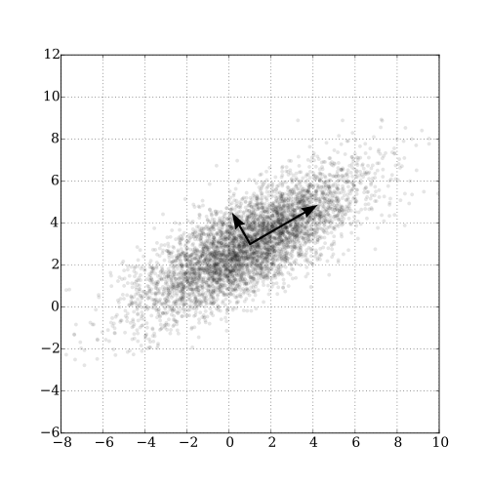
What is Principal Component Analysis?
The Concept of PCA
PCA creates new variables (components) that are:
  Linear combinations of original variables
  Uncorrelated with each other
  Ordered by importance (amount of variance explained)
The mathematical idea:
  For each plant i and component k:
  $Z_{ik}=a_{i1}Y_{1}+a_{i2}Y_{2}+...+a_{in}Y_{n}$
Where:
  $Z_{ik}$ = score on principal component k
  $Y_{j}$ = standardized value of original variable j
  $a_{ij}$ = loading (weight) of variable j on component i
Goal: Find loadings that maximize variance in first component, then second, etc.
https://upload.wikimedia.org/wikipedia/commons/thumb/f/f5/GaussianScatterPCA.svg/500px-GaussianScatterPCA.svg.png

Slide 13
Principal Components: Properties
Understanding Components are:
1. Orthogonal (perpendicular)
  Components are uncorrelated
  Each captures independent information
2. Ordered by variance
  PC1 explains the most variance
  PC2 explains second most (of remaining variance)
  And so on…
3. Linear combinations
  Each component is a weighted sum of original variables
  Weights (loadings) show variable importance
Why this matters:
Dimension reduction:
  Start with 10 correlated variables
  End with 2-3 uncorrelated components
  Retain most information with fewer dimensions
Easier interpretation:
  PC1 might represent “overall size”
  PC2 might represent “shape”
  Components often have biological meaning
Better for analysis:
  Can use in regression, ANOVA
  No multicollinearity problems
  Variables are standardized

Slide 14
Performing PCA in R
Step 3: Run the Analysis
# Perform PCA using prcomp()
# center = TRUE: center variables (mean = 0)
# scale. = TRUE: scale variables (sd = 1)
pca_result <- prcomp(darl_numeric,
center = TRUE,
scale = TRUE)
# What's in the result?
names(pca_result)
## [1] "sdev" "rotation" "center" "scale" "x"

Slide 15
Understanding the Output
## Importance of components:
## PC1 PC2 PC3 PC4 PC5 PC6 PC7
## Standard deviation 2.2332 1.3288 1.2354 0.75701 0.59301 0.51062 0.46177
## Proportion of Variance 0.4987 0.1766 0.1526 0.05731 0.03517 0.02607 0.02132
## Cumulative Proportion 0.4987 0.6753 0.8279 0.88521 0.92038 0.94645 0.96777
## PC8 PC9 PC10
## Standard deviation 0.3768 0.33982 0.25457
## Proportion of Variance 0.0142 0.01155 0.00648
## Cumulative Proportion 0.9820 0.99352 1.00000
Output components:
sdev: standard deviations of each PC (square root of eigenvalues)
rotation: loadings matrix (how variables load on PCs)
x: PC scores for each observation
center: variable means
scale: variable standard deviations

Slide 16
Eigenvalues and Variance Explained
How Much Variance Does Each PC Explain?
Eigenvalues ($λ$) measure variance explained by each component.
The proportion of variance for PC j is:
  ${\text{Proportion}}_{j}=\frac{λ_{j}}{\sum_{k=1}^{n}{λ_{k}}}$
In practice:
  PC1 always explains the most variance
  We want the first few PCs to explain most (>70%) of total variance
  allows dimension reduction
## # A tibble: 10 × 4
## PC Eigenvalue Proportion Cumulative
## <chr> <dbl> <dbl> <dbl>
## 1 PC1 4.99 0.499 0.499
## 2 PC2 1.77 0.177 0.675
## 3 PC3 1.53 0.153 0.828
## 4 PC4 0.573 0.057 0.885
## 5 PC5 0.352 0.035 0.92
## 6 PC6 0.261 0.026 0.946
## 7 PC7 0.213 0.021 0.968
## 8 PC8 0.142 0.014 0.982
## 9 PC9 0.115 0.012 0.994
## 10 PC10 0.065 0.006 1

Slide 17
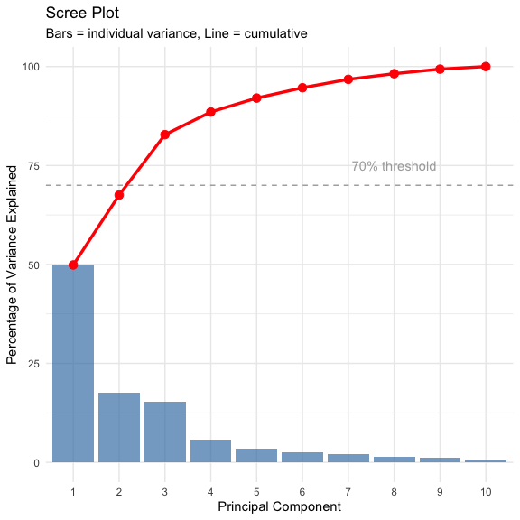
Scree Plot: Choosing Components
How Many Components to Use?
A scree plot shows variance explained by each component.
How to read it:
  Look for an “elbow” - sharp change in slope
  Keep components before the elbow
  Discard components in the “scree” (rubble)
In this data:
  PC1 explains 49.9% of variance
  PC2 explains 17.7%
  PC3 explains 15.3%
  First 3 PCs explain 77.3% of variance
Decision: Use PC1, PC2, and PC3 for interpretation.
remaining 7 components explain 17.1% (mostly noise).

Slide 18
Understanding Loadings
What are Loadings?
Loadings are the weights ($a_{ij}$) that show how each original variable contributes to each principal component.
For PC1:
  $Z_{1}=a_{11}Y_{1}+a_{12}Y_{2}+...+a_{1p}Y_{p}$
Interpreting loadings:
  Large positive loading: variable increases with PC
  Large negative loading: variable decreases with PC
  Near-zero loading: variable unimportant for PC
Guidelines:
  Loadings > 0.3 or < -0.3 are worth considering
  Loadings > 0.5 or < -0.5 are important
  Sign (+ or -) can flip; patterns matter more
PC1 loadings:
  Most variables have similar positive values
  All ~0.31 to 0.40 except keel (-0.18) and tube (-0.002)
  Suggests PC1 measures “overall size”
## PC1 PC2 PC3
## height -0.278 -0.449 0.198
## mouth_diam -0.369 -0.110 0.214
## tube_diam 0.040 -0.602 -0.390
## keel_diam 0.202 -0.491 -0.328
## wing1_length -0.375 0.171 -0.280
## wing2_length -0.342 0.131 -0.415
## wingsprea -0.239 0.156 -0.549
## hoodmass_g -0.385 -0.057 0.185
## tubemass_g -0.355 -0.320 0.263
## wingmass_g -0.393 0.080 -0.007

Slide 19
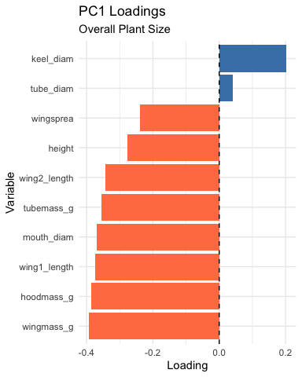
Interpreting PC1: Overall Size
PC1 Interpretation - Looking at PC1 loadings:
Key patterns:
Most variables load positively and similarly: - Height: 0.310 - Mouth diameter: 0.400
  Wing lengths: 0.386, 0.372
  Wing spread: 0.256
  Biomass: 0.397, 0.380, 0.230
Exception: Keel diameter (-0.177) and tube diameter (~0)
Biological meaning: PC1 represents overall plant size
  most measurements scale together (bigger plants have bigger everything).
## # A tibble: 10 × 2
## Variable Loading
## <chr> <dbl>
## 1 wingmass_g -0.393
## 2 hoodmass_g -0.385
## 3 wing1_length -0.375
## 4 mouth_diam -0.369
## 5 tubemass_g -0.355
## 6 wing2_length -0.342
## 7 height -0.278
## 8 wingsprea -0.239
## 9 keel_diam 0.202
## 10 tube_diam 0.0402
High PC1 → large plants
Low PC1 → small plants

Slide 20
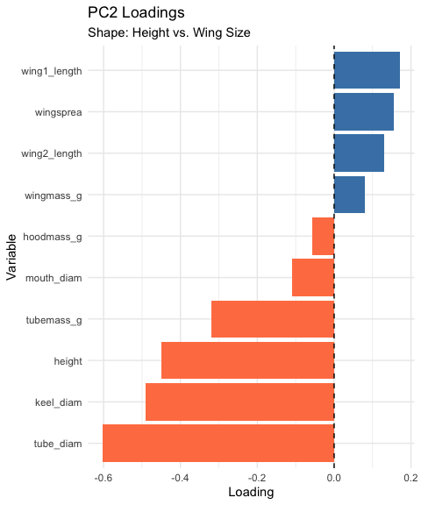
Interpreting PC2: Shape Contrast
PC2 Interpretation
Looking at PC2 loadings:
Key patterns:
  Height: -0.419 (negative, moderate)
  Mouth: -0.250 (negative, moderate)
  Wing measurements: positive (0.275-0.434)
  Wing spread: 0.434 (positive, strong)
  Biomass: mostly negative
Biological meaning: PC2 represents shape trade-offs
  tall narrow pitchers vs. short wide pitchers with large wings.
## # A tibble: 10 × 2
## Variable Loading
## <chr> <dbl>
## 1 tube_diam -0.602
## 2 keel_diam -0.491
## 3 height -0.449
## 4 tubemass_g -0.320
## 5 wing1_length 0.171
## 6 wingsprea 0.156
## 7 wing2_length 0.131
## 8 mouth_diam -0.110
## 9 wingmass_g 0.0800
## 10 hoodmass_g -0.0575
High PC2 → short plants with large wings
Low PC2 → tall narrow plants

Slide 21
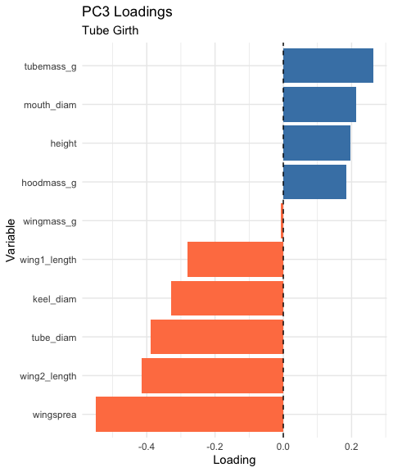
Interpreting PC3
PC3 Interpretation
Looking at PC3 loadings:
Key patterns:
Dominated by:
  Tube diameter: 0.743 (very strong positive)
  Keel diameter: 0.576 (strong positive)
  Most other variables near zero
Biological meaning: PC3 represents tube girth
  width/diameter of tube structure independent of height or wing size.
  Plants with high PC3 scores = fat tubes, allowing to trap larger prey?
## # A tibble: 10 × 2
## Variable Loading
## <chr> <dbl>
## 1 wingsprea -0.549
## 2 wing2_length -0.415
## 3 tube_diam -0.390
## 4 keel_diam -0.328
## 5 wing1_length -0.280
## 6 tubemass_g 0.263
## 7 mouth_diam 0.214
## 8 height 0.198
## 9 hoodmass_g 0.185
## 10 wingmass_g -0.00743
High PC3 → fat tubes
Low PC3 → skinny tubes

Slide 22
Principal Component Scores
What are PC Scores?
PC scores are values of each principal component for each obs./plant
Each plant gets a score on each PC:
  PC1 score = measure of size
  PC2 score = measure of shape
  PC3 score = measure of tube girth
How they’re calculated:
For plant i on PC1:
  ${\text{PC1}}_{i}=0.31×height_{i}+0.40×mouth_{i}+...$
  Using the standardized values and loadings we saw earlier.
## # A tibble: 10 × 5
## plant_id site PC1 PC2 PC3
## <int> <chr> <dbl> <dbl> <dbl>
## 1 1 TJH -1.92 0.0772 1.53
## 2 2 TJH 3.35 1.53 0.755
## 3 3 TJH 0.918 -0.0320 0.248
## 4 4 TJH -0.983 0.236 -0.242
## 5 5 TJH 1.15 -1.02 1.54
## 6 6 TJH -1.37 -0.613 0.847
## 7 7 TJH -1.50 -1.63 0.693
## 8 8 TJH -0.651 0.121 -0.412
## 9 9 TJH 2.48 -0.0786 -0.260
## 10 10 TJH -1.11 -1.27 2.27

Slide 23
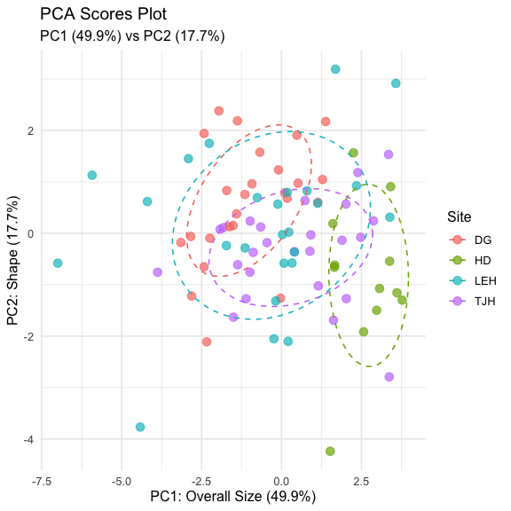
Visualizing PCA Results: Scores Plot
Ordination of Sites
We can plot PC scores to visualize:
  How plants are distributed in PC space
  Whether sites differ in morphology
  Patterns and groupings
In this plot:
  Each point = one plant
  Position determined by PC1 and PC2 scores
  Colors indicate collection site
Observations:
  Sites show some separation
  HD (orange) plants have lower PC1 (smaller)
  TJH (pink) plants variable but lower PC2
  Some overlap among sites
This is called ordination - ordering objects along axes.
The ordination

Slide 24
Different visualization of PCA Scores

Slide 25
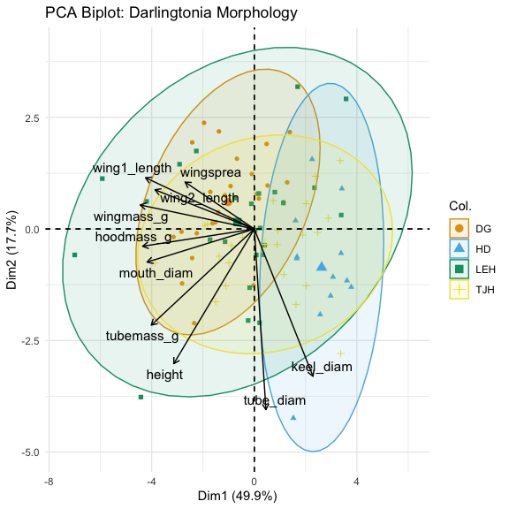
PCA Biplot: Combining Scores and Loadings
Reading a Biplot
A biplot shows both:
  Points = plants (PC scores)
  Arrows = original variables (loadings)
How to interpret arrows:
Length = how important the variable is
Direction = how the variable relates to PCs
Angle between arrows = correlation
  Small angle = positively correlated
  90° = uncorrelated
  180° = negatively correlated
How to interpret points:
  Plants in the direction of an arrow are high in that variable
  Plants opposite an arrow are low in that variable
The plot

Slide 26
Biplot Interpretation
Key Patterns in the Biplot
Variable relationships:
  Most morphological and biomass variables point together (right and slightly down):
    Height, mouth, masses - These are highly correlated
    All contribute to PC1 (size)
Wing variables (wing1_length, wing2_length, wingspread) point more upward:
  Contribute positively to PC2
    Represent the “wing dimension” of shape
Site separation:
  HD (blue): Lower PC1, plants are smaller overall
  DG (orange): Higher PC1, plants are larger
  TJH (yellow) and LEH (green): Intermediate and variable
Biological Interpretation
What determines plant morphology?
  Size (PC1, 45.8% variance)
    Primary source of variation
    Most measurements scale together
    May reflect resource availability or age
  Shape trade-offs (PC2, 16.7% variance)
    Tall narrow vs. short wide with large wings
    May reflect different trapping strategies
    Or developmental/environmental constraints
  Tube dimensions (PC3, 14.8% variance)
    Independent aspect of morphology
    May affect prey capture efficiency
  Sites differ primarily in overall size, with some shape variation.

Slide 27
Testing Site Differences with ANOVA
Step 4: Statistical Analysis
Now that we have PC scores, we can test if sites differ:
  Result: Sites differ significantly in PC1 (F = 9.26, P < 0.001)
# Test for site differences on PC1 (size)
anova_pc1 <- aov(PC1 ~ site, data = pc_scores)
summary(anova_pc1)
## Df Sum Sq Mean Sq F value Pr(>F)
## site 3 124.3 41.44 11.29 2.75e-06 ***
## Residuals 83 304.6 3.67
## ---
## Signif. codes: 0 '***' 0.001 '**' 0.01 '*' 0.05 '.' 0.1 ' ' 1
# Calculate means by site
pc_scores %>%
group_by(site) %>%
summarize(
mean_PC1 = mean(PC1),
sd_PC1 = sd(PC1),
n = n()
)
## # A tibble: 4 × 4
## site mean_PC1 sd_PC1 n
## <chr> <dbl> <dbl> <int>
## 1 DG -1.02 1.38 25
## 2 HD 2.63 0.857 12
## 3 LEH -0.659 2.61 25
## 4 TJH 0.423 1.90 25

Slide 28
ANOVA for PC2 and PC3
Testing Shape and Tube Differences
Results:
  PC2 (shape): F = 5.36, P = 0.002 (significant)
    PC3 (tube girth): F = 1.45, P = 0.234 (not significant)
# Test for site differences on PC2 (shape)
anova_pc2 <- aov(PC2 ~ site, data = pc_scores)
summary(anova_pc2)
## Df Sum Sq Mean Sq F value Pr(>F)
## site 3 21.63 7.209 4.595 0.00502 **
## Residuals 83 130.22 1.569
## ---
## Signif. codes: 0 '***' 0.001 '**' 0.01 '*' 0.05 '.' 0.1 ' ' 1
# Test for site differences on PC3 (tube girth)
anova_pc3 <- aov(PC3 ~ site, data = pc_scores)
summary(anova_pc3)
## Df Sum Sq Mean Sq F value Pr(>F)
## site 3 43.68 14.561 13.8 2.2e-07 ***
## Residuals 83 87.58 1.055
## ---
## Signif. codes: 0 '***' 0.001 '**' 0.01 '*' 0.05 '.' 0.1 ' ' 1
# Summary statistics
pc_scores %>% group_by(site) %>% summarize(mean_PC2 = mean(PC2),mean_PC3 = mean(PC3))
## # A tibble: 4 × 3
## site mean_PC2 mean_PC3
## <chr> <dbl> <dbl>
## 1 DG 0.604 0.542
## 2 HD -0.863 -1.26
## 3 LEH 0.155 -0.555
## 4 TJH -0.345 0.618

Slide 29
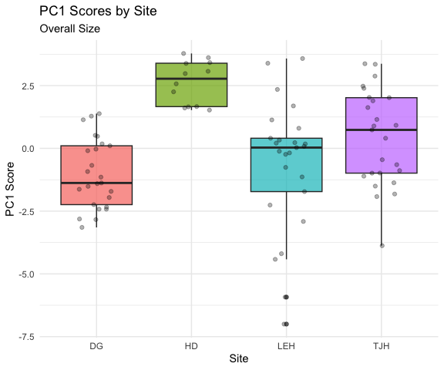
Visualizing Site Differences
Box Plots of PC Scores
HD plants are significantly smaller than plants at other sites.
TJH plants have different shapes
  taller and narrower with smaller wings.

Slide 30
Post-hoc Comparisons
Which Sites Differ?
## contrast estimate SE df t.ratio p.value
## DG - HD -3.651 0.673 83 -5.427 <0.0001
## DG - LEH -0.366 0.542 83 -0.675 0.9064
## DG - TJH -1.447 0.542 83 -2.671 0.0442
## HD - LEH 3.285 0.673 83 4.883 <0.0001
## HD - TJH 2.204 0.673 83 3.276 0.0082
## LEH - TJH -1.082 0.542 83 -1.996 0.1977
##
## P value adjustment: tukey method for comparing a family of 4 estimates
## site emmean SE df lower.CL upper.CL .group
## DG -1.024 0.383 83 -1.786 -0.262 a
## LEH -0.659 0.383 83 -1.421 0.103 ab
## TJH 0.423 0.383 83 -0.339 1.185 b
## HD 2.626 0.553 83 1.526 3.726 c
##
## Confidence level used: 0.95
## P value adjustment: tukey method for comparing a family of 4 estimates
## significance level used: alpha = 0.05
## NOTE: If two or more means share the same grouping symbol,
## then we cannot show them to be different.
## But we also did not show them to be the same.

Slide 31
Distance Between Sites
Calculating Euclidean Distance Between Groups
Calculate the distance between site centroids (mean PC scores):
  $d_{k,j}=\sqrt{\sum_{i=1}^{p}{(}{\overset{‾}{Z}}_{i,k}−{\overset{‾}{Z}}_{i,j})^{2}}$
  Where ${\overset{‾}{Z}}_{i,k}$ is the mean of PC i for site k.
Using all PCs preserves the true Euclidean distance from the original data.
Using just PC1-PC3 (77% of variance) gives approximate distances.
HD is most different from other sites (smallest plants).
# Calculate site centroids (means)
site_means <- pc_scores %>%
group_by(site) %>%
summarize(across(PC1:PC3, mean))
site_means
## # A tibble: 4 × 4
## site PC1 PC2 PC3
## <chr> <dbl> <dbl> <dbl>
## 1 DG -1.02 0.604 0.542
## 2 HD 2.63 -0.863 -1.26
## 3 LEH -0.659 0.155 -0.555
## 4 TJH 0.423 -0.345 0.618
# Calculate distance matrix
site_dist <- site_means %>%
dplyr::select(PC1, PC2, PC3) %>%
dist() %>%
round(3)
site_dist
## 1 2 3
## 2 4.328
## 3 1.241 3.511
## 4 1.732 2.942 1.672

Slide 32
Visualization of the distances
# 1. Prepare PC Scores with Site
pc_scores_for_dist <- as.data.frame(pca_result$x) %>%
mutate(site = darlingtonia$site)
# 2. Calculate the mean PC scores for each site (the site "centroids")
site_centroids <- pc_scores_for_dist %>%
group_by(site) %>%
summarise(across(starts_with("PC"), mean)) %>%
ungroup()
# 3. Set site names as row names BEFORE calculating distances
site_centroids_matrix <- site_centroids %>%
column_to_rownames("site") # This keeps site names as row names
# 4. Calculate the Euclidean distance matrix between site centroids
dist_matrix <- dist(site_centroids_matrix, method = "euclidean")
# Display the distance matrix
dist_matrix
## DG HD LEH
## HD 4.346434
## LEH 1.621198 3.659711
## TJH 1.843120 3.021386 1.960547
# Visualize the distance matrix
fviz_dist(dist_matrix,
gradient = list(low = "#00AFBB", high = "#FC4E07"))

Slide 33
Summary: PCA Results for Darlingtonia
What We Learned
Dimension Reduction Success
  ☒ Started with: 10 correlated variables
  ☒ Reduced to: 3 principal components
  ☒ Retained: 77.3% of variance
This makes data easier to visualize, interpret, and analyze.
Biological Insights - Three major axes of morphological variation: - PC1 (45.8%): Overall size
  Larger vs. smaller plants
  HD site has smallest plants - PC2 (16.7%): Shape contrast
  Tall/narrow vs. short/wide with large wings
  TJH site has taller, narrower plants - PC3 (14.8%): Tube girth
  Fat vs. skinny tubes
  No significant site differences
Statistical Findings
  Sites differ significantly in size (PC1)
  Sites differ significantly in shape (PC2)
  Sites do not differ in tube girth (PC3)
PCA Advantages
  ☒ Reduced 10 dimensions to 3
  ☒ Created uncorrelated variables
  ☒ Revealed biological patterns
  ☒ Enabled statistical testing
  ☒ Simplified visualization
Key Take-Home Messages
  PCA good for exploratory analysis of multivariate data
  Always standardize when different units/scales
  Loadings reveal variables contributions to each component
  Scores used in subsequent analyses (ANOVA, regression)
  Biplots visualize both samples and variables simultaneously

Slide 34
When to Use PCA
PCA is Appropriate When:
  ☒ Variables are continuous (not categorical)
  ☒ Variables are correlated (redundancy exists) + Linear relationships
  ☒ Goal is dimension reduction or data exploration
  ☒ Sample size adequate (at least 3× number of variables)
PCA Assumptions:
  Linearity: relationships between variables are linear
  Adequate correlation: variables must be correlated
  No severe outliers: can distort results
  Sample size: need enough observations
Always Check:
  Correlation matrix (are variables correlated?)
  Scree plot (how many components needed?)
  Loadings (biological interpretation makes sense?)
  Outliers (check scores plots)

Slide 35
When to Consider Alternatives:
Different data types:
  Categorical variables → MCA (Multiple
  Correspondence Analysis) - Species composition data → CA (Correspondence Analysis)
  Distance/dissimilarity matrices → PCoA (Principal Coordinates Analysis)
Different goals: - Classification → Discriminant Analysis
  Non-linear patterns → NMDS (Non-metric Multidimensional Scaling)
  Hypothesis testing → MANOVA
Problems with PCA:
  Strong outliers present
  Non-linear relationships
  Variables are uncorrelated
  Many zeros in data
PCA works best for morphological, physiological, and environmental variables!

Slide 36
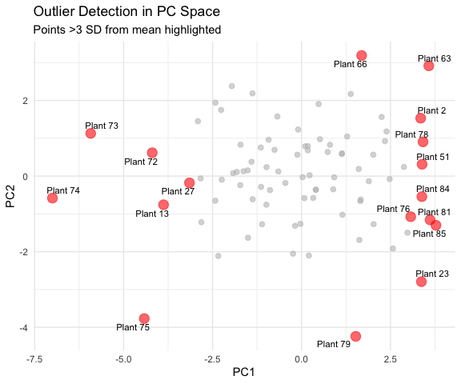
Additional PCA Diagnostics
Checking Assumptions and Quality
Sampling Adequacy
Kaiser-Meyer-Olkin (KMO) Test:
Measures sampling adequacy
Values > 0.6 = acceptable
Values > 0.8 = good
Our overall KMO = 0.80 (good!)
# KMO test requires psych package
KMO(cor(darl_numeric))
## Kaiser-Meyer-Olkin factor adequacy
## Call: KMO(r = cor(darl_numeric))
## Overall MSA = 0.76
## MSA for each item =
## height mouth_diam tube_diam keel_diam wing1_length wing2_length
## 0.64 0.84 0.47 0.61 0.85 0.80
## wingsprea hoodmass_g tubemass_g wingmass_g
## 0.76 0.78 0.72 0.86
2. Outlier Detection
Check for influential observations:

Slide 37
PCA vs. Other Ordination Methods
Comparison Table
Method | Data Type | Distance/Similarity | Linear? | Eigenanalysis?
PCA | Continuous, correlated | Euclidean (correlation) | Yes | Yes
CA | Count data, species | Chi-square | No | Yes
PCoA | Any (via distance matrix) | Any distance metric | N/A | Yes
NMDS | Any (via distance matrix) | Any distance metric | No | No
DCA | Species abundance | Weighted averaging | No | Yes

Slide 38
Advanced Topics in PCA
Topics We Haven’t Covered
Factor Analysis: - Similar to PCA but with different goals - Assumes latent “factors” cause observed variables - Uses rotation to improve interpretation - More common in social sciences
Robust PCA: - Less sensitive to outliers - Uses robust covariance estimators - Useful with messy ecological data
Sparse PCA: - Forces many loadings to exactly zero - Easier to interpret - Better for very high-dimensional data
Functional PCA: - For time series or spatial data - Treats curves as observations - Common in physiology
Probabilistic PCA: - Includes uncertainty estimation - Can handle missing data - Maximum likelihood framework
Kernel PCA: - Handles non-linear relationships - Uses kernel trick from machine learning - More flexible but harder to interpret
These are beyond our scope but worth knowing exist!

Slide 39
Practical Tips for PCA
Best Practices

Slide 40
Before PCA:
Explore your data
  Check distributions
  Identify outliers
  Understand variable scales
Check correlations
  Make correlation plot
  Ensure variables are correlated
  Consider removing redundant variables
Standardize appropriately
  Use scale = TRUE for different units
  Consider centering only for same units
Check sample size
  Need at least 3× variables
  More is better (50+ ideal)
During PCA:
Examine scree plot
  Look for elbow
  Consider cumulative variance
  Usually keep 2-5 components
Interpret loadings
  Look for patterns
  Consider biological meaning
  Ignore very small loadings
Check scores plots
  Look for outliers
  Identify patterns/groups
  Consider site/treatment effects
After PCA:
Report clearly
  State why you used PCA
  Report variance explained
  Describe component interpretation
Use results appropriately
  PC scores can go into other analyses
  Don’t over-interpret small components
  Remember: exploratory tool!

Slide 41
Reporting PCA Results
What to Include in Papers/Theses

Slide 42
Methods Section:
“We performed principal component analysis (PCA) on 10 morphological and biomass variables measured on 89 Darlingtonia californica plants from four sites. Variables were standardized (mean = 0, SD = 1) prior to analysis to account for different measurement scales. PCA was conducted using the prcomp() function in R. We retained principal components with eigenvalues > 1 and that cumulatively explained >70% of variance.”
Results Section:
“The first three principal components explained 77.3% of variance (PC1: 45.8%, PC2: 16.7%, PC3: 14.8%). PC1 represented overall plant size, with high positive loadings for most morphological and biomass variables…”
Essential Figures:
Scree plot - shows variance explained
Loadings plot - shows variable contributions
Scores plot or biplot - shows samples in PC space
Essential Tables:
Variance explained by each PC
Loadings for retained PCs (usually PC1-PC3)
ANOVA results if testing groups
Don’t Report:
All 10 PCs if only 3 are meaningful
Tiny loadings (< 0.3)
Every individual PC score
Raw eigenvalues (report % variance instead)

Slide 43
Common PCA Mistakes to Avoid
Mistakes Students Make:
❌ Not standardizing data with different units
→ ✓ Always use scale = TRUE for different units
❌ Forgetting to check correlations
→ ✓ Make correlation plot first
❌ Using too many components
→ ✓ Use scree plot, keep components above elbow
❌ Over-interpreting small loadings
→ ✓ Focus on loadings > |0.3|
❌ Ignoring signs on loadings
→ ✓ Sign can flip; look at patterns
❌ Treating PC scores as original data
→ ✓ Remember PCs are derived variables
❌ Using PCA on categorical data
→ ✓ Use appropriate method (CA, MCA)
❌ Not checking for outliers
→ ✓ Plot scores, check for extreme values
❌ Assuming PCs have biological meaning
→ ✓ Interpret carefully, components are mathematical
❌ Using PCA with too few samples
→ ✓ Need n > 3p (preferably n > 50)
❌ Not reporting variance explained
→ ✓ Always report % variance for each PC
❌ Forgetting that PCA is exploratory
→ ✓ Use for patterns, not hypothesis testing

Slide 44
Practice Exercise
Exercise 1: Subset Analysis
Try running PCA on just the morphological variables (exclude biomass):
# Select only morphological variables
darl_morph <- darlingtonia %>%
select(height, mouth_diam, tube_diam,
keel_diam, wing1_length,
wing2_length, wingsprea)
# Run PCA
pca_morph <- prcomp(darl_morph,
scale. = TRUE)
# Examine results
summary(pca_morph)
# How do results differ from full PCA?
Exercise 2: Site-Specific PCA
Run PCA on just one site (e.g., DG):
# Filter to one site
darl_dg <- darlingtonia %>%
filter(site == "DG") %>%
select(-site)
# Run PCA
pca_dg <- prcomp(darl_dg,
scale. = TRUE)
# Compare to overall PCA
summary(pca_dg)
# Do the same patterns emerge?
Exercise 3: Interpretation
What does PC1 represent in each analysis?
How much variance is explained?
Do you see the same patterns?

Slide 45
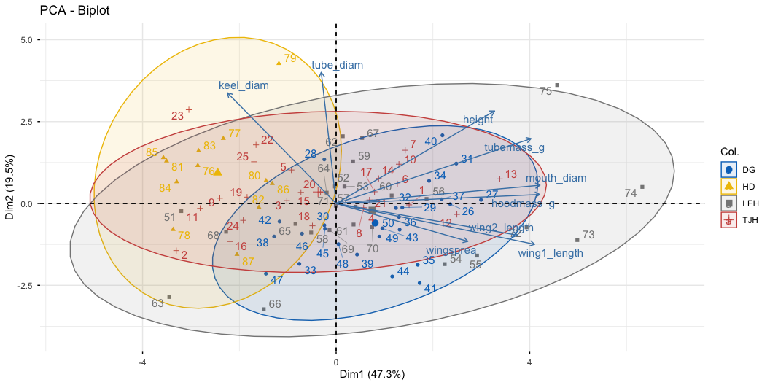
Some other ways

Slide 46
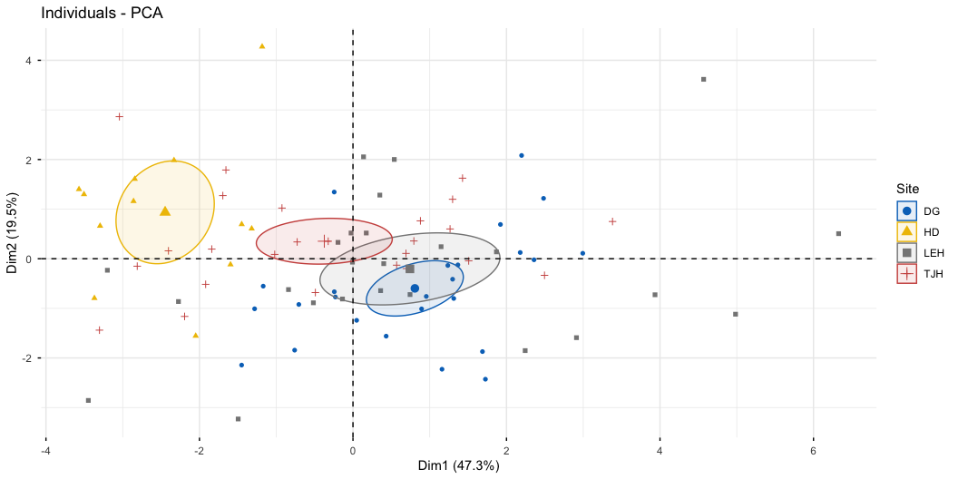

Slide 47
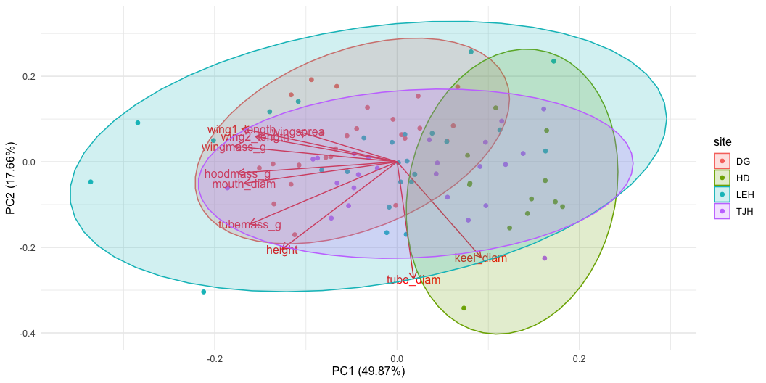

Slide 48
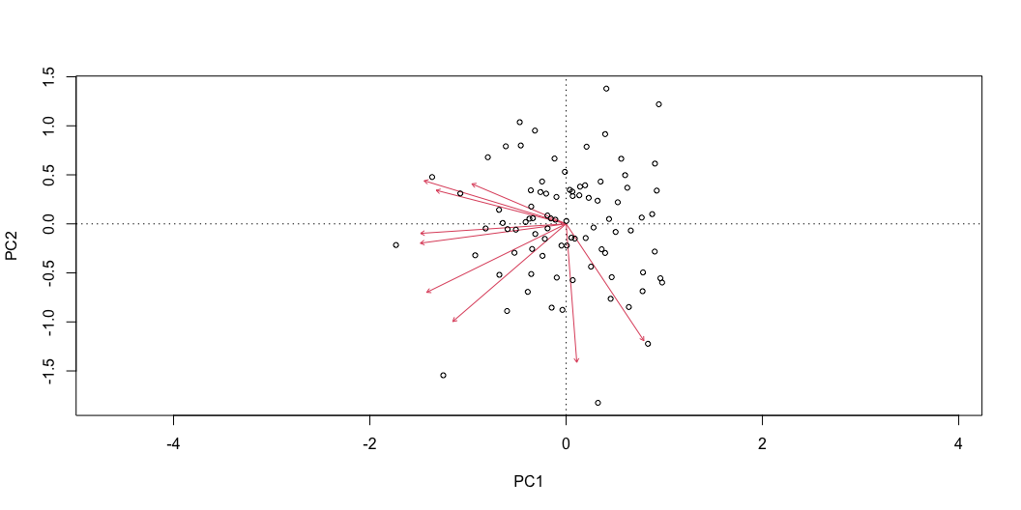

Slide 49
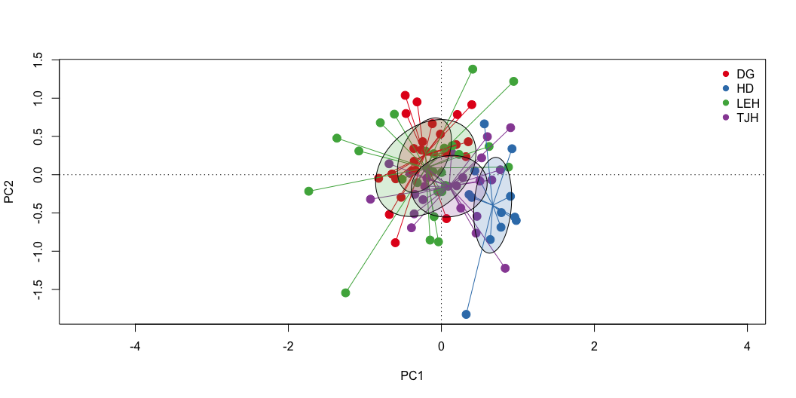

Slide 50
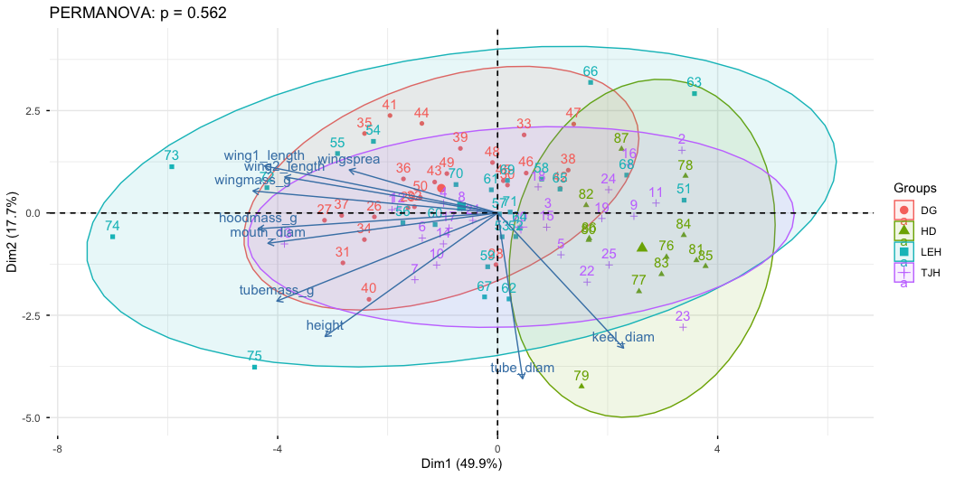

Slide 51
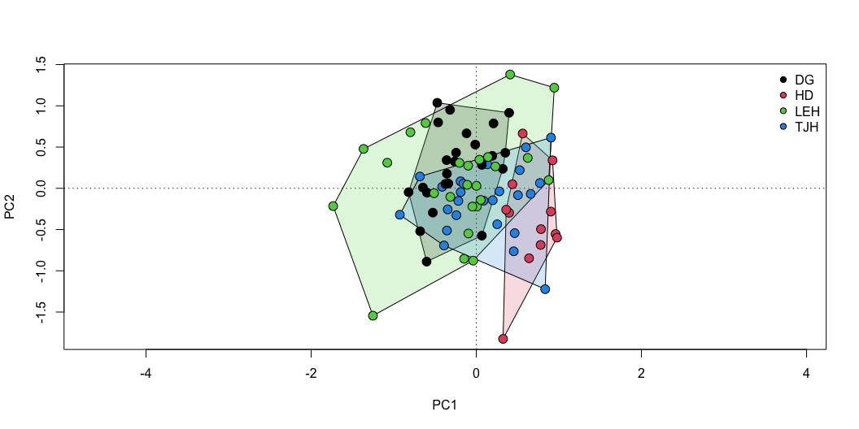
## Permutation test for adonis under reduced model
## Permutation: free
## Number of permutations: 999
##
## adonis2(formula = darl_scaled ~ site, data = darlingtonia, permutations = 999, method = "euclidean")
## Df SumOfSqs R2 F Pr(>F)
## Model 3 189.72 0.24512 8.9836 0.001 ***
## Residual 83 584.28 0.75488
## Total 86 774.00 1.00000
## ---
## Signif. codes: 0 '***' 0.001 '**' 0.01 '*' 0.05 '.' 0.1 ' ' 1

Slide 52
## $parent_call
## [1] "darl_scaled ~ site , strata = Null , permutations 999"
##
## $TJH_vs_DG
## Df SumOfSqs R2 F Pr(>F)
## Model 1 32.602 0.10636 5.7128 0.002 **
## Residual 48 273.930 0.89364
## Total 49 306.532 1.00000
## ---
## Signif. codes: 0 '***' 0.001 '**' 0.01 '*' 0.05 '.' 0.1 ' ' 1
##
## $TJH_vs_LEH
## Df SumOfSqs R2 F Pr(>F)
## Model 1 47.72 0.10517 5.6414 0.005 **
## Residual 48 406.06 0.89483
## Total 49 453.78 1.00000
## ---
## Signif. codes: 0 '***' 0.001 '**' 0.01 '*' 0.05 '.' 0.1 ' ' 1
##
## $TJH_vs_HD
## Df SumOfSqs R2 F Pr(>F)
## Model 1 69.308 0.25135 11.751 0.001 ***
## Residual 35 206.432 0.74865
## Total 36 275.740 1.00000
## ---
## Signif. codes: 0 '***' 0.001 '**' 0.01 '*' 0.05 '.' 0.1 ' ' 1
##
## $DG_vs_LEH
## Df SumOfSqs R2 F Pr(>F)
## Model 1 26.24 0.06493 3.3333 0.021 *
## Residual 48 377.85 0.93507
## Total 49 404.09 1.00000
## ---
## Signif. codes: 0 '***' 0.001 '**' 0.01 '*' 0.05 '.' 0.1 ' ' 1
##
## $DG_vs_HD
## Df SumOfSqs R2 F Pr(>F)
## Model 1 131.09 0.42382 25.745 0.001 ***
## Residual 35 178.22 0.57618
## Total 36 309.31 1.00000
## ---
## Signif. codes: 0 '***' 0.001 '**' 0.01 '*' 0.05 '.' 0.1 ' ' 1
##
## $LEH_vs_HD
## Df SumOfSqs R2 F Pr(>F)
## Model 1 101.69 0.2468 11.468 0.001 ***
## Residual 35 310.35 0.7532
## Total 36 412.04 1.0000
## ---
## Signif. codes: 0 '***' 0.001 '**' 0.01 '*' 0.05 '.' 0.1 ' ' 1
##
## attr(,"class")
## [1] "pwadstrata" "list"
##
## Pairwise comparisons using permutation MANOVAs on a distance matrix
##
## data: vegdist(darl_scaled, method = "euclidean") by darlingtonia$site
## 999 permutations
##
## DG HD LEH
## HD 0.006 - -
## LEH 0.096 0.006 -
## TJH 0.006 0.006 0.018
##
## P value adjustment method: bonferroni
results come from different statistical tests being used. Let me break down what each is doing: 1. pairwise.adonis2() - PERMANOVA on subsets What it does: For each pair, it subsets the data to just those 2 sites and runs a separate PERMANOVA Results: All p-values ≤ 0.016 (5 of 6 are p = 0.001) Interpretation: Tests if centroids (mean positions) differ between site pairs 2. pairwise.perm.manova() - Different test entirely What it does: Uses a MANOVA-based approach with permutations on the full distance matrix Results: More conservative - DG vs LEH now p = 0.078 (not significant) Interpretation: Also tests centroid differences but uses a different statistical framework
Why the differences matter: Location (Centroid) Tests:
pairwise.adonis2() and pairwise.perm.manova() both test if site means differ They give slightly different p-values due to different algorithms, but similar conclusions Use these to answer: “Are sites morphologically different?”

