Slide 1
Lecture 17 - Principal Component Analysis (PCA)
Bill Perry

Slide 2
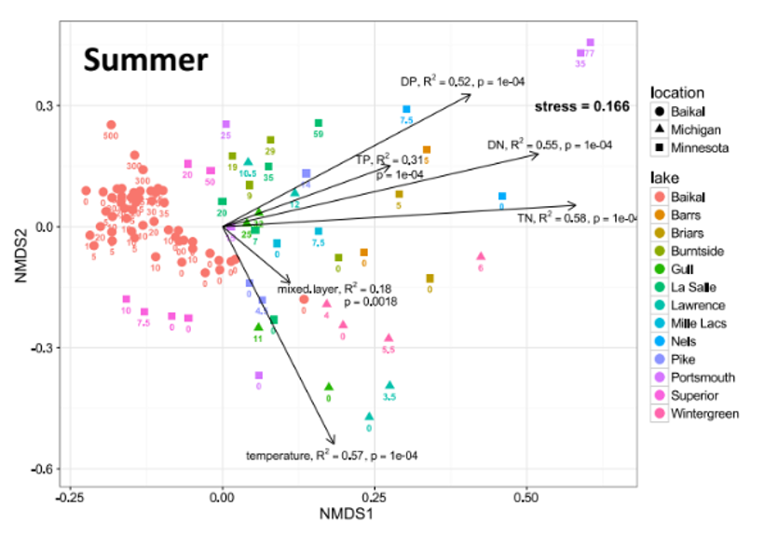
Lecture 16: Review
Review
Multivariate data
Multivariate statistics in ecology: overview
Eigenvectors, eigenvalues, components
Distance and dissimilarity in MV space
Data standardization
Graphics
Screening MV data
MANOVA

Slide 3
Review: Eigenvectors and Components
Eigenvectors, eigenvalues and components
Common goal of MV analysis is variable reduction: can we derive new variables (based on linear combinations of “original” variables) that explain variation in data?
For data set with i= 1 to n objects and j = 1 to p original variables we seek new variables (principal components) using the equation:
$$z_{ik}=c_{1}y_{i1}+c_{2}y_{i2}+⋯c_{j}y_{ij}+⋯+c_{p}y_{ip}$$

Slide 4
Review: Component Interpretation
zik is value of new variable k for object I
yi1- yip are values of original variables for object i
c1-cp are coefficients that show importance of the original variables to new derived variable
$$z_{ik}=c_{1}y_{i1}+c_{2}y_{i2}+⋯c_{j}y_{ij}+⋯+c_{p}y_{ip}$$

Slide 5
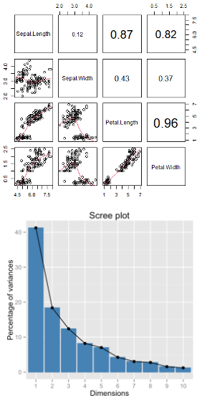
Review: Component Properties
Eigenvectors, eigenvalues and components
Derived variables are found so that:
First derived variable explains most of the variation in the data
Second most of the remaining variation
And so on…
As many derived variables as original variables (p)
Derived variables are uncorrelated with each other

Slide 6
Review: Eigenvalues and Eigenvectors
Eigenvectors, eigenvalues and components
Eigenvalues (latent roots) represent amount of variation in data explained by the new k= 1 to p derived variables (λ1, λ2 …λp).
Eigenvalues are population parameters and are estimated using ML to get sample statistics (l1, l2…lp)
Eigenvectors are lists of coefficients (c) that show contribution of original variables to new, derived variables
Each new variable has an eigenvalue and an eigenvector
New variables (components) are derived from a p x p covariance or correlation matrix of original variables

Slide 7
Lecture 17: PCA Goals and Introduction
Common goals of MV data analysis are variable reduction (finding derived variables that summarize data) and exploration of patterns in data (scaling/ordination)
Can use association (correlation/ covariance) matrices (PCA) or dissimilarity measures (MDS)
In PCA: take p old variables and transform them into p “new/derived” uncorrelated variables (principal components)

Slide 8
Data for PCA Analysis
sepal_length sepal_width petal_length petal_width species ind 1 5.1 3.5 1.4 0.2 setosa 1 2 4.9 3.0 1.4 0.2 setosa 2 3 4.7 3.2 1.3 0.2 setosa 3 4 4.6 3.1 1.5 0.2 setosa 4 5 5.0 3.6 1.4 0.2 setosa 5 6 5.4 3.9 1.7 0.4 setosa 6 7 4.6 3.4 1.4 0.3 setosa 7 8 5.0 3.4 1.5 0.2 setosa 8 9 4.4 2.9 1.4 0.2 setosa 9 10 4.9 3.1 1.5 0.1 setosa 10 11 5.4 3.7 1.5 0.2 setosa 11 12 4.8 3.4 1.6 0.2 setosa 12 13 4.8 3.0 1.4 0.1 setosa 13 14 4.3 3.0 1.1 0.1 setosa 14 15 5.8 4.0 1.2 0.2 setosa 15 16 5.7 4.4 1.5 0.4 setosa 16 17 5.4 3.9 1.3 0.4 setosa 17 18 5.1 3.5 1.4 0.3 setosa 18 19 5.7 3.8 1.7 0.3 setosa 19 20 5.1 3.8 1.5 0.3 setosa 20 21 5.4 3.4 1.7 0.2 setosa 21 22 5.1 3.7 1.5 0.4 setosa 22 23 4.6 3.6 1.0 0.2 setosa 23 24 5.1 3.3 1.7 0.5 setosa 24 25 4.8 3.4 1.9 0.2 setosa 25 26 5.0 3.0 1.6 0.2 setosa 26 27 5.0 3.4 1.6 0.4 setosa 27 28 5.2 3.5 1.5 0.2 setosa 28 29 5.2 3.4 1.4 0.2 setosa 29 30 4.7 3.2 1.6 0.2 setosa 30 31 4.8 3.1 1.6 0.2 setosa 31 32 5.4 3.4 1.5 0.4 setosa 32 33 5.2 4.1 1.5 0.1 setosa 33 34 5.5 4.2 1.4 0.2 setosa 34 35 4.9 3.1 1.5 0.2 setosa 35 36 5.0 3.2 1.2 0.2 setosa 36 37 5.5 3.5 1.3 0.2 setosa 37 38 4.9 3.6 1.4 0.1 setosa 38 39 4.4 3.0 1.3 0.2 setosa 39 40 5.1 3.4 1.5 0.2 setosa 40 41 5.0 3.5 1.3 0.3 setosa 41 42 4.5 2.3 1.3 0.3 setosa 42 43 4.4 3.2 1.3 0.2 setosa 43 44 5.0 3.5 1.6 0.6 setosa 44 45 5.1 3.8 1.9 0.4 setosa 45 46 4.8 3.0 1.4 0.3 setosa 46 47 5.1 3.8 1.6 0.2 setosa 47 48 4.6 3.2 1.4 0.2 setosa 48 49 5.3 3.7 1.5 0.2 setosa 49 50 5.0 3.3 1.4 0.2 setosa 50 51 7.0 3.2 4.7 1.4 versicolor 51 52 6.4 3.2 4.5 1.5 versicolor 52 53 6.9 3.1 4.9 1.5 versicolor 53 54 5.5 2.3 4.0 1.3 versicolor 54 55 6.5 2.8 4.6 1.5 versicolor 55 56 5.7 2.8 4.5 1.3 versicolor 56 57 6.3 3.3 4.7 1.6 versicolor 57 58 4.9 2.4 3.3 1.0 versicolor 58 59 6.6 2.9 4.6 1.3 versicolor 59 60 5.2 2.7 3.9 1.4 versicolor 60 61 5.0 2.0 3.5 1.0 versicolor 61 62 5.9 3.0 4.2 1.5 versicolor 62 63 6.0 2.2 4.0 1.0 versicolor 63 64 6.1 2.9 4.7 1.4 versicolor 64 65 5.6 2.9 3.6 1.3 versicolor 65 66 6.7 3.1 4.4 1.4 versicolor 66 67 5.6 3.0 4.5 1.5 versicolor 67 68 5.8 2.7 4.1 1.0 versicolor 68 69 6.2 2.2 4.5 1.5 versicolor 69 70 5.6 2.5 3.9 1.1 versicolor 70 71 5.9 3.2 4.8 1.8 versicolor 71 72 6.1 2.8 4.0 1.3 versicolor 72 73 6.3 2.5 4.9 1.5 versicolor 73 74 6.1 2.8 4.7 1.2 versicolor 74 75 6.4 2.9 4.3 1.3 versicolor 75 76 6.6 3.0 4.4 1.4 versicolor 76 77 6.8 2.8 4.8 1.4 versicolor 77 78 6.7 3.0 5.0 1.7 versicolor 78 79 6.0 2.9 4.5 1.5 versicolor 79 80 5.7 2.6 3.5 1.0 versicolor 80 81 5.5 2.4 3.8 1.1 versicolor 81 82 5.5 2.4 3.7 1.0 versicolor 82 83 5.8 2.7 3.9 1.2 versicolor 83 84 6.0 2.7 5.1 1.6 versicolor 84 85 5.4 3.0 4.5 1.5 versicolor 85 86 6.0 3.4 4.5 1.6 versicolor 86 87 6.7 3.1 4.7 1.5 versicolor 87 88 6.3 2.3 4.4 1.3 versicolor 88 89 5.6 3.0 4.1 1.3 versicolor 89 90 5.5 2.5 4.0 1.3 versicolor 90 91 5.5 2.6 4.4 1.2 versicolor 91 92 6.1 3.0 4.6 1.4 versicolor 92 93 5.8 2.6 4.0 1.2 versicolor 93 94 5.0 2.3 3.3 1.0 versicolor 94 95 5.6 2.7 4.2 1.3 versicolor 95 96 5.7 3.0 4.2 1.2 versicolor 96 97 5.7 2.9 4.2 1.3 versicolor 97 98 6.2 2.9 4.3 1.3 versicolor 98 99 5.1 2.5 3.0 1.1 versicolor 99 100 5.7 2.8 4.1 1.3 versicolor 100 101 6.3 3.3 6.0 2.5 virginica 101 102 5.8 2.7 5.1 1.9 virginica 102 103 7.1 3.0 5.9 2.1 virginica 103 104 6.3 2.9 5.6 1.8 virginica 104 105 6.5 3.0 5.8 2.2 virginica 105 106 7.6 3.0 6.6 2.1 virginica 106 107 4.9 2.5 4.5 1.7 virginica 107 108 7.3 2.9 6.3 1.8 virginica 108 109 6.7 2.5 5.8 1.8 virginica 109 110 7.2 3.6 6.1 2.5 virginica 110 111 6.5 3.2 5.1 2.0 virginica 111 112 6.4 2.7 5.3 1.9 virginica 112 113 6.8 3.0 5.5 2.1 virginica 113 114 5.7 2.5 5.0 2.0 virginica 114 115 5.8 2.8 5.1 2.4 virginica 115 116 6.4 3.2 5.3 2.3 virginica 116 117 6.5 3.0 5.5 1.8 virginica 117 118 7.7 3.8 6.7 2.2 virginica 118 119 7.7 2.6 6.9 2.3 virginica 119 120 6.0 2.2 5.0 1.5 virginica 120 121 6.9 3.2 5.7 2.3 virginica 121 122 5.6 2.8 4.9 2.0 virginica 122 123 7.7 2.8 6.7 2.0 virginica 123 124 6.3 2.7 4.9 1.8 virginica 124 125 6.7 3.3 5.7 2.1 virginica 125 126 7.2 3.2 6.0 1.8 virginica 126 127 6.2 2.8 4.8 1.8 virginica 127 128 6.1 3.0 4.9 1.8 virginica 128 129 6.4 2.8 5.6 2.1 virginica 129 130 7.2 3.0 5.8 1.6 virginica 130 131 7.4 2.8 6.1 1.9 virginica 131 132 7.9 3.8 6.4 2.0 virginica 132 133 6.4 2.8 5.6 2.2 virginica 133 134 6.3 2.8 5.1 1.5 virginica 134 135 6.1 2.6 5.6 1.4 virginica 135 136 7.7 3.0 6.1 2.3 virginica 136 137 6.3 3.4 5.6 2.4 virginica 137 138 6.4 3.1 5.5 1.8 virginica 138 139 6.0 3.0 4.8 1.8 virginica 139 140 6.9 3.1 5.4 2.1 virginica 140 141 6.7 3.1 5.6 2.4 virginica 141 142 6.9 3.1 5.1 2.3 virginica 142 143 5.8 2.7 5.1 1.9 virginica 143 144 6.8 3.2 5.9 2.3 virginica 144 145 6.7 3.3 5.7 2.5 virginica 145 146 6.7 3.0 5.2 2.3 virginica 146 147 6.3 2.5 5.0 1.9 virginica 147 148 6.5 3.0 5.2 2.0 virginica 148 149 6.2 3.4 5.4 2.3 virginica 149 150 5.9 3.0 5.1 1.8 virginica 150 species_ind 1 setosa_1 2 setosa_2 3 setosa_3 4 setosa_4 5 setosa_5 6 setosa_6 7 setosa_7 8 setosa_8 9 setosa_9 10 setosa_10 11 setosa_11 12 setosa_12 13 setosa_13 14 setosa_14 15 setosa_15 16 setosa_16 17 setosa_17 18 setosa_18 19 setosa_19 20 setosa_20 21 setosa_21 22 setosa_22 23 setosa_23 24 setosa_24 25 setosa_25 26 setosa_26 27 setosa_27 28 setosa_28 29 setosa_29 30 setosa_30 31 setosa_31 32 setosa_32 33 setosa_33 34 setosa_34 35 setosa_35 36 setosa_36 37 setosa_37 38 setosa_38 39 setosa_39 40 setosa_40 41 setosa_41 42 setosa_42 43 setosa_43 44 setosa_44 45 setosa_45 46 setosa_46 47 setosa_47 48 setosa_48 49 setosa_49 50 setosa_50 51 versicolor_51 52 versicolor_52 53 versicolor_53 54 versicolor_54 55 versicolor_55 56 versicolor_56 57 versicolor_57 58 versicolor_58 59 versicolor_59 60 versicolor_60 61 versicolor_61 62 versicolor_62 63 versicolor_63 64 versicolor_64 65 versicolor_65 66 versicolor_66 67 versicolor_67 68 versicolor_68 69 versicolor_69 70 versicolor_70 71 versicolor_71 72 versicolor_72 73 versicolor_73 74 versicolor_74 75 versicolor_75 76 versicolor_76 77 versicolor_77 78 versicolor_78 79 versicolor_79 80 versicolor_80 81 versicolor_81 82 versicolor_82 83 versicolor_83 84 versicolor_84 85 versicolor_85 86 versicolor_86 87 versicolor_87 88 versicolor_88 89 versicolor_89 90 versicolor_90 91 versicolor_91 92 versicolor_92 93 versicolor_93 94 versicolor_94 95 versicolor_95 96 versicolor_96 97 versicolor_97 98 versicolor_98 99 versicolor_99 100 versicolor_100 101 virginica_101 102 virginica_102 103 virginica_103 104 virginica_104 105 virginica_105 106 virginica_106 107 virginica_107 108 virginica_108 109 virginica_109 110 virginica_110 111 virginica_111 112 virginica_112 113 virginica_113 114 virginica_114 115 virginica_115 116 virginica_116 117 virginica_117 118 virginica_118 119 virginica_119 120 virginica_120 121 virginica_121 122 virginica_122 123 virginica_123 124 virginica_124 125 virginica_125 126 virginica_126 127 virginica_127 128 virginica_128 129 virginica_129 130 virginica_130 131 virginica_131 132 virginica_132 133 virginica_133 134 virginica_134 135 virginica_135 136 virginica_136 137 virginica_137 138 virginica_138 139 virginica_139 140 virginica_140 141 virginica_141 142 virginica_142 143 virginica_143 144 virginica_144 145 virginica_145 146 virginica_146 147 virginica_147 148 virginica_148 149 virginica_149 150 virginica_150

Slide 9
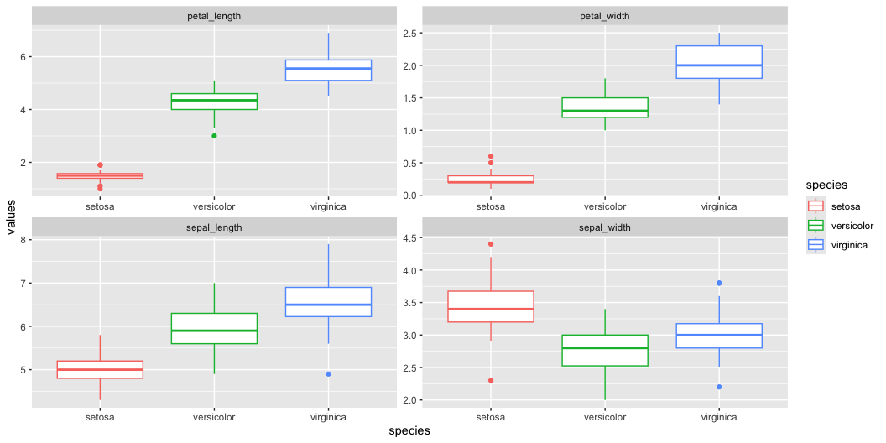
Step 1: Explore the Iris Dataset
As in every case you should be looking at the data first - every time…
Right is the data on iris from a long dataframe

Slide 10
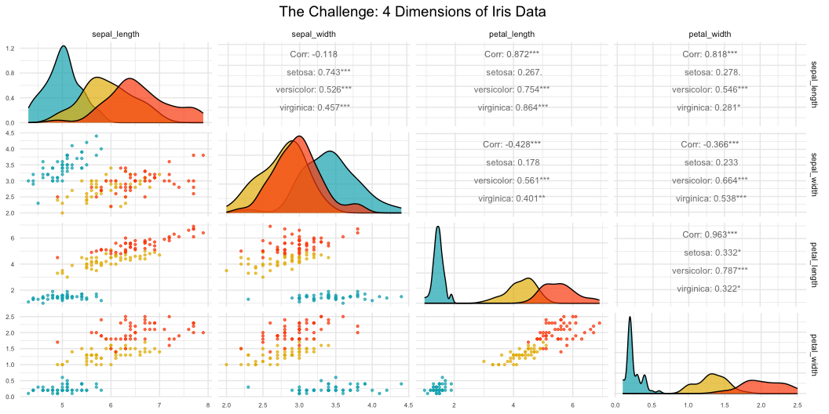
What is PCA? Goals and Overview
Principal Component Analysis Goals:
Variable Reduction: Transform many correlated variables into fewer uncorrelated components
Data Exploration: Visualize patterns and relationships in high-dimensional data
Noise Reduction: Focus on the most important sources of variation
Dimension Reduction: Make complex datasets easier to analyze and interpret
Today’s Example: Iris flower measurements - can we reduce 4 measurements to 2-3 components that capture most variation?

Slide 11
High-Dimensional Data Visualization
Principal Component Analysis Goals:
Variable Reduction: Transform many correlated variables into fewer uncorrelated components
Data Exploration: Visualize patterns and relationships in high-dimensional data
Noise Reduction: Focus on the most important sources of variation
Dimension Reduction: Make complex datasets easier to analyze and interpret
Today’s Example: Iris flower measurements - can we reduce 4 measurements to fewer components that capture most variation?

Slide 12
PCA Assumptions - Critical to Check First!
Key Assumptions:
Linear relationships between variables
No extreme outliers (can distort results)
Variables should be correlated (if not, PCA won’t reduce dimensions)
Adequate sample size (generally n > 50, preferably n > 100)
No missing data (complete cases only)
Consider standardization when variables have different scales
Important: PCA works best when original variables are moderately to highly correlated!
Let’s check these assumptions with our iris data…

Slide 13
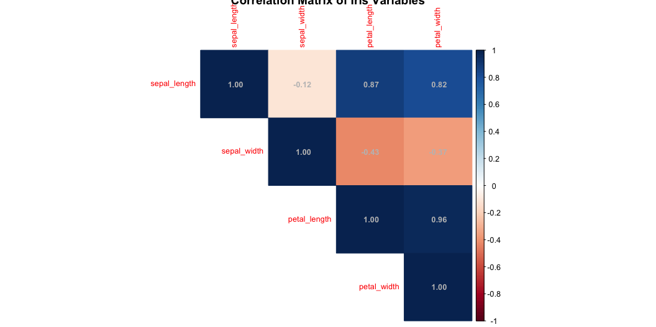
Step 2: Check PCA Assumptions - Correlations
[1] "Correlation Matrix:"
sepal_length sepal_width petal_length petal_width sepal_length 1.000 -0.118 0.872 0.818 sepal_width -0.118 1.000 -0.428 -0.366 petal_length 0.872 -0.428 1.000 0.963 petal_width 0.818 -0.366 0.963 1.000

Slide 14
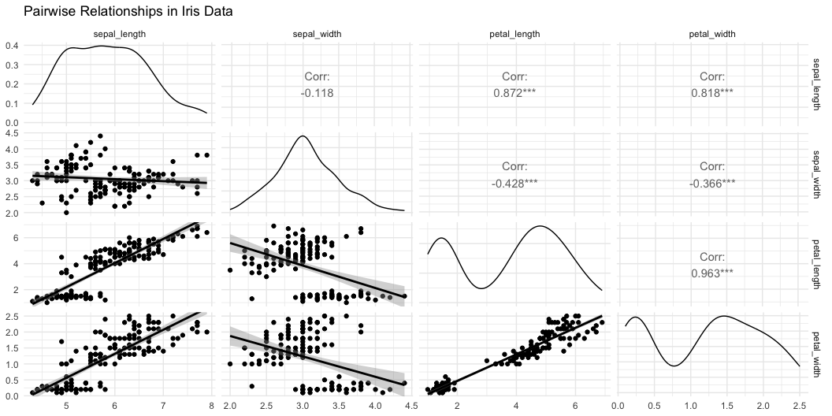
Step 2: Check PCA Assumptions - Linearity

Slide 15
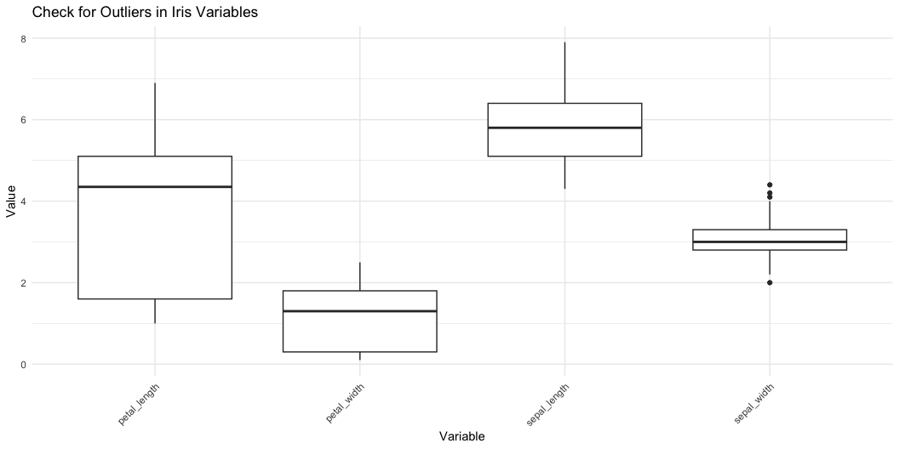
Step 2: Check PCA Assumptions - Outliers

Slide 16
Step 3: Standardize the Data
STANDARDIZATION: Making all variables comparable

Slide 17
Why standardize?
Our measurements have different units and scales:
Sepal length: ranges from ~4-8 cm
Sepal width: ranges from ~2-4 cm
Petal length: ranges from ~1-7 cm
Petal width: ranges from ~0.1-2.5 cm
Without standardization, PCA would be dominated by variables with larger numbers (like petal length) simply because they have bigger values, not because they’re more important biologically
What does standardization do?
Converts each variable to have:
Mean = 0 (centered at zero)
Standard deviation = 1 (same spread)
This gives all variables equal weight in the analysis
How to interpret standardized values: Example: A sepal length of 5.1 cm might become -0.9 after standardization, meaning it’s 0.9 standard deviations below the average sepal length
[1] "Means after standardization (should be ~0):"
sepal_length sepal_width petal_length petal_width 0 0 0 0
[1] "Standard deviations after standardization (should be 1):"
sepal_length sepal_width petal_length petal_width 1 1 1 1

Slide 18
Step 4: Perform PCA - The Mathematics
What is PCA doing?
Principal Component Analysis finds new variables (called components) that capture the most variation in your data. Think of it as finding the “best viewing angles” to see differences between flowers.
The mathematics (simplified):
PCA rotates your data to find the direction with maximum spread (PC1)
Then finds the next direction with maximum spread perpendicular to PC1 (PC2)
Continues until it has as many components as original variables (4 in our case)
Why center = FALSE and scale = FALSE?
We already standardized our data in Step 3, so we tell R not to do it again: - center = FALSE: Don’t subtract the mean (we already did) - scale = FALSE: Don’t divide by standard deviation (we already did)
What the summary shows:
Standard deviation: How much variation each component captures
Proportion of Variance: Percentage of total variation explained by each component
Cumulative Proportion: Running total of variance explained
Importance of components: PC1 PC2 PC3 PC4 Standard deviation 1.7084 0.9560 0.38309 0.14393 Proportion of Variance 0.7296 0.2285 0.03669 0.00518 Cumulative Proportion 0.7296 0.9581 0.99482 1.00000

Slide 19
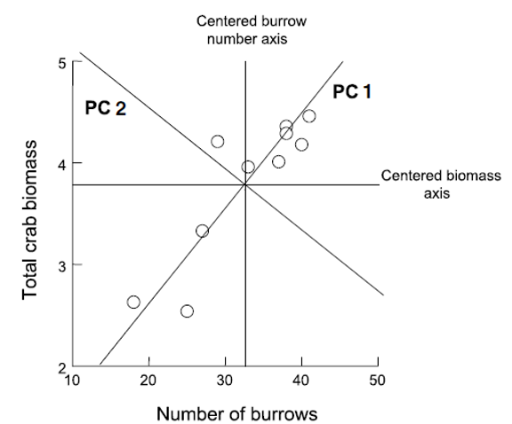
Deriving Components: 2D Visualization
How are new uncorrelated components derived? One way to think it is in terms of axis rotation Consider a 2-variable dataset:

Slide 20
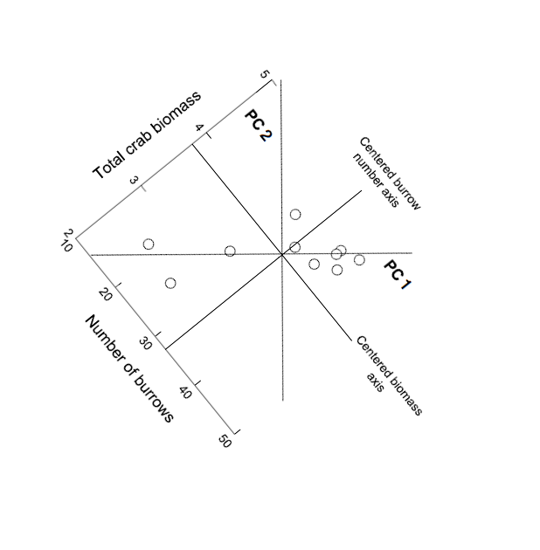
Component Derivation: Axis Rotation
Goal is to “rotate the axes” around center of the data “cloud” in such a way that most of the variation lies along the first axis Then find second axis that explains the second-most variation AND is orthogonal to first axis

Slide 21
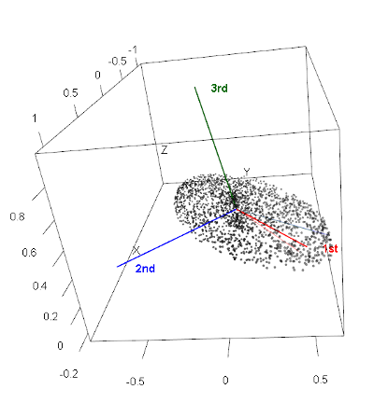
Component Derivation: Multivariate Extension
Easy to picture in 2D (or even 3D), but harder in multivariate space Practically, components are “extracted” from a covariance of correlation matrix among original variables Will extract as many principal components as original variables

Slide 22
Component Information: Eigenvalues and Eigenvectors
Get two important pieces of information from PCA: eigenvectors and eigenvalues
Eigenvalues (latent roots)- how much of the variation is explained by each component?
Eigenvectors- list of coefficients for original variables. There are p coefficients in an eigenvector and p eigenvectors
Correlation bw original variables will result in fewer components explaining more variance; variable reduction will fail if original variables are not correlated

Slide 23
Step 4: Understanding Eigenvalues and Variance
Understanding Eigenvalues and Variance
What are eigenvalues?
Eigenvalues tell us how much variation each principal component captures.
Larger eigenvalues = more important components.
Key terms explained:
Eigenvalue: The amount of variance captured by each component (always positive)
Proportion of Variance: What percentage of total variation this component explains
Cumulative Variance: Running total - helps us decide how many components we need
How to read the results:
If PC1 has eigenvalue = 2.9, it captures 2.9 “units” of variance
If Prop_Variance = 0.728, PC1 explains 72.8% of all variation in the data
If Cumsum_Variance = 0.959 at PC2, the first 2 components together explain 95.9% of variation
Why this matters:
This table helps us decide how many components to keep.
If 2 components explain 95% of variance, we’ve successfully reduced 4 variables to 2
We only lose 5% of information without including the other variables!
[1] "PCA Summary:"
Component | Eigenvalue | Prop_Variance | Cumsum_Variance
PC1 | 2.918 | 0.730 | 0.730
PC2 | 0.914 | 0.229 | 0.958
PC3 | 0.147 | 0.037 | 0.995
PC4 | 0.021 | 0.005 | 1.000

Slide 24
Step 5: Determine Number of Components - Scree Plot
What is a Scree Plot?
A scree plot shows how much variance each component explains, helping us decide how many components we need. The name comes from the geological term “scree” - loose rocks at the base of a cliff - because the plot often looks like a steep cliff followed by rubble.
How to read a Scree Plot:
Y-axis: Percentage of variance explained by each component
X-axis: Component number (PC1, PC2, etc.)
The pattern: Usually shows a steep drop followed by a leveling off
The “Elbow Method”:
Look for where the line “bends” or forms an elbow:
Components before the elbow = important (steep slope)
Components after the elbow = less important (gentle slope)
Keep components up to and including the elbow
What to look for in our plot:
If PC1 explains 70% and PC2 explains 20%, but PC3 only explains 5%, the elbow is at PC2
This suggests keeping the first 2 components
The dramatic drop from PC1 to PC2, then gentle decline after, confirms our dimension reduction worked well

Slide 25
Step 5: Component Selection Rules
[1] "Components with eigenvalue > 1: 1"
[1] "Components needed for 80% variance: 2"

Slide 26
Step 6: Interpret the Components - Loadings
What are Component Loadings
Loadings tell us how much each original variable contributes to each principal component. Think of them as “recipes” that show how to mix your original measurements to create the new components.
How to read the loadings table
Values range from -1 to +1 (like correlations)
Large positive values (e.g., 0.8): This variable contributes strongly in the positive direction
Large negative values (e.g., -0.8): This variable contributes strongly in the negative direction
Values near 0: This variable doesn’t contribute much to this component
Interpreting the patterns:
If all loadings have similar signs: Component represents overall size (all measurements increase/decrease together)
If loadings have mixed signs: Component represents shape or proportions (some measurements increase while others decrease)
Dominant variables: Variables with the largest absolute loadings drive that component’s meaning
Example interpretation:
If PC1 has all negative loadings around -0.5, it means:
Flowers with high PC1 scores have small values for ALL measurements
This component captures “overall flower size”
The negative sign just indicates direction (could flip signs and interpretation)
[1] "Component Loadings:"
Variable PC1 PC2 PC3 PC4 sepal_length sepal_length 0.5210659 -0.37741762 0.7195664 0.2612863 sepal_width sepal_width -0.2693474 -0.92329566 -0.2443818 -0.1235096 petal_length petal_length 0.5804131 -0.02449161 -0.1421264 -0.8014492 petal_width petal_width 0.5648565 -0.06694199 -0.6342727 0.5235971

Slide 27
Step 6: Eigenvector Properties
Key properties of eigenvectors/loadings:
Unit length: Each eigenvector has length 1 (sum of squares = 1)
Orthogonal: Eigenvectors are perpendicular to each other (dot product = 0)
Ordered by importance: First eigenvector (PC1) explains most variance
The complete picture:
Eigenvectors = The directions (loadings)
Eigenvalues = The importance of each direction (variance explained)
Together they fully describe the PCA transformation

Slide 28
Step 6b: Visualization of Component Loadings
What does this plot show?
This is a visual representation of the loadings table, showing how each original variable contributes to PC1 and PC2. It’s like a map of how your original measurements relate to the new principal components.
How to read the plot:
Arrows represent your original variables (sepal_length, sepal_width, etc.)
Arrow direction shows which PC the variable contributes to
Arrow length indicates the strength of contribution (longer = stronger)
Arrow color shows the overall contribution magnitude (red = highest, blue = lowest)
The circle represents the maximum possible contribution
Key interpretations from this plot:
PC1 (horizontal axis, 73% variance):
All arrows point roughly left (negative direction)
All variables contribute almost equally to PC1
This confirms PC1 represents “overall flower size”
PC2 (vertical axis, 22.9% variance):
Sepal_width points down (negative)
Other variables point slightly up (positive)
This creates a contrast: sepal width vs. everything else
PC2 captures “flower shape” - wide sepals vs. long petals

Slide 29
Loading Plot Interpretation
What the arrow positions tell us:
Variables pointing in same direction = positively correlated
Variables at 90° angles = uncorrelated
Variables pointing opposite directions = negatively correlated
The practical meaning:
Flowers with high PC1 scores have large values for all measurements
Flowers with high PC2 scores have narrow sepals but long/wide petals
The plot confirms our dimension reduction worked - we’ve captured 95.9% of variation in just 2 dimensions!

Slide 30
Step 7: PCA Biplot - The Main Result
Key insights from this biplot:
Species separation:
Setosa (blue): Clearly separated on the left (negative PC1)
Versicolor (yellow): In the middle
Virginica (red): On the right (positive PC1)
PCA successfully separates species without being told about them!
Understanding flower characteristics:
Setosa flowers: Small overall (negative PC1), relatively wide sepals (positive PC2)
Virginica flowers: Large overall (positive PC1), especially long petals
Versicolor flowers: Intermediate in most characteristics
Variable relationships:
Petal measurements point together → highly correlated
Sepal width points differently → captures different information
All arrows point right → all measurements increase from setosa to virginica

Slide 31
Step 7: PCA Scores Plot - Alternative Visualization

Slide 32
Step 8: Interpret PC1 Results
Understanding PC1 Loadings:
The loadings show how each original variable contributes to PC1:
Sepal length: 0.521 - Strong positive contribution
Sepal width: -0.269 - Moderate negative contribution
Petal length: 0.580 - Strong positive contribution
Petal width: 0.565 - Strong positive contribution
[1] "PC1 Loadings (all variables contribute similarly):"
sepal_length sepal_width petal_length petal_width 0.521 -0.269 0.580 0.565
PC1 Interpretation: Overall flower size
- All variables have similar negative loadings
- Higher PC1 values = smaller flowers overall
- Lower PC1 values = larger flowers overall

Slide 33
PC1 Interpretation: Overall Flower Size
PC1 Interpretation: Overall flower size (with a twist)
Note: The output says “all variables have similar negative loadings” but the actual values show mostly positive loadings. This is likely due to a sign flip - PCA signs can be arbitrary. Let’s interpret based on the actual values shown:
Three variables (sepal length, petal length, petal width) have similar positive loadings (~0.52-0.58)
Sepal width has a negative loading (-0.269)
This means PC1 captures flowers where length and width measurements (except sepal width) vary together
What PC1 scores mean:
Higher PC1 values = Longer petals, longer sepals, wider petals, but narrower sepals
Lower PC1 values = Shorter petals, shorter sepals, narrower petals, but wider sepals
PC1 essentially captures “overall flower size except sepal width goes opposite”
Biological interpretation:
PC1 distinguishes between:
Small flowers with relatively wide sepals (negative PC1) - typical of setosa
Large flowers with relatively narrow sepals (positive PC1) - typical of virginica

Slide 34
Step 8: Interpret PC2 Results
Understanding PC2 Loadings:
The loadings show how each original variable contributes to PC2:
Sepal length: -0.377 - Moderate negative contribution
Sepal width: -0.923 - Very strong negative contribution
Petal length: -0.024 - Almost no contribution
Petal width: -0.067 - Very small negative contribution
[1] "PC2 Loadings:"
sepal_length sepal_width petal_length petal_width -0.377 -0.923 -0.024 -0.067
PC2 Interpretation: Flower shape contrast
- Positive loadings: sepal width
- Negative loadings: petal length and width, sepal length
- Higher PC2 = wider sepals relative to petal size
- Lower PC2 = longer/wider petals relative to sepal width

Slide 35
PC2 Interpretation: Flower Shape Contrast
PC2 Interpretation: Correcting the output
Note: The output says “Positive loadings: sepal width” but the actual value is -0.923 (negative). All loadings are actually negative, with sepal width being the most strongly negative.
What PC2 actually represents:
All variables have negative loadings, but sepal width is dominant (-0.923)
Petal measurements contribute very little (-0.024 and -0.067)
This component is primarily driven by sepal width, with some contribution from sepal length
What PC2 scores mean:
Higher PC2 values = Smaller measurements overall, especially narrow sepals
Lower PC2 values = Larger measurements overall, especially wide sepals
Since sepal width has the strongest loading, PC2 primarily captures sepal width variation
Biological interpretation:
PC2 helps distinguish:
Flowers with narrow sepals and smaller overall size (positive PC2)
Flowers with wide sepals and larger overall size (negative PC2)
This dimension helps separate species that have similar PC1 scores but different sepal proportions

Slide 36
Step 9: How Well Does PCA Work?

Slide 37
Summary: What We Learned
Key Findings:
Successful dimension reduction: 4 variables → 2 components explaining ~96% of variance
PC1 (72.8% variance): Overall flower size
All measurements contribute similarly
Separates large from small flowers
PC2 (23.1% variance): Shape contrast
Sepal width vs. petal dimensions
Separates flower shape types
Species separation: PCA naturally groups the three iris species based on their morphological differences
PCA Success Criteria Met:
✓ Variables were correlated ✓ Linear relationships ✓ No major outliers ✓ Adequate sample size ✓ Clear dimension reduction ✓ Interpretable components

Slide 38
When to Use PCA vs. Other Methods
Use PCA when:
Variables are continuous and correlated
Goal is dimension reduction or data exploration
Linear relationships between variables
Want to remove redundancy in measurements
Consider alternatives when:
Variables are categorical → use MCA (Multiple Correspondence Analysis)
Focus on species composition → use ordination methods like NMDS
Want to classify/predict → use discriminant analysis or machine learning
PCA is excellent for exploring patterns in biological measurements like morphology, physiology, or environmental variables!

