Slide 1
Lecture 03
Bill Perry

Slide 2

Lecture 2: Review of data and graphing
We covered
How to design a well-organized project
How to implement good naming conventions
  Controlled vocabulary
  Including units in names
Create and use metadata effectively
Build tidy, well-structured spreadsheets
Understand data repositories
Create effective visualizations with ggplot2
These are variables - do you know what they mean?
TGW - yep its a thing
ODO - what do you think it is?
NO3 - what is it? Are you sure? Why might you get in legal trouble if you used this?

Slide 3
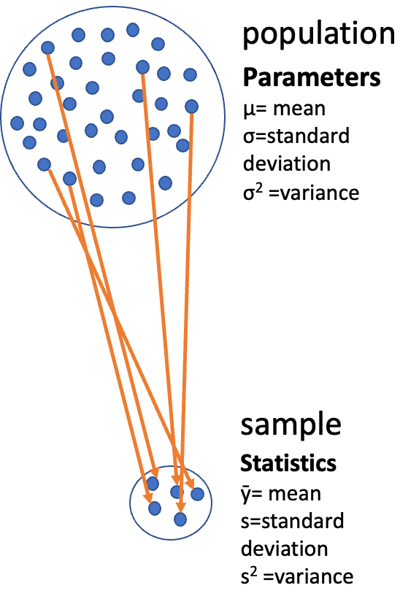
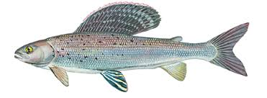
Lecture 3: Descriptive Statistics and Uncertainty in R and Tidyverse
The objectives:
Understand why statistics is vital in biology
Distinguish between different types of biological variables
Learn about accuracy, precision, and bias in measurements
Calculate and interpret measures of central tendency (mean, median, geometric mean)
Calculate and interpret measures of spread (standard deviation, variance, IQR)
Understand data transformations for skewed distributions
Visualize descriptive statistics for our data
Learn how to handle uncertainty in our data
We’ll use a dataset on grayling fish from two different lakes to explore these concepts..

Slide 4
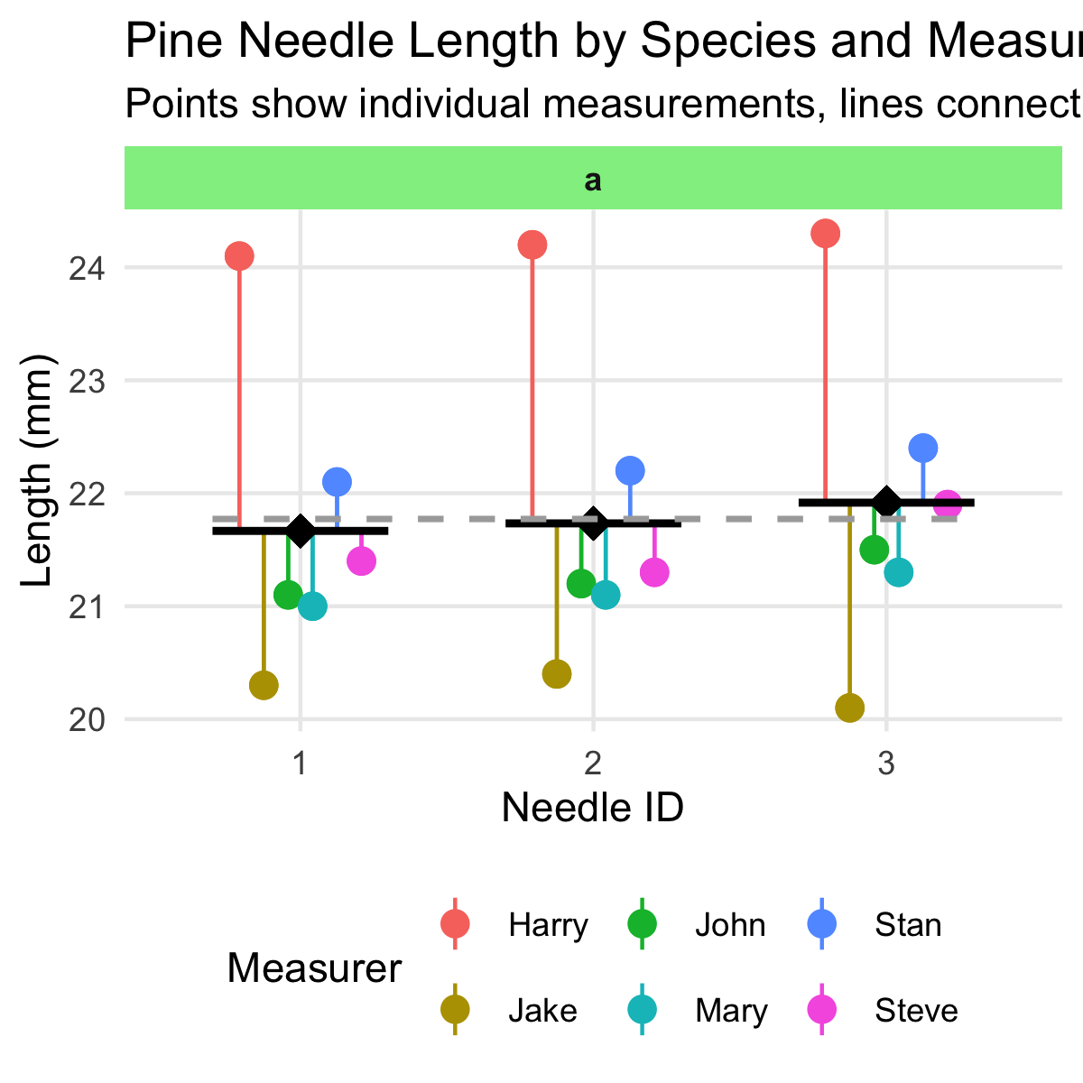
Lecture 3: Why Statistics is Vital in Biology
Biology is fundamentally different from fields like physics in that:
Most biological phenomena are probabilistic rather than deterministic
  Responses occur with some characteristic probability, not with certainty
All biological material varies, which is essential for evolution (recall Darwin’s postulates):
  Variation exists within populations
  Some variation is heritable
  Some heritable variation affects survival/reproduction
Environmental conditions (in nature, lab, or greenhouse) always vary
Measurements include error
Multiple unmeasured causal factors influence nearly all biological systems
Statistics helps us understand biological processes in this variable world by:
Condensing variation into summary form (Descriptive statistics)
Testing whether observations are consistent with predictions (Inferential statistics)

Slide 5
Practice Exercise 1: Pine Data Analysis
Practice Exercise 1: Can you do this for the pine data we have collected?
Let’s recreate the basic histogram of fish lengths from our last class. Use the sculpin_df data frame that’s already loaded.
# Write your code here to read in the file
# How do you examine the data - what are the ways you think and lets try it!

Slide 6
Lecture 3: Populations and Samples
Before we dive into descriptive statistics, let’s clarify some fundamental concepts:
Population: The entire group of things under consideration; the group for which answers obtained from measurements and statistical analysis are pertinent.
Sample: A subset of the population that is actually measured.
Sample unit: The individual thing drawn from the population.
Types of populations:
Observational population: Usually finite but may be very large (e.g., head width of all corn earworms in a field)
Experimental population: Often conceptually infinite (e.g., all possible goldenrod plants that could receive a specific fertilizer treatment)
Sampling involves
inference - generalizing from what is observed in the sample to what is present in the population.
Valid inference requires random sampling.

Slide 7
Lecture 3: Parameters vs. Statistics
It’s important to distinguish between:
Parameters: True numerical values for a population (usually denoted by Greek letters)
Statistics: Estimates of parameters based on samples (usually denoted by Roman letters)
For example:
Population mean (μ) is estimated by sample mean (Y̅)
Population standard deviation (σ) is estimated by sample standard deviation (s)
The standard deviation formula above includes n-1 in the denominator (rather than n) to provide an unbiased estimate of the population parameter.

Slide 8
Lecture 3: Kinds of Biological Variables
Understanding the type of variable you’re working with is essential for selecting appropriate statistics:
Measurement or Quantitative Variables
Continuous: Any value between extremes of scale is possible (e.g., mass, length)
Discrete (meristic): Only fixed values (usually integers) between extremes are possible (e.g., bristle number, egg count)
Rank Variables (Ordinal)
Assign only order, not quantity
Nothing implied about relative distance between values
Categorical Variables (Qualitative)
No quantitative information (e.g., male/female, living/dead)
Some are simplifications of quantitative variables (e.g., color instead of wavelength)

Slide 9
Lecture 3: Derived Variables
Derived Variables
Percentages, Proportions: Ratio of some component to total
Ratios: Relation of two variables
Rates: Quantity per unit (time, mass, etc.)
Indices: More complex derived variables (e.g., condition index)
Let’s explore our grayling fish dataset and identify the types of variables it contains.

Slide 10
Practice Exercise 2: Examining Grayling Data
Practice Exercise 2: Can you do this for the pine data we have collected?
Let’s examine the different data and determine what they are?
# Write your code here to read in the file
# How do you examine the data - what are the ways you think and lets try it!
# Load the grayling data
grayling_df <- read_csv("data/gray_I3_I8.csv")
# Take a look at the first few rows
head(grayling_df)
# A tibble: 6 × 5
site lake species length_mm mass_g
<dbl> <chr> <chr> <dbl> <dbl>
1 113 I3 arctic grayling 266 135
2 113 I3 arctic grayling 290 185
3 113 I3 arctic grayling 262 145
4 113 I3 arctic grayling 275 160
5 113 I3 arctic grayling 240 105
6 113 I3 arctic grayling 265 145

Slide 11
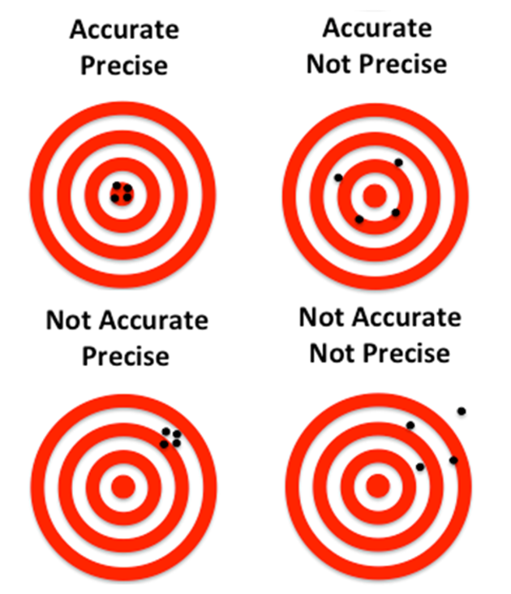
Lecture 3: Accuracy, Precision, and Bias
When taking biological measurements, understanding measurement quality is essential:
Accuracy: Closeness of measured value to true value
Precision: Closeness of repeated measurements to each other (repeatability)
Bias: Systematic departure from the true value
Accuracy is a function of both precision and bias. For statisticians, bias is usually a more serious problem than low precision because:
It’s harder to detect (true value usually unknown)
Low precision can be compensated for by increased sample size

Slide 12
Practice Exercise: Sources of Error
Practice Exercise 1: What are potential sources of error in pine needles or fish?
For our grayling data, potential sources of measurement error might include:
Precision issues:
  Variations in how fish are measured (e.g., slightly bent fish)
Bias issues:
  Systematic underestimation of length if measurements aren’t taken from the true tip of the snout to the end of the tail
Accuracy issues? what could they be?

Slide 13
Lecture 3: Measures of Central Tendency - Mean
The two most common measures of central tendency are the mean and the median.
The Arithmetic Mean The arithmetic mean is the average of a set of measurements:
$$\overset{‾}{Y}=\frac{\sum_{i=1}^{n}{Y_{i}}}{n}$$
Where:
$Y_{i}$ represents each individual measurement
$n$ is the total number of observations
Mean length of all fish: 324.5 mm
lake | mean_length
I3 | 265.6061
I8 | 362.5980

Slide 14
Lecture 3: Measures of Central Tendency - Median
The Median
The median is the middle value of a sorted dataset.
If there is an even number of observations, it’s the average of the two middle values.
Median length of all fish: 324.5 mm
lake | median_length
I3 | 266
I8 | 373

Slide 15
Lecture 3: Measures of Spread - Variance and Standard Deviation
The spread of a distribution tells us how variable the measurements are.
Variance and Standard Deviation
The variance is
$$s^{2}=\frac{\sum_{i=1}^{n}{{\left(Y_{i}−\overset{‾}{Y}\right)}^{2}}}{n−1}$$
The standard deviation is the square root of variance
measures how far observations typically are from the mean and are in the units of the mean:
$$s=\sqrt{\frac{\sum_{i=1}^{n}{{\left(Y_{i}−\overset{‾}{Y}\right)}^{2}}}{n−1}}$$
Variance of length: 4225.9 mm²
Standard deviation of length: 65 mm
lake | var_length | sd_length
I3 | 801.104 | 28.30378
I8 | 2,739.371 | 52.33901

Slide 16
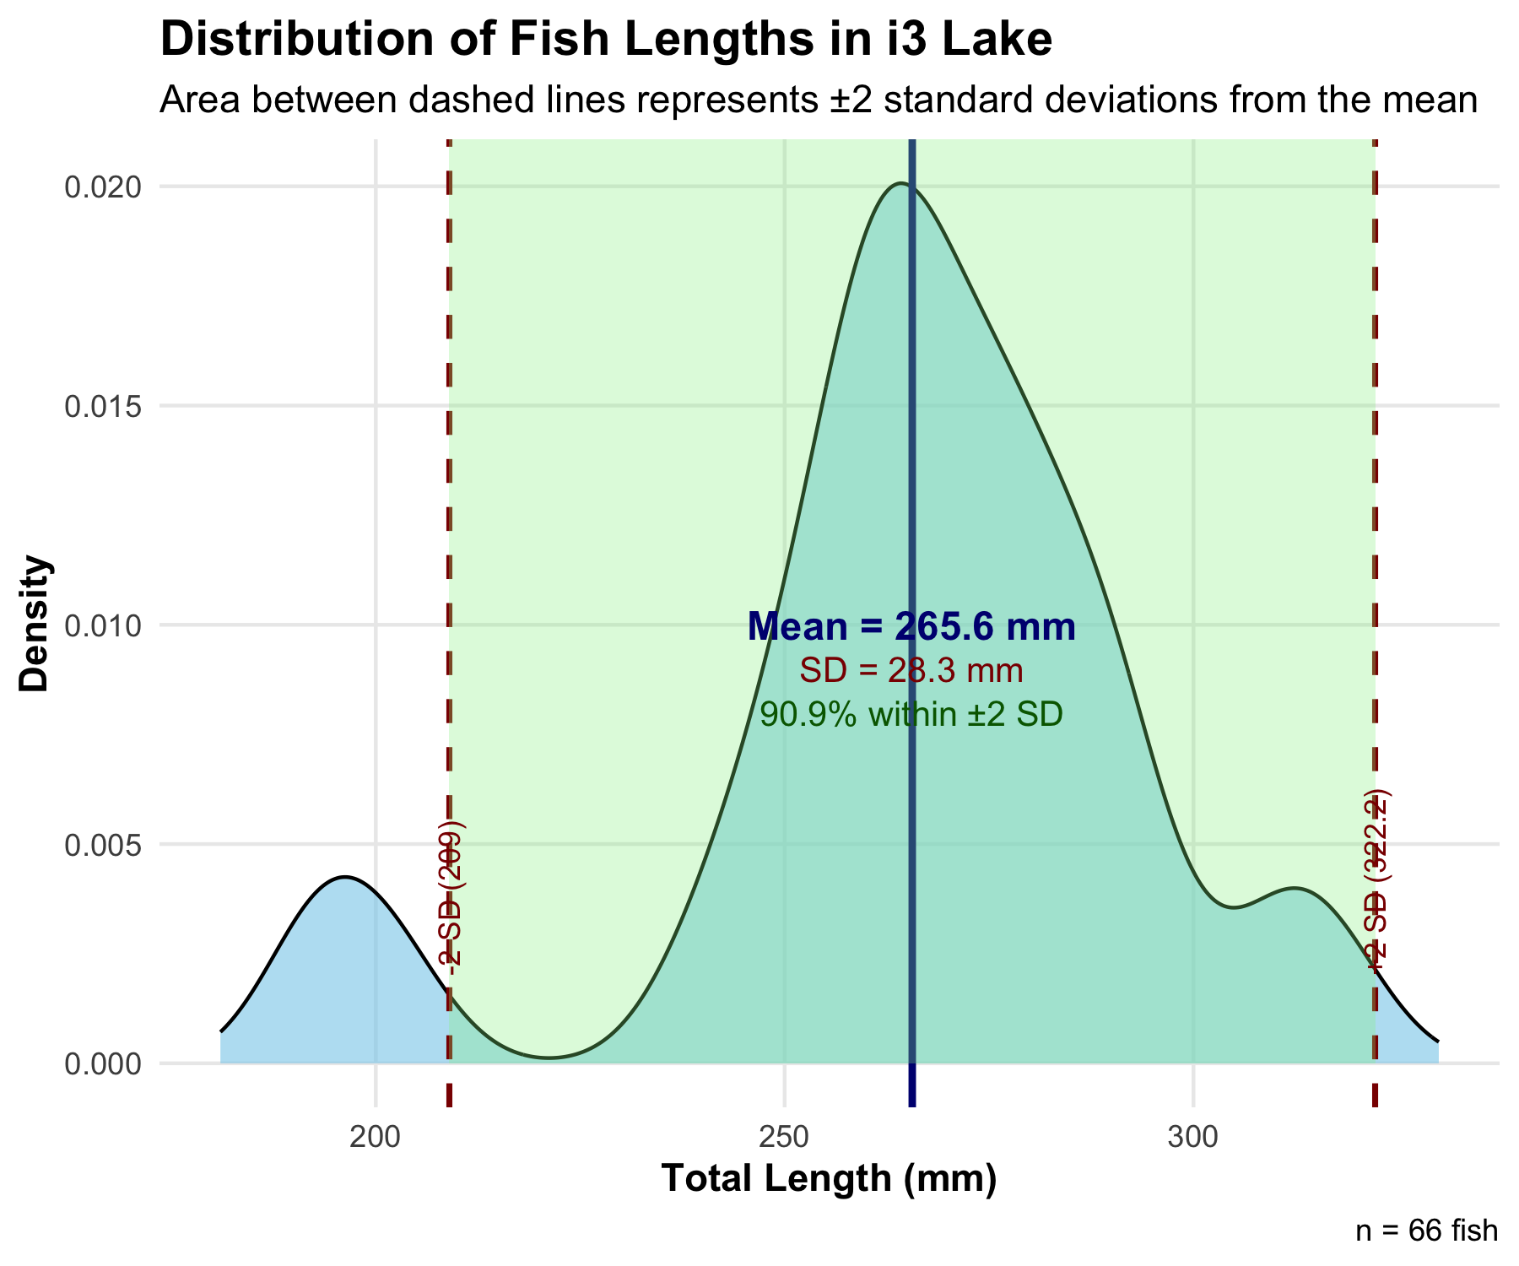
Lecture 3: Understanding Standard Deviation
The area under the curve of a bell shaped curve within + and - 2 Standard deviations on each side includes about 95% of the data
i3 Lake Fish Length Summary:
Number of fish: 66
Mean length: 265.61 mm
Standard Deviation: 28.3 mm
Range for ±2 SD: 209 to 322.21 mm
Percentage within ±2 SD: 90.91 %

Slide 17
Lecture 3: Coefficient of Variation
The coefficient of variation (CV) expresses the standard deviation as a percentage of the mean:
$$CV=\frac{s}{\overset{‾}{Y}}×100\%$$
This is useful for comparing the variability of measurements with different units or vastly different scales.
Coefficient of variation: 10.7 %
lake | cv_length
I3 | 10.65630
I8 | 14.43444

Slide 18
Lecture 3: Interquartile Range
The interquartile range (IQR) is the range of the middle 50% of the data:
$$IQR=Q_{3}−Q_{1}$$
Where $Q_{1}$ is the first quartile (25th percentile) and $Q_{3}$ is the third quartile (75th percentile).
First quartile: 270.75 mm
Third quartile: 377 mm
Interquartile range: 106.25 mm
lake | q1 | q3 | iqr
I3 | 256 | 280 | 24
I8 | 340 | 401 | 61

Slide 19
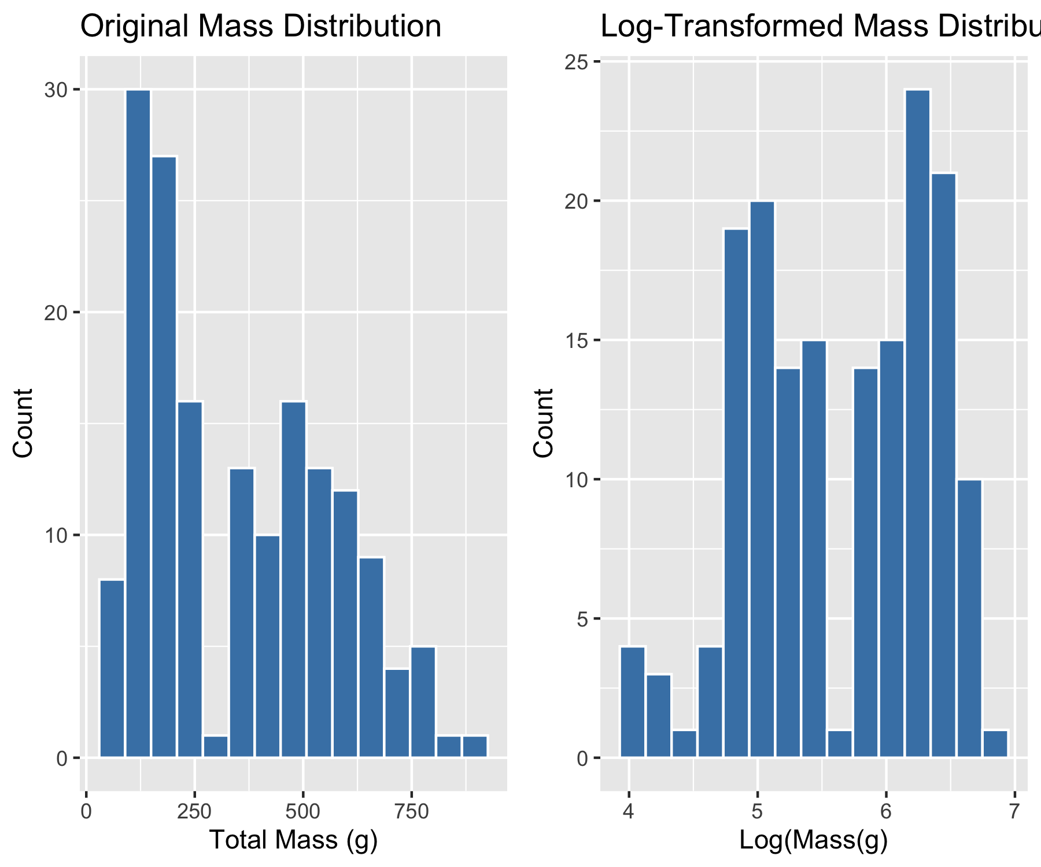
Lecture 3: Data Transformations for Skewed Distributions
Biological data are often skewed (asymmetrical), which can make the arithmetic mean less representative of central tendency. Data transformations can help address this issue.
Logarithmic Transformation
The logarithmic transformation is one of the most common for right-skewed biological data:
When data are log-normally distributed, the geometric mean often provides a better measure of central tendency than the arithmetic mean.

Slide 20
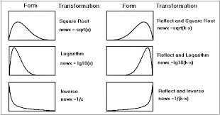
Lecture 3: When to Use Transformations
Log transformation: When data are right-skewed or follow multiplicative rather than additive processes
Square root transformation: For count data or data where variance increases with the mean
Inverse transformation: For strongly right-skewed data
Arcsine square root transformation: For proportions or percentages (though logistic regression is often preferred now)

Slide 21
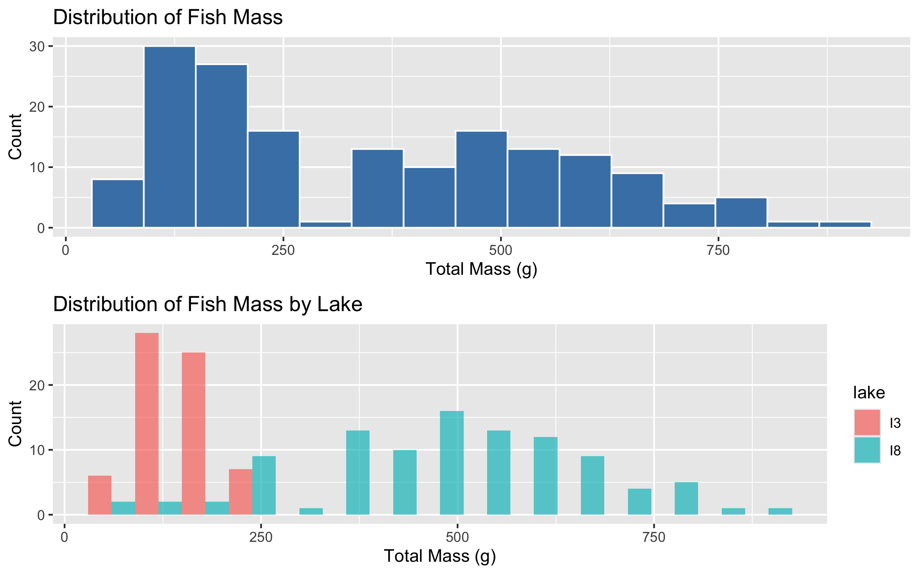
Lecture 3: Visualizing Distributions - Histograms
Histograms
Histograms show the frequency distribution of our data.

Slide 22
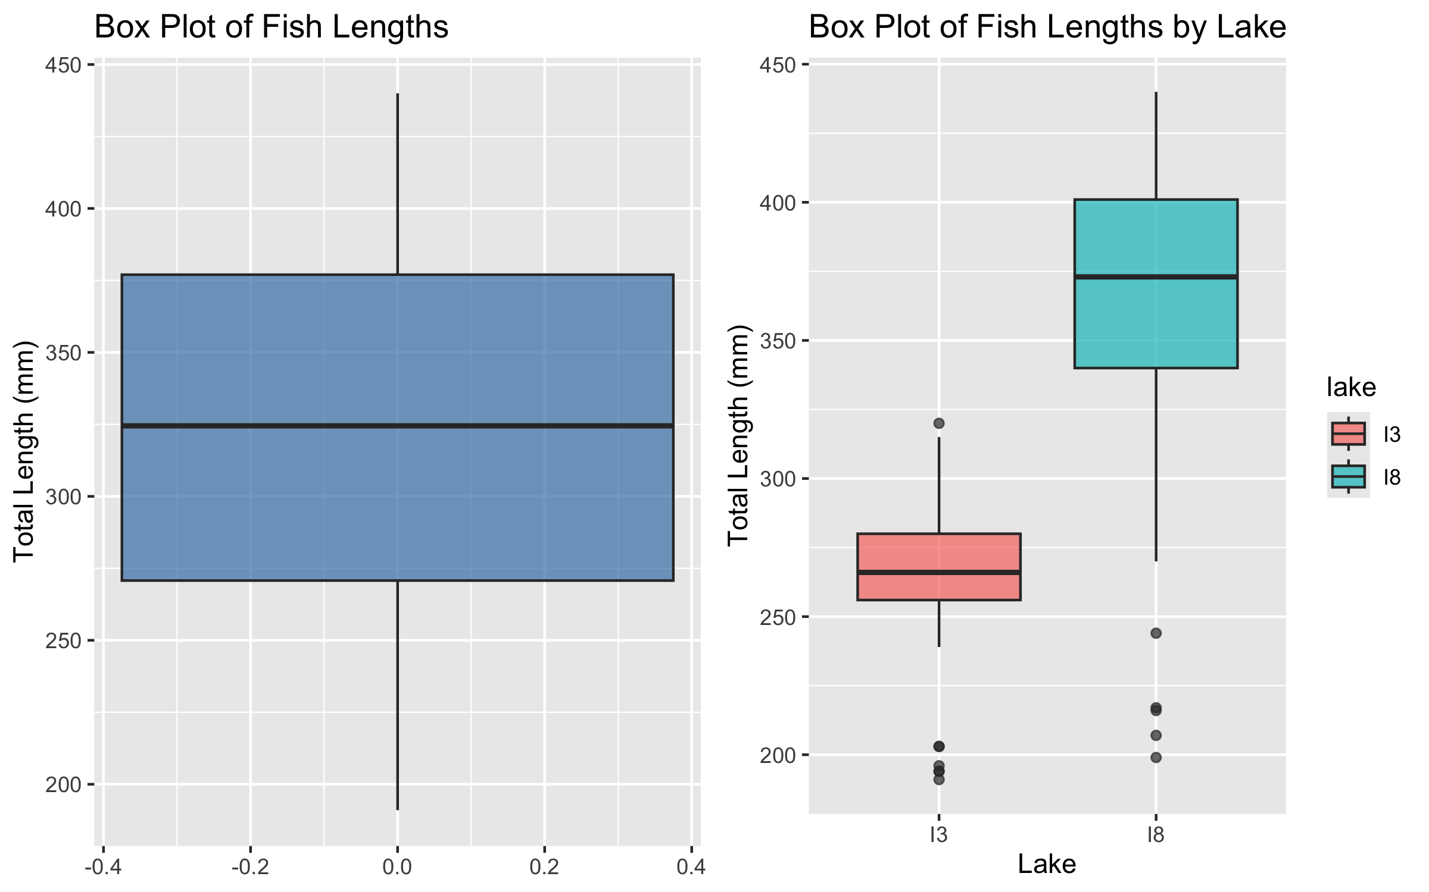
Lecture 3: Visualizing Distributions - Box Plots
Box Plots
Box plots show the median, quartiles, and potential outliers.

Slide 23
Lecture 3: Comparing Mean vs. Median
The mean and median measure different aspects of a distribution:
Mean: Center of gravity of the distribution
Median: Middle value of the data
When a distribution is symmetric, the mean and median are similar. When it’s skewed or has outliers, they can differ significantly.
lake | mean | median | sd | iqr | skewness
I3 | 265.6061 | 266 | 28.30378 | 24 | -0.8826195
I8 | 362.5980 | 373 | 52.33901 | 61 | -1.0909961

Slide 24
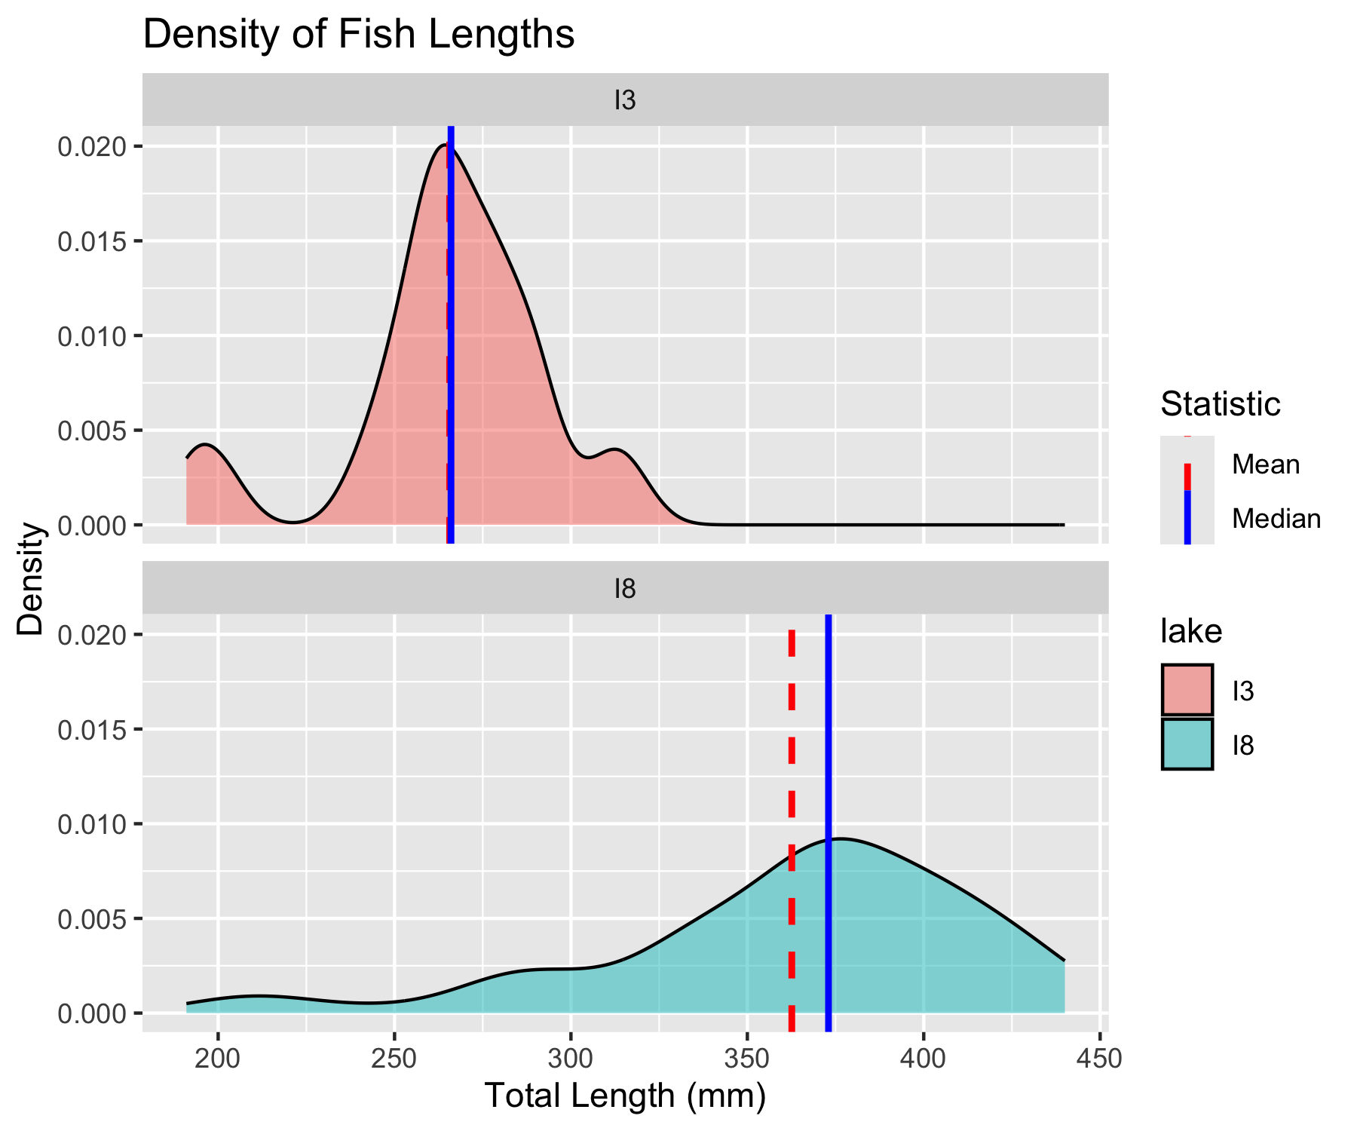
Lecture 3: Density Plot - Mean vs. Median
The mean and median measure different aspects of a distribution:
Mean: Center of gravity of the distribution
Median: Middle value of the data
When a distribution is symmetric, the mean and median are similar. When it’s skewed or has outliers, they can differ significantly.

Slide 25
Lecture 3: Standard Deviation vs. Interquartile Range
The standard deviation and interquartile range both measure spread, but:
Standard deviation: Sensitive to outliers
Interquartile range: Robust against outliers
When the data is approximately normal, the IQR ≈ 1.35 × standard deviation.
lake | sd | iqr | ratio_iqr_sd
I3 | 28.30 | 24.00 | 0.85
I8 | 52.34 | 61.00 | 1.17

Slide 26
Lecture 3: Understanding Percentiles
Percentiles are values that divide a dataset into 100 equal parts.
The 25th percentile is the first quartile (Q1)
The 50th percentile is the median
The 75th percentile is the third quartile (Q3)
The IQR is the difference between Q3 and Q1.
Percentile | Value
10th | 251.1
25th (Q1) | 270.8
50th (Median) | 324.5
75th (Q3) | 377.0
90th | 408.6

Slide 27
Lecture 3: Handling Missing Values
Let’s examine how missing values affect our descriptive statistics by looking at the mass variable, which has some missing data.
[1] 2
Mean mass without handling NAs: NA g
Mean mass with na.rm=TRUE: 351.2289 g
lake | mean_mass | median_mass | sd_mass | n_missing
I3 | 150.5 | 147.0 | 42.2 | 0
I8 | 483.7 | 490.0 | 176.5 | 2

Slide 28
Lecture 3: Best Practices for Missing Values
Always check for missing values in your data before calculating statistics.
Use na.rm = TRUE when calculating summary statistics to handle missing values.
Report the number of missing values along with your statistics.
Consider whether the missing values are random or might introduce bias.

Slide 29
Sampling from a Population
Now that we have estimates of the sample we need to relate that to the population

Slide 30
In reality, we rarely know the true population parameters. When studying fish in lakes I3 and I8:
The population includes all grayling fish in each lake
The true population mean (μ) and standard deviation (σ) are unknown
Our dataset is a sample from this population
We use the sample mean (x̄) to estimate μ
Sampling introduces random variation in our estimates
Let’s demonstrate how different samples from the same population can give different estimates.
If we could sample all fish in the lake, we would know the true mean length. But that’s usually impossible in ecology!

Slide 31
Demonstrating Sampling Variation
Let’s take several random samples from Lake I3 and see how the sample means vary:
# Filter for Lake I3
i3_data <- grayling_df %>% filter(lake == "I3")
# Function to take a random sample and calculate the mean
sample_mean <- function(data, sample_size) {
sample_data <- sample_n(data, sample_size)
return(mean(sample_data$length_mm))
}
# Take 10 different samples of size 15 from Lake I3
set.seed(123) # For reproducibility
sample_size <- 15
sample_means <- replicate(10, sample_mean(i3_data, sample_size))
# Create a data frame with sample numbers and means
samples_df <- data.frame(
sample_number = 1:10,
sample_mean = sample_means
)

Slide 32
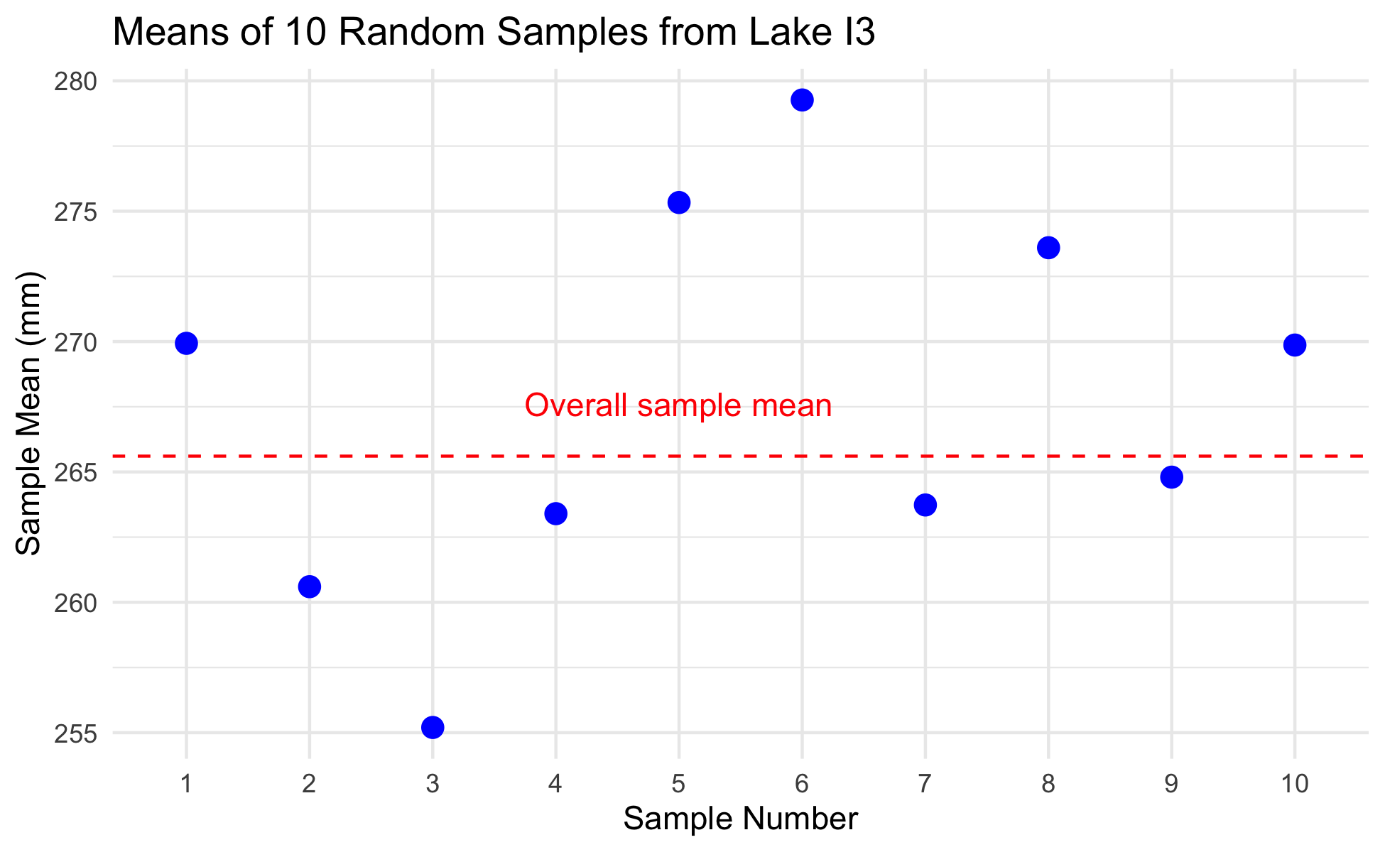
Plotting Sample Variation
# Display the sample means
samples_df
sample_number sample_mean
1 1 269.9333
2 2 260.6000
3 3 255.2000
4 4 263.4000
5 5 275.3333
6 6 279.2667
7 7 263.7333
8 8 273.6000
9 9 264.8000
10 10 269.8667
# Calculate the mean and standard deviation of the sample means
mean(sample_means)
[1] 267.5733
sd(sample_means)
[1] 7.346063
# Plot the different sample means
ggplot(samples_df, aes(x = factor(sample_number), y = sample_mean)) +
geom_point(size = 3, color = "blue") +
geom_hline(yintercept = mean(i3_data$length_mm),
linetype = "dashed", color = "red") +
annotate("text", x = 5, y = mean(i3_data$length_mm) + 2,
label = "Overall sample mean", color = "red") +
labs(title = "Means of 10 Random Samples from Lake I3",
x = "Sample Number",
y = "Sample Mean (mm)") +
theme_minimal()

Slide 33
Notice how each sample’s mean differs from the overall mean. This demonstrates sampling variation.

Slide 34
Standard Error: Quantifying Uncertainty
The standard error of the mean (SEM) measures the precision of a sample mean as an estimate of the population mean.
Formula: $SE_{\overset{‾}{x}}=\frac{s}{\sqrt{n}}$
Where: - s is the sample standard deviation - n is the sample size
The standard error tells us: - How much uncertainty is in our estimate - How much sample means are expected to vary - How close our sample mean is likely to be to the true population mean
Remember: - Standard deviation (s) describes the variability in the individual data points - Standard error (SE) describes the variability in the sample mean itself - As sample size increases, SE decreases (more precise estimate)

Slide 35
Standard Error for Our Grayling Data
Let’s calculate and visualize the standard error for both lakes:
# Calculate mean, SD, and SE for each lake
grayling_stats <- grayling_df %>%
group_by(lake) %>%
summarize(
mean_length = mean(length_mm),
sd_length = sd(length_mm),
n = n(),
se_length = sd_length / sqrt(n)
)
# Display the statistics
grayling_stats
# A tibble: 2 × 5
lake mean_length sd_length n se_length
<chr> <dbl> <dbl> <int> <dbl>
1 I3 266. 28.3 66 3.48
2 I8 363. 52.3 102 5.18

Slide 36
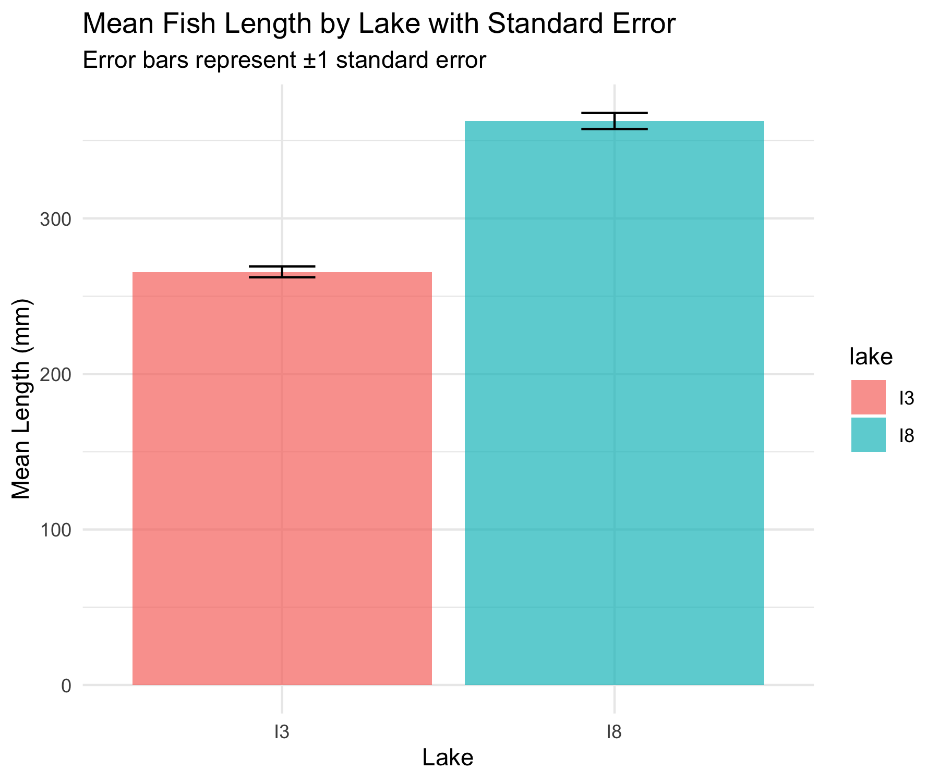
Visualizing Standard Error

Slide 37
Sampling Distribution of the Mean
The sampling distribution of the mean is the theoretical distribution of all possible sample means of a given sample size from a population.
Important properties: 1. It is centered at the population mean (μ) 2. Its standard deviation is the standard error (σ/√n) 3. For large sample sizes, it approaches a normal distribution (Central Limit Theorem)
The larger the sample size: - The narrower the sampling distribution - The smaller the standard error - The more precise our estimate of the population mean
Let’s simulate the sampling distribution for Lake I3 fish data.

Slide 38
Simulating the Sampling Distribution
Let’s simulate taking many samples from Lake I3 to visualize the sampling distribution:
# Filter for Lake I3
i3_data <- grayling_df %>% filter(lake == "I3")
# Number of samples to simulate
num_simulations <- 1000
sample_size <- 20
# Simulate many samples and calculate means
set.seed(456) # For reproducibility
simulated_means <- replicate(num_simulations, sample_mean(i3_data, sample_size))
# Calculate the mean and standard deviation of the simulated means
mean_of_means <- mean(simulated_means)
sd_of_means <- sd(simulated_means)
# Create a data frame with the simulated means
simulated_df <- data.frame(sample_mean = simulated_means)

Slide 39
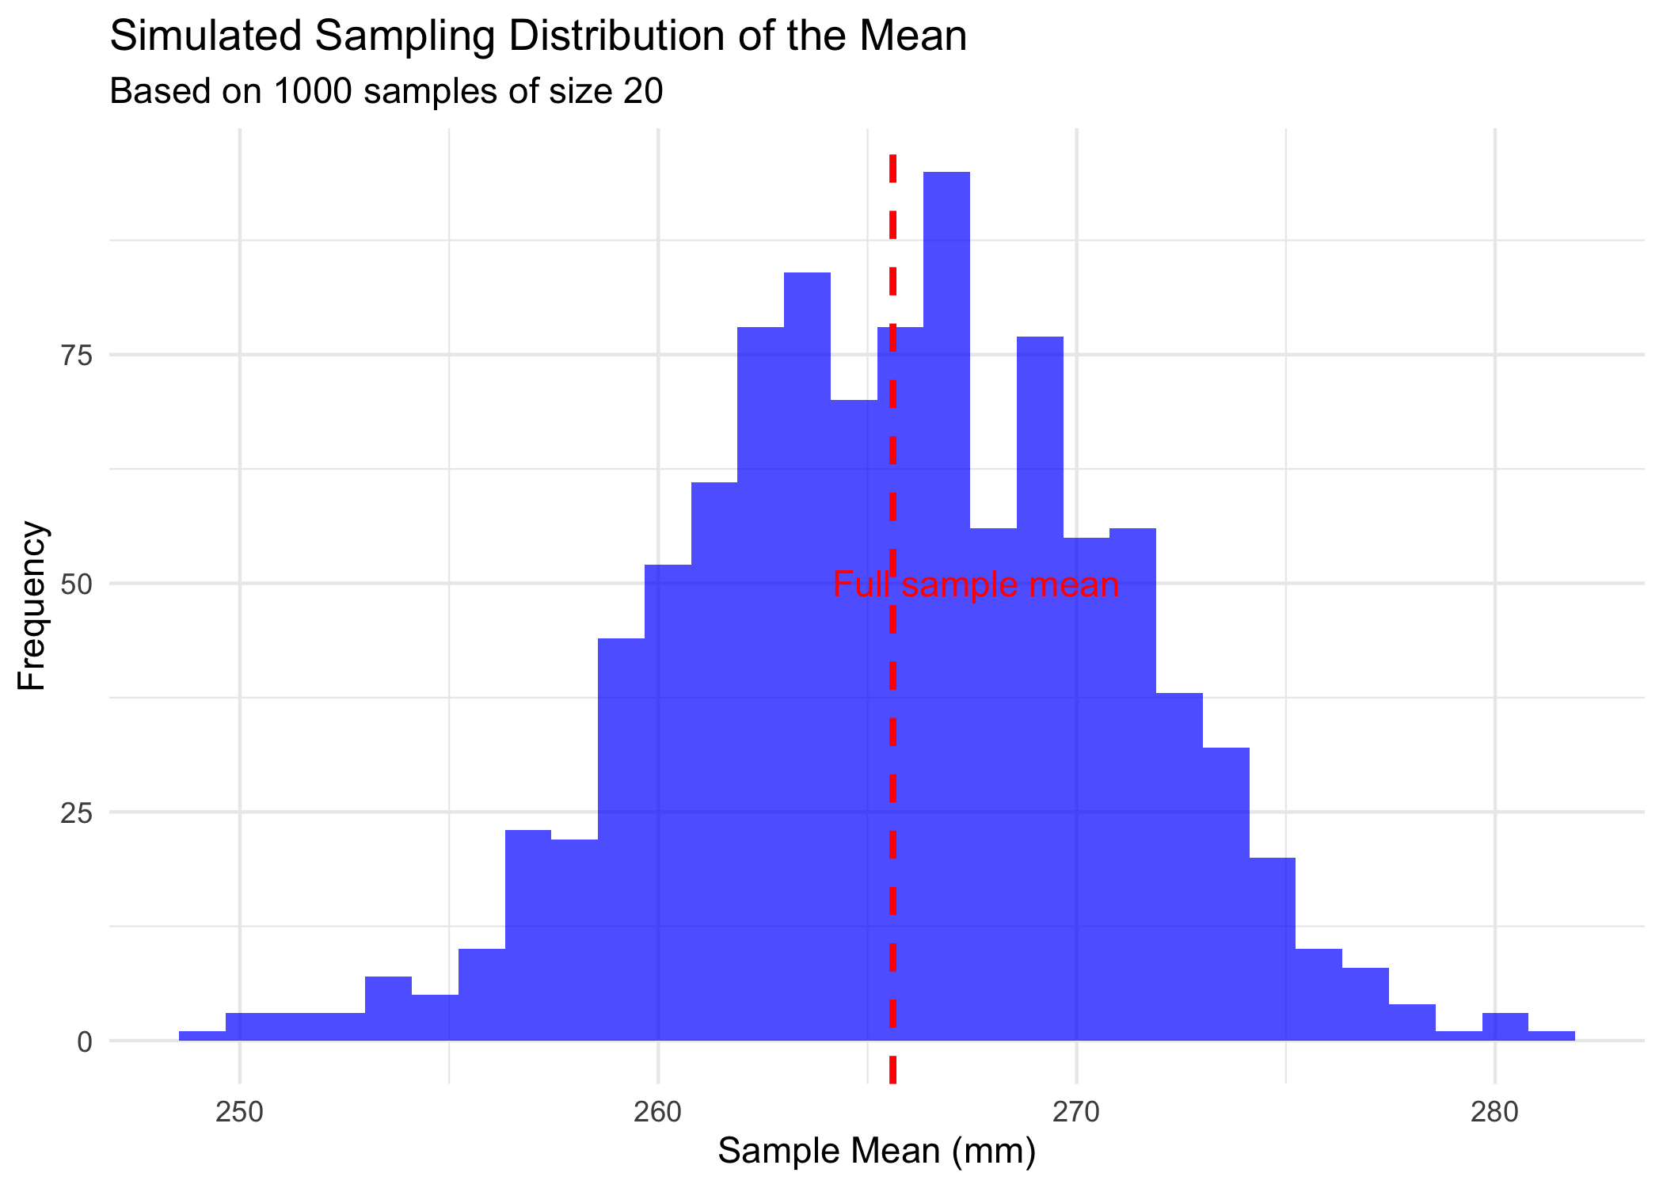
Plotting Sampling Distribution
# Plot the sampling distribution
ggplot(simulated_df, aes(x = sample_mean)) +
geom_histogram(bins = 30, fill = "blue", alpha = 0.7) +
geom_vline(xintercept = mean(i3_data$length_mm),
linetype = "dashed", color = "red", size = 1) +
annotate("text", x = mean(i3_data$length_mm) + 2, y = 50,
label = "Full sample mean", color = "red") +
labs(title = "Simulated Sampling Distribution of the Mean",
subtitle = paste("Based on", num_simulations, "samples of size", sample_size),
x = "Sample Mean (mm)",
y = "Frequency") +
theme_minimal()

Slide 40
Notice that the simulated sampling distribution:
Is approximately normally distributed
Is centered around the overall sample mean
Has a spread that is related to the standard error

Slide 41
Standard Error and Sample Size
Let’s see how the standard error changes with different sample sizes:

Slide 42
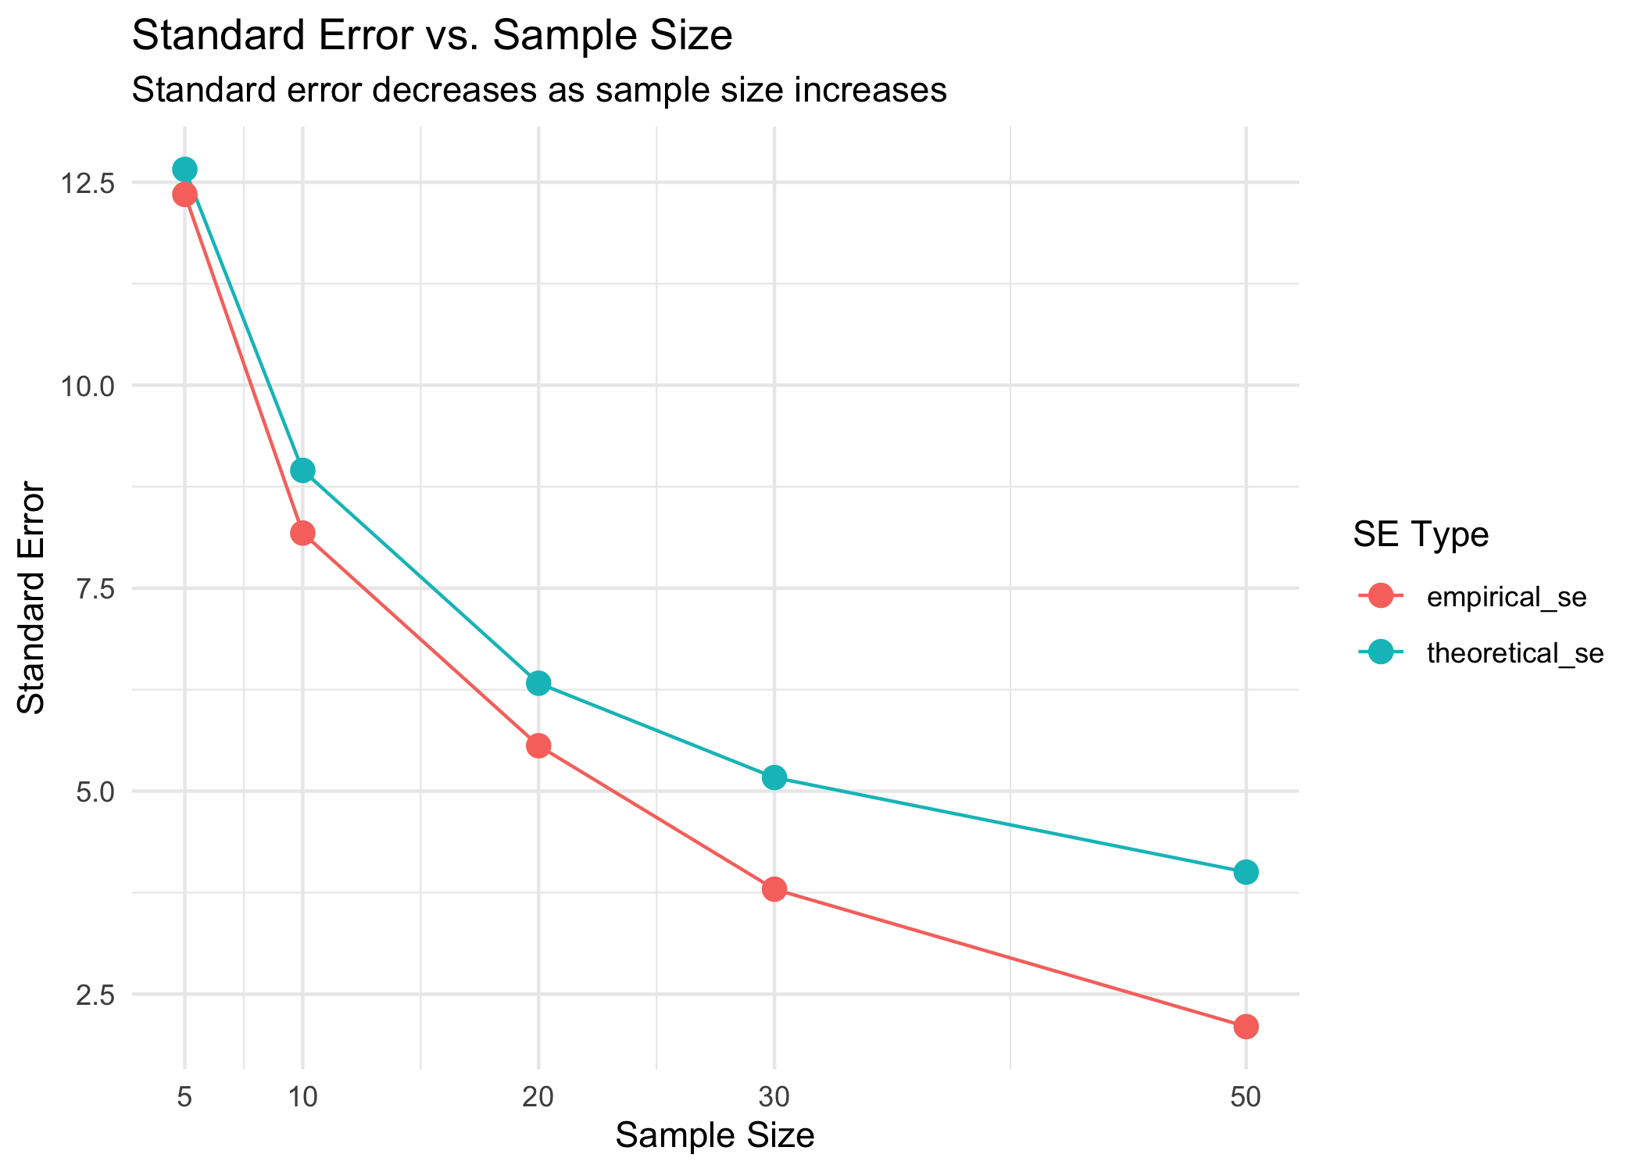
Sample Size vs. Standard Error
# Display the results
results
sample_size empirical_se theoretical_se
1 5 12.349407 12.657835
2 10 8.178270 8.950441
3 20 5.558957 6.328918
4 30 3.792177 5.167540
5 50 2.099744 4.002759
# Plot how SE changes with sample size
results_long <- pivot_longer(results,
cols = c(empirical_se, theoretical_se),
names_to = "se_type",
values_to = "standard_error")
ggplot(results_long, aes(x = sample_size, y = standard_error, color = se_type)) +
geom_line() +
geom_point(size = 3) +
scale_x_continuous(breaks = sample_sizes) +
labs(title = "Standard Error vs. Sample Size",
subtitle = "Standard error decreases as sample size increases",
x = "Sample Size",
y = "Standard Error",
color = "SE Type") +
theme_minimal()

Slide 43
Confidence Intervals
A confidence interval is a range of values that is likely to contain the true population parameter.
The 95% confidence interval for the mean is approximately:
$\overset{‾}{x}±2×SE_{\overset{‾}{x}}$
This “2 SE rule of thumb” means: - The interval extends 2 standard errors below and above the sample mean - About 95% of such intervals constructed from different samples would contain the true population mean
Confidence intervals provide a way to express the precision of our estimates.

Slide 44
Calculating Confidence Intervals for Grayling Data
Let’s calculate and visualize the 95% confidence intervals for the mean fish length in each lake:
# Calculate 95% confidence intervals
grayling_ci <- grayling_df %>%
group_by(lake) %>%
summarize(
mean_length = mean(length_mm),
sd_length = sd(length_mm),
n = n(),
se_length = sd_length / sqrt(n),
ci_lower = mean_length - 2 * se_length,
ci_upper = mean_length + 2 * se_length
)
# Display the confidence intervals
grayling_ci
# A tibble: 2 × 7
lake mean_length sd_length n se_length ci_lower ci_upper
<chr> <dbl> <dbl> <int> <dbl> <dbl> <dbl>
1 I3 266. 28.3 66 3.48 259. 273.
2 I8 363. 52.3 102 5.18 352. 373.

Slide 45
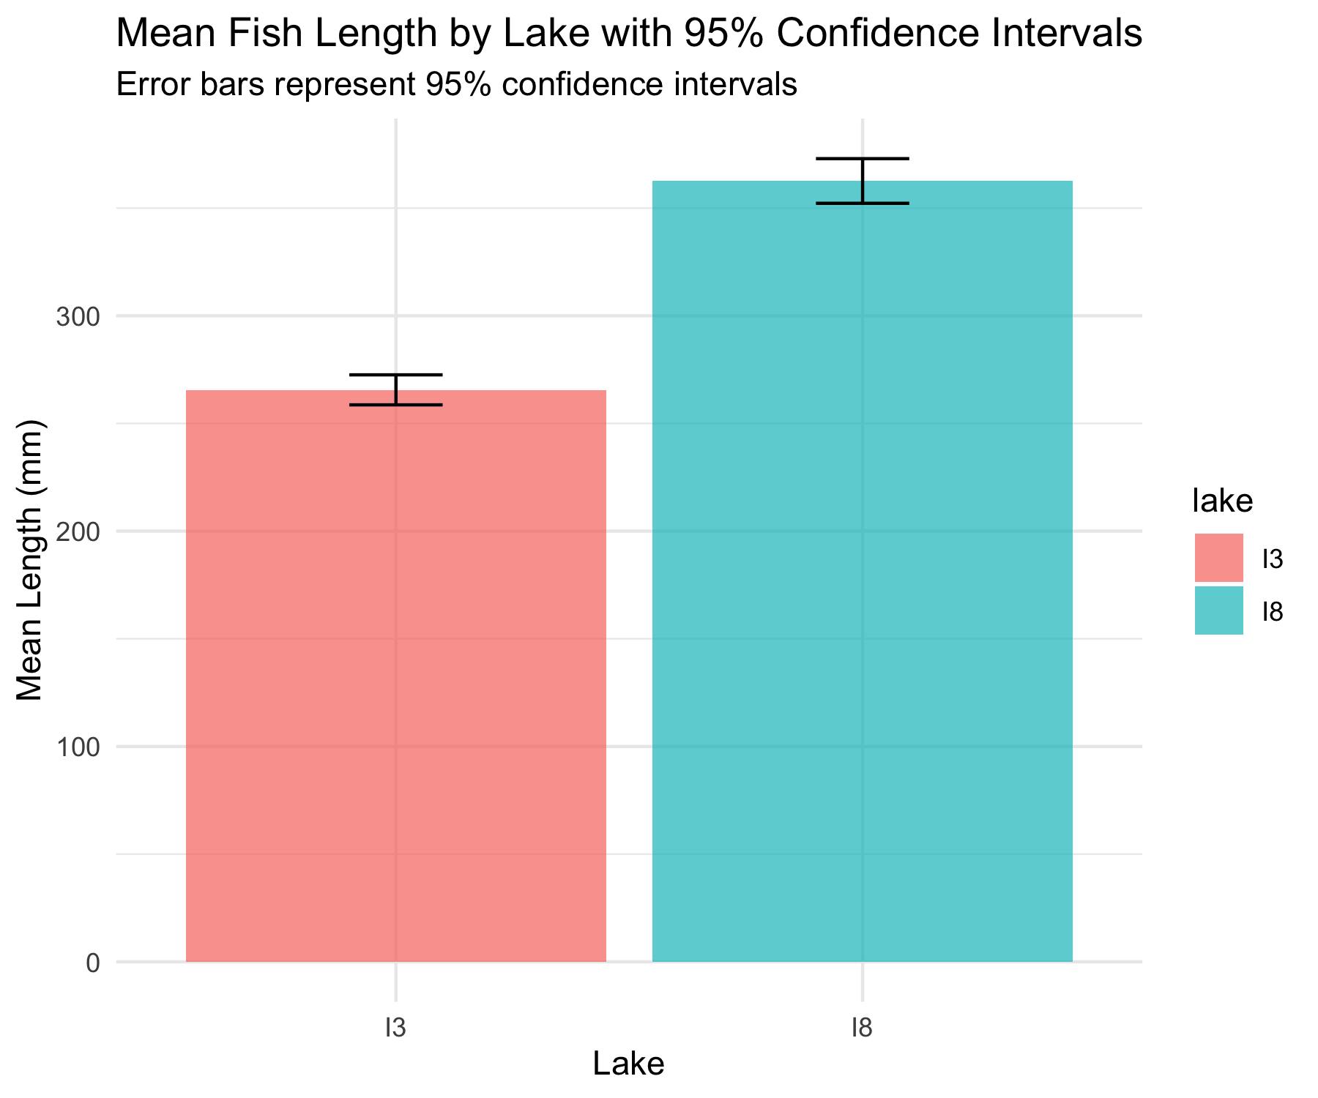
Visualizing Confidence Intervals
# Plot with confidence intervals
ggplot(grayling_ci, aes(x = lake, y = mean_length, fill = lake)) +
geom_bar(stat = "identity", alpha = 0.7) +
geom_errorbar(aes(ymin = ci_lower, ymax = ci_upper),
width = 0.2) +
labs(title = "Mean Fish Length by Lake with 95% Confidence Intervals",
subtitle = "Error bars represent 95% confidence intervals",
x = "Lake",
y = "Mean Length (mm)") +
theme_minimal()

Slide 46
Different Types of Error Bars
Let’s compare different ways of displaying uncertainty in our estimates:
# Calculate statistics for different types of error bars
grayling_error_bars <- grayling_df %>% group_by(lake) %>%
summarize(mean_length = mean(length_mm),
sd_length = sd(length_mm), n = n(),
se_length = sd_length / sqrt(n),
ci_lower = mean_length - 1.96 * se_length,
ci_upper = mean_length + 1.96 * se_length,
one_sd_lower = mean_length - sd_length,
one_sd_upper = mean_length + sd_length)
# Create a data frame for plotting different error types
lake_i3 <- grayling_error_bars %>% filter(lake == "I3")
error_types <- data.frame(
error_type = c("Standard Deviation", "Standard Error", "95% Confidence Interval"),
lower = c(lake_i3$one_sd_lower,
lake_i3$mean_length - lake_i3$se_length,
lake_i3$ci_lower),
upper = c(lake_i3$one_sd_upper,
lake_i3$mean_length + lake_i3$se_length,
lake_i3$ci_upper))

Slide 47
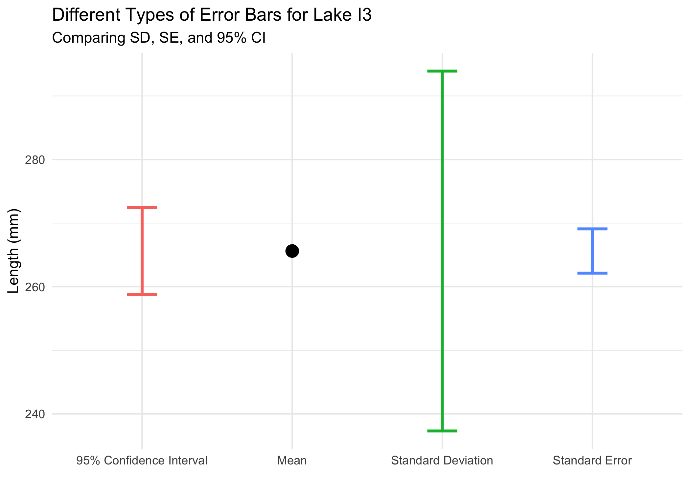
Comparing Error Bar Types
# Plot the comparison
ggplot() +
geom_point(data = lake_i3, aes(x = "Mean",
y = mean_length), size = 4) +
geom_errorbar(data = error_types,
aes(x = error_type, ymin = lower,
ymax = upper, color = error_type),
width = 0.2, linewidth = 1) +
labs(title = "Different Types of Error Bars for Lake I3",
subtitle = "Comparing SD, SE, and 95% CI",
x = "",
y = "Length (mm)",
color = "Error Bar Type") +
theme_minimal() +
theme(legend.position = "none")

Slide 48
Key Takeaways
The standard error measures the precision of a sample statistic as an estimate of a population parameter
The standard error of the mean decreases as sample size increases: $SE_{\overset{‾}{x}}=\frac{s}{\sqrt{n}}$
The sampling distribution shows the variation in sample statistics that would be expected due to random sampling
Confidence intervals provide a range of plausible values for the population parameter
Larger sample sizes provide more precise estimates (narrower confidence intervals)
When reporting results, always include a measure of precision (SE or

Slide 49
For Further Practice
Try calculating the standard error and confidence intervals for other variables in the dataset
Experiment with different sample sizes to see how they affect the precision of estimates
Compare the means of the two lakes using confidence intervals - do they overlap?
Consider how these concepts extend to other statistics beyond the mean

Slide 50
Lecture 3: Conclusion
In this lecture, we’ve explored:
Why statistics is essential in biology
Types of biological variables and their properties
Accuracy, precision, and bias in measurements
Measures of central tendency (mean, median, geometric mean)
Measures of spread (standard deviation, variance, and interquartile range)
Data transformations for skewed distributions
Visualization techniques for understanding distributions
Handling missing values
These tools form the foundation of statistical analysis and will be essential as we move forward to more complex statistical methods.

