Slide 1
Lecture 05: Probability and Statistical Inference
Bill Perry

Slide 2
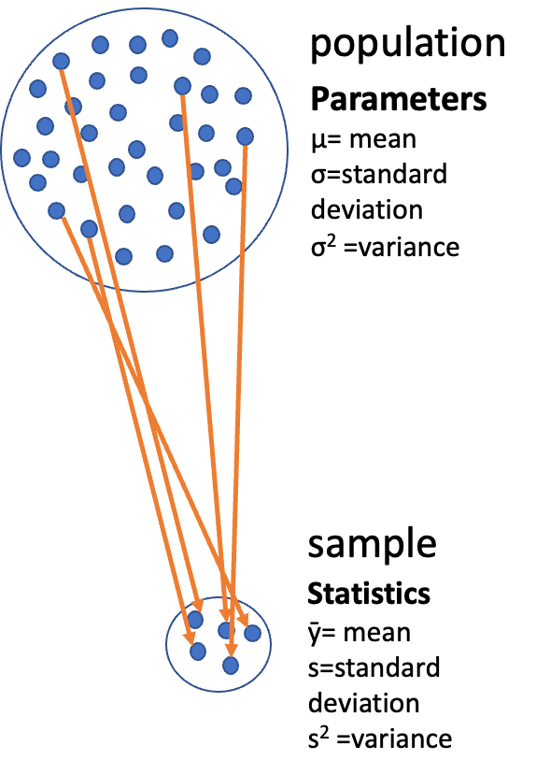
Lecture 4: Review
Introduction to histograms or frequency distributions
Probability Distribution Functions (PDF)
Descriptive Statistics
  Center - mean, median, mode
  Spread - range, variance, standard deviation

Slide 3
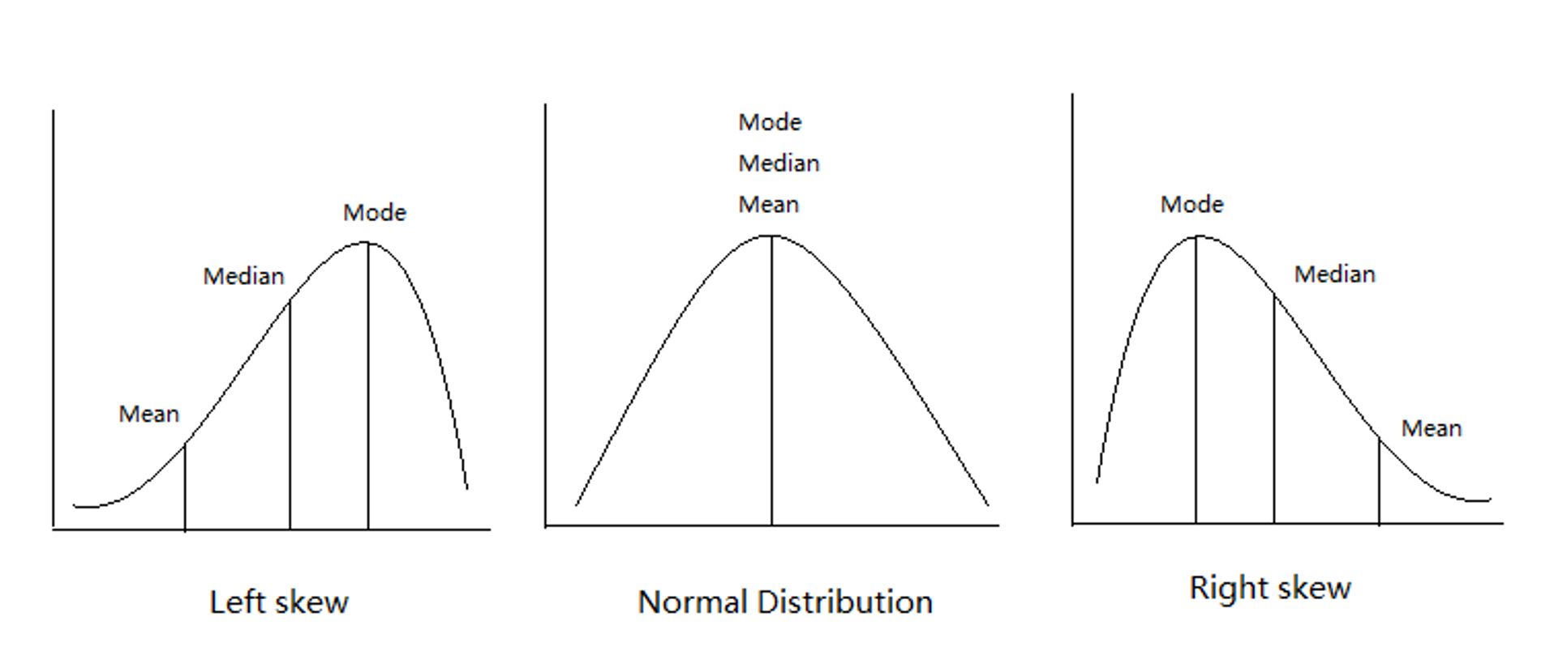
Lecture 4: Review - Statistical Concepts
Introduction to histograms or frequency distributions
Probability Distribution Functions (PDF)
Descriptive Statistics
  Center - mean, median, mode
  Spread - range, variance, standard deviation

Slide 4
Lecture 4: Review - Summary Statistics
Introduction to histograms or frequency distributions
Probability Distribution Functions (PDF)
Descriptive Statistics
  Center - mean, median, mode
  Spread - range, variance, standard deviation
lake | mean_length | sd_length | se_length | count
I3 | 265.6061 | 28.30378 | 3.483954 | 66
I8 | 362.5980 | 52.33901 | 5.182334 | 102

Slide 5
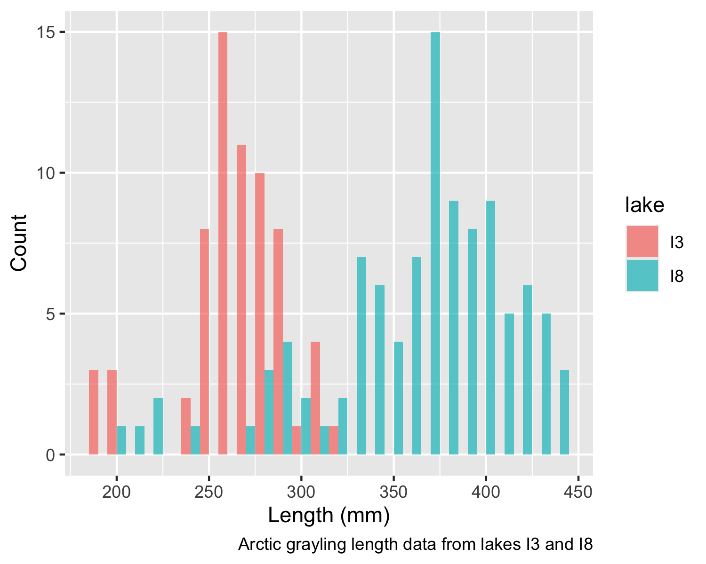
Lecture 5: Probability and Statistical Inference
The goals for today
Statistical inference fundamentals
Hypothesis testing principles
T Distributions
One sample T Tests
Two sample T Test

Slide 6
Lecture 5: Confidence intervals
In the more typical case DON’T know the population σ or standard deviation
estimate it from the samples
and when sample size is <~30)
can’t use the standard normal (z) distribution
Instead, we use Student’s t distribution

Slide 7
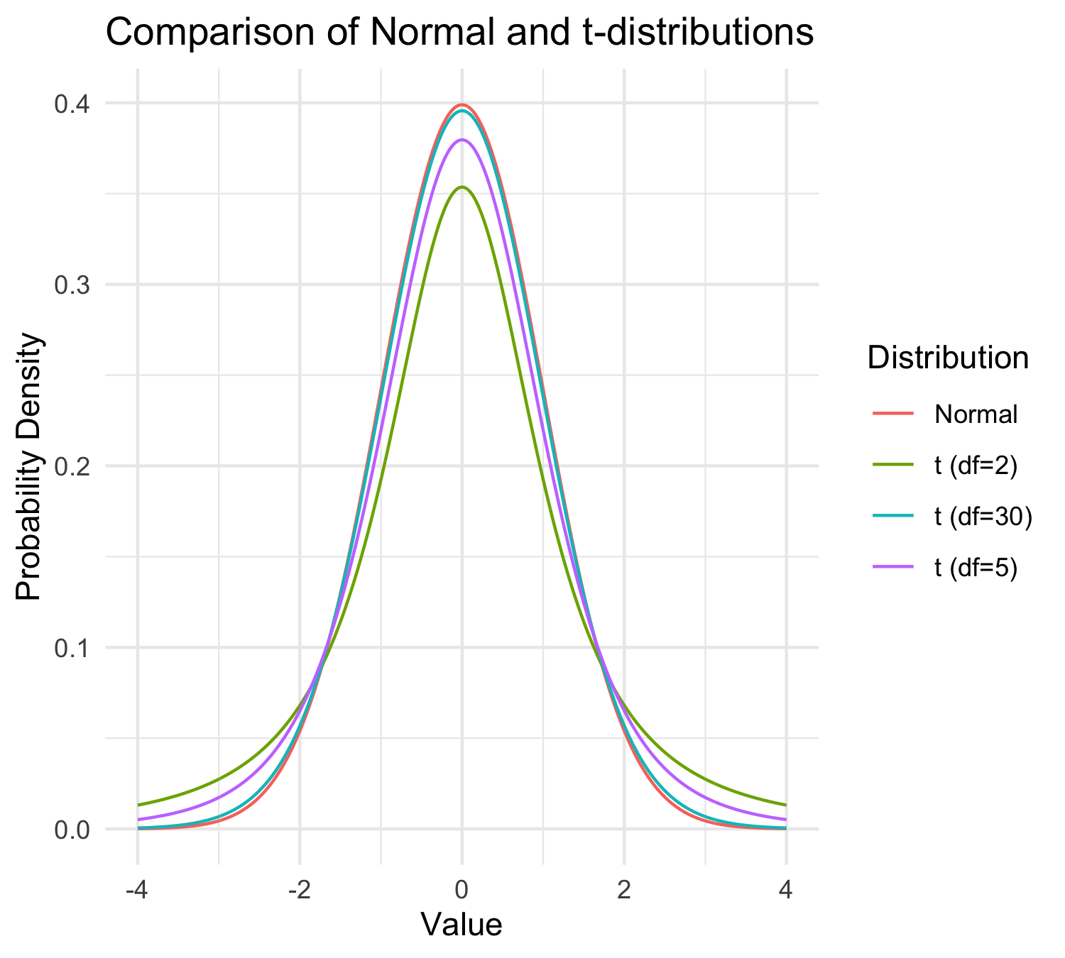
Lecture 5: Understanding t-distribution
When sample sizes are small, the t-distribution is more appropriate than the normal distribution.
Similar to normal distribution but with heavier tails
Shape depends on degrees of freedom (df = n-1)
With large df (>30), approaches the normal distribution
Used for:
  Small sample sizes
  When population standard deviation is unknown
  Calculating confidence intervals
  Conducting t-tests

Slide 8
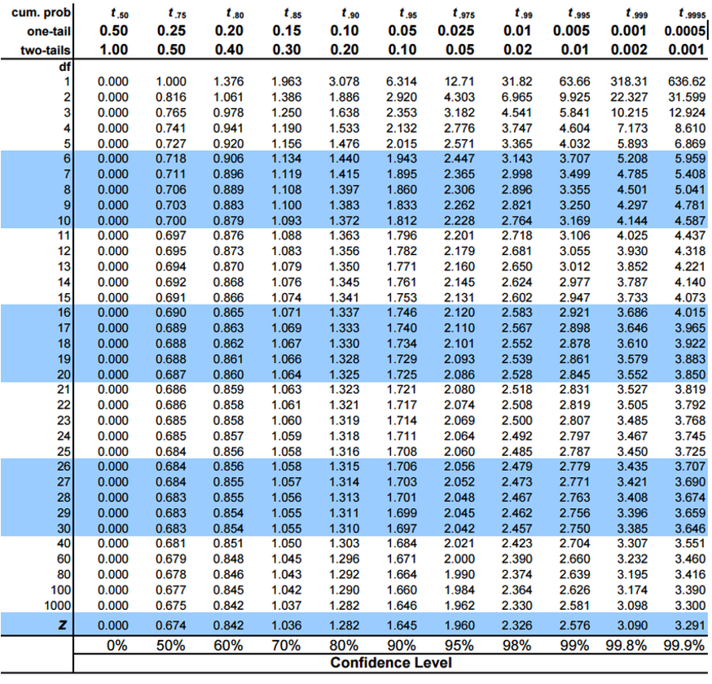
Lecture 5: t-distribution Properties
When sample sizes are small, the t-distribution is more appropriate than the normal distribution.
Similar to normal distribution (1.96 = 2.5% tails) but with heavier tails
Shape depends on degrees of freedom (df = n-1)
With large df (>30), approaches the normal distribution
Used for:
  Small sample sizes
  When population standard deviation is unknown
  Calculating confidence intervals
  Conducting t-tests

Slide 9
Practice Exercise 4: Using the t-distribution
Practice Exercise 4: Using the t-distribution
Let’s compare confidence intervals using the normal approximation (z) versus the t-distribution for our fish data.
# Calculate CI using both z and t distributions for a smaller subset
small_sample <- grayling_df %>%
filter(lake == "I3") %>%
slice_sample(n = 10)
# Calculate statistics
sample_mean <- mean(small_sample$length_mm)
sample_sd <- sd(small_sample$length_mm)
sample_n <- nrow(small_sample)
sample_se <- sample_sd / sqrt(sample_n)
# Calculate confidence intervals
z_ci_lower <- sample_mean - 1.96 * sample_se
z_ci_upper <- sample_mean + 1.96 * sample_se
# For t-distribution, get critical value for 95% CI with df = n-1
t_crit <- qt(0.975, df = sample_n - 1)
t_ci_lower <- sample_mean - t_crit * sample_se
t_ci_upper <- sample_mean + t_crit * sample_se
# Display results
cat("Mean:", round(sample_mean, 1), "mm\n")
Mean: 276.2 mm
cat("Standard deviation:", round(sample_sd, 2), "mm\n")
Standard deviation: 17.22 mm
cat("Standard error:", round(sample_se, 2), "mm\n")
Standard error: 5.44 mm
cat("95% CI using z:", round(z_ci_lower, 1), "to", round(z_ci_upper, 1), "mm\n")
95% CI using z: 265.5 to 286.9 mm
cat("95% CI using t:", round(t_ci_lower, 1), "to", round(t_ci_upper, 1), "mm\n")
95% CI using t: 263.9 to 288.5 mm
cat("t critical value:", round(t_crit, 3), "vs z critical value: 1.96\n")
t critical value: 2.262 vs z critical value: 1.96

Slide 10
Student’s t-distribution Formula
To calculate CI for sample from “unknown” population:
$\text{CI}=\overset{‾}{y}±t⋅\frac{s}{\sqrt{n}}$
Where:
ȳ is sample mean
𝑛 is sample size
s is sample standard deviation
t t-value corresponding the probability of the CI
t in t-table for different degrees of freedom (n-1)

Slide 11
Lecture 5: Student’s t-distribution Table
Here is a t-table
Values of t that correspond to probabilities
Probabilities listed along top
Sample dfs are listed in the left-most column
Probabilities are given for one-tailed and two-tailed “questions”

Slide 12
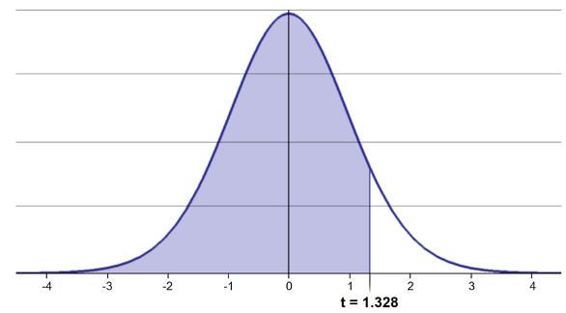
Lecture 5: One-tailed Questions
One-tailed questions: area of distribution left or (right) of a certain value
n=20 (df=19) - 90% of the observations found left
t= 1.328 (10% are outside)

Slide 13
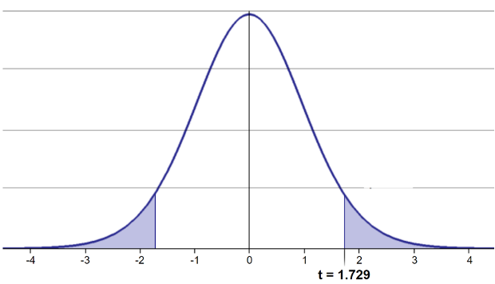
Lecture 5: Two-tailed Questions
Two-tailed questions refer to area between certain values
n= 20 (df=19), 90% of the observations are between
t=-1.729 and t=1.729 (10% are outside)

Slide 14
Lecture 5: Calculating CI Example
Let’s calculate CIs again:
Use two-sided test
$\text{CI}=\overset{‾}{y}±t⋅\frac{s}{\sqrt{n}}$
95% CI Sample A: = 272.8 ± 2.262 * (37.81/(9^0.5)) = 1.650788
The 95% CI is between 244.3 and 301.3
“The 95% CI for the population mean from sample A is 272.8 ± 28.5”

Slide 15
Lecture 5: Applications of t-distribution
So:
Can assess confidence that population mean is within a certain range
Can use t distribution to ask questions like:
  “What is probability of getting sample with mean = ȳ from population with mean = µ?” (1 sample t-test)
  “What is the probability that two samples came from same population?” (2 sample t-test)

Slide 16
Lecture 5: Single Sample T-Test
We want to test if the mean fish length in I3 differs from 240mm.
Activity: Define hypotheses and identify assumptions
H₀: μ = 240 (The mean fish length in I3 is 240mm)
H₁: μ ≠ 240 (The mean fish length in I3 is not 240mm)
Assumptions for t-test:
Data is normally distributed
Observations are independent
No significant outliers

Slide 17
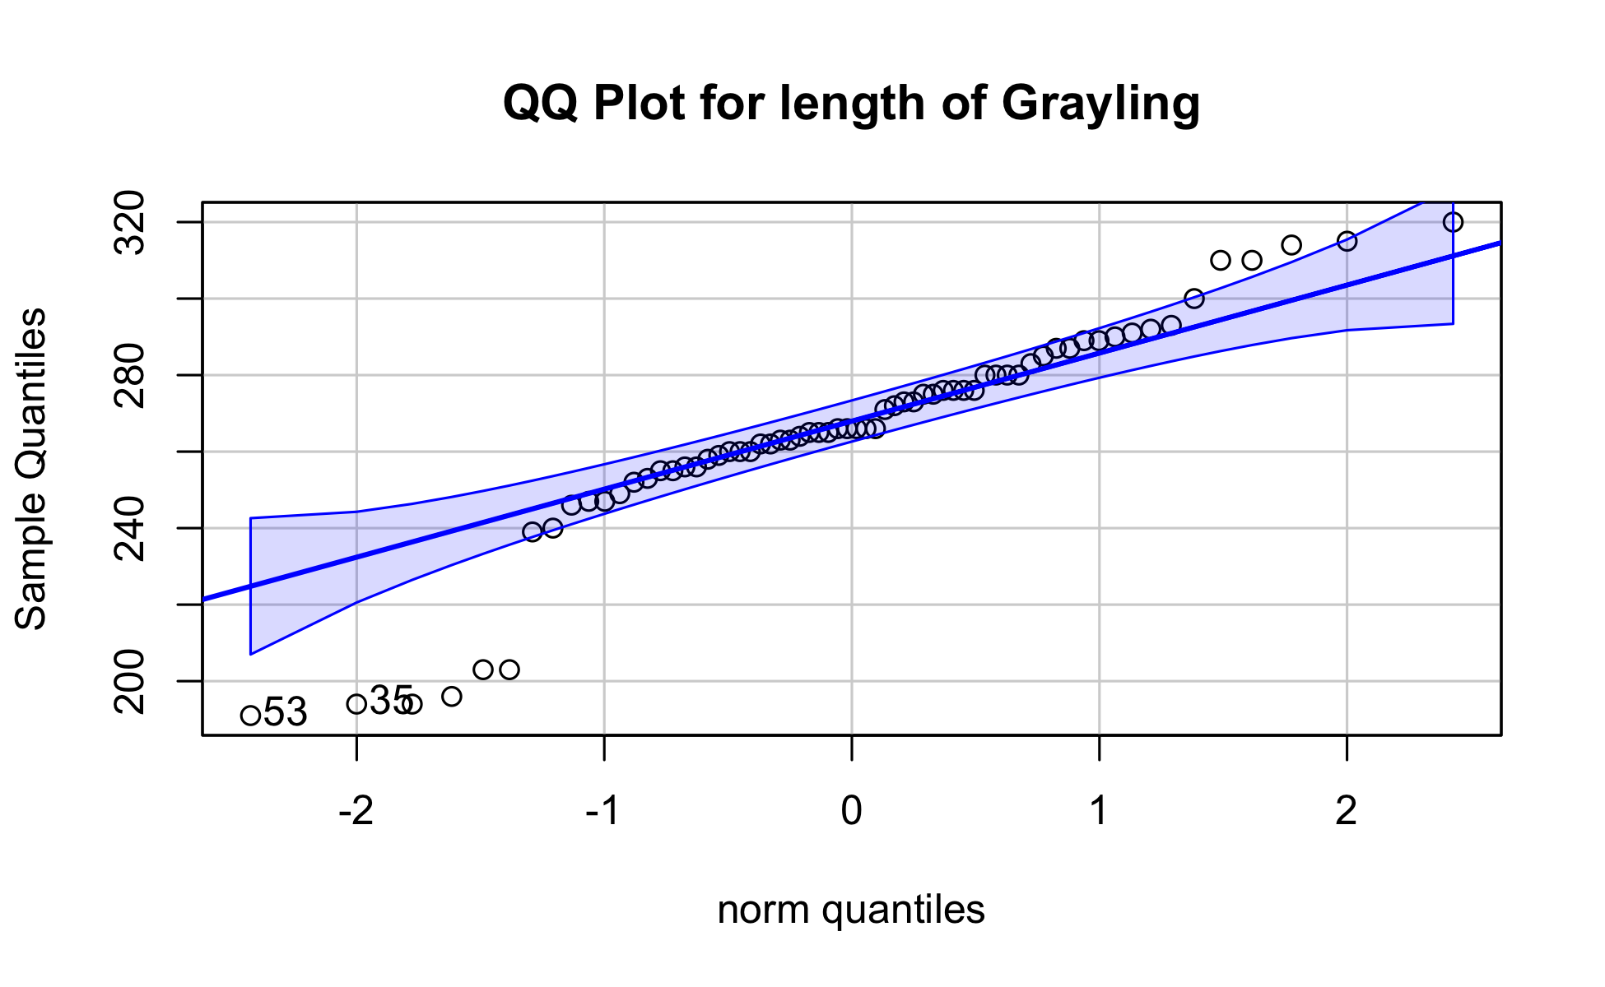
Assumptions in R - qqplots from car
# Filter for just windward side needles
# YOUR TASK: Test normality of windward pine needle lengths
# QQ Plot
qqPlot(i3_df$length_mm,
main = "QQ Plot for length of Grayling",
ylab = "Sample Quantiles")

Slide 18
[1] 53 35

Slide 19
Statistical Test of Normality
Shapiro-Wilk test
# Shapiro-Wilk test
shapiro_test <- shapiro.test(i3_df$length_mm)
print(shapiro_test)
Shapiro-Wilk normality test
data: i3_df$length_mm
W = 0.91051, p-value = 0.0001623

Slide 20
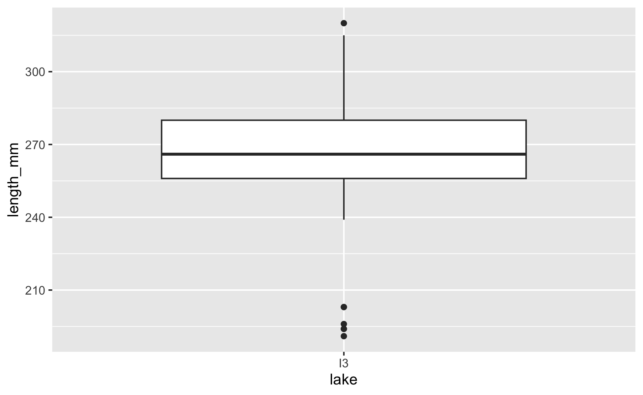
Checking for Outliers
# Check for outliers using boxplot
# YOUR CODE HERE
i3_df %>% ggplot(aes(lake, length_mm))+geom_boxplot()

Slide 21
Practice Exercise 1: One-Sample t-Test
Practice Exercise 1: One-Sample t-Test
Let’s perform a one-sample t-test to determine if the mean fish length in I3 Lake differs from 240 mm:
# what is the mean
i3_mean <- mean(i3_df$length_mm, na.rm=TRUE)
cat("Mean:", round(i3_mean, 1), "mm\n")
Mean: 265.6 mm
# Perform a one-sample t-test
t_test_result <- t.test(i3_df$length_mm, mu = 240)
# View the test results
t_test_result
One Sample t-test
data: i3_df$length_mm
t = 7.3497, df = 65, p-value = 4.17e-10
alternative hypothesis: true mean is not equal to 240
95 percent confidence interval:
258.6481 272.5640
sample estimates:
mean of x
265.6061
Interpret this test result by answering these questions:
What was the null hypothesis?
What was the alternative hypothesis?
What does the p-value tell us?
Should we reject or fail to reject the null hypothesis at α = 0.05?
What is the practical interpretation of this result for fish biologists?

Slide 22
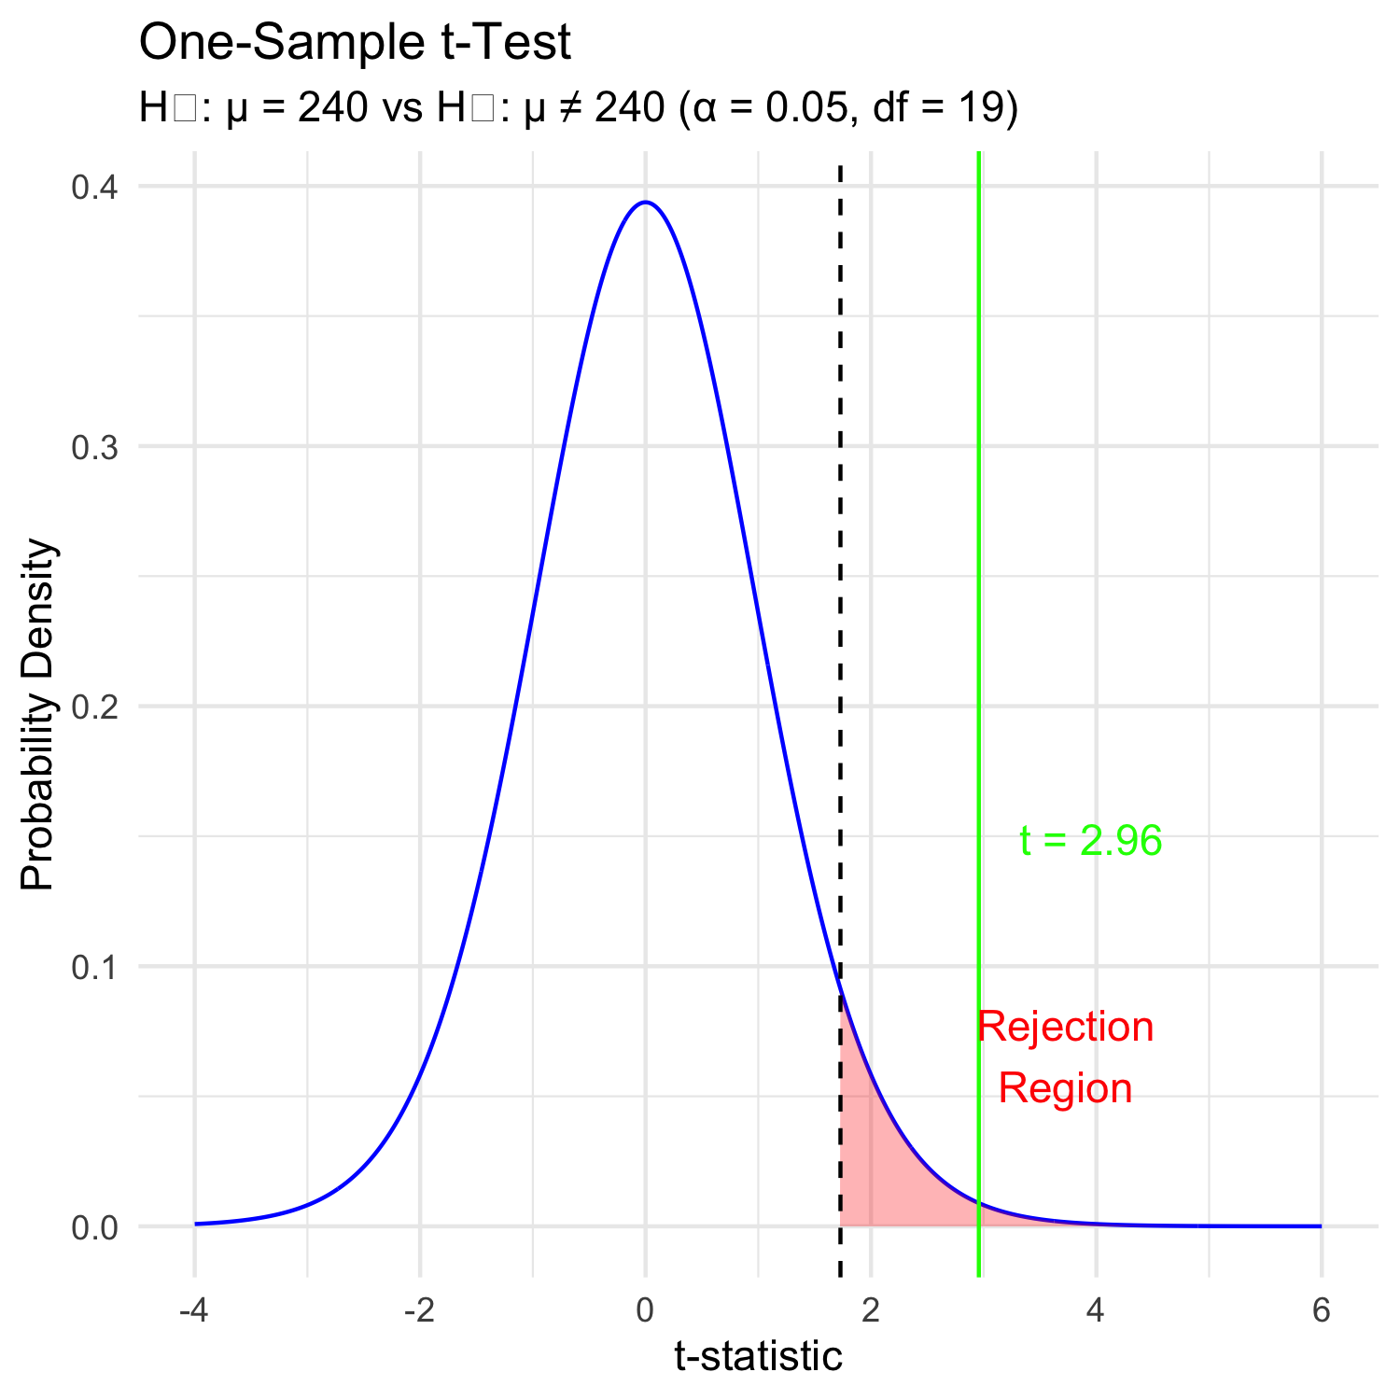
Lecture 5: Hypothesis Testing Framework
Hypothesis testing is a systematic way to evaluate research questions using data.
Key components:
Null hypothesis (Ho): Typically assumes “no effect” or “no difference”
Alternative hypothesis (Ha): The claim we’re trying to support
Statistical test: Method for evaluating evidence against H₀
P-value: Probability of observing our results (or more extreme) if H₀ is true
Significance level (α): Threshold for rejecting H₀, typically 0.05
Decision rule: Reject Ho if p-value < α == p < 0.05

Slide 23
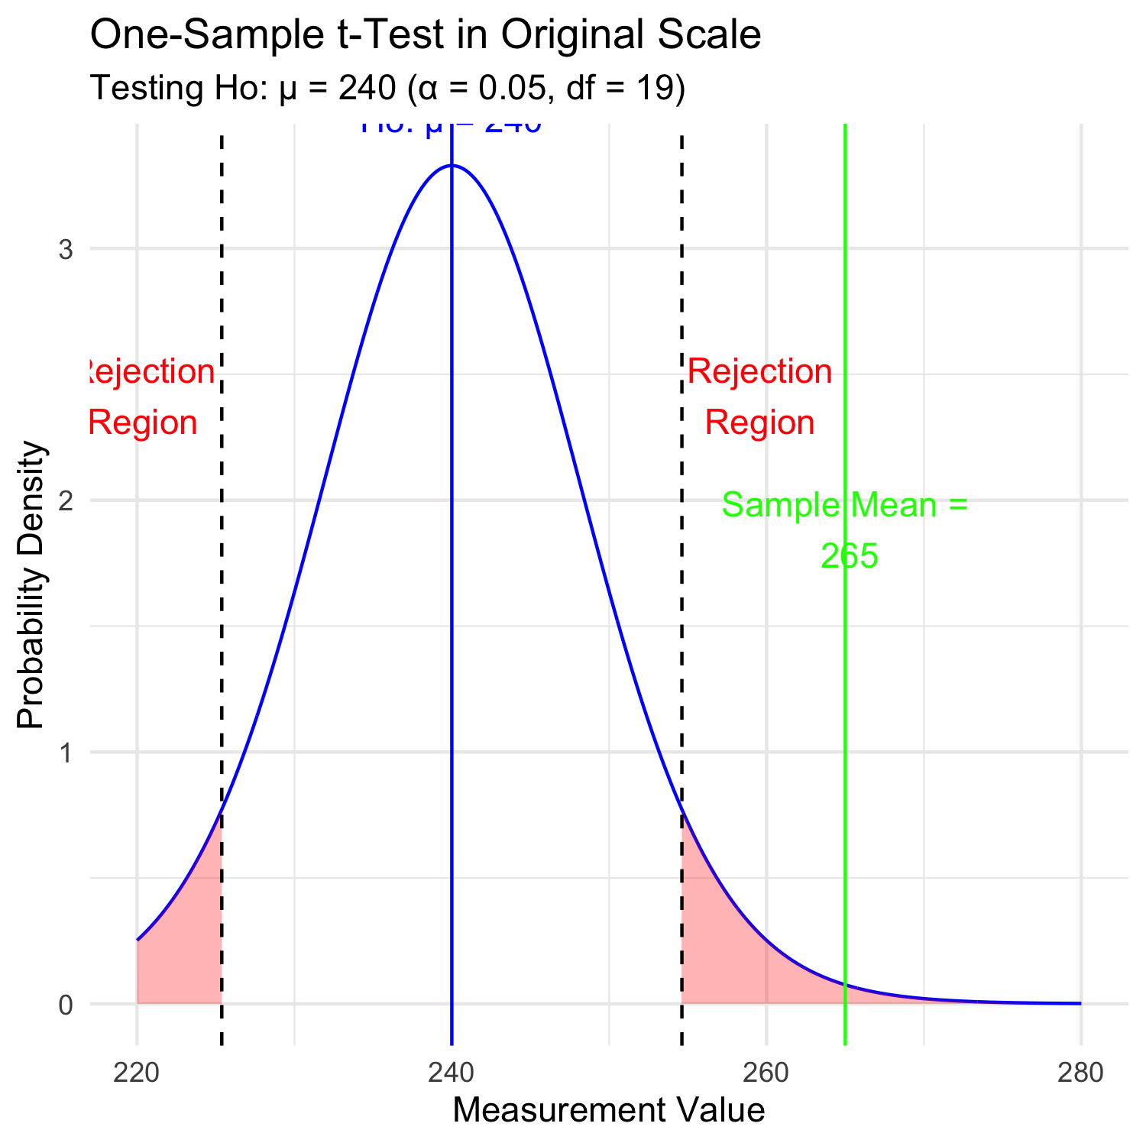
Lecture 5: Hypothesis Testing - Original Scale
Hypothesis testing is a systematic way to evaluate research questions using data.
Key components:
Null hypothesis (H₀): Typically assumes “no effect” or “no difference”
Alternative hypothesis (Hₐ): The claim we’re trying to support
Statistical test: Method for evaluating evidence against H₀
P-value: Probability of observing our results (or more extreme) if H₀ is true
Significance level (α): Threshold for rejecting H₀, typically 0.05
Decision rule: Reject H₀ if p-value < α

Slide 24
Lecture 5: Interpreting One-Sample T-Test Results
Activity: Interpret the t-test results
What does the p-value tell us?
Should we reject or fail to reject the null hypothesis?
How to report this result in a scientific paper:
“A two-tailed, one-sample t-test at α=0.05 showed that the mean pine needle length on the windward side (… mm, SD = …) [was/was not] significantly different from the expected 55 mm, t(…) = …, p = …”

Slide 25
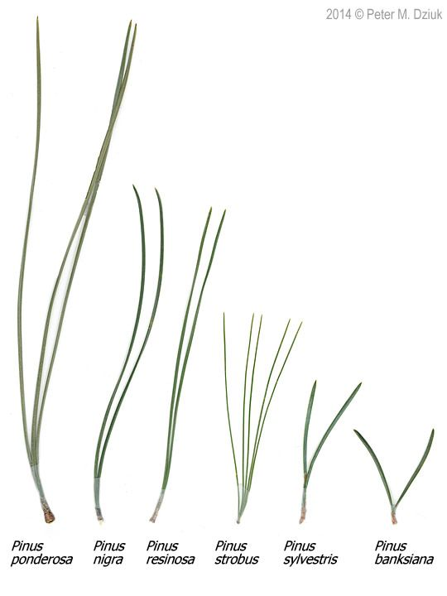
Lecture 5: Two Sample T-Tests Introduction
For example
what is probability that population X is the same as population Y?
How would you assess this question using what we learned?
This is what we will do with the pine needles…

Slide 26
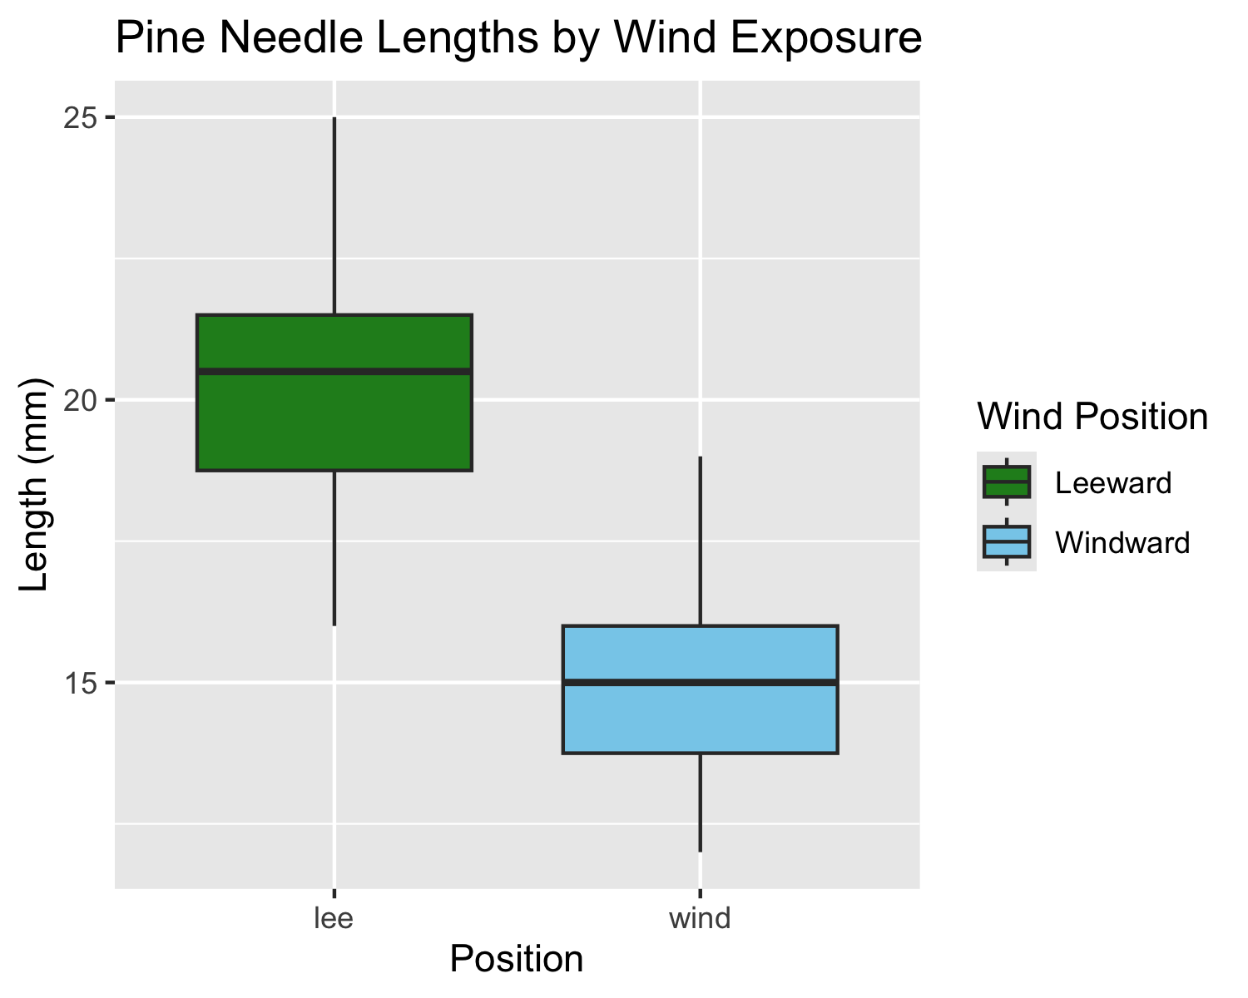
Lecture 5: Comparing Two Samples
For example
what is probability that population X is the same as population Y?
How would you assess this question using what we learned?
# Now create a boxplot to visualize the difference in fish lengths between these lakes:
pine_df <- read_csv("data/pine_needles.csv")
# Create a boxplot comparing the two lakes
pine_wind_plot <- pine_df %>%
ggplot(aes(x = wind, y = length_mm, fill = wind)) +
geom_boxplot() +
labs(title = "Pine Needle Lengths by Wind Exposure",
x = "Position",
y = "Length (mm)",
fill = "Wind Position") +
scale_fill_manual(values = c("lee" = "forestgreen", "wind" = "skyblue"),
labels = c("lee" = "Leeward", "wind" = "Windward"))
pine_wind_plot
# Based on the t-test results and the boxplot
#
# what can you conclude about the fish populations in these two lakes?

Slide 27
Practice Exercise 2: Formulating Hypotheses
Practice Exercise 2: Formulating Hypotheses
For the following research questions about pine needles write the null and alternative hypotheses:
Are needles on the lee side longer than the needles on the windy side?
What are the hypotheses?
Ho =
Ha =

Slide 28
Lecture 5: Two-Sample T-Test Framework
Now, let’s compare pine needle lengths between windward and leeward sides of trees.
Question: Is there a significant difference in needle length between the windward and leeward sides?
This requires a two-sample t-test.
Two-sample t-test compares means from two independent groups.
$t=\frac{{\overset{‾}{x}}_{1}−{\overset{‾}{x}}_{2}}{S_{p}\sqrt{\frac{1}{n_{1}}+\frac{1}{n_{2}}}}$
where:
x̄₁ and x̄₂: These represent the sample means of the two groups you’re comparing
s²ₚ: This is the pooled variance, calculated as: s²ₚ = [(n₁ - 1)s₁² + (n₂ - 1)s₂²] / (n₁ + n₂ - 2), where s₁² and s₂² are the sample variances of the two groups.
n₁ and n₂: These are the sample sizes of the two groups.
√(1/n₁ + 1/n₂): This represents the pooled standard error.
$t=\frac{SIGNAL}{NOISE}$

Slide 29
Practice Exercise 3: Summary Statistics
Practice Exercise 3: Calculate summary statistics grouped by wind exposure
Before conducting the test, we need to understand the data for each group.
You need this and the graph to see what is going on ….
  group_summary <- pine_df %>%
  group_by(wind) %>%
  summarize(
  mean_length = mean(length_mm),
  sd_length = sd(length_mm),
  n = n(),
  se_length = sd_length / sqrt(n)
  )
  print(group_summary)
  # A tibble: 2 × 5
  wind mean_length sd_length n se_length
  <chr> <dbl> <dbl> <int> <dbl>
  1 lee 20.4 2.45 24 0.500
  2 wind 14.9 1.91 24 0.390

Slide 30
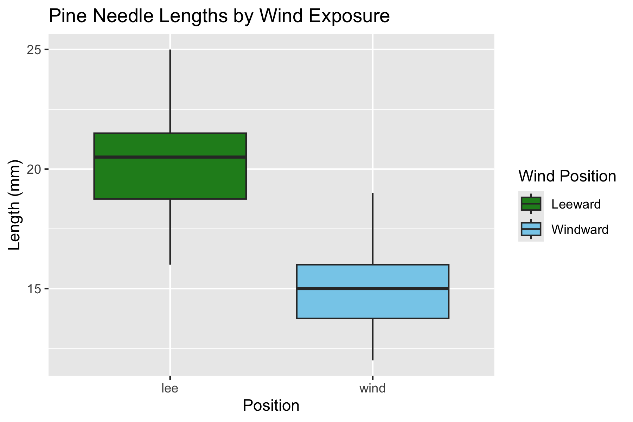
Visualizing Group Differences
# Create a boxplot comparing the two sides
pine_wind_plot

Slide 31
Practice Exercise 4: Effect Size
Practice Exercise 4: Effect size
We could also look at the difference in means… some cool code here
# Assuming your dataframe is called df
group_summary %>%
summarize(difference = mean_length[wind == "wind"] - mean_length[wind == "lee"])
# A tibble: 1 × 1
difference
<dbl>
1 -5.5

Slide 32
Practice Exercise 5: ggplot Summary Statistics
Practice Exercise 5: Using GGPLOT to get summary stats
GGplot also has code to make the mean and standard error plots we are interested in along whit a lot of others
# Assuming your dataframe is called df
pine_mean_se_plot <- ggplot(pine_df, aes(x = wind, y = length_mm, color = wind)) +
stat_summary(fun = mean, geom = "point") +
stat_summary(fun.data = mean_se, geom = "errorbar", width = 0.2) +
labs(title = "Mean Pine Needle Length by Wind Exposure",
x = "Wind Exposure",
y = "Mean Length (mm)") +
coord_cartesian(ylim = c(0,25))+
scale_color_manual(values = c("lee" = "forestgreen", "wind" = "skyblue"),
labels = c("lee" = "Leeward", "wind" = "Windward"))+
theme_classic()
pine_mean_se_plot

Slide 33
Lecture 5: Testing Assumptions for Two-Sample T-Test
For a two-sample t-test, we need to check:
Normality within each group
Equal variances between groups (for standard t-test)
Independent observations
If assumptions are violated:
Welch’s t-test (unequal variances)
Non-parametric alternatives (Mann-Whitney U test)

Slide 34
Practice Exercise 6: Creating Group Data
Practice Exercise 6: Test normality of windward pine needle lengths
qqplots
Note you need to test each groups separately…
# Assuming your dataframe is called df
pine_mean_se_plot

Slide 35
Practice Exercise 7: Separate Group Data
Practice Exercise 7: Test normality of windward pine needle lengths
qqplots
Note you need to test each groups separately…
# how do you make separate dataframes to do this on?
# Separate data by groups
windward_data <- pine_df %>% filter(wind == "wind")
leeward_data <- pine_df %>% filter(wind == "lee")
head(leeward_data)
# A tibble: 6 × 6
date group n_s wind tree_no length_mm
<chr> <chr> <chr> <chr> <dbl> <dbl>
1 3/20/25 cephalopods n lee 1 20
2 3/20/25 cephalopods n lee 1 21
3 3/20/25 cephalopods n lee 1 23
4 3/20/25 cephalopods n lee 1 25
5 3/20/25 cephalopods n lee 1 21
6 3/20/25 cephalopods n lee 1 16

Slide 36
Practice Exercise 8: QQ Plot for Windward Data
Practice Exercise 8: Test normality of windward pine needle lengths
qqplots
Note you need to test each groups separately…
# QQ Plot for windward group
qqPlot(windward_data$length_mm,
main = "QQ Plot for Windward Pine Needles",
ylab = "Sample Quantiles")
[1] 21 22

Slide 37
Practice Exercise 9: Shapiro-Wilk Test
Practice Exercise 9: Test normality of windward pine needle lengths
Shapiro-Wilk test
Note you need to test each groups separately…
# Shapiro-Wilk test for windward group
shapiro_windward <- shapiro.test(windward_data$length_mm)
print("Shapiro-Wilk test for windward data:")
[1] "Shapiro-Wilk test for windward data:"
print(shapiro_windward)
Shapiro-Wilk normality test
data: windward_data$length_mm
W = 0.96062, p-value = 0.451

Slide 38
Practice Exercise 10: QQ Plot for Leeward Data
Practice Exercise 10: Test normality of leeward pine needle lengths
qqplots
Note you need to test each groups separately…
# You can also test the leeward group
# QQ Plot for leeward group
qqPlot(leeward_data$length_mm,
main = "QQ Plot for Leeward Pine Needles",
ylab = "Sample Quantiles")
[1] 4 16

Slide 39
Practice Exercise 11: Shapiro-Wilk for Leeward
Practice Exercise 11: Test normality of leeward pine needle lengths
Shapiro-Wilk test
Note you need to test each groups separately…
# Shapiro-Wilk test for leeward group
shapiro_lee <- shapiro.test(leeward_data$length_mm)
print("Shapiro-Wilk test for leeward data:")
[1] "Shapiro-Wilk test for leeward data:"
print(shapiro_lee)
Shapiro-Wilk normality test
data: leeward_data$length_mm
W = 0.95477, p-value = 0.3425

Slide 40
Practice Exercise 12: Combined Normality Test
Practice Exercise 12: Test Normality at one time
There are always a lot of ways to do this in R
# there are always two ways
# Test for normality using Shapiro-Wilk test for each wind group
# All in one pipeline using tidyverse approach
normality_results <- pine_df %>%
group_by(wind) %>%
summarize(
shapiro_stat = shapiro.test(length_mm)$statistic,
shapiro_p_value = shapiro.test(length_mm)$p.value,
normal_distribution = if_else(shapiro_p_value > 0.05, "Normal", "Non-normal")
)
# Print the results
print(normality_results)
# A tibble: 2 × 4
wind shapiro_stat shapiro_p_value normal_distribution
<chr> <dbl> <dbl> <chr>
1 lee 0.955 0.343 Normal
2 wind 0.961 0.451 Normal

Slide 41
Practice Exercise 13: Test Equal Variances
Practice Exercise 13: Test equal variances
Levenes test can be done on the original dataframe
# Method 1: Using car package's leveneTest
# This is often preferred as it's more robust to departures from normality
levene_result <- leveneTest(length_mm ~ wind, data = pine_df)
print("Levene's Test for Homogeneity of Variance:")
[1] "Levene's Test for Homogeneity of Variance:"
print(levene_result)
Levene's Test for Homogeneity of Variance (center = median)
Df F value Pr(>F)
group 1 1.2004 0.2789
46

Slide 42
Lecture 5: Conducting the Two-Sample T-Test
Now we can compare the mean pine needle lengths between windward and leeward sides.
Ho: μ₁ = μ₂ (The mean needle lengths are equal)
Ha: μ₁ ≠ μ₂ (The mean needle lengths are different)
Deciding between:
Standard t-test (equal variances)
Welch’s t-test (unequal variances)
Note the Levenes Test should be NOT SIGNIFICANT - What is the null hypothesis
Levene's Test for Homogeneity of Variance (center = median)
Df F value Pr(>F)
group 1 1.2004 0.2789
46

Slide 43
Lecture 5: Running the Two-Sample T-Test
Now we can do a two sample TTEST
Calculate t-statistic manually (optional)
YOUR CODE HERE:
t = (mean1 - mean2) / sqrt((s1^2/n1) + (s2^2/n2))
Tip
# YOUR TASK: Conduct a two-sample t-test
# Use var.equal=TRUE for standard t-test or var.equal=FALSE for Welch's t-test
# Standard t-test (if variances are equal)
t_test_result <- t.test(length_mm ~ wind, data = pine_df, var.equal = TRUE)
print("Standard two-sample t-test:")
[1] "Standard two-sample t-test:"
print(t_test_result)
Two Sample t-test
data: length_mm by wind
t = 8.6792, df = 46, p-value = 3.01e-11
alternative hypothesis: true difference in means between group lee and group wind is not equal to 0
95 percent confidence interval:
4.224437 6.775563
sample estimates:
mean in group lee mean in group wind
20.41667 14.91667
# Welch's t-test (if variances are unequal)
# YOUR CODE HERE

Slide 44
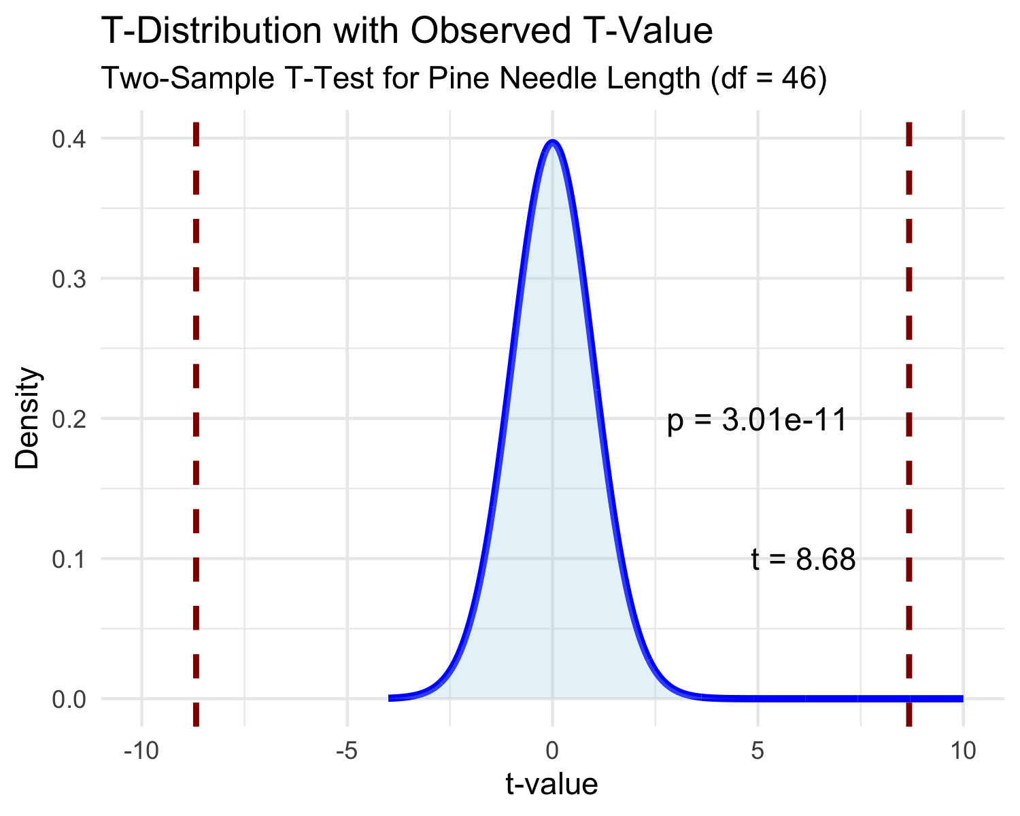
Lecture 5: Interpreting Two-Sample T-Test Results
Interpret the results of the two-sample t-test
What can we conclude about the needle lengths on windward vs. leeward sides?
How to report this result in a scientific paper:
“A two-tailed, two-sample t-test at α=0.05 showed [a significant/no significant] difference in needle length between windward (M = …, SD = …) and leeward (M = …, SD = …) sides of pine trees, t(…) = …, p = ….”

Slide 45
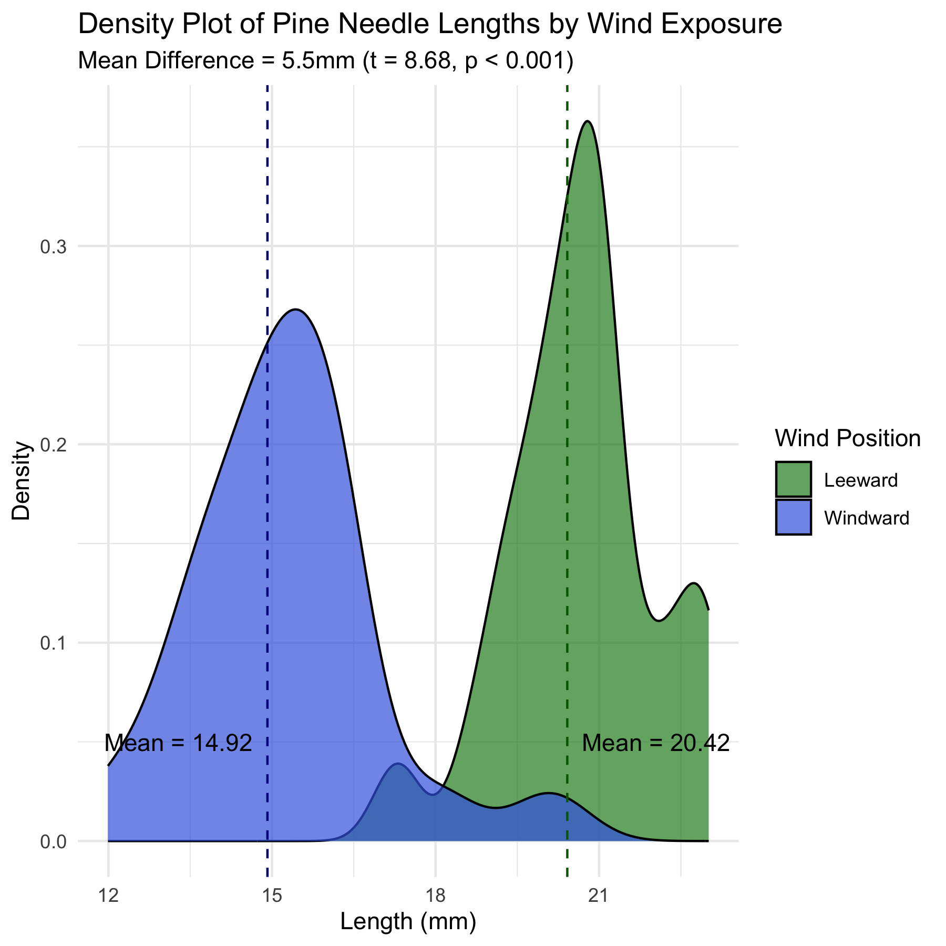
Lecture 5: Visualizing the Results
Interpret the results of the two-sample t-test
What can we conclude about the needle lengths on windward vs. leeward sides?
How to report this result in a scientific paper:
“A two-tailed, two-sample t-test at α=0.05 showed [a significant/no significant] difference in needle length between windward (M = …, SD = …) and leeward (M = …, SD = …) sides of pine trees, t(…) = …, p = ….”

Slide 46
Lecture 5: Assumptions of Parametric Tests
Common assumptions for t-tests:
Normality: Data comes from normally distributed populations
Equal variances (for two-sample tests)
Independence: Observations are independent
No outliers: Extreme values can influence results
What can we do if our data violates these assumptions?
Alternatives when assumptions are violated:
Data transformation (log, square root, etc.)
Non-parametric tests
Robust statistical methods

Slide 47
Lecture 5: Summary and Conclusions
In this activity, we’ve:
Formulated hypotheses about pine needle length
Tested assumptions for parametric tests
Conducted one-sample and two-sample t-tests
Visualized data using appropriate methods
Learned how to interpret and report t-test results
Key takeaways:
Always check assumptions before conducting tests
Visualize your data to understand patterns
Report results comprehensively
Consider alternatives when assumptions are violated

