Slide 1
Lecture 06
Bill Perry

Slide 2
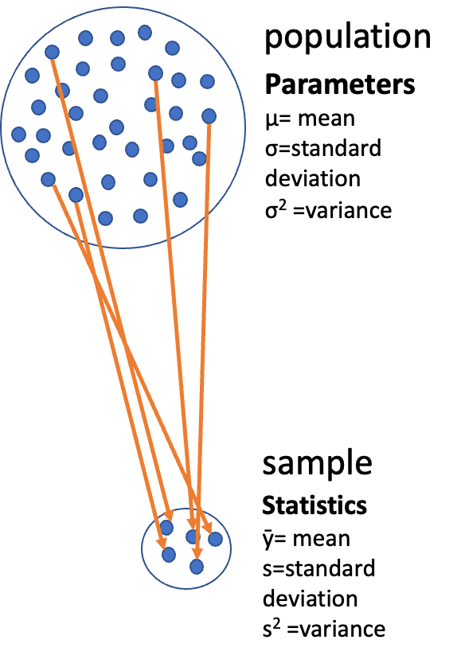
Lecture 5: Review
Covered
Statistical inference fundamentals
Hypothesis testing principles
T Distributions
One sample T Tests
Two sample T

Slide 3

Lecture 6: Overview
The objectives:
p-values
Brief review
H test for a single population
1- and 2-sided tests
Hypothesis tests for two populations
Assumptions of parametric tests

Slide 4

Lecture 6: Statistical hypothesis testing
Major goal of statistics:
  inferences about populations from samples…
    assign degree of confidence to inferences
  Statistical hypothesis testing:
    formalized approach to inference
  Hypotheses ask whether samples come from populations with certain properties
  Often interested in questions about population means
    but other questions are of interest

Slide 5

Lecture 6: Hypothesis Components
Useful hypotheses:
Rely on specifying
  Ho is the hypothesis of “no effect”
    two samples from population with same mean
    sample is from population of mean = X
  Ha (research or alternate hypothesis)
    is the opposite of the Ho
    or predicts that there is an effect of x on y
    but does NOT suggest a direction which is a prediction

Slide 6
Lecture 6: Hypothesis Examples
Together Ho and Ha encompass all possible outcomes:
Ho: µ=0, Ha: µ ≠ 0
  mean equals 0 or mean does not equal 0
Ho: µ = 35, Ha: µ ≠ 35
  mean equals 35 or mean does not equal 35
Ho: µ1 = µ2, Ha: µ1 ≠ µ2
  mean of population 1 equals mean of population 2 or it does not
Ho: µ > 0, Ha: µ ≤ 0
  can be directional mean is greater than 0 or mean is not equal or less than 0
  this becomes a one sided test as it predicts only one direction

Slide 7
Lecture 6: Statistical Testing Framework
Statistical tests assess likelihood of the null hypothesis being true
If the Ho is likely false, then Ha assumed to be correct
More precisely:
  the long run probability of obtaining sample value (or more extreme one) if the null hypothesis is true
    p(data|Ho) - the probability of observing the data given that the null hypothesis Ho is true

Slide 8
Lecture 6: Understanding P-values
Hypothesis tests
Expressed as p-value (0-never to 1-always )
Interpret p-value as:
  probability of obtaining sample value of statistic (or more extreme one) if Ho is true
High p-value:
  high probability of obtaining sample statistic under Ho
    if the null hypothesis (Ho) were true, you would frequently observe data similar to your sample statistic
    your observed results are quite compatible with what the null hypothesis predicts
Low p-value: low probability of obtaining sample statistic under Ho
  if the null hypothesis (Ho) were true, you would rarely observe data similar to or more extreme than your sample statistic
  Your results are unusual under the null hypothesis, suggesting that either you’ve witnessed a rare event or the null hypothesis may be incorrect

Slide 9
Lecture 6: P-value Interpretation
Statistical test results:
p = 0.3 means that if I repeated the study 100 times, I would get this (or more extreme) result due to chance 30 times
p = 0.03 means that if I repeated the study 100 times, I would get this (or more extreme) result due to chance 3 times
Which p-value suggests Ho likely false?
At what point reject Ho?
p < 0.05 conventional “significance threshold” (α = alpha or p value)
p < 0.05 means: if Ho is true and we repeated the study 100 times
we would get this (or more extreme) result less than 5 times due to chance

Slide 10
Lecture 6: Significance Levels and Interpretation
Statistical test results:
α is the rate at which we will reject a true null hypothesis (Type I error rate)
Lowering α will lower likelihood of incorrectly rejecting a true null hypothesis (e.g., 0.01, 0.001)
Both Hs and α are specified BEFORE collection of data and analysis
Traditionally α=0.05 is used as a cut off for rejecting null hypothesis
There is nothing magical about 0.05 - actual p-values need to be reported - also need to decide prior to study
p-value range | Interpretation
P > 0.10 | No evidence against Ho - data appear consistent with Ho
0.05 < P < 0.10 | Weak evidence against the Ho in favor of Ha
0.01 < P < 0.05 | Moderate evidence against Ho in favor of Ha
0.001 < P < 0.01 | Strong evidence against Ho in favor of Ha
P < 0.001 | Very strong evidence against Ho in favor of Ha

Slide 11
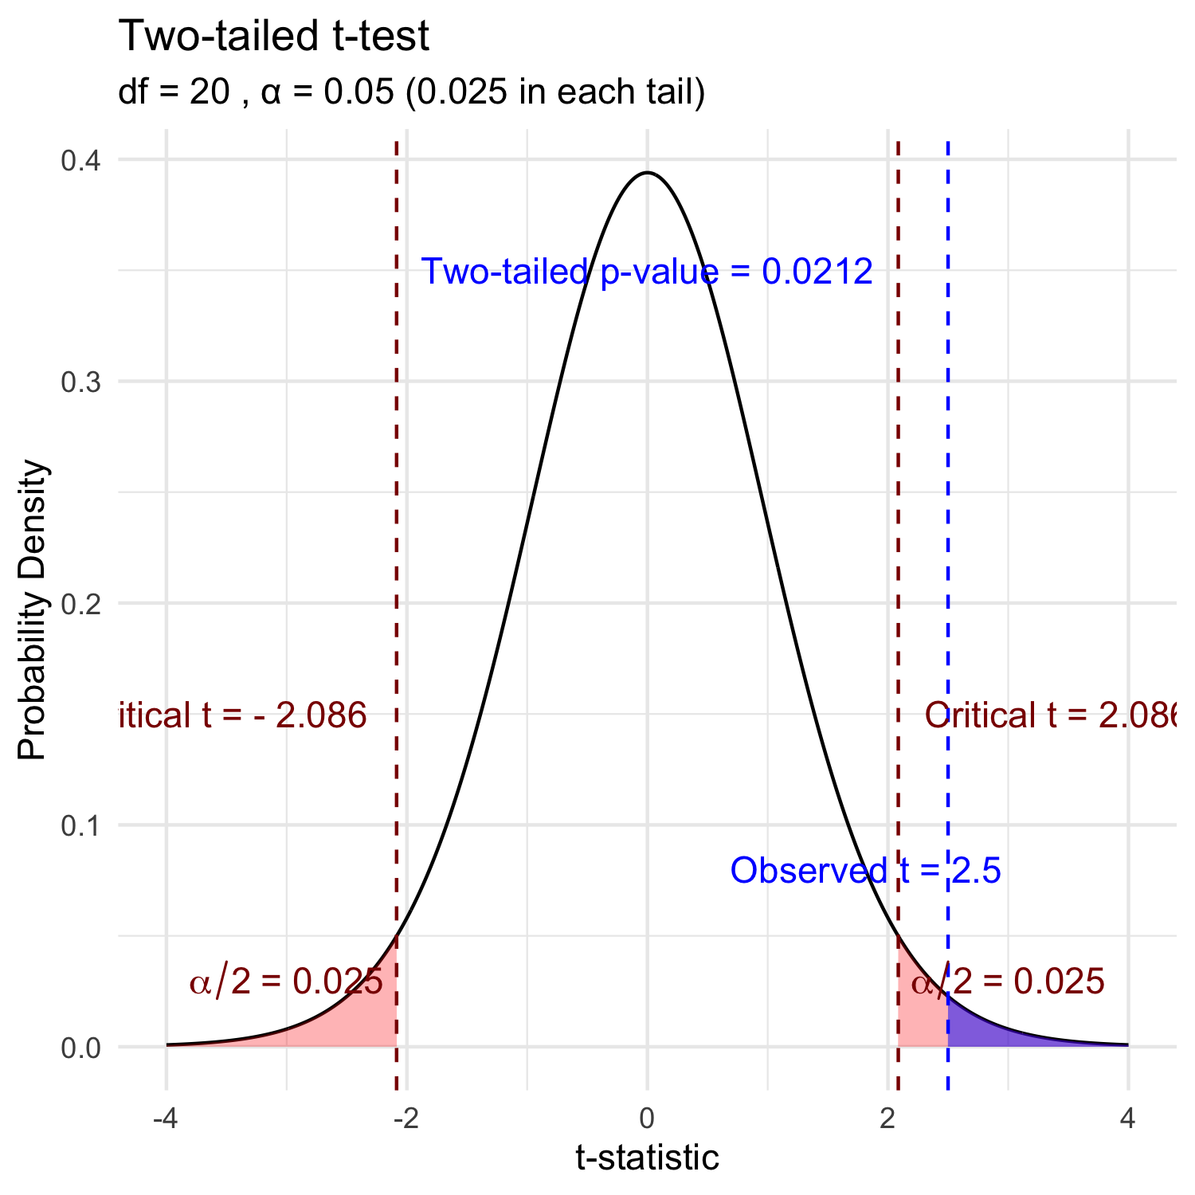
Lecture 6: Understanding P-values Visually
A p-value is the probability of observing the sample result (or something more extreme) if the null hypothesis is true.
Common interpretations:
  p < 0.05: Strong evidence against H₀
  0.05 ≤ p < 0.10: Moderate evidence against H₀
  p ≥ 0.10: Insufficient evidence against H₀
Common misinterpretations:
  p-value is NOT the probability that H₀ is true
  p-value is NOT the probability that results occurred by chance
  Statistical significance ≠ practical significance
Note that there is a difference in how to state the hypotheses
  one sample TTEST
  two sample TTEST

Slide 12

Lecture 6: Historical Context

Slide 13
Lecture 6: Fisher’s Perspective
Fisher:
p-value as informal measure of discrepancy between data and Ho
“If p is between 0.1 and 0.9 there is certainly no reason to suspect the hypothesis tested. If it is below 0.02 it is strongly indicated that the hypothesis fails to account for the whole of the facts. We shall not often be astray if we draw a conventional line at .05 …”

Slide 14
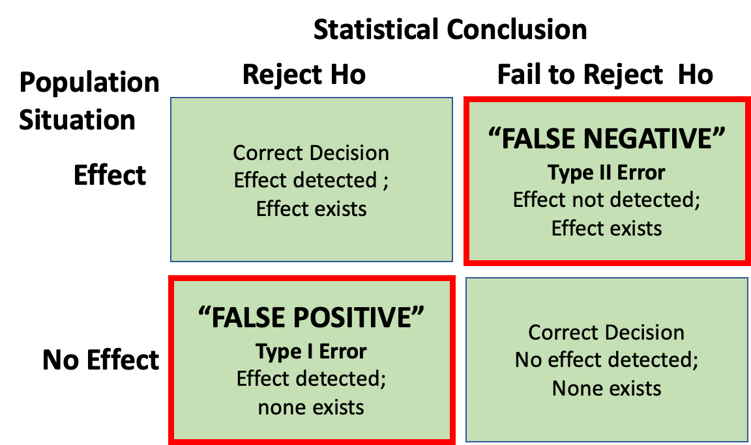
Decision errors
Even good studies can reach incorrect conclusions
“Decision errors”
Two types of decision errors
Want to know probability of making these errors

Slide 15
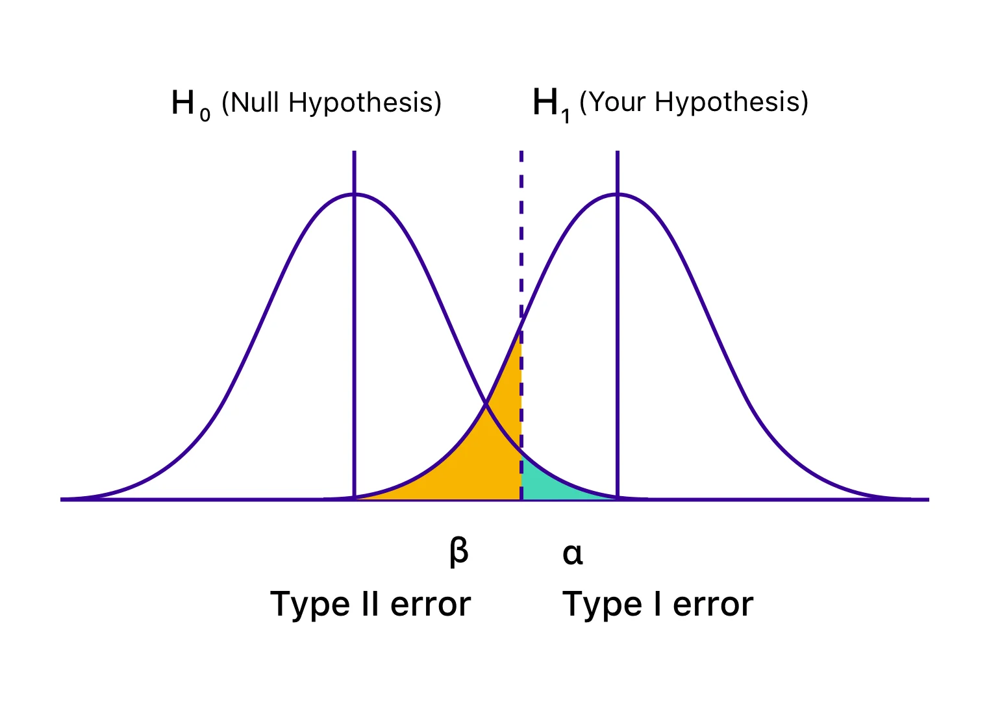
Type I and Type II Errors - Concept
Type I error rate
  α: wrongly reject H₀ when it’s true
  α = 0.05 means a type I error rate of 5%
Type II error rate, β
  wrongly fail to reject H₀ when it’s false
Power = 1-β: probability of correctly rejecting H₀ when H₁ is true
Inverse relationship between type I and type II error - but not straightforward
Result of chance - sample not representative of population
Which type of error is more dangerous?

Slide 16
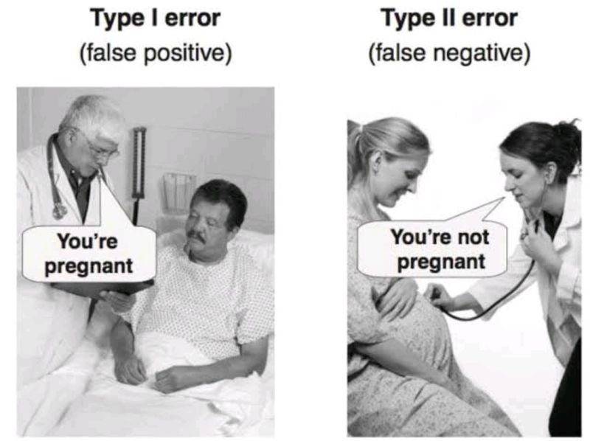
Lecture 6: Type I and Type II Errors - Details
When making decisions based on hypothesis tests, two types of errors can occur:
Type I Error (False Positive) - Rejecting H₀ when it’s actually true - Probability = α (significance level) - “Finding an effect that isn’t real”
Type II Error (False Negative) - Failing to reject H₀ when it’s actually false - Probability = β - “Missing an effect that is real”
Statistical Power = 1 - β - Probability of correctly rejecting a false H₀ - Increases with: - Larger sample size - Larger effect size - Lower variability - Higher α level
The red area represents the power in the experiment
The farther apart the means the lower the beta error is… or you have higher power.

Slide 17
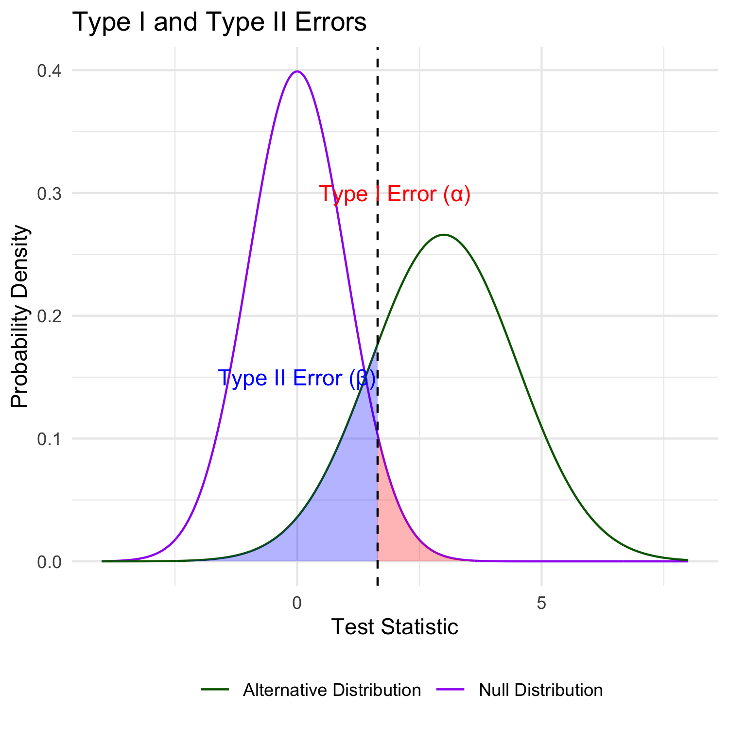
Lecture 6: Type I and Type II Errors - Visualization
When making decisions based on hypothesis tests, two types of errors can occur:
Type I Error (False Positive) - Rejecting H₀ when it’s actually true - Probability = α (significance level) - “Finding an effect that isn’t real”
Type II Error (False Negative) - Failing to reject H₀ when it’s actually false - Probability = β - “Missing an effect that is real”
Statistical Power = 1 - β - Probability of correctly rejecting a false H₀ - Increases with: - Larger sample size - Larger effect size - Lower variability - Higher α level
The red area represents the power in the experiment
The farther apart the means the lower the beta error is… or you have higher power.

Slide 18
Practice Exercise: Interpreting Errors and Power
Practice Exercise 6: Interpreting P-values and Errors
Given the following scenarios, identify whether a Type I or Type II error might have occurred:
A researcher concludes that a new fishing regulation increased grayling size, when in fact it had no effect.
A study fails to detect a real decline in grayling population due to warming water, concluding there was no effect.
Let’s calculate the power of our t-test to detect a 30 mm difference in length between lakes:
pooled standard deviation
  This is the combined standard deviation of both groups weighted by respective degrees of freedom.
Cohen’s d
  standardized difference between means - here assuming a difference of 30 units (mm)
  delta = 0.6741298: The standardized effect size (Cohen’s d)
library(car)
library(patchwork)
library(tidyverse)
grayling_df <- read_csv("data/gray_I3_I8.csv")
i3_df <- grayling_df %>% filter(lake=="I3")
i8_df <- grayling_df %>% filter(lake=="I8")
# Calculate power for detecting a 30 mm difference
n1 <- nrow(i3_df)
n2 <- nrow(i8_df)
sd_pooled <- sqrt((var(i3_df$length_mm) * (n1-1) +
var(i8_df$length_mm) * (n2-1)) /
(n1 + n2 - 2))
# Calculate power
effect_size <- 30 / sd_pooled # Cohen's d
df <- n1 + n2 - 2
alpha <- 0.05
power <- power.t.test(n = min(n1, n2),
delta = effect_size,
sd = 1, # Using standardized effect size
sig.level = alpha,
type = "two.sample",
alternative = "two.sided")
# Display results
power
Two-sample t test power calculation
n = 66
delta = 0.6741298
sd = 1
sig.level = 0.05
power = 0.9702076
alternative = two.sided
NOTE: n is number in *each* group

Slide 19
What is Power
Statistical power represents the probability of detecting a true effect (rejecting the null hypothesis when it is false). In this case, with a power of 97%, there’s a 97% chance of detecting a true difference of 30 units between the means of the two groups if such a difference actually exists.
A power analysis like this is typically done for one of these purposes:
Before data collection to determine required sample size
After a study to evaluate if the sample size was adequate
To determine the minimum detectable effect size with the given sample
With 97% power, this test has excellent ability to detect the specified effect size. Generally, 80% power is considered acceptable, so 97% indicates a very well-powered study for detecting a difference of 30mm between the groups.

Slide 20
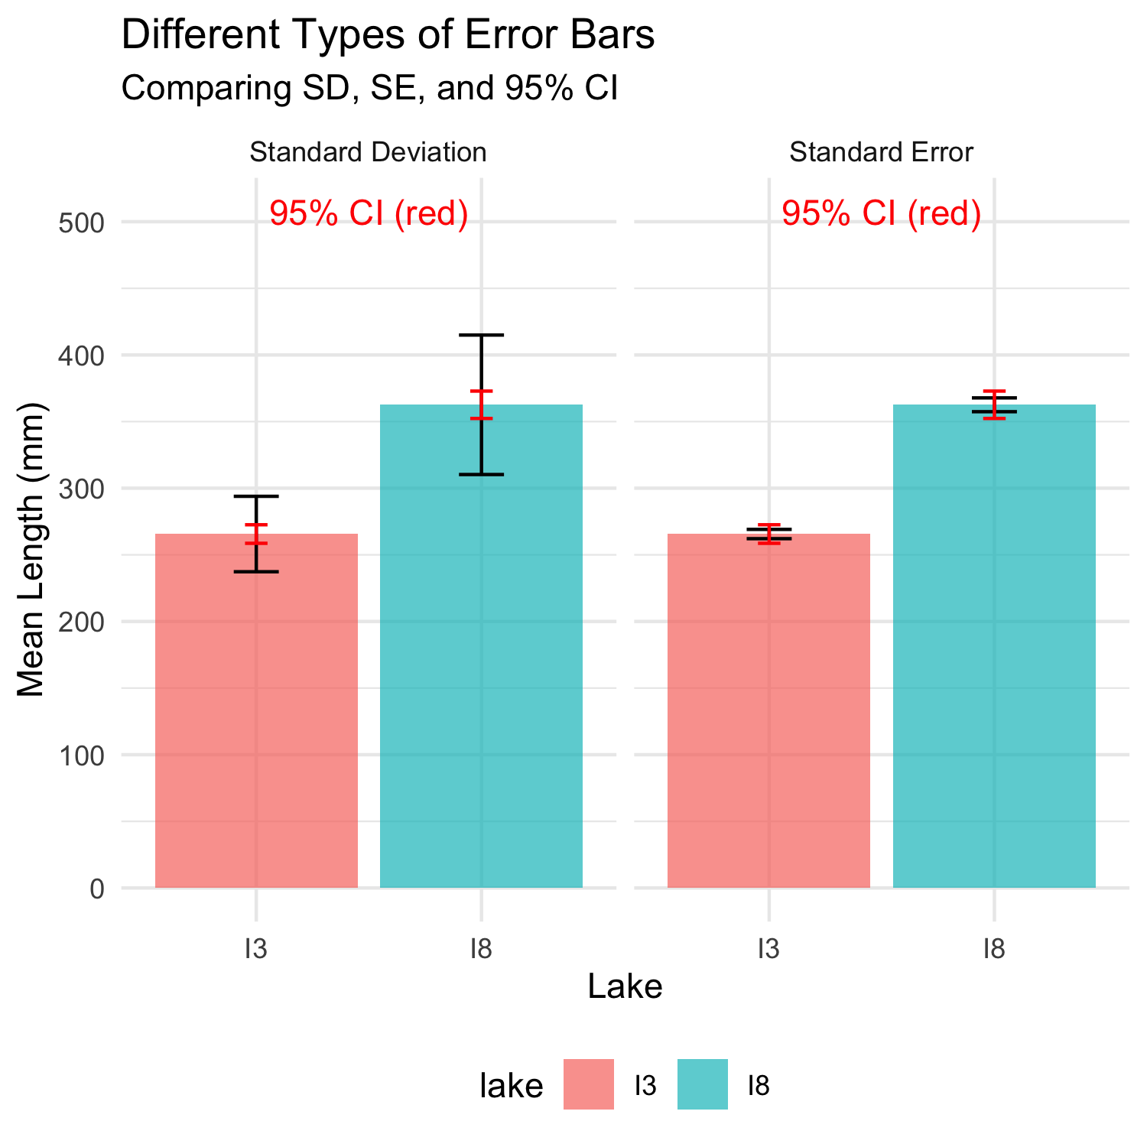
Lecture 6: Error Bars and Their Interpretation
Error bars are graphical representations of the variability of data that show:
The precision of a measurement
The uncertainty around an estimate
A confidence interval for a parameter
Common types of error bars:
Standard Error (SE): Shows precision of the mean
Standard Deviation (SD): Shows variability in the data
Confidence Interval (CI): Shows plausible range for parameter
When interpreting graphs:
Always check what the error bars represent
Non-overlapping 95% CI bars suggest statistically significant differences
Error bars help assess both statistical and practical significance

Slide 21
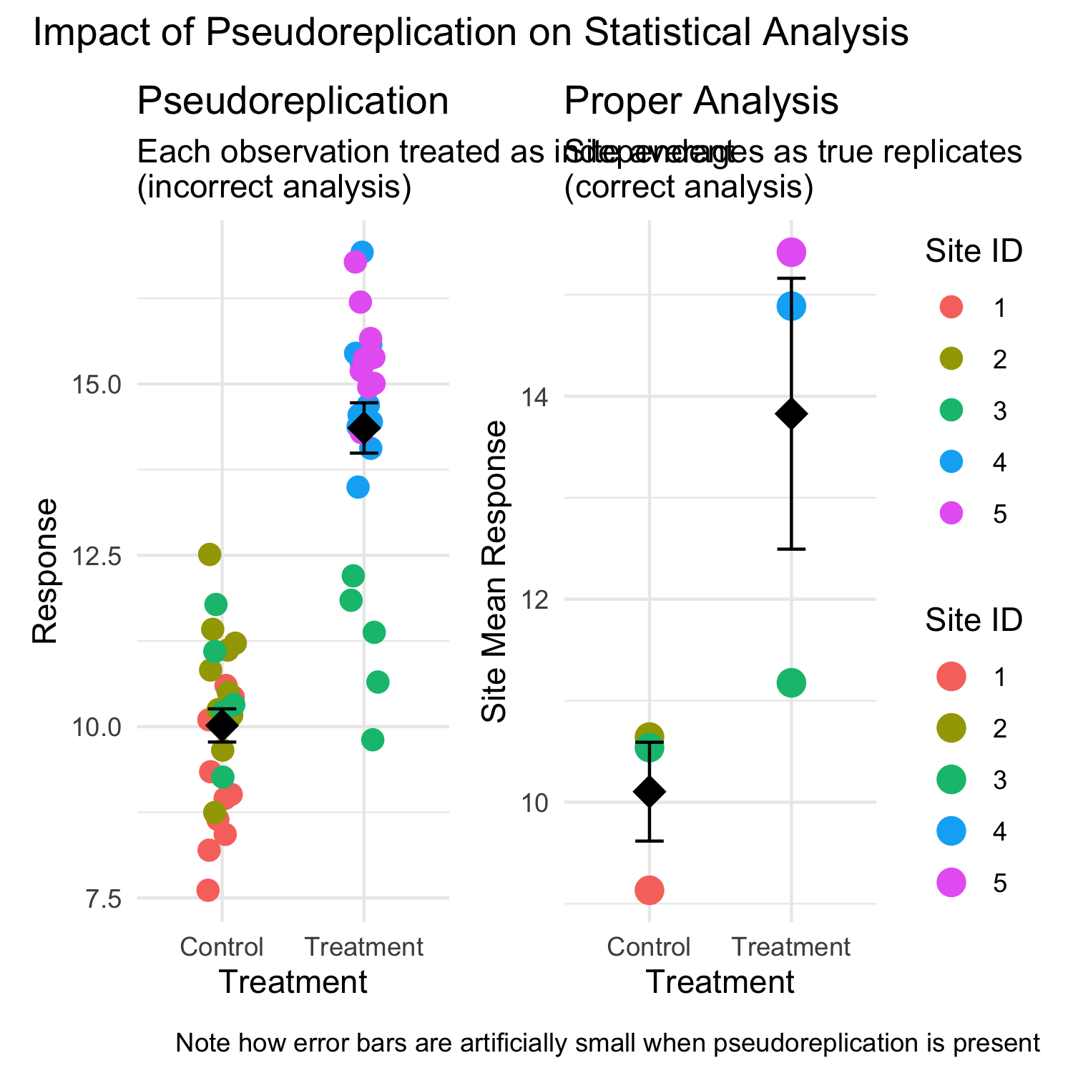
Lecture 6: Sampling and Pseudoreplication
Pseudoreplication occurs when measurements that are not independent are analyzed as if they were independent.
A critical consideration in experimental design
Results in underestimated standard errors and confidence intervals
Leads to inflated Type I error rates (false positives)
Examples of pseudoreplication:
Measuring the same individual multiple times
Treating multiple fish from the same tank as independent
Using multiple data points from a single site
How to avoid pseudoreplication:
Identify the true experimental unit
Use appropriate statistical techniques (e.g., mixed models)
Be clear about the level of replication

Slide 22
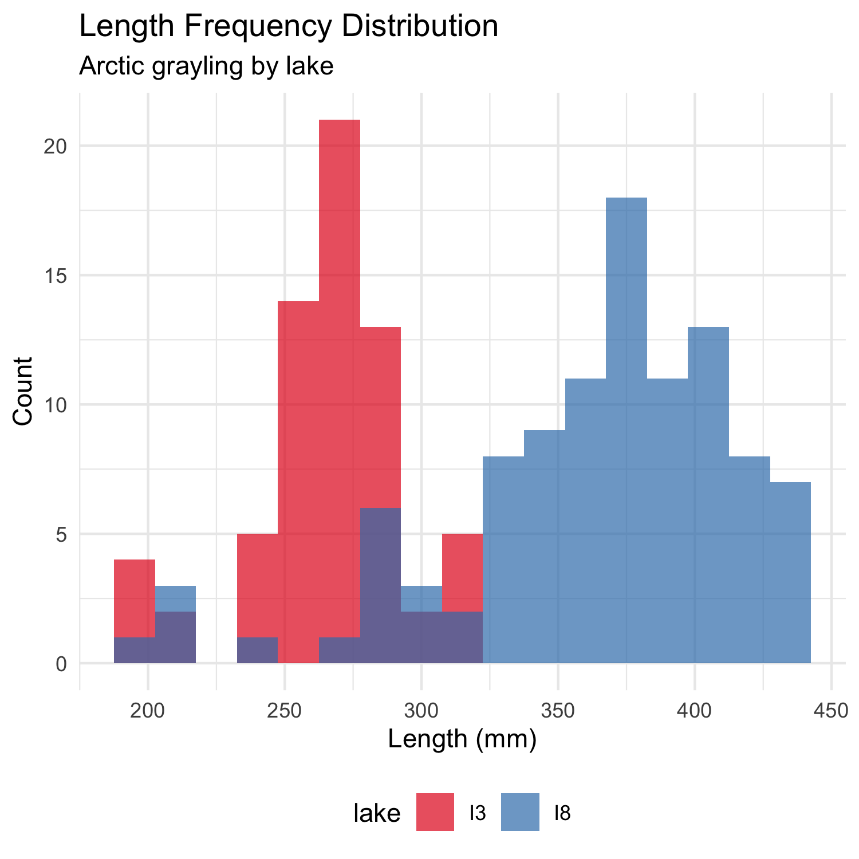
Lecture 6: Practical Applications in Fish Biology
The statistical concepts we’ve covered today are essential for fisheries biologists and ecologists:
Standard error quantifies uncertainty in growth rate estimates
Confidence intervals provide plausible ranges for population parameters
Hypothesis testing evaluates effects of management practices
P-values determine significance of environmental impacts
Real-world applications:
Assessing population health and structure
Evaluating effectiveness of fishing regulations
Quantifying relationships between fish size and habitat variables
Predicting impacts of climate change on fish populations
Designing effective conservation strategies

Slide 23
Lecture 6: Summary and Key Takeaways
Key concepts covered:
P-values measure evidence against the null hypothesis
  Not the probability that H₀ is true
  Should be interpreted in context with effect size
Hypothesis testing provides a framework for making decisions
  Null and alternative hypotheses must be specified beforehand
  α level determines Type I error rate
Type I and Type II errors represent different kinds of mistakes
  Type I (α): False positive - rejecting true H₀
  Type II (β): False negative - failing to reject false H₀
  Statistical power = 1 - β
Error bars communicate uncertainty in different ways
  Always check what type of error bar is shown
  CI bars help assess statistical significance
Pseudoreplication inflates significance
  Identify true experimental units
  Account for non-independence in analysis

