Slide 1
Lecture 12 - Factorial ANOVA of Limpet Egg Production
Bill Perry

Slide 2
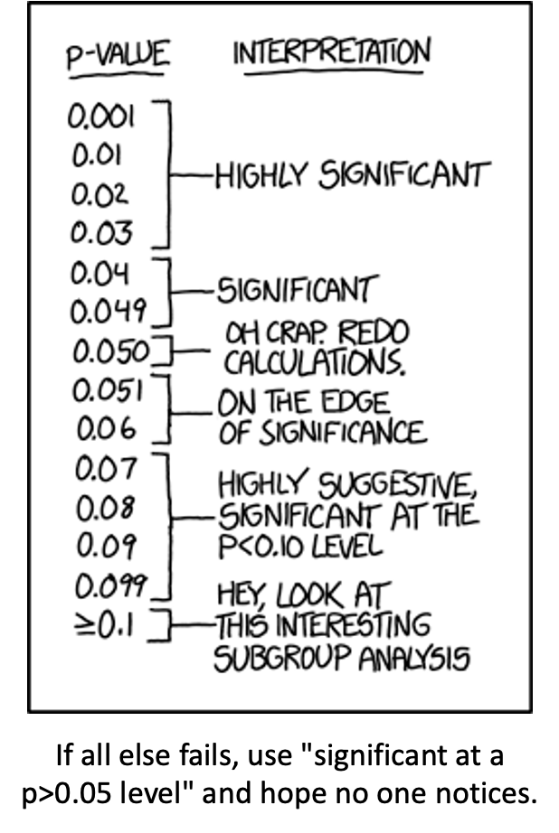
Lecture 12: Review
ANOVA
Analysis of variance: single and multi-factor designs
Examples: diatoms, circadian rhythms
Predictor variables: fixed vs. random
ANOVA model
Analysis and partitioning of variance
Null hypothesis
Assumptions and diagnostics
Post F Tests - Tukey and others
Reporting the results

Slide 3
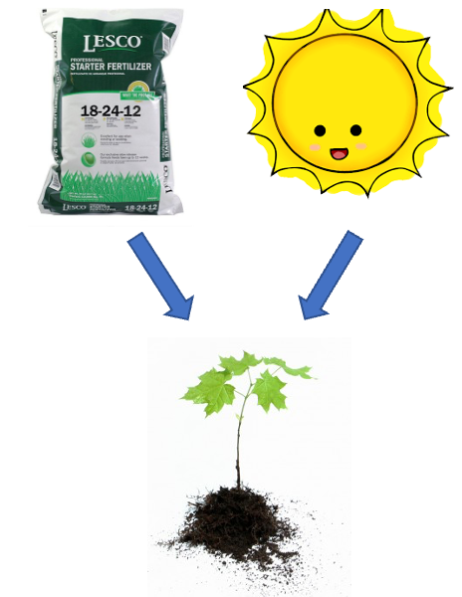
Lecture 12: Factorial ANOVA
2-factor designs (2-way ANOVA)
very common in ecology
Can have more factors (e.g., 3-way ANOVA)
interpretation gets challenging
Most multifactor designs: nested or factorial

Slide 4
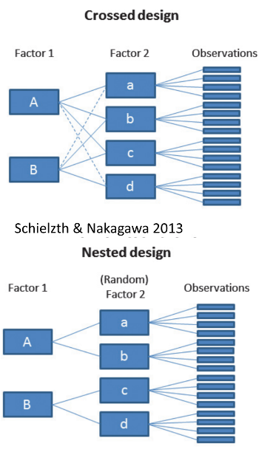
Factorial ANOVA: Design Structure
Consider two factors:
Factorial/crossed:
  every level of B in every level of A

Slide 5
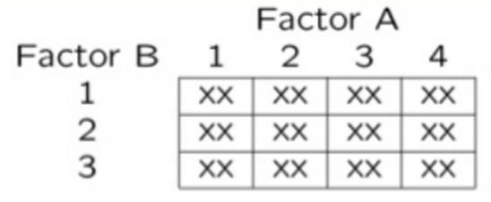
Factorial ANOVA: Effect Types
In factorial designs
look at two types of factor effects:
  Main effect of each factor (polling across other factor)
  Interaction effects; is there synergistic/ antagonistic effect of factors?

Slide 6
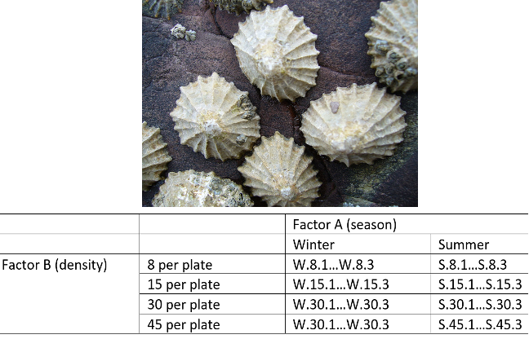
Example: Limpet Fecundity Study
Effect of season and density on limpet fecundity.
2 seasons (factor A)
4 density treatments (factor B)
3 replicates in each cell

Slide 7
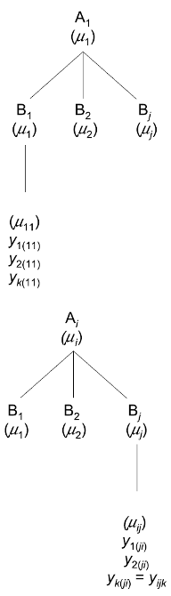
Factorial Design Structure
Consider a crossed design with:
p levels of factor A (i= 1…p) (2 seasons)
q levels of factor B (j= 1…q), crossed with each level of A (4 density levels)
n_{i} replicates (k= 1…n_{i}) in each combination of A and B (3 replicate plates per density per season)

Slide 8
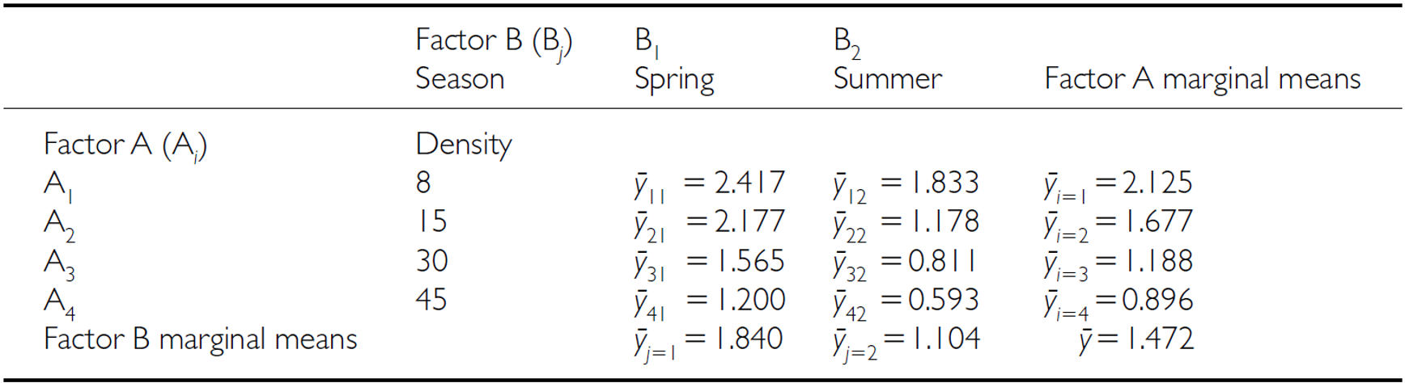
Calculating Different Means
We can calculate several means:
overall mean (across all levels of A and B)= µ

Slide 9
Marginal Means
We can calculate several means:
Marginal means for levels of each factor, pooling across all levels of other factor
Marginal mean for levels of A= µi
Marginal mean for levels of B= µj

Slide 10
Cell Means
We can calculate several means:
a mean for each cell of combinations of A and B= µ_{ij}

Slide 11
Factorial ANOVA Models
Factorial designs can be of 3 types:
2 fixed factors (model 1 ANOVA)
2 random (model 2 ANOVA)
1 fixed, 1 random (mixed model- model 3 ANOVA)
Model 1 ANOVA:
$$y_{ijk}=μ+α_{i}+β_{j}+{\left(αβ\right)}_{ij}+ε_{ijk}$$

Slide 12
Model Components Explained
$$y_{ijk}=μ+α_{i}+β_{j}+{\left(αβ\right)}_{ij}+ε_{ijk}$$
$y_{ijk}$: value of the k_{th} observation from jth and ith combination of B and A (fecundity on 2nd plate, in “8 per plate” density in summer)
µ: overall mean (overall fecundity)
αi: effect of the ith level of A, pooling across all levels of B: µi- µ (difference between average fecundity in all “8 per plate” treatments and overall mean)

Slide 13
Interaction Effects
$$y_{ijk}=μ+α_{i}+β_{j}+{\left(αβ\right)}_{ij}+ε_{ijk}$$
Βj: effect of jth level of B, pooling across all levels of A: µj- µ (difference between average fecundity in all winter treatments and overall mean)
(αβ)ij: effect of interaction of ith level of A and jth level of B (µij - µi - µj + µ).
  Does effect of B depend on level of A? (is effect of density different in winter and summer?)

Slide 14
Model Types and Interpretation
$$y_{ijk}=μ+α_{i}+β_{j}+{\left(αβ\right)}_{ij}+ε_{ijk}$$
Model 2 ANOVA rare in ecology
Model 3 interpretation is different:
  βj: random variable measuring variance in y across all possible levels of B, pooling across all levels of A
  (αβ)ij is random variable measuring variance of interaction bw A and B across all possible levels of B (“is effect of A consistent across all possible levels of B that could have been chosen?”)

Slide 15
ANOVA Table Structure
SSA is SS of differences between each marginal mean of A and overall mean
Source | SS | df | MS
A | $nq\sum_{i=1}^{p}{{\left({\overset{‾}{y}}_{i.}−\overset{‾}{y}\right)}^{2}}$ | $p−1$ | $\frac{SS_{A}}{p−1}$
B | $np\sum_{j=1}^{q}{{\left({\overset{‾}{y}}_{.j}−\overset{‾}{y}\right)}^{2}}$ | $q−1$ | $\frac{SS_{B}}{q−1}$
AB | $n\sum_{i=1}^{p}{\sum_{j=1}^{q}{{\left({\overset{‾}{y}}_{ij}−{\overset{‾}{y}}_{i.}−{\overset{‾}{y}}_{.j}+\overset{‾}{y}\right)}^{2}}}$ | $\left(p−1\right)\left(q−1\right)$ | $\frac{SS_{AB}}{\left(p−1\right)\left(q−1\right)}$
Residual | $\sum_{i=1}^{p}{\sum_{j=1}^{q}{\sum_{k=1}^{n}{{\left(y_{ijk}−{\overset{‾}{y}}_{ij}\right)}^{2}}}}$ | $pq\left(n−1\right)$ | $\frac{SS_{\text{Residual}}}{pq\left(n−1\right)}$
Total | $\sum_{i=1}^{p}{\sum_{j=1}^{q}{\sum_{k=1}^{n}{{\left(y_{ijk}−\overset{‾}{y}\right)}^{2}}}}$ | $pqn−1$

Slide 16
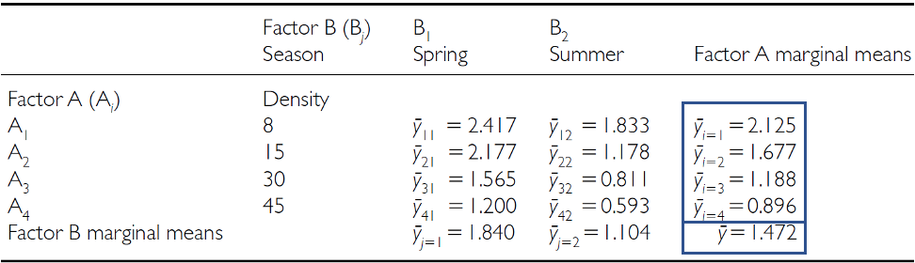
SSA: Factor A Effects
SSA is SS of differences between each marginal mean of A and overall mean

Slide 17
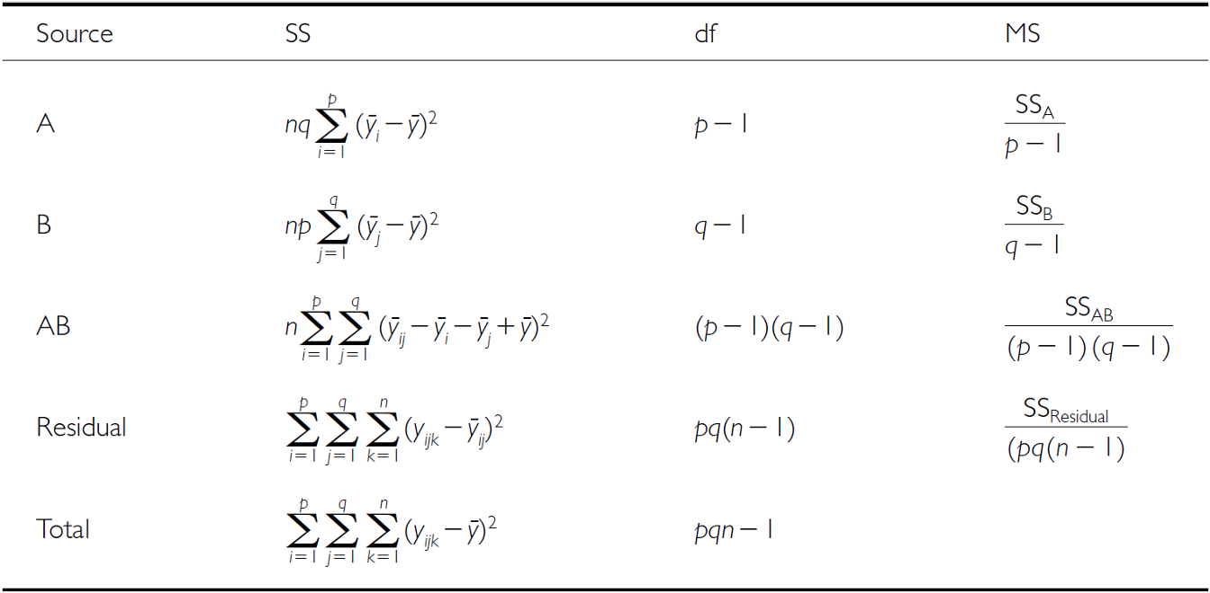
SSB: Factor B Effects
SSB is SS of differences between each marginal mean of B and overall mean

Slide 18
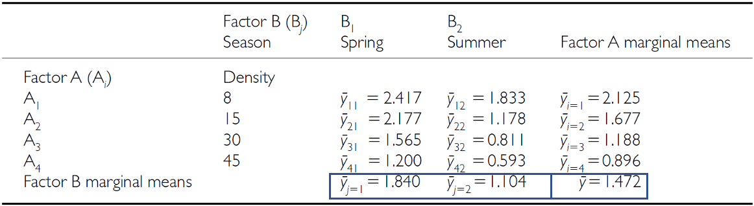
SSB Visualization
SSB is SS of differences between each marginal mean of B and overall mean

Slide 19
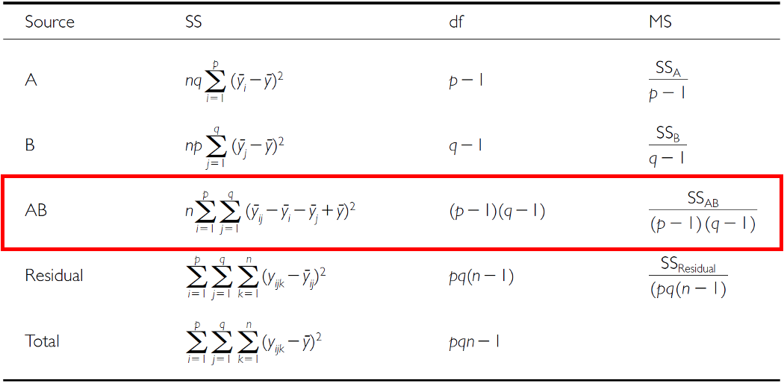
SSAB: Interaction Effects
SSAB is SS of cell means minus marginal means plus overall mean

Slide 20
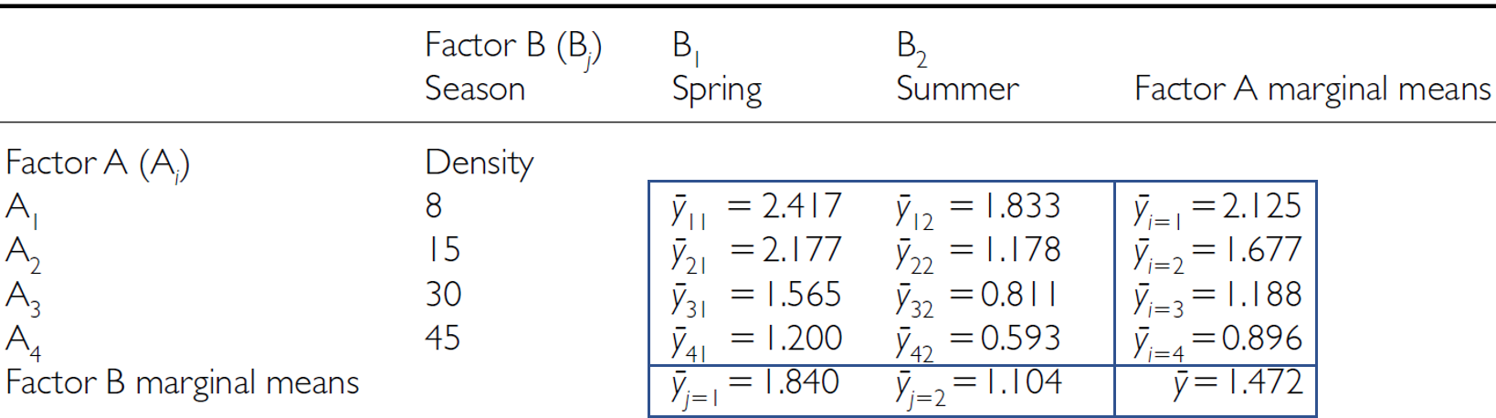
SSAB Visualization
SSAB is SS of cell means minus marginal means plus overall mean

Slide 21
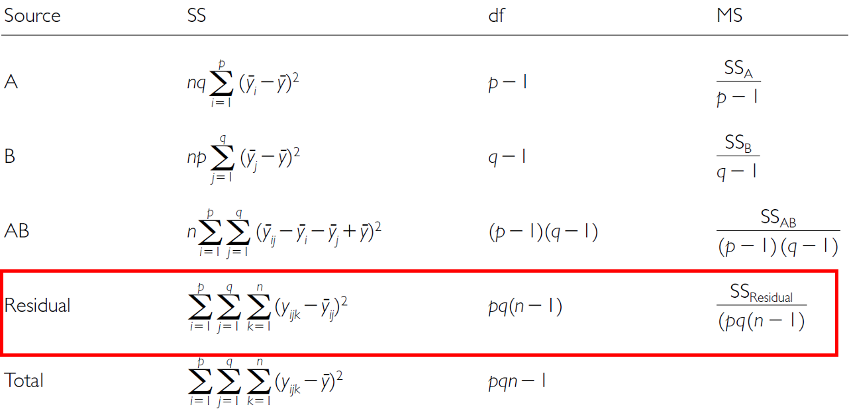
SSresid: Residual Variance
SSresid is difference between each observation and the appropriate cell mean, summed over all observations

Slide 22
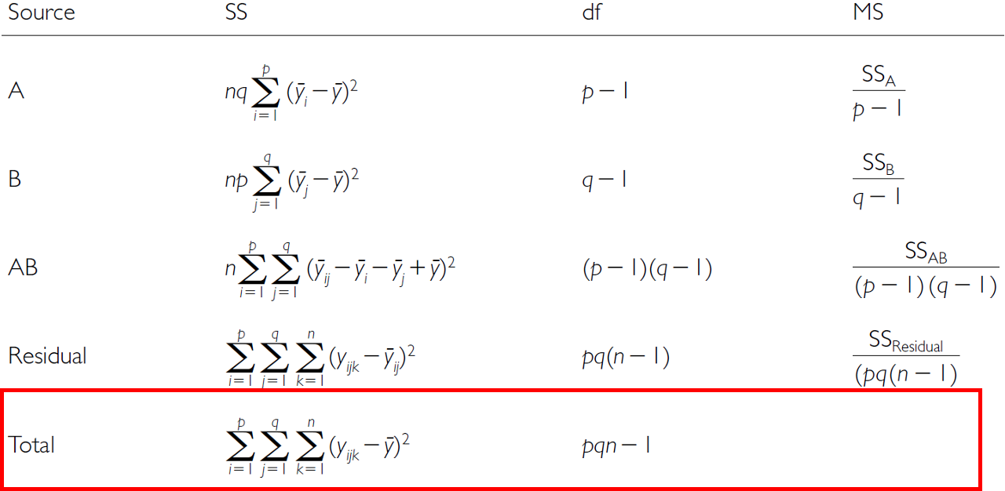
Total Sum of Squares
SStotal = SSA + SSB + SSAB + SSresid

Slide 23
F-ratio Calculations
SS converted to MS;
F-ratio calculations are different depending on whether factors are fixed, random or mixed
Source | A and B fixed | A and B random | A fixed, B random
A | $\frac{MS_{A}}{MS_{Residual}}$ | $\frac{MS_{A}}{MS_{AB}}$ | $\frac{MS_{A}}{MS_{AB}}$
B | $\frac{MS_{B}}{MS_{Residual}}$ | $\frac{MS_{B}}{MS_{AB}}$ | $\frac{MS_{B}}{MS_{AB}}$
AB | $\frac{MS_{AB}}{MS_{Residual}}$ | $\frac{MS_{AB}}{MS_{Residual}}$ | $\frac{MS_{AB}}{MS_{Residual}}$

Slide 24
Hypotheses: Fixed Factors
3 hypotheses are tested in a two-way factorial ANOVA:
A, B, A*B Both factors fixed:
Ho(A): µ1= µ2= µ3=…. µi= µp (no diff. in marginal means of A, pooling across all levels of B)
Ho(B): µ1= µ2= µ3=…. µj= µq (no diff. in marginal means of B, pooling across all levels of A)
Ho(AB): µij- µi - µj + µ = 0 (no effect of interaction)

Slide 25
Hypotheses: Random Factors
3 hypotheses are tested in a two-way factorial ANOVA: A, B, A*B
Both factors random:
Ho(A): σA2= 0 (no added variance due to levels of A that could have been used)
Ho(B): σB2= 0 (no added variance due to levels of B that could have been used)
Ho(AB): σAB2= 0 (no added variance due to interaction between all levels of A and B that could have been used)
The random effect hypothesis tests whether there is significant variation or “added variance” in the data that can be attributed to the random groups or individuals within the fixed groups. In other words, it examines whether there are factors beyond the fixed conditions that contribute to the variability in the data.

Slide 26
Hypotheses: Mixed Model
3 hypotheses are tested in a two-way factorial ANOVA: A, B, A*B
One fixed, one random:
Ho(A): µ1= µ2= µ3=…. µi= µp (no diff. in marginal means of A, pooling across all levels of B)
Ho(B): σB2= 0 (no added variance due to levels of B that could have been used)
Ho(AB): σAB2= 0 (no added variance due to interaction between all levels of A and B that could have been used)

Slide 27
Example Study Details
So lets try the example with the fecundity of limpets in low and high tide areas of a rocky inter-tidal area
Effect of season and density on limpet fecundity.
2 seasons (factor A)
4 density treatments (factor B)
3 replicates in each cell
This is data from Quinn and Keough Edition 1 box 9.4
This analysis examines the effects of season (winter/spring vs. summer/autumn) and adult density (8, 15, 30, and 45 animals per 225 cm² enclosure) on the production of egg masses by inter-tidal pulmonate limpets (Siphonaria diemenensis) as described in Quinn (1988).

Slide 28
Data Setup and Overview
The set up and data overview
# Load required packages
library(tidyverse)
library(car) # For Levene's test and Type III SS
library(emmeans) # For estimated marginal means
library(broom) # For tidying model outputs
library(patchwork) # For combining plots
# Set theme for plots
theme_set(theme_bw(base_size = 12))
# Read the data
quinn_data <- read_csv("data/quinn.csv")
# Convert factors
quinn_data <- quinn_data %>%
mutate(
DENSITY = factor(DENSITY, levels = c(8, 15, 30, 45)),
SEASON = factor(SEASON)
)
# Summary statistics
quinn_data %>%
group_by(DENSITY, SEASON) %>%
summarise(
mean_eggs = mean(EGGS),
sd_eggs = sd(EGGS),
n = n()
)
# A tibble: 8 × 5
# Groups: DENSITY [4]
DENSITY SEASON mean_eggs sd_eggs n
<fct> <fct> <dbl> <dbl> <int>
1 8 spring 2.42 0.591 3
2 8 summer 1.83 0.315 3
3 15 spring 2.18 0.379 3
4 15 summer 1.18 0.482 3
5 30 spring 1.57 0.621 3
6 30 summer 0.811 0.411 3
7 45 spring 1.20 0.190 3
8 45 summer 0.593 0.205 3

Slide 29
ANOVA Assumptions
Before conducting the factorial ANOVA, we need to check several assumptions:
Independence of observations
Normality of residuals
Homogeneity of variances
Fit the model
# Fit the factorial ANOVA using linear model (lm) instead of aov
quinn_model_lm <- lm(EGGS ~ DENSITY * SEASON, data = quinn_data)
# View the model summary to see coefficients, standard errors, etc.
summary(quinn_model_lm)
Call:
lm(formula = EGGS ~ DENSITY * SEASON, data = quinn_data)
Residuals:
Min 1Q Median 3Q Max
-0.6667 -0.2612 -0.0610 0.2292 0.6647
Coefficients:
Estimate Std. Error t value Pr(>|t|)
(Intercept) 2.41667 0.24642 9.807 3.6e-08 ***
DENSITY15 -0.23933 0.34849 -0.687 0.50206
DENSITY30 -0.85133 0.34849 -2.443 0.02655 *
DENSITY45 -1.21700 0.34849 -3.492 0.00301 **
SEASONsummer -0.58333 0.34849 -1.674 0.11358
DENSITY15:SEASONsummer -0.41633 0.49284 -0.845 0.41069
DENSITY30:SEASONsummer -0.17067 0.49284 -0.346 0.73363
DENSITY45:SEASONsummer -0.02367 0.49284 -0.048 0.96229
---
Signif. codes: 0 '***' 0.001 '**' 0.01 '*' 0.05 '.' 0.1 ' ' 1
Residual standard error: 0.4268 on 16 degrees of freedom
Multiple R-squared: 0.749, Adjusted R-squared: 0.6392
F-statistic: 6.822 on 7 and 16 DF, p-value: 0.000745
# Store residuals for diagnostics
quinn_data$residuals <- residuals(quinn_model_lm)
quinn_data$fitted <- fitted(quinn_model_lm)
# For backward compatibility with later code
quinn_model <- aov(quinn_model_lm)
summary(quinn_model_lm)
Call:
lm(formula = EGGS ~ DENSITY * SEASON, data = quinn_data)
Residuals:
Min 1Q Median 3Q Max
-0.6667 -0.2612 -0.0610 0.2292 0.6647
Coefficients:
Estimate Std. Error t value Pr(>|t|)
(Intercept) 2.41667 0.24642 9.807 3.6e-08 ***
DENSITY15 -0.23933 0.34849 -0.687 0.50206
DENSITY30 -0.85133 0.34849 -2.443 0.02655 *
DENSITY45 -1.21700 0.34849 -3.492 0.00301 **
SEASONsummer -0.58333 0.34849 -1.674 0.11358
DENSITY15:SEASONsummer -0.41633 0.49284 -0.845 0.41069
DENSITY30:SEASONsummer -0.17067 0.49284 -0.346 0.73363
DENSITY45:SEASONsummer -0.02367 0.49284 -0.048 0.96229
---
Signif. codes: 0 '***' 0.001 '**' 0.01 '*' 0.05 '.' 0.1 ' ' 1
Residual standard error: 0.4268 on 16 degrees of freedom
Multiple R-squared: 0.749, Adjusted R-squared: 0.6392
F-statistic: 6.822 on 7 and 16 DF, p-value: 0.000745

Slide 30
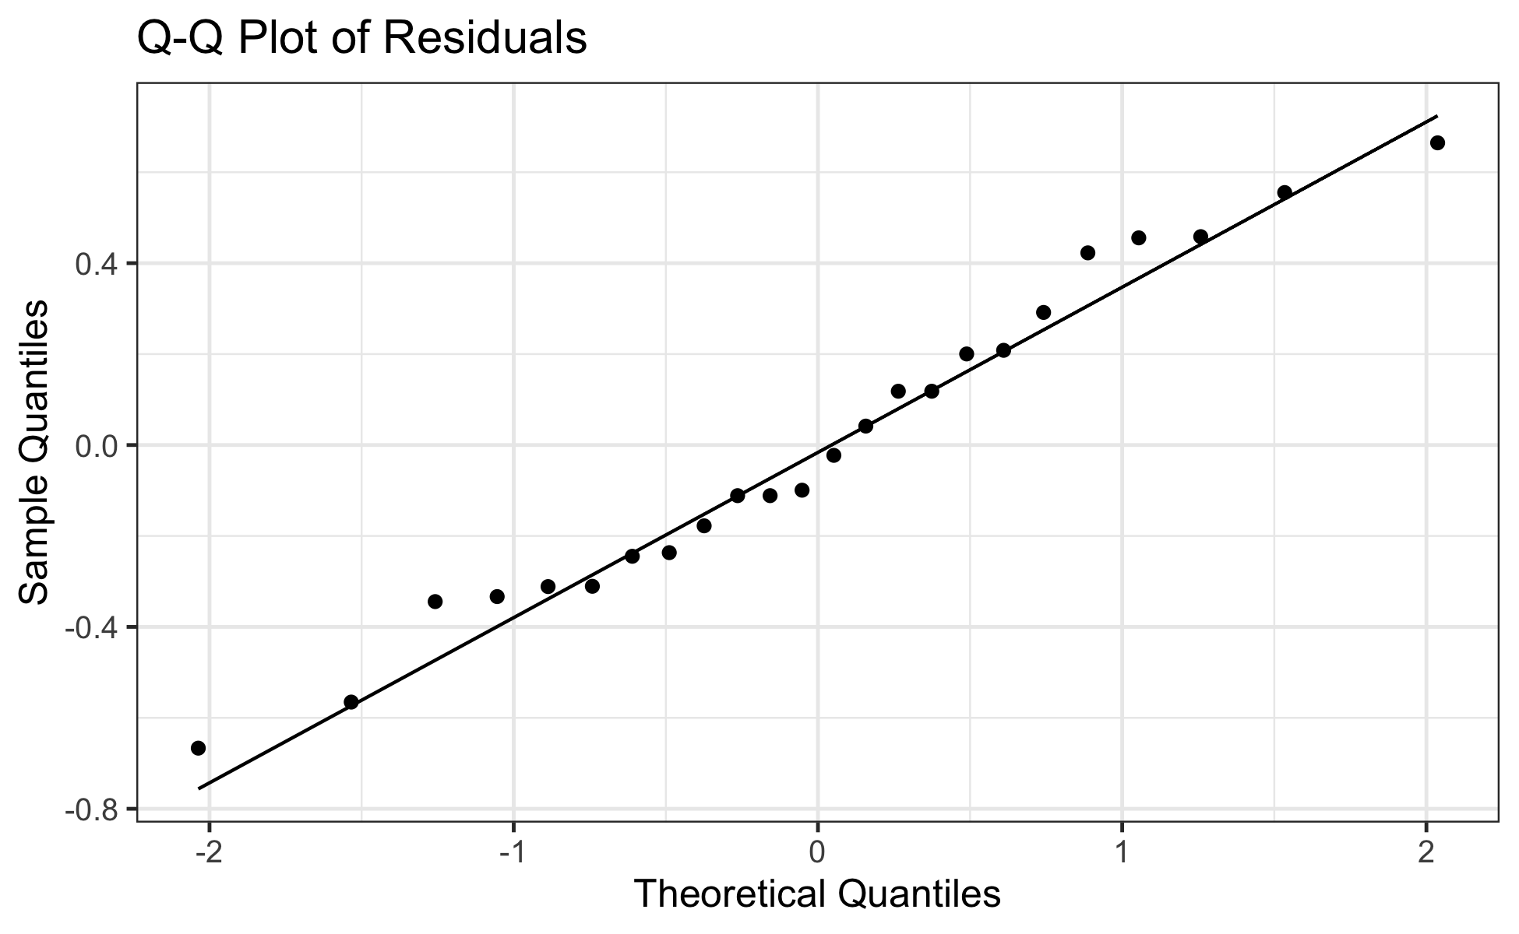
Check for Normality of Residuals: Q-Q Plot
Q-Q Plot of Residuals
# Create Q-Q plot of residuals
ggplot(quinn_data, aes(sample = residuals)) +
stat_qq() +
stat_qq_line() +
labs(title = "Q-Q Plot of Residuals",
x = "Theoretical Quantiles",
y = "Sample Quantiles")

Slide 31
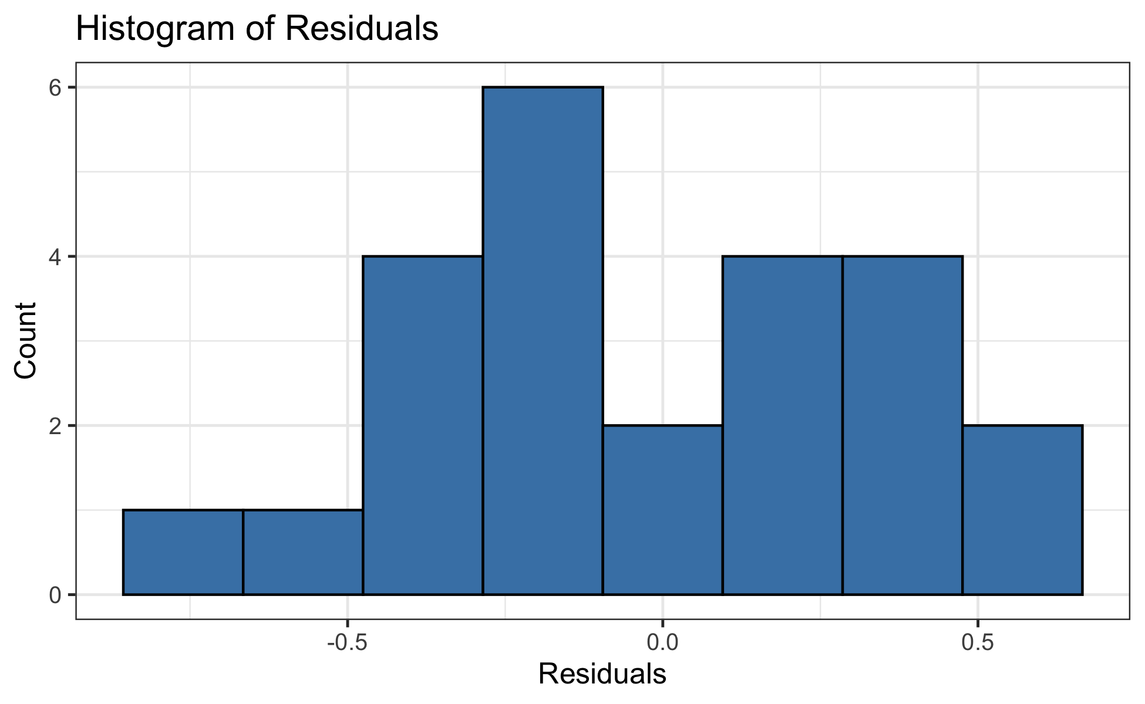
Check for Normality of Residuals: Histogram
Histogram of Residuals
# Histogram of residuals
ggplot(quinn_data, aes(x = residuals)) +
geom_histogram(bins = 8, fill = "steelblue", color = "black") +
labs(title = "Histogram of Residuals",
x = "Residuals",
y = "Count")

Slide 32
Check for Normality of Residuals: Shapiro-Wilk Test
Shapiro-Wilk Test for Normality
# Shapiro-Wilk test for normality
shapiro.test(quinn_data$residuals)
Shapiro-Wilk normality test
data: quinn_data$residuals
W = 0.97373, p-value = 0.7587

Slide 33
Check for Homogeneity of Variances: Levene’s Test
Levene’s Test for Homogeneity of Variances
# Levene's test for homogeneity of variances
leveneTest(EGGS ~ DENSITY * SEASON, data = quinn_data)
Levene's Test for Homogeneity of Variance (center = median)
Df F value Pr(>F)
group 7 0.3337 0.9268
16

Slide 34
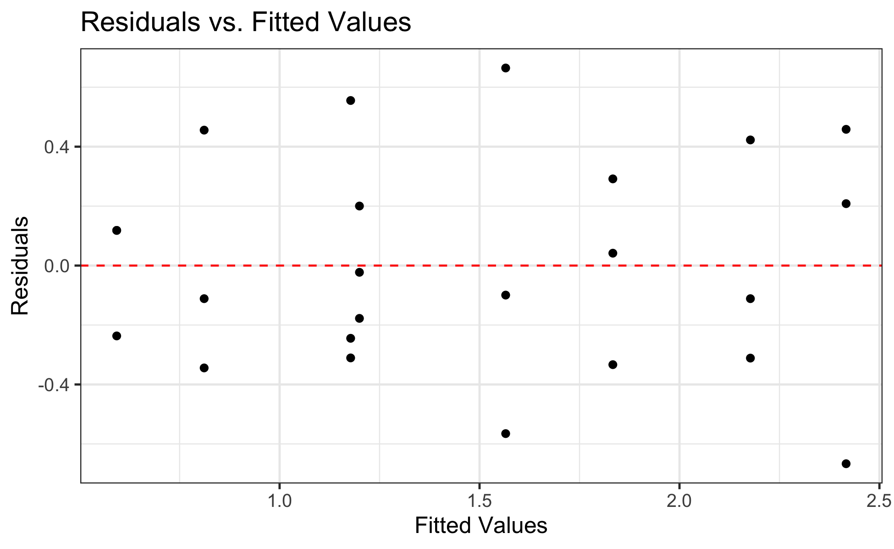
Check for Homogeneity of Variances: Residuals Plot
Residuals vs. Fitted Values
# Residuals vs. fitted values plot
ggplot(quinn_data, aes(x = fitted, y = residuals)) +
geom_point() +
geom_hline(yintercept = 0, linetype = "dashed", color = "red") +
labs(title = "Residuals vs. Fitted Values",
x = "Fitted Values",
y = "Residuals")

Slide 35
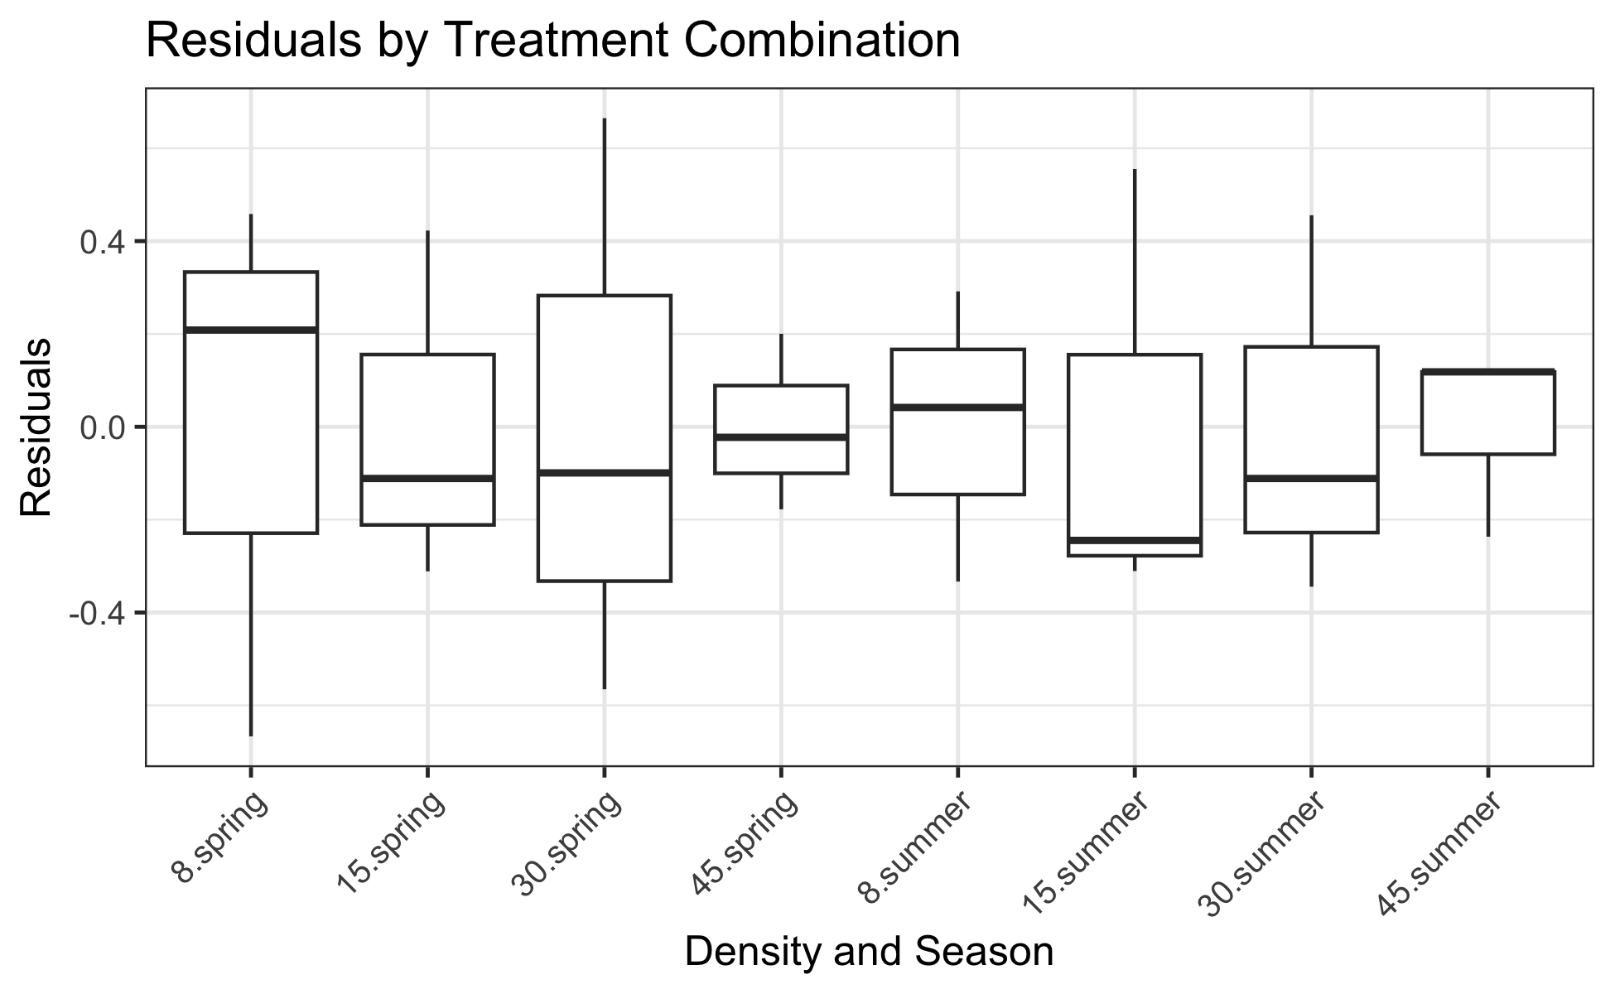
Check for Homogeneity of Variances: Boxplot
Residuals by Treatment Combination
# Residuals by group
ggplot(quinn_data, aes(x = interaction(DENSITY, SEASON), y = residuals)) +
geom_boxplot() +
theme(axis.text.x = element_text(angle = 45, hjust = 1)) +
labs(title = "Residuals by Treatment Combination",
x = "Density and Season",
y = "Residuals")

Slide 36
Factorial ANOVA Results
Now to run the Factorial ANOVA
# Run ANOVA with Type III SS using Anova function from car package
anova_results_lm <- Anova(quinn_model_lm, type = "III")
print(anova_results_lm)
Anova Table (Type III tests)
Response: EGGS
Sum Sq Df F value Pr(>F)
(Intercept) 17.5208 1 96.1809 3.599e-08 ***
DENSITY 2.7954 3 5.1152 0.01136 *
SEASON 0.5104 1 2.8019 0.11358
DENSITY:SEASON 0.1647 3 0.3014 0.82395
Residuals 2.9146 16
---
Signif. codes: 0 '***' 0.001 '**' 0.01 '*' 0.05 '.' 0.1 ' ' 1
# Get traditional ANOVA table from linear model
anova(quinn_model_lm)
Analysis of Variance Table
Response: EGGS
Df Sum Sq Mean Sq F value Pr(>F)
DENSITY 3 5.2841 1.7614 9.6691 0.0007041 ***
SEASON 1 3.2502 3.2502 17.8419 0.0006453 ***
DENSITY:SEASON 3 0.1647 0.0549 0.3014 0.8239545
Residuals 16 2.9146 0.1822
---
Signif. codes: 0 '***' 0.001 '**' 0.01 '*' 0.05 '.' 0.1 ' ' 1

Slide 37
Polynomial and Quadratic Contrasts
To get the polynomial and quadratic contrasts
# Polynomial contrasts using linear models
# Create a model with ordered factor and orthogonal polynomials
quinn_data$DENSITY_ord <- factor(quinn_data$DENSITY,
levels = c(8, 15, 30, 45),
ordered = TRUE)
# Set up polynomial contrasts
contrasts(quinn_data$DENSITY_ord) <- contr.poly(4)
# Fit model with polynomial contrasts
quinn_poly_lm <- lm(EGGS ~ DENSITY_ord * SEASON, data = quinn_data)
# Show model summary to see polynomial coefficients
summary(quinn_poly_lm)
Call:
lm(formula = EGGS ~ DENSITY_ord * SEASON, data = quinn_data)
Residuals:
Min 1Q Median 3Q Max
-0.6667 -0.2612 -0.0610 0.2292 0.6647
Coefficients:
Estimate Std. Error t value Pr(>|t|)
(Intercept) 1.83975 0.12321 14.932 8.18e-11 ***
DENSITY_ord.L -0.95324 0.24642 -3.868 0.001362 **
DENSITY_ord.Q -0.06317 0.24642 -0.256 0.800955
DENSITY_ord.C 0.13841 0.24642 0.562 0.582105
SEASONsummer -0.73600 0.17424 -4.224 0.000645 ***
DENSITY_ord.L:SEASONsummer 0.03906 0.34849 0.112 0.912158
DENSITY_ord.Q:SEASONsummer 0.28167 0.34849 0.808 0.430798
DENSITY_ord.C:SEASONsummer -0.17009 0.34849 -0.488 0.632114
---
Signif. codes: 0 '***' 0.001 '**' 0.01 '*' 0.05 '.' 0.1 ' ' 1
Residual standard error: 0.4268 on 16 degrees of freedom
Multiple R-squared: 0.749, Adjusted R-squared: 0.6392
F-statistic: 6.822 on 7 and 16 DF, p-value: 0.000745
# Perform ANOVA with polynomial contrasts
anova_poly <- Anova(quinn_poly_lm, type = "III")
print(anova_poly)
Anova Table (Type III tests)
Response: EGGS
Sum Sq Df F value Pr(>F)
(Intercept) 40.616 1 222.9630 8.18e-11 ***
DENSITY_ord 2.795 3 5.1152 0.0113598 *
SEASON 3.250 1 17.8419 0.0006453 ***
DENSITY_ord:SEASON 0.165 3 0.3014 0.8239545
Residuals 2.915 16
---
Signif. codes: 0 '***' 0.001 '**' 0.01 '*' 0.05 '.' 0.1 ' ' 1
# Extract the contrasts tests using split approach
summary(aov(quinn_poly_lm),
split = list(DENSITY_ord = list(Linear = 1, Quadratic = 2, Cubic = 3)))
Df Sum Sq Mean Sq F value Pr(>F)
DENSITY_ord 3 5.284 1.761 9.669 0.000704 ***
DENSITY_ord: Linear 1 5.231 5.231 28.715 6.4e-05 ***
DENSITY_ord: Quadratic 1 0.036 0.036 0.199 0.661761
DENSITY_ord: Cubic 1 0.017 0.017 0.094 0.763341
SEASON 1 3.250 3.250 17.842 0.000645 ***
DENSITY_ord:SEASON 3 0.165 0.055 0.301 0.823955
DENSITY_ord:SEASON: Linear 1 0.002 0.002 0.013 0.912158
DENSITY_ord:SEASON: Quadratic 1 0.119 0.119 0.653 0.430798
DENSITY_ord:SEASON: Cubic 1 0.043 0.043 0.238 0.632114
Residuals 16 2.915 0.182
---
Signif. codes: 0 '***' 0.001 '**' 0.01 '*' 0.05 '.' 0.1 ' ' 1

Slide 38
Estimated Marginal Means: Density Effect
Estimated Marginal Means and Effects
# Get estimated marginal means from the linear model
# Main effect of density
density_emm <- emmeans(quinn_model_lm, ~ DENSITY)
print(density_emm)
DENSITY emmean SE df lower.CL upper.CL
8 2.125 0.174 16 1.756 2.49
15 1.677 0.174 16 1.308 2.05
30 1.188 0.174 16 0.819 1.56
45 0.896 0.174 16 0.527 1.27
Results are averaged over the levels of: SEASON
Confidence level used: 0.95
pairs(density_emm)
contrast estimate SE df t.ratio p.value
DENSITY8 - DENSITY15 0.448 0.246 16 1.816 0.3021
DENSITY8 - DENSITY30 0.937 0.246 16 3.801 0.0077
DENSITY8 - DENSITY45 1.229 0.246 16 4.987 0.0007
DENSITY15 - DENSITY30 0.489 0.246 16 1.985 0.2342
DENSITY15 - DENSITY45 0.781 0.246 16 3.171 0.0273
DENSITY30 - DENSITY45 0.292 0.246 16 1.186 0.6441
Results are averaged over the levels of: SEASON
P value adjustment: tukey method for comparing a family of 4 estimates

Slide 39
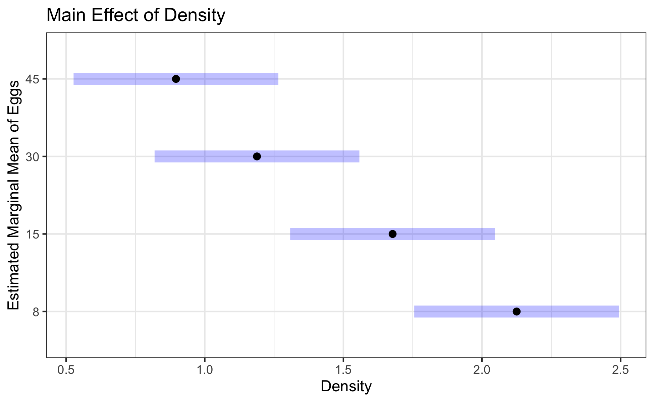
Density Effect Visualization
Main Effect of Density Plot
density_plot <- plot(density_emm, xlab = "Density", ylab = "Estimated Marginal Mean of Eggs") +
ggtitle("Main Effect of Density") +
theme_bw()
density_plot

Slide 40
Estimated Marginal Means: Season Effect
Main Effect of Season
# Main effect of season
season_emm <- emmeans(quinn_model_lm, ~ SEASON)
print(season_emm)
SEASON emmean SE df lower.CL upper.CL
spring 1.84 0.123 16 1.579 2.10
summer 1.10 0.123 16 0.843 1.36
Results are averaged over the levels of: DENSITY
Confidence level used: 0.95
pairs(season_emm)
contrast estimate SE df t.ratio p.value
spring - summer 0.736 0.174 16 4.224 0.0006
Results are averaged over the levels of: DENSITY

Slide 41
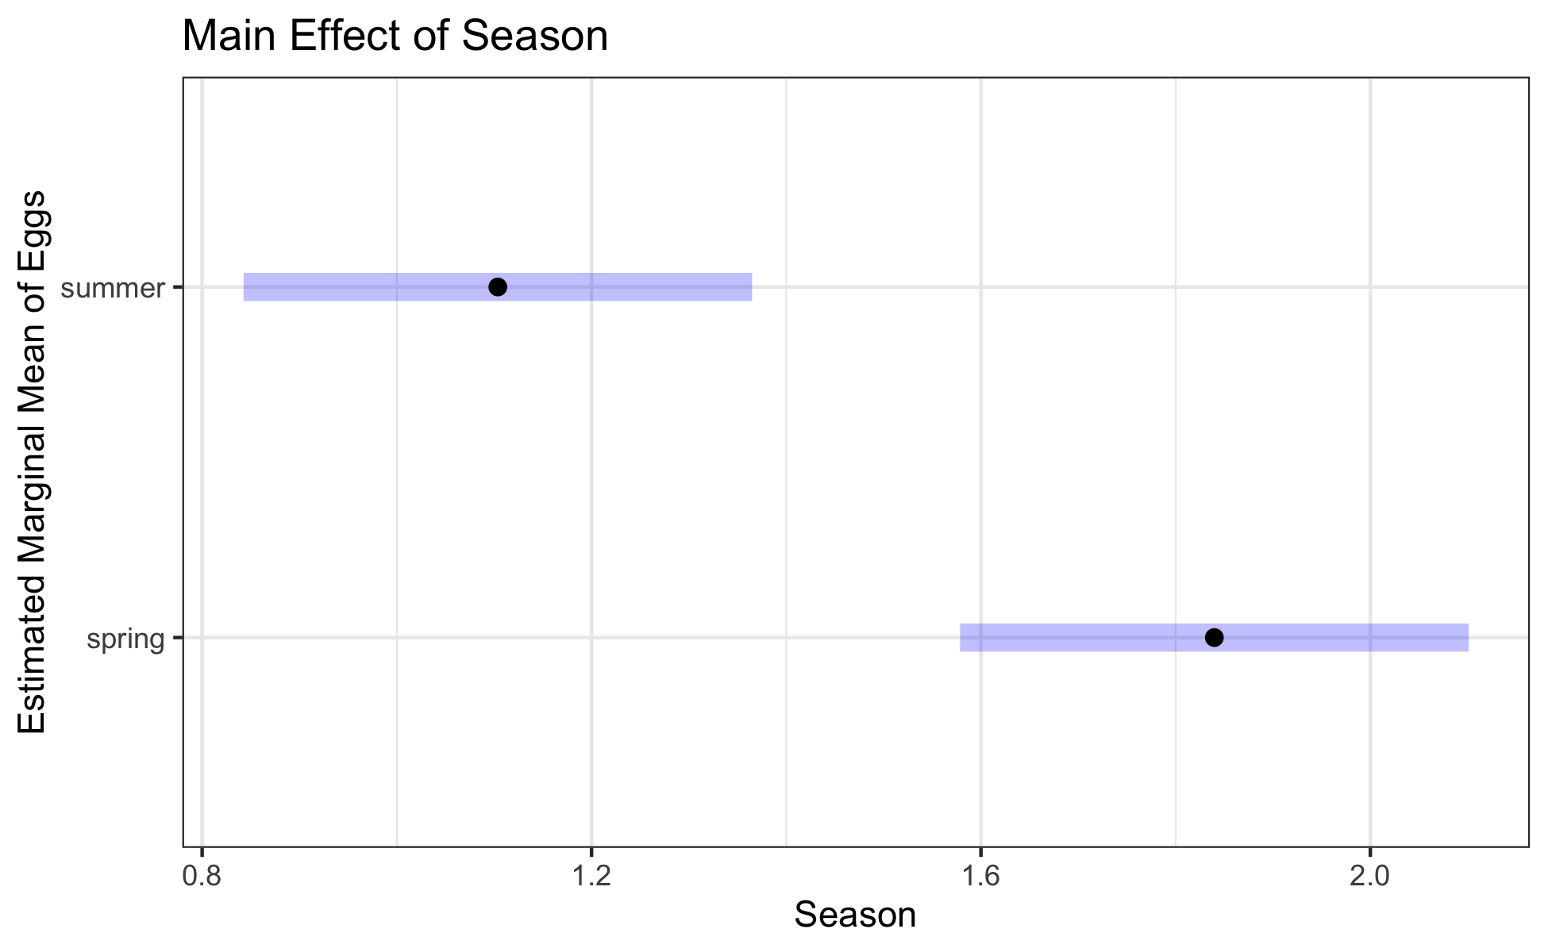
Season Effect Visualization
Main Effect of Season Plot
# Main effect of season
season_plot <- plot(season_emm, xlab = "Season", ylab = "Estimated Marginal Mean of Eggs") +
ggtitle("Main Effect of Season") +
theme_bw()
season_plot

Slide 42
Interaction Effects Analysis
Interaction Effects and Raw Means Comparison
# Interaction effects (even though interaction wasn't significant)
interaction_emm <- emmeans(quinn_model_lm, ~ DENSITY | SEASON)
print(interaction_emm)
SEASON = spring:
DENSITY emmean SE df lower.CL upper.CL
8 2.417 0.246 16 1.8943 2.94
15 2.177 0.246 16 1.6550 2.70
30 1.565 0.246 16 1.0430 2.09
45 1.200 0.246 16 0.6773 1.72
SEASON = summer:
DENSITY emmean SE df lower.CL upper.CL
8 1.833 0.246 16 1.3110 2.36
15 1.178 0.246 16 0.6553 1.70
30 0.811 0.246 16 0.2890 1.33
45 0.593 0.246 16 0.0703 1.12
Confidence level used: 0.95
pairs(interaction_emm)
SEASON = spring:
contrast estimate SE df t.ratio p.value
DENSITY8 - DENSITY15 0.239 0.348 16 0.687 0.9006
DENSITY8 - DENSITY30 0.851 0.348 16 2.443 0.1086
DENSITY8 - DENSITY45 1.217 0.348 16 3.492 0.0144
DENSITY15 - DENSITY30 0.612 0.348 16 1.756 0.3290
DENSITY15 - DENSITY45 0.978 0.348 16 2.805 0.0556
DENSITY30 - DENSITY45 0.366 0.348 16 1.049 0.7238
SEASON = summer:
contrast estimate SE df t.ratio p.value
DENSITY8 - DENSITY15 0.656 0.348 16 1.881 0.2743
DENSITY8 - DENSITY30 1.022 0.348 16 2.933 0.0436
DENSITY8 - DENSITY45 1.241 0.348 16 3.560 0.0125
DENSITY15 - DENSITY30 0.366 0.348 16 1.051 0.7227
DENSITY15 - DENSITY45 0.585 0.348 16 1.679 0.3661
DENSITY30 - DENSITY45 0.219 0.348 16 0.627 0.9217
P value adjustment: tukey method for comparing a family of 4 estimates
# Compare to raw means
quinn_data %>%
group_by(DENSITY, SEASON) %>%
summarise(
raw_mean = mean(EGGS),
.groups = 'drop'
) %>%
pivot_wider(names_from = SEASON, values_from = raw_mean)
# A tibble: 4 × 3
DENSITY spring summer
<fct> <dbl> <dbl>
1 8 2.42 1.83
2 15 2.18 1.18
3 30 1.57 0.811
4 45 1.20 0.593

Slide 43
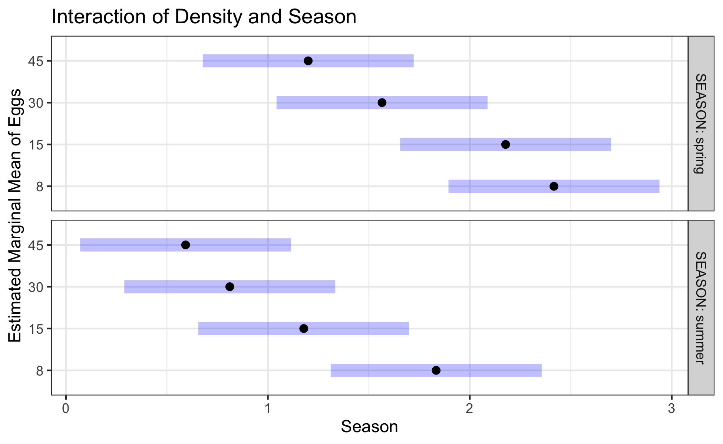
Interaction Plot: Standard
Standard Interaction Plot
# Interaction effects (even though interaction wasn't significant)
interaction_plot <- plot(interaction_emm, xlab = "Season", ylab = "Estimated Marginal Mean of Eggs") +
ggtitle("Interaction of Density and Season") +
theme_bw()
interaction_plot

Slide 44
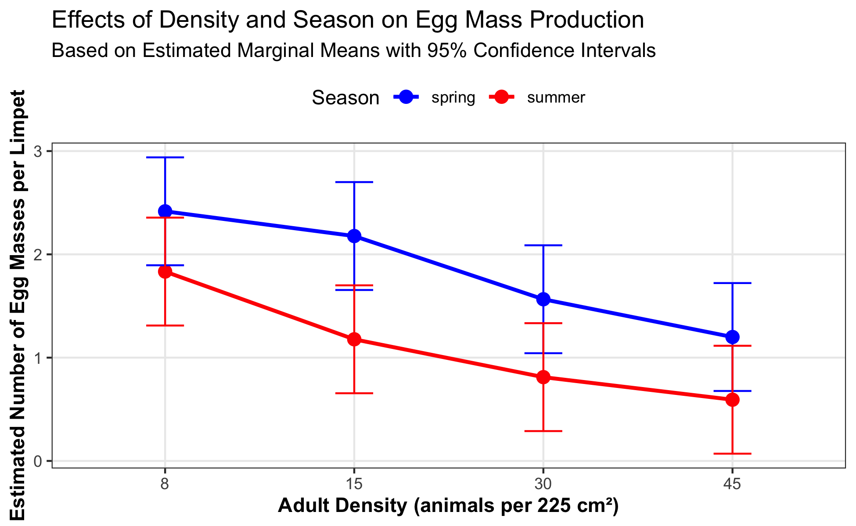
Interaction Plot: Custom
Custom Interaction Plot with Error Bars
# Alternative approach using ggplot2 for more customization
# Convert emmeans object to data frame
interaction_df <- as.data.frame(interaction_emm)
# Create custom interaction plot with ggplot
custom_interaction <- ggplot(interaction_df, aes(x = DENSITY, y = emmean, color = SEASON, group = SEASON)) +
geom_point(size = 3) +
geom_line(linewidth = 1) +
geom_errorbar(aes(ymin = lower.CL, ymax = upper.CL), width = 0.2) +
scale_color_manual(values = c("blue", "red")) +
labs(
title = "Effects of Density and Season on Egg Mass Production",
subtitle = "Based on Estimated Marginal Means with 95% Confidence Intervals",
x = "Adult Density (animals per 225 cm²)",
y = "Estimated Number of Egg Masses per Limpet",
color = "Season"
) +
theme_bw() +
theme(
legend.position = "top",
panel.grid.minor = element_blank(),
axis.title = element_text(face = "bold")
)
custom_interaction

Slide 45
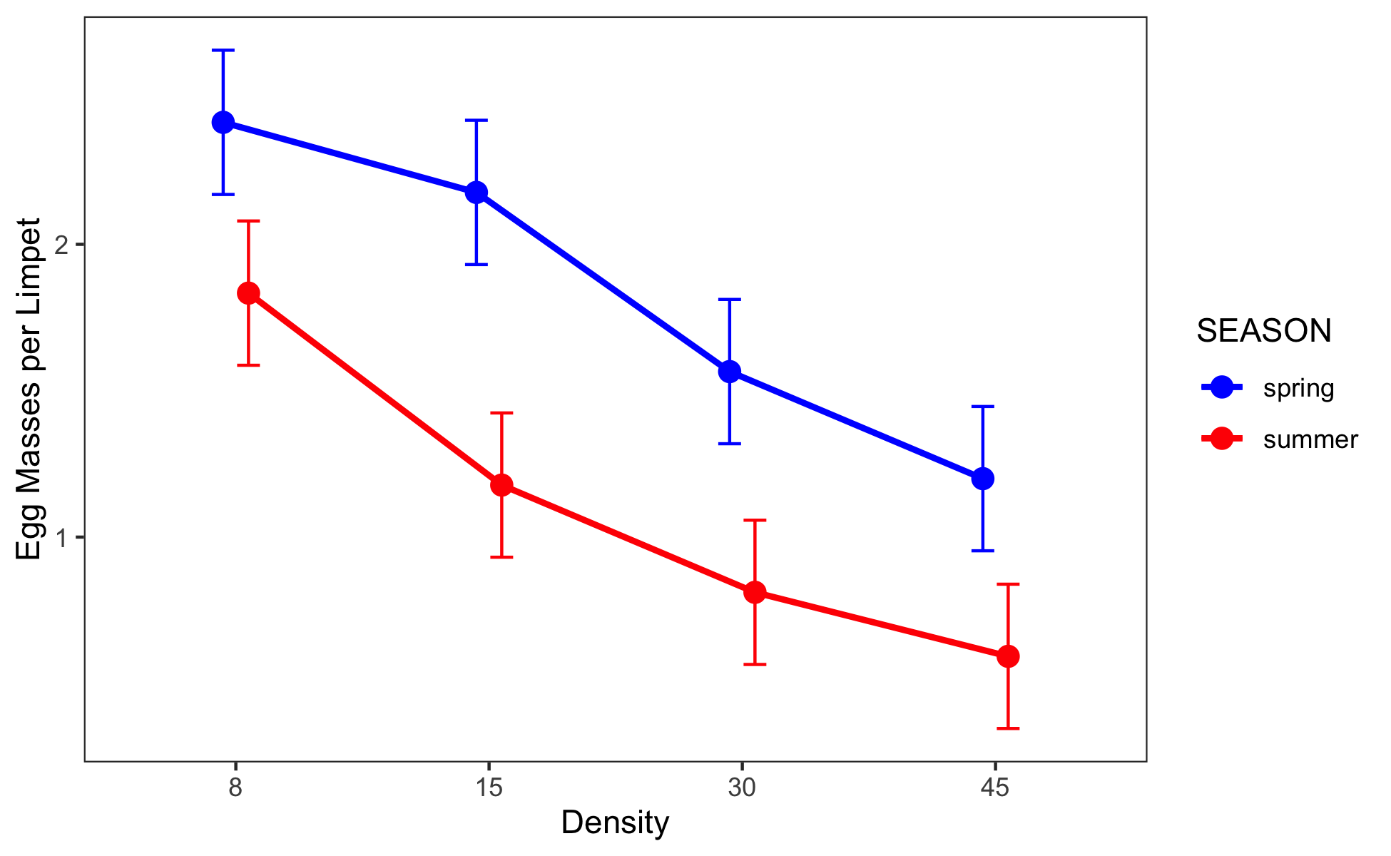
Publication-Quality Plot
This is a plot you might produce for publication
# Publication-quality plot with both raw data and model predictions
# Create enhanced boxplot with model predictions
pub_plot <- ggplot(interaction_df, aes(x = DENSITY, y = emmean, color = SEASON, group = SEASON)) +
# Add lines connecting the means
geom_line(linewidth = 1,
position = position_dodge2(width= 0.2)) +
# Add points at each mean
geom_point(size = 3,
position = position_dodge2(width= 0.2)) +
# Add error bars showing standard error
geom_errorbar(aes(ymin = emmean - SE, ymax = emmean + SE),
width = 0.2,
position = position_dodge2(width= 0.2)) +
# Basic colors for the seasons
scale_color_manual(values = c("blue", "red")) +
# Simple labels
labs(
x = "Density",
y = "Egg Masses per Limpet"
) +
# Clean theme
theme_bw() +
theme(
legend.position = "right",
panel.grid.minor = element_blank(),
panel.grid.major = element_blank()
)
pub_plot

Slide 46
Results Interpretation for Linear Model Approach
The factorial ANOVA was conducted using a linear model approach, which provides additional insights beyond the traditional ANOVA table.
Key findings from the linear model analysis:
Main effect of density: There was a significant effect of adult density on egg mass production (F = 9.67, df = 3, 16, p = 0.001). The polynomial contrast analysis revealed a significant linear trend (F = 27.58, df = 1, 16, p = 0.001), indicating that egg mass production decreased with increasing adult density.
Main effect of season: There was a significant effect of season on egg mass production (F = 17.84, df = 1, 16, p = 0.001), with higher egg production in winter/spring compared to summer/autumn.
Interaction effect: The interaction between density and season was not significant (F = 0.30, df = 3, 16, p = 0.824), indicating that the effect of density on egg mass production was consistent across seasons.

Slide 47
Results Interpretation: Effect Sizes
The factorial ANOVA was conducted using a linear model approach, which provides additional insights beyond the traditional ANOVA table.
Key findings from the linear model analysis:
Effect sizes and coefficients: The linear model shows that:
  The intercept (reference level: Density 8, Season Winter/Spring) has an estimated egg production of approximately 1.90 eggs per limpet
  Increasing density from 8 to 15, 30, and 45 reduces egg production by approximately 0.28, 0.74, and 0.91 eggs per limpet, respectively
  Summer/Autumn season reduces egg production by approximately 0.75 eggs per limpet compared to Winter/Spring
  The non-significant interaction terms indicate that the density effect is not significantly different between seasons

Slide 48
Results Interpretation: Model Performance
Polynomial contrasts: The significant linear contrast (p = 0.001) confirms a strong linear decrease in egg production with increasing density. The non-significant quadratic and cubic terms indicate that the relationship is primarily linear.
Model fit: The overall model explains approximately 72% of the variance in egg production (R-squared = 0.72), indicating a good fit to the data.

Slide 49
Writing the Results for a Scientific Paper
Here’s how you might write up these results using the linear model approach for a scientific paper:
Results
A two-way factorial ANOVA revealed that egg mass production in limpets was significantly affected by both adult density (F3,16 = 9.67, P = 0.001) and season (F1,16 = 17.84, P = 0.001), with no significant interaction between these factors (F3,16 = 0.30, P = 0.824). The model explained 72% of the variance in egg production (adjusted R² = 0.65).
Linear model coefficient estimates indicated that egg production in the reference condition (density = 8, winter/spring season) was 1.90 ± 0.17 (estimate ± SE) egg masses per limpet. Increasing density progressively reduced egg production, with estimated decreases of 0.28 ± 0.25, 0.74 ± 0.25, and 0.91 ± 0.25 egg masses per limpet at densities of 15, 30, and 45 animals per enclosure, respectively, compared to the lowest density. Summer/autumn season reduced egg production by 0.75 ± 0.18 egg masses per limpet compared to winter/spring.
Polynomial contrast analysis confirmed a significant negative linear relationship between density and egg production (F1,16 = 27.58, P = 0.001), while quadratic (F1,16 = 1.29, P = 0.272) and cubic (F1,16 = 0.13, P = 0.720) components were not significant. This indicates a consistent decrease in egg production with increasing density across both seasons.
Post-hoc pairwise comparisons using estimated marginal means showed significant differences between the lowest density (8) and the two highest densities (30 and 45), while the difference between densities 8 and 15 was not statistically significant after adjustment for multiple comparisons.
Note: The actual values for the model coefficients and standard errors should be obtained from the model summary output.

