Slide 1
Lecture 18 - Multivariate Community Analysis
Bill Perry

Slide 2
Lecture 18: Multivariate Community Analysis
Let’s import the data and start to explore it
# Set theme
theme_set(theme_minimal() +
theme(text = element_text(size = 12),
plot.title = element_text(size = 14, face = "bold")))
# Load data
doubs_env <- read_csv("data/DoubsEnv.csv") %>%
rename(site = 1) %>%
mutate(site = as.factor(site))
doubs_spe <- read_csv("data/DoubsSpe.csv") %>%
rename(site = 1) %>%
mutate(site = as.factor(site))
# Create river reach groups based on distance from source
doubs_env <- doubs_env %>%
mutate(reach = case_when(
das <= 30 ~ "Upper",
das <= 80 ~ "Middle",
TRUE ~ "Lower"
) %>% factor(levels = c("Upper", "Middle", "Lower")))
doubs_spe <- doubs_spe %>%
left_join(doubs_env %>% select(site, reach), by = "site")
cat("Species data structure:\n")
Species data structure:
str(doubs_spe)
tibble [29 × 29] (S3: tbl_df/tbl/data.frame)
$ site : Factor w/ 29 levels "1","2","3","4",..: 1 2 3 4 5 6 7 8 9 10 ...
$ CHA : num [1:29] 0 0 0 0 0 0 0 0 0 1 ...
$ TRU : num [1:29] 3 5 5 4 2 3 5 0 1 3 ...
$ VAI : num [1:29] 0 4 5 5 3 4 4 1 4 4 ...
$ LOC : num [1:29] 0 3 5 5 2 5 5 3 4 1 ...
$ OMB : num [1:29] 0 0 0 0 0 0 0 0 0 1 ...
$ BLA : num [1:29] 0 0 0 0 0 0 0 0 0 0 ...
$ HOT : num [1:29] 0 0 0 0 0 0 0 0 0 0 ...
$ TOX : num [1:29] 0 0 0 0 0 0 0 0 0 0 ...
$ VAN : num [1:29] 0 0 0 0 5 1 1 0 2 0 ...
$ CHE : num [1:29] 0 0 0 1 2 2 1 5 2 1 ...
$ BAR : num [1:29] 0 0 0 0 0 0 0 0 0 0 ...
$ SPI : num [1:29] 0 0 0 0 0 0 0 0 0 0 ...
$ GOU : num [1:29] 0 0 0 1 2 1 0 0 1 0 ...
$ BRO : num [1:29] 0 0 1 2 4 1 0 0 0 0 ...
$ PER : num [1:29] 0 0 0 2 4 1 0 0 0 0 ...
$ BOU : num [1:29] 0 0 0 0 0 0 0 0 0 0 ...
$ PSO : num [1:29] 0 0 0 0 0 0 0 0 0 0 ...
$ ROT : num [1:29] 0 0 0 0 2 0 0 0 0 0 ...
$ CAR : num [1:29] 0 0 0 0 0 0 0 0 0 0 ...
$ TAN : num [1:29] 0 0 0 1 3 2 0 1 0 0 ...
$ BCO : num [1:29] 0 0 0 0 0 0 0 0 0 0 ...
$ PCH : num [1:29] 0 0 0 0 0 0 0 0 0 0 ...
$ GRE : num [1:29] 0 0 0 0 0 0 0 0 0 0 ...
$ GAR : num [1:29] 0 0 0 0 5 1 0 4 0 0 ...
$ BBO : num [1:29] 0 0 0 0 0 0 0 0 0 0 ...
$ ABL : num [1:29] 0 0 0 0 0 0 0 0 0 0 ...
$ ANG : num [1:29] 0 0 0 0 0 0 0 0 0 0 ...
$ reach: Factor w/ 3 levels "Upper","Middle",..: 1 1 1 1 1 2 2 2 3 3 ...
cat("\nEnvironmental data structure:\n")
Environmental data structure:
str(doubs_env)
tibble [29 × 13] (S3: tbl_df/tbl/data.frame)
$ site : Factor w/ 29 levels "1","2","3","4",..: 1 2 3 4 5 6 7 8 9 10 ...
$ das : num [1:29] 0.3 2.2 10.2 18.5 21.5 ...
$ alt : num [1:29] 934 932 914 854 849 846 841 752 617 483 ...
$ pen : num [1:29] 48 3 3.7 3.2 2.3 3.2 6.6 1.2 9.9 4.1 ...
$ deb : num [1:29] 0.84 1 1.8 2.53 2.64 2.86 4 4.8 10 19.9 ...
$ pH : num [1:29] 7.9 8 8.3 8 8.1 7.9 8.1 8 7.7 8.1 ...
$ dur : num [1:29] 45 40 52 72 84 60 88 90 82 96 ...
$ pho : num [1:29] 0.01 0.02 0.05 0.1 0.38 0.2 0.07 0.3 0.06 0.3 ...
$ nit : num [1:29] 0.2 0.2 0.22 0.21 0.52 0.15 0.15 0.82 0.75 1.6 ...
$ amm : num [1:29] 0 0.1 0.05 0 0.2 0 0 0.12 0.01 0 ...
$ oxy : num [1:29] 12.2 10.3 10.5 11 8 10.2 11.1 7.2 10 11.5 ...
$ dbo : num [1:29] 2.7 1.9 3.5 1.3 6.2 5.3 2.2 5.2 4.3 2.7 ...
$ reach: Factor w/ 3 levels "Upper","Middle",..: 1 1 1 1 1 2 2 2 3 3 ...

Slide 3
Today’s Data: The Doubs River
About the Doubs River Dataset

Slide 4
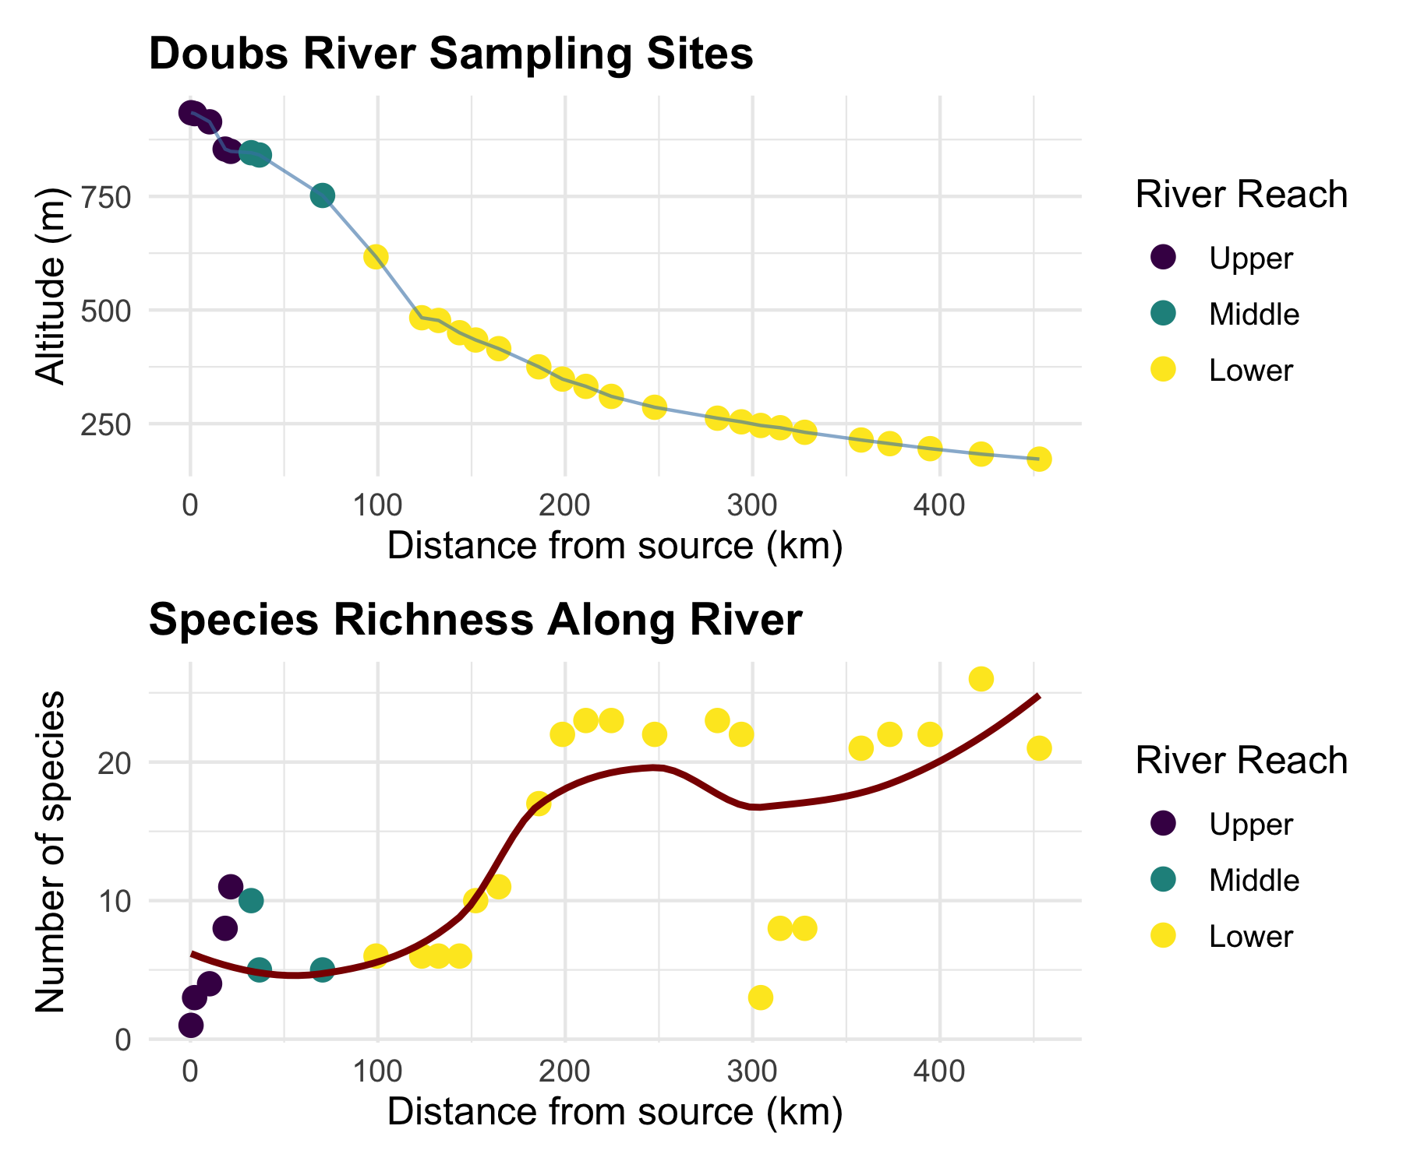
Study System:
Doubs River, France
29 sites from upstream to downstream
Collected by Verneaux (1973)
Classic community ecology dataset
Two Datasets:
Environmental: 11 water quality variables
Species: 27 fish species abundances (0-5 scale)
Research Questions:
How do fish communities change along the river?
Which environmental factors drive community composition?
Are there distinct community types?
# Show the sampling design
p1 <- doubs_env %>%
ggplot(aes(das, alt, color = reach)) +
geom_point(size = 3) +
geom_line(color = "steelblue", alpha = 0.6) +
labs(title = "Doubs River Sampling Sites",
x = "Distance from source (km)",
y = "Altitude (m)",
color = "River Reach") +
scale_color_viridis_d()
# Show species richness along river
species_richness <- doubs_spe %>%
select(-site, -reach) %>%
mutate(richness = rowSums(. > 0)) %>%
bind_cols(doubs_env %>% select(das, reach))
p2 <- species_richness %>%
ggplot(aes(das, richness, color = reach)) +
geom_point(size = 3) +
geom_smooth(method = "loess", se = FALSE, color = "darkred") +
labs(title = "Species Richness Along River",
x = "Distance from source (km)",
y = "Number of species",
color = "River Reach") +
scale_color_viridis_d()
p1 / p2

Slide 5
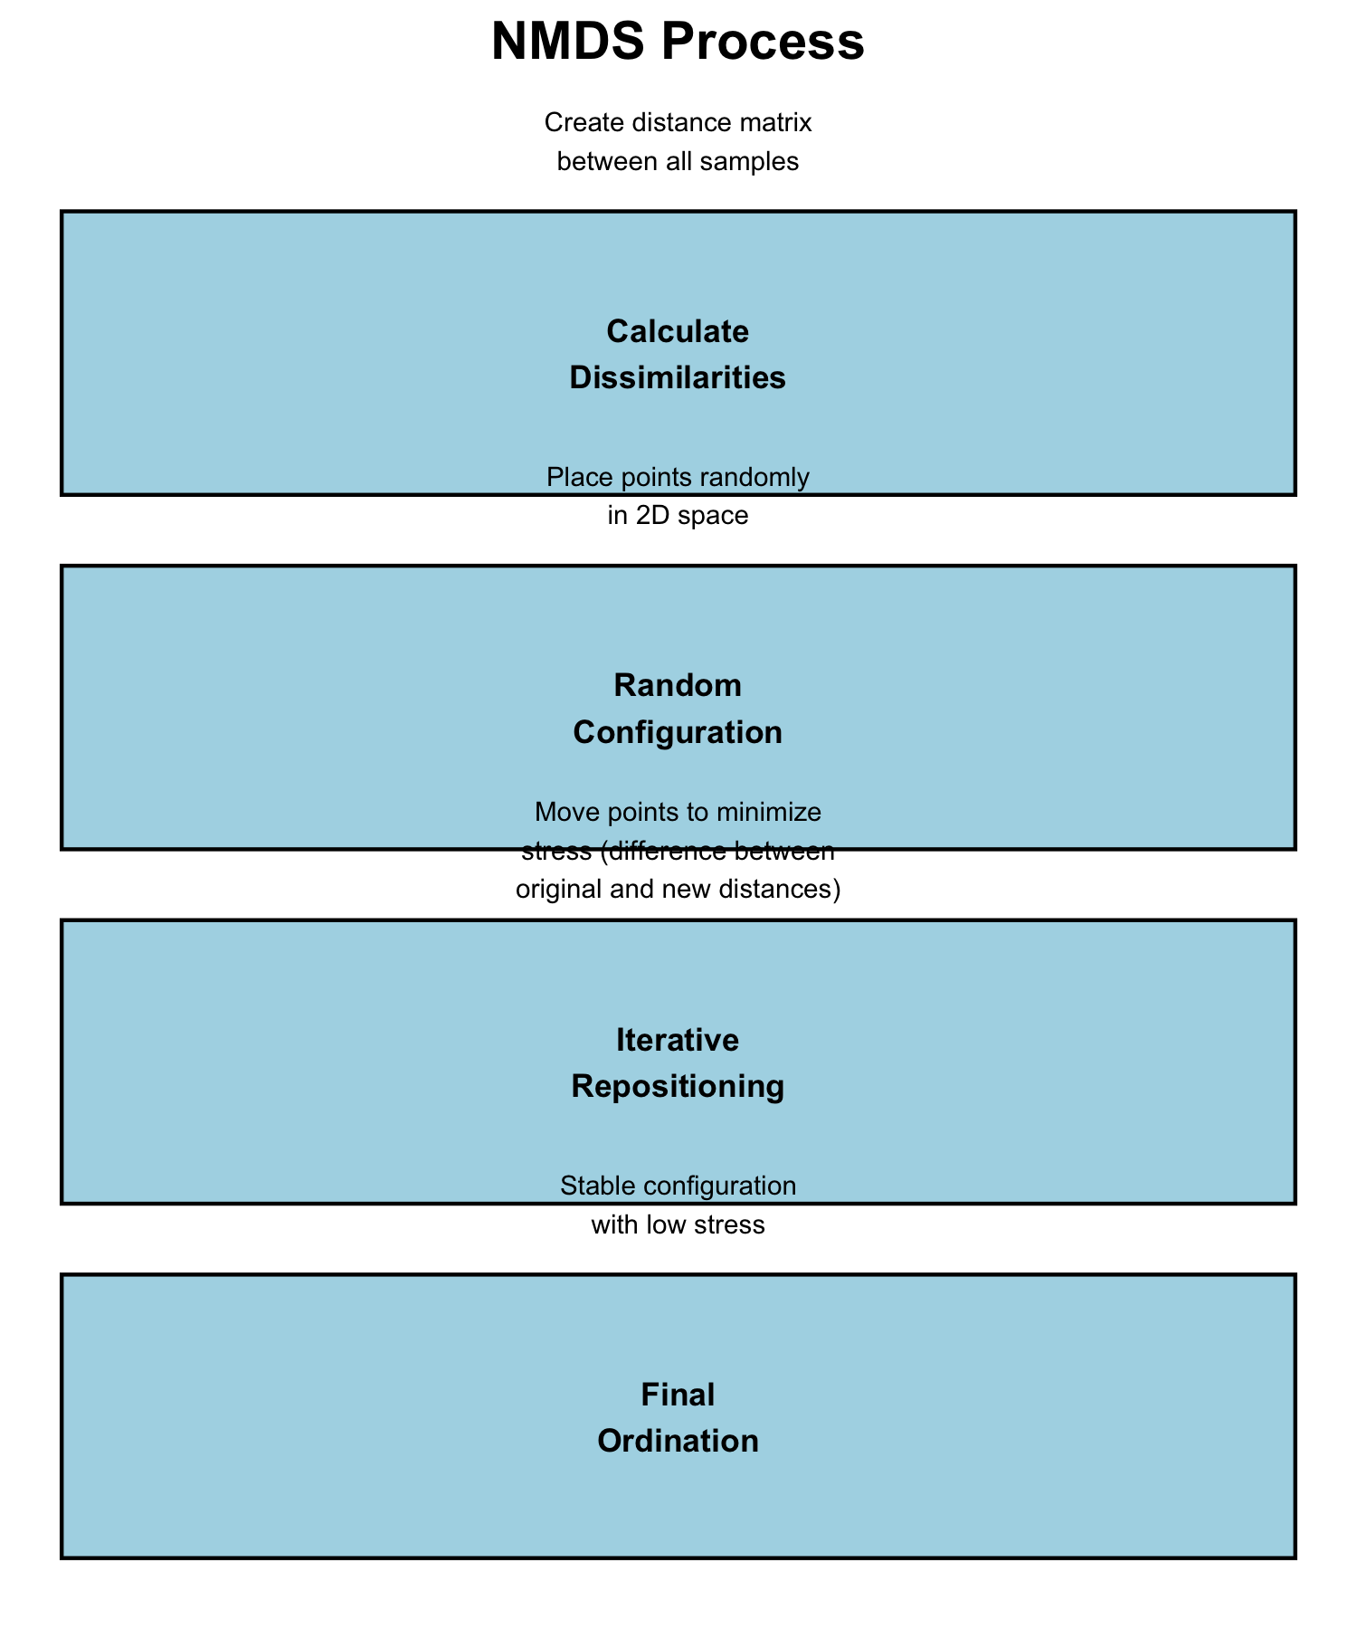
Non-metric Multidimensional Scaling (NMDS)
What is NMDS?
Overview of NMDS:
Purpose: Visualize dissimilarity between objects in 2D/3D space
Goal: Preserve rank order of distances, not exact distances
Method: Iterative repositioning to minimize stress
Output: Ordination plot showing relationships between samples
Key Differences from PCA:
Uses dissimilarity matrices (not covariance)
Non-parametric (rank-based)
Better for non-linear ecological relationships
No assumption about data distribution
# Conceptual diagram of NMDS process
tibble(
step = 1:4,
process = c("Calculate\nDissimilarities",
"Random\nConfiguration",
"Iterative\nRepositioning",
"Final\nOrdination"),
description = c("Create distance matrix\nbetween all samples",
"Place points randomly\nin 2D space",
"Move points to minimize\nstress (difference between\noriginal and new distances)",
"Stable configuration\nwith low stress")
) %>%
ggplot(aes(1, step)) +
geom_rect(aes(xmin = 0.5, xmax = 1.5, ymin = step - 0.4, ymax = step + 0.4),
fill = "lightblue", color = "black") +
geom_text(aes(label = process), fontface = "bold", size = 3) +
geom_text(aes(label = description, y = step - 0.6), size = 2.5) +
scale_y_reverse() +
labs(title = "NMDS Process") +
theme_void() +
theme(plot.title = element_text(hjust = 0.5, size = 14, face = "bold"))

Slide 6
How NMDS Works

Slide 7
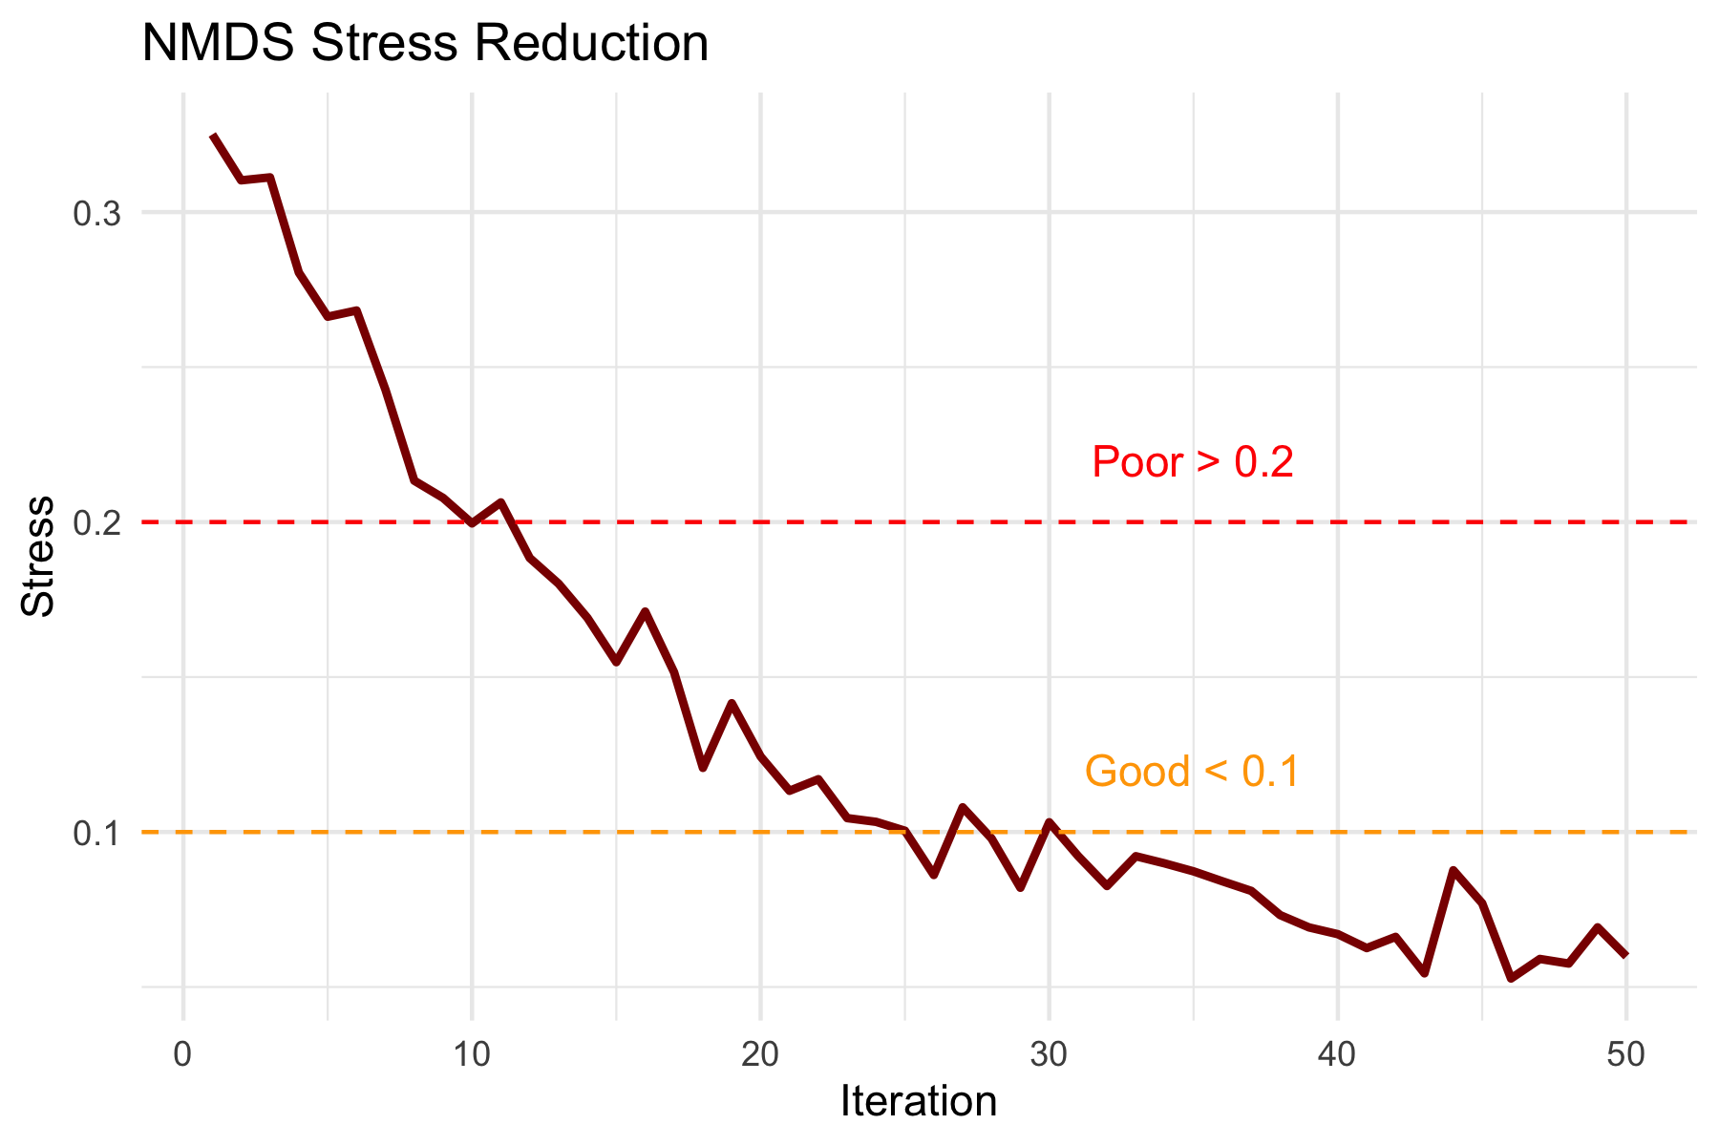
The NMDS Algorithm:
Calculate dissimilarity matrix between all pairs of sites
Start with random configuration of points in 2D space
Calculate stress = difference between original distances and ordination distances
Move points to reduce stress
Repeat until stress cannot be reduced further
Try multiple random starts to avoid local minima
Stress Values: - < 0.1: Good representation - 0.1-0.2: Acceptable - > 0.2: Poor representation
# Simulate stress reduction over iterations
set.seed(123)
iterations <- 1:50
stress <- 0.3 * exp(-iterations/15) + 0.05 + rnorm(50, 0, 0.01)
stress[stress < 0.05] <- 0.05
tibble(iterations, stress) %>%
ggplot(aes(iterations, stress)) +
geom_line(color = "darkred", size = 1) +
geom_hline(yintercept = 0.1, linetype = "dashed", color = "orange") +
geom_hline(yintercept = 0.2, linetype = "dashed", color = "red") +
annotate("text", x = 35, y = 0.12, label = "Good < 0.1", color = "orange") +
annotate("text", x = 35, y = 0.22, label = "Poor > 0.2", color = "red") +
labs(title = "NMDS Stress Reduction",
x = "Iteration",
y = "Stress") +
theme_minimal()

Slide 8
NMDS Assumptions

Slide 9
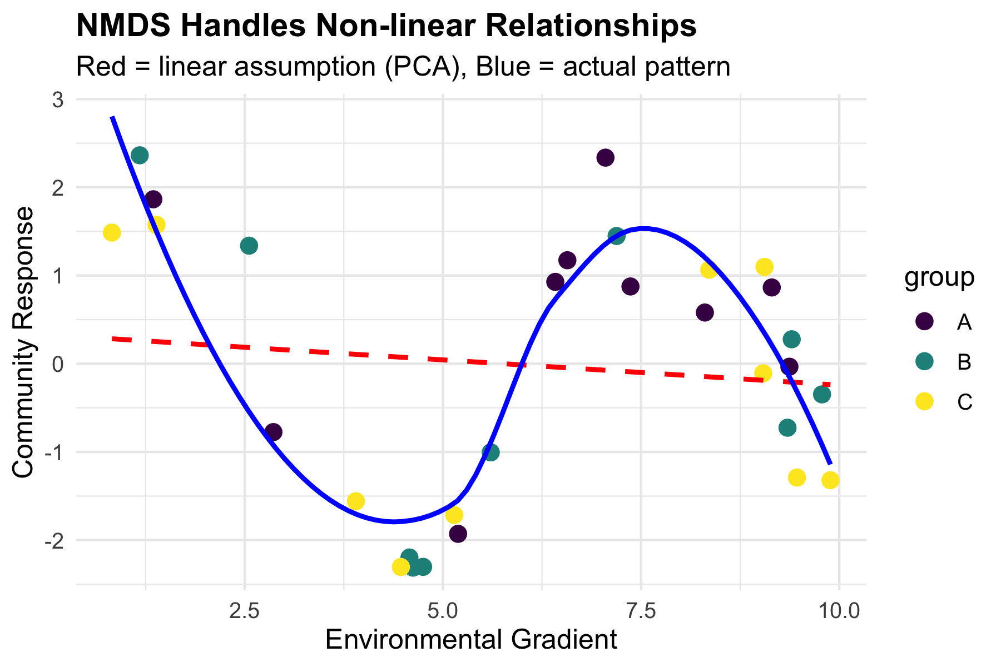
NMDS Assumptions:
✅ Few assumptions:
Samples are independent
Dissimilarity measure is appropriate
Sufficient data for stable solution
❌ No assumptions about:
Data distribution
Linear relationships
Homoscedasticity
Normality
This makes NMDS very robust for ecological data!
# Show why NMDS is robust - non-linear example
set.seed(42)
n <- 30
x <- runif(n, 0, 10)
y <- 2 * sin(x) + rnorm(n, 0, 0.5)
group <- rep(c("A", "B", "C"), each = 10)
tibble(x, y, group) %>%
ggplot(aes(x, y, color = group)) +
geom_point(size = 3) +
geom_smooth(method = "lm", se = FALSE, color = "red", linetype = "dashed") +
geom_smooth(method = "loess", se = FALSE, color = "blue") +
labs(title = "NMDS Handles Non-linear Relationships",
subtitle = "Red = linear assumption (PCA), Blue = actual pattern",
x = "Environmental Gradient",
y = "Community Response") +
scale_color_viridis_d()

Slide 10
NMDS in Practice
Running NMDS on Fish Communities
# Prepare species data (remove site column)
spe_matrix <- doubs_spe %>%
select(-site, -reach) %>%
as.matrix()
# Add small constant to avoid issues with zeros
spe_matrix <- spe_matrix + 0.1
# Run NMDS with multiple random starts
set.seed(123)
fish_nmds <- metaMDS(spe_matrix,
distance = "bray", # Bray-Curtis dissimilarity
k = 2, # 2 dimensions
trymax = 100) # Maximum tries
Run 0 stress 0.07449349
Run 1 stress 0.1201175
Run 2 stress 0.1201749
Run 3 stress 0.1195174
Run 4 stress 0.1201175
Run 5 stress 0.1468615
Run 6 stress 0.1395204
Run 7 stress 0.09450578
Run 8 stress 0.07460885
... Procrustes: rmse 0.02069815 max resid 0.09861179
Run 9 stress 0.1273318
Run 10 stress 0.1200159
Run 11 stress 0.1273318
Run 12 stress 0.07449349
... Procrustes: rmse 4.373445e-06 max resid 1.595028e-05
... Similar to previous best
Run 13 stress 0.09450578
Run 14 stress 0.140665
Run 15 stress 0.07459993
... Procrustes: rmse 0.02014078 max resid 0.09796964
Run 16 stress 0.1262615
Run 17 stress 0.07460885
... Procrustes: rmse 0.02069823 max resid 0.09861196
Run 18 stress 0.09134568
Run 19 stress 0.07460885
... Procrustes: rmse 0.02069807 max resid 0.09861147
Run 20 stress 0.07460885
... Procrustes: rmse 0.02069863 max resid 0.09861444
*** Best solution repeated 1 times
# Check the stress
cat("Final stress:", round(fish_nmds$stress, 3))
Final stress: 0.074

Slide 11
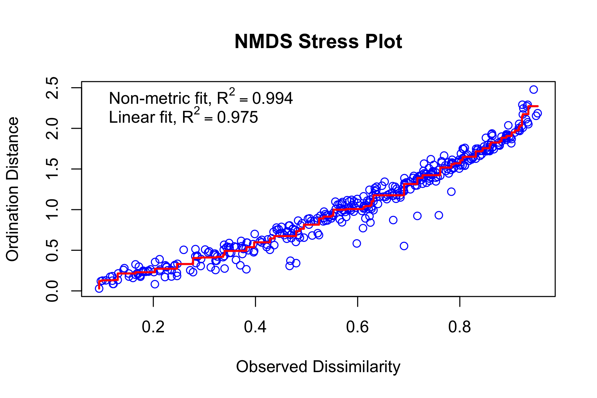
Code Explanation:
metaMDS(): Main NMDS function from vegan package
distance = "bray": Bray-Curtis dissimilarity (best for abundance data)
k = 2: Two dimensions for plotting
trymax = 100: Try 100 random starting configurations
Small constant added to avoid zero-distance issues
# Create stress plot (Shepard diagram)
stressplot(fish_nmds, main = "NMDS Stress Plot")

Slide 12
Interpreting NMDS Output
# Detailed look at NMDS results
summary(fish_nmds)
Length Class Mode
nobj 1 -none- numeric
nfix 1 -none- numeric
ndim 1 -none- numeric
ndis 1 -none- numeric
ngrp 1 -none- numeric
diss 406 -none- numeric
iidx 406 -none- numeric
jidx 406 -none- numeric
xinit 58 -none- numeric
istart 1 -none- numeric
isform 1 -none- numeric
ities 1 -none- numeric
iregn 1 -none- numeric
iscal 1 -none- numeric
maxits 1 -none- numeric
sratmx 1 -none- numeric
strmin 1 -none- numeric
sfgrmn 1 -none- numeric
dist 406 -none- numeric
dhat 406 -none- numeric
points 58 -none- numeric
stress 1 -none- numeric
grstress 1 -none- numeric
iters 1 -none- numeric
icause 1 -none- numeric
call 5 -none- call
model 1 -none- character
distmethod 1 -none- character
distcall 1 -none- character
data 1 -none- character
distance 1 -none- character
converged 1 -none- numeric
tries 1 -none- numeric
bestry 1 -none- numeric
engine 1 -none- character
species 54 -none- numeric

Slide 13
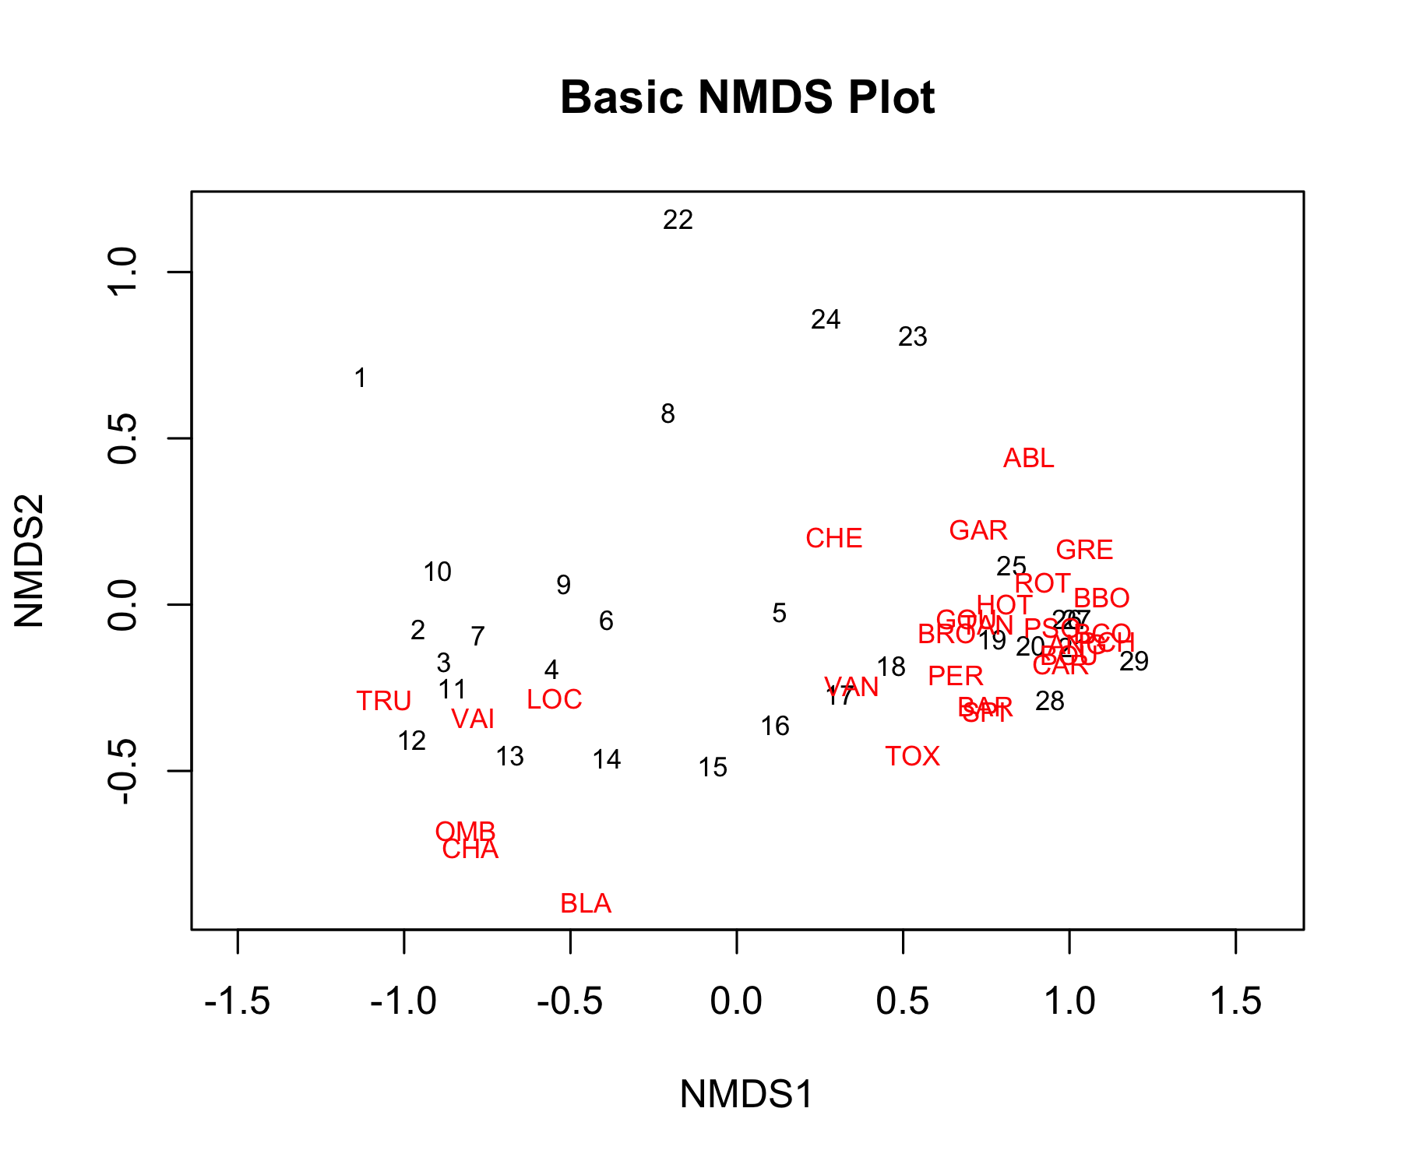
Understanding the Output:
Stress = 0.074: This is excellent
Our 2D representation preserves the original distances well
Convergent solutions: Found stable solutions from multiple tries
Two dimensions: Axis 1 and Axis 2 have no inherent meaning (unlike PCA components)
No eigenvalues: NMDS doesn’t calculate variance explained per axis
# Basic NMDS plot
plot(fish_nmds, type = "t", main = "Basic NMDS Plot")

Slide 14
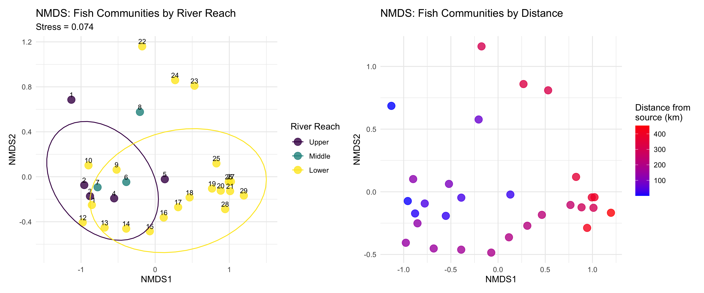
Creating Enhanced NMDS Plots
# Extract NMDS scores and add grouping information
nmds_scores <- fish_nmds$points %>%
as.data.frame() %>%
rownames_to_column("site_num") %>%
mutate(site_num = as.numeric(site_num)) %>%
left_join(doubs_env %>% mutate(site_num = as.numeric(site)), by = "site_num") %>%
select(MDS1, MDS2, reach, das, site)
# Create enhanced plots
p1 <- nmds_scores %>%
ggplot(aes(MDS1, MDS2)) +
geom_point(aes(color = reach), size = 4, alpha = 0.8) +
geom_text(aes(label = site), hjust = 0.5, vjust = -0.5, size = 3) +
stat_ellipse(aes(color = reach), level = 0.75) +
labs(title = "NMDS: Fish Communities by River Reach",
subtitle = paste("Stress =", round(fish_nmds$stress, 3)),
x = "NMDS1", y = "NMDS2",
color = "River Reach") +
scale_color_viridis_d() +
theme_minimal()
p2 <- nmds_scores %>%
ggplot(aes(MDS1, MDS2)) +
geom_point(aes(color = das), size = 4, alpha = 0.8) +
scale_color_gradient(low = "blue", high = "red", name = "Distance from\nsource (km)") +
labs(title = "NMDS: Fish Communities by Distance",
x = "NMDS1", y = "NMDS2") +
theme_minimal()
p1 + p2

Slide 15
What the NMDS Shows:
Clear separation between river reaches
Gradient pattern from upper to lower reaches
Sites within each reach are more similar to each other than to other reaches

Slide 16
PERMANOVA: Testing Multivariate Differences
What is PERMANOVA?

Slide 17
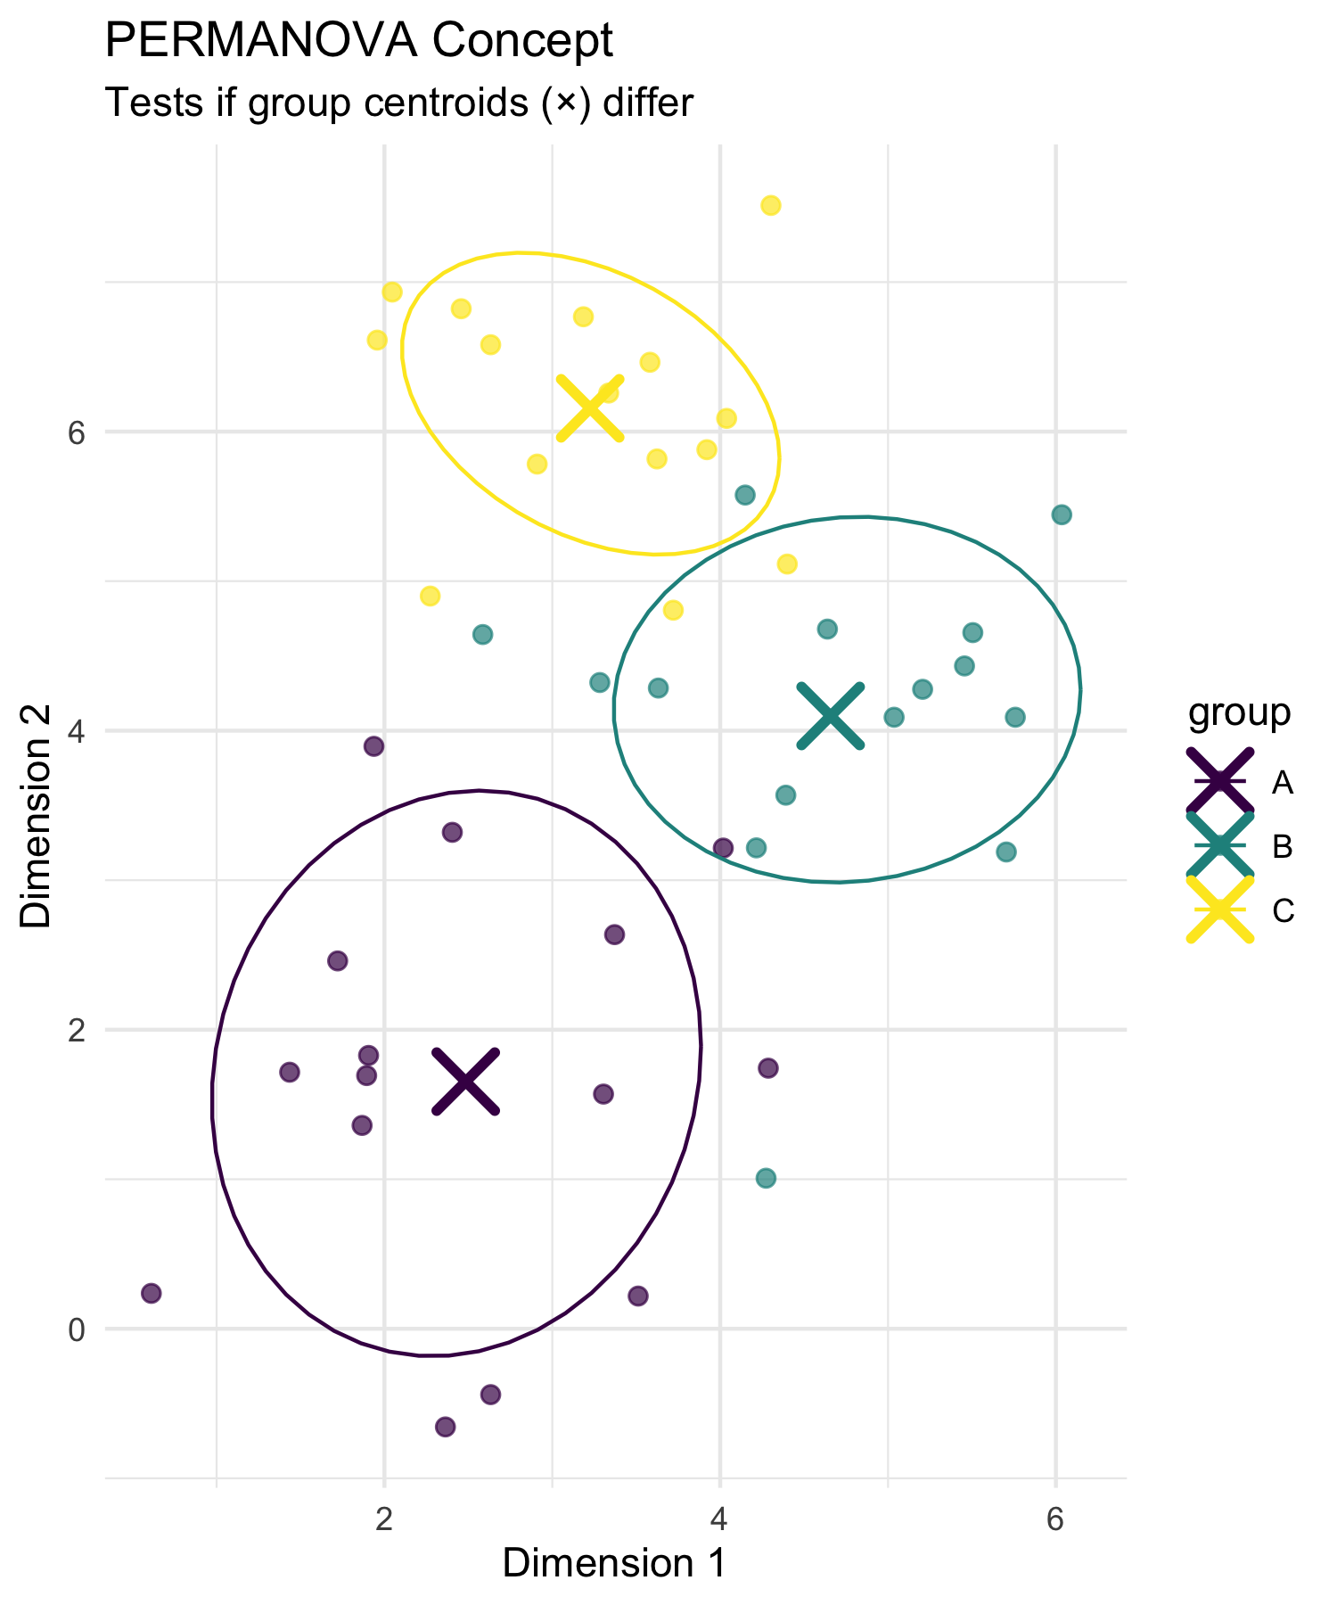
PERMANOVA (Permutational Multivariate ANOVA):
Purpose: Test whether groups have different multivariate centroids
Method: ANOVA using distance matrices instead of raw data
Advantage: No distributional assumptions
Permutation: Creates null distribution by randomly reassigning group labels
Think of it as:
Multivariate version of ANOVA
Uses distances between samples instead of means
Tests: “Are the centers of these groups different in multivariate space?”
# Conceptual visualization of PERMANOVA
set.seed(42)
group_a <- data.frame(x = rnorm(15, 2, 1), y = rnorm(15, 2, 1), group = "A")
group_b <- data.frame(x = rnorm(15, 5, 1), y = rnorm(15, 4, 1), group = "B")
group_c <- data.frame(x = rnorm(15, 3, 1), y = rnorm(15, 6, 1), group = "C")
combined <- rbind(group_a, group_b, group_c)
# Calculate centroids
centroids <- combined %>%
group_by(group) %>%
summarise(x = mean(x), y = mean(y), .groups = "drop")
combined %>%
ggplot(aes(x, y, color = group)) +
geom_point(size = 2, alpha = 0.7) +
geom_point(data = centroids, size = 6, shape = 4, stroke = 2) +
stat_ellipse(level = 0.68) +
labs(title = "PERMANOVA Concept",
subtitle = "Tests if group centroids (×) differ",
x = "Dimension 1", y = "Dimension 2") +
scale_color_viridis_d() +
theme_minimal()

Slide 18
How PERMANOVA Works

Slide 19
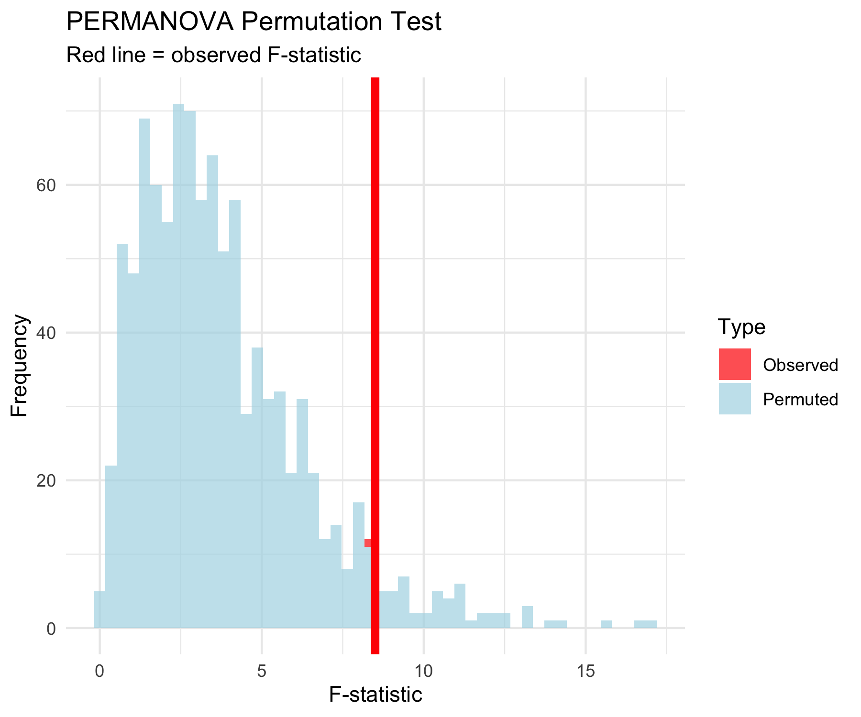
PERMANOVA Algorithm:
Calculate distance matrix between all pairs of samples
Calculate F-statistic based on distances:
  Between-group sum of squares
  Within-group sum of squares
Permute group labels randomly (e.g., 999 times)
Recalculate F-statistic for each permutation
Compare observed F to permutation distribution
P-value = proportion of permuted F ≥ observed F
Why permutation?
No assumptions about data distribution
Creates empirical null distribution
Accounts for complex dependency structures
# Simulate PERMANOVA permutation distribution
set.seed(123)
observed_F <- 8.5
null_F <- c(rgamma(999, 2, 0.5), observed_F)
tibble(F_statistic = null_F,
type = c(rep("Permuted", 999), "Observed")) %>%
ggplot(aes(F_statistic)) +
geom_histogram(aes(fill = type), bins = 50, alpha = 0.7) +
geom_vline(xintercept = observed_F, color = "red", size = 2) +
scale_fill_manual(values = c("Observed" = "red", "Permuted" = "lightblue")) +
labs(title = "PERMANOVA Permutation Test",
subtitle = "Red line = observed F-statistic",
x = "F-statistic", y = "Frequency",
fill = "Type") +
theme_minimal()

Slide 20
PERMANOVA Hypotheses

Slide 21
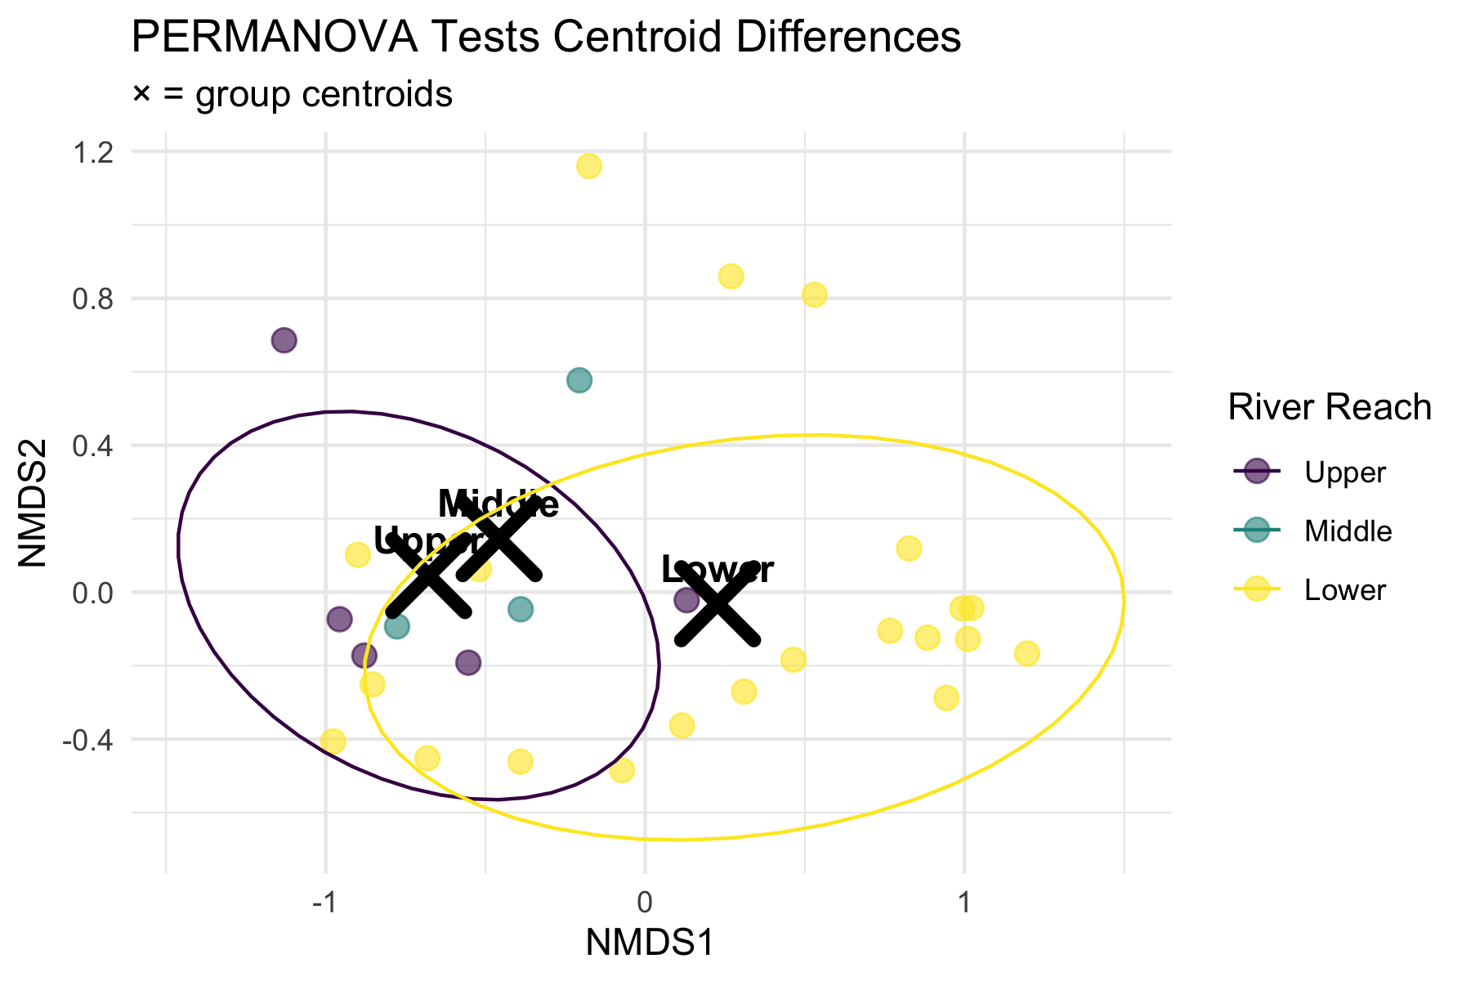
Research Question: “Do fish communities differ significantly between river reaches?”
Statistical Hypotheses:
H₀: The centroids of fish communities are the same across all river reaches (Upper = Middle = Lower)
H₁: At least one river reach has a different community centroid
In practical terms:
H₀: River position doesn’t affect community composition
H₁: River position significantly affects community composition
# Visualize the hypothesis being tested
nmds_scores %>%
group_by(reach) %>%
summarise(cent_x = mean(MDS1), cent_y = mean(MDS2), .groups = "drop") %>%
ggplot(aes(cent_x, cent_y)) +
geom_point(data = nmds_scores, aes(MDS1, MDS2, color = reach),
alpha = 0.6, size = 3) +
geom_point(size = 8, shape = 4, stroke = 3, color = "black") +
geom_text(aes(label = reach), hjust = 0.5, vjust = -0.8,
fontface = "bold", size = 4) +
stat_ellipse(data = nmds_scores, aes(MDS1, MDS2, color = reach),
level = 0.75) +
labs(title = "PERMANOVA Tests Centroid Differences",
subtitle = "× = group centroids",
x = "NMDS1", y = "NMDS2",
color = "River Reach") +
scale_color_viridis_d() +
theme_minimal()

Slide 22
PERMANOVA Assumptions

Slide 23
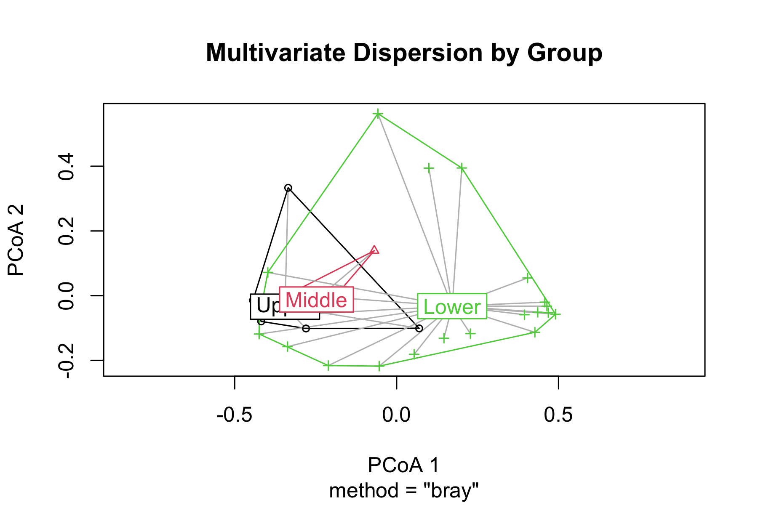
PERMANOVA Assumptions:
✅ Required:
Independence: Samples are independent
Exchangeability: Under H₀, observations are exchangeable between groups
Homogeneity of dispersion: Groups have similar multivariate spread
❌ Not required:
Normality
Linearity
Specific distribution
Checking Assumptions:
Use betadisper() to test homogeneity of dispersion
If violated, PERMANOVA tests dispersion differences, not location differences
# Check homogeneity of dispersion assumption
spe_dist <- vegdist(spe_matrix, method = "bray")
dispersion_test <- betadisper(spe_dist, doubs_env$reach)
# Test for homogeneity
dispersion_anova <- anova(dispersion_test)
cat("Homogeneity of dispersion test p-value:", round(dispersion_anova$`Pr(>F)`[1], 4))
Homogeneity of dispersion test p-value: 0.0784
# Plot dispersions
plot(dispersion_test, main = "Multivariate Dispersion by Group")

Slide 24
Running PERMANOVA
PERMANOVA on Fish Communities
# Run PERMANOVA using adonis2 (newer version)
perm_result <- adonis2(spe_matrix ~ reach,
data = doubs_env,
distance = "bray",
permutations = 999)
# Display results
perm_result
Permutation test for adonis under reduced model
Permutation: free
Number of permutations: 999
adonis2(formula = spe_matrix ~ reach, data = doubs_env, permutations = 999, distance = "bray")
Df SumOfSqs R2 F Pr(>F)
Model 2 1.0249 0.1849 2.9489 0.012 *
Residual 26 4.5180 0.8151
Total 28 5.5429 1.0000
---
Signif. codes: 0 '***' 0.001 '**' 0.01 '*' 0.05 '.' 0.1 ' ' 1

Slide 25
Line-by-line interpretation:
reach: The factor being tested (river reach)
Df = 2: Degrees of freedom (3 groups - 1)
SumOfSqs: Between-group sum of squares
R2: Proportion of variance explained by reach
F: F-statistic (ratio of between/within group variation)
Pr(>F): P-value from permutation test
What this means:
Significant result (p < 0.001): We reject H₀
River reach explains substantial variation in fish communities
Fish communities differ significantly between river reaches
Very few permutations gave F ≥ observed F

Slide 26
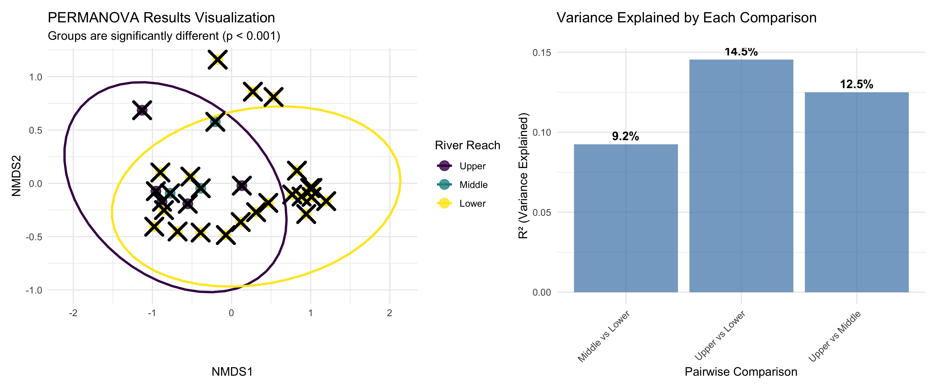
Pairwise PERMANOVA Tests
# Function for pairwise PERMANOVA
pairwise_permanova <- function(data, groups, distance_method = "bray") {
group_levels <- levels(as.factor(groups))
n_groups <- length(group_levels)
results <- tibble(
comparison = character(),
F_statistic = numeric(),
R2 = numeric(),
p_value = numeric()
)
for(i in 1:(n_groups-1)) {
for(j in (i+1):n_groups) {
# Subset data for this comparison
group1 <- group_levels[i]
group2 <- group_levels[j]
indices <- which(groups %in% c(group1, group2))
sub_data <- data[indices, ]
sub_groups <- droplevels(groups[indices])
# Run PERMANOVA
result <- adonis2(sub_data ~ sub_groups,
distance = distance_method,
permutations = 999)
# Store results
results <- results %>%
add_row(
comparison = paste(group1, "vs", group2),
F_statistic = result$F[1],
R2 = result$R2[1],
p_value = result$Pr[1]
)
}
}
# Apply Bonferroni correction
results$p_adjusted <- p.adjust(results$p_value, method = "bonferroni")
return(results)
}
# Run pairwise tests
pairwise_results <- pairwise_permanova(spe_matrix, doubs_env$reach)
pairwise_results %>%
mutate(across(c(F_statistic, R2), ~round(.x, 3)),
across(c(p_value, p_adjusted), ~round(.x, 4)))
# A tibble: 3 × 5
comparison F_statistic R2 p_value p_adjusted
<chr> <dbl> <dbl> <dbl> <dbl>
1 Upper vs Middle 0.857 0.125 0.528 1
2 Upper vs Lower 4.08 0.145 0.012 0.036
3 Middle vs Lower 2.24 0.092 0.087 0.261
Interpretation of Pairwise Results:
All pairwise comparisons are statistically significant even after Bonferroni correction
Upper vs Lower shows the strongest difference (highest F-statistic)
Each comparison explains a substantial portion of variance (R² > 0.3)
Biological interpretation: Fish communities change progressively down the river
Visualizing PERMANOVA Results
# Create visualization of PERMANOVA results
p1 <- nmds_scores %>%
ggplot(aes(MDS1, MDS2, color = reach)) +
geom_point(size = 4, alpha = 0.8) +
stat_ellipse(level = 0.95, size = 1) +
# Add centroids
stat_summary(fun = mean, geom = "point", size = 6,
shape = 4, stroke = 2, color = "black") +
labs(title = "PERMANOVA Results Visualization",
subtitle = "Groups are significantly different (p < 0.001)",
x = "NMDS1", y = "NMDS2",
color = "River Reach") +
scale_color_viridis_d() +
theme_minimal()
# Show R-squared values
p2 <- pairwise_results %>%
ggplot(aes(comparison, R2)) +
geom_col(fill = "steelblue", alpha = 0.7) +
geom_text(aes(label = paste0(round(R2*100, 1), "%")),
vjust = -0.5, fontface = "bold") +
labs(title = "Variance Explained by Each Comparison",
x = "Pairwise Comparison",
y = "R² (Variance Explained)") +
theme_minimal() +
theme(axis.text.x = element_text(angle = 45, hjust = 1))
p1 + p2

Slide 27
ANOSIM: Analysis of Similarities
What is ANOSIM?

Slide 28
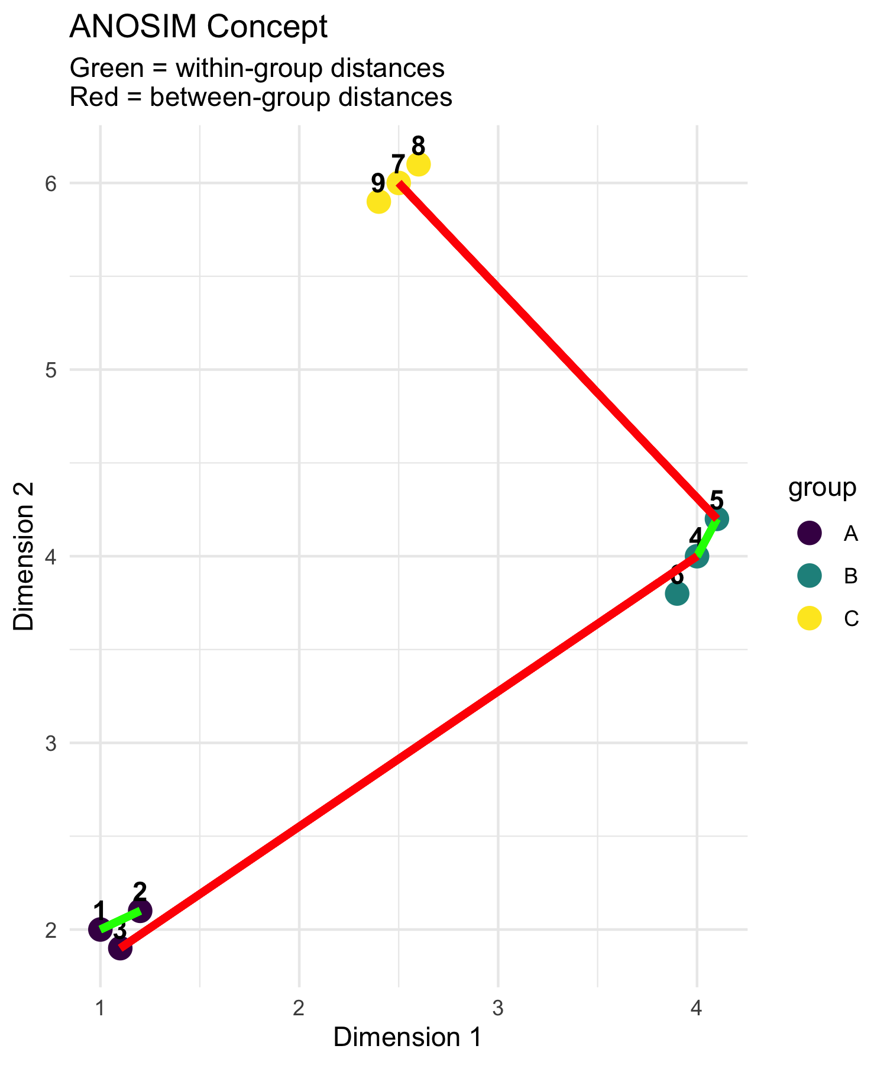
ANOSIM (Analysis of Similarities):
Purpose: Test whether samples within groups are more similar than samples between groups
Method: Based on rank dissimilarities
Statistic: R-statistic ranging from -1 to +1
Interpretation:
  R ≈ 1: Groups are completely separated
  R ≈ 0: Groups are indistinguishable
  R < 0: More dissimilarity within groups than between
Differences from PERMANOVA:
ANOSIM uses ranks of distances
PERMANOVA uses actual distances
ANOSIM is more robust but less powerful
# Conceptual diagram showing ANOSIM logic
set.seed(42)
# Create example distance matrix
sample_points <- tibble(
x = c(1, 1.2, 1.1, 4, 4.1, 3.9, 2.5, 2.6, 2.4),
y = c(2, 2.1, 1.9, 4, 4.2, 3.8, 6, 6.1, 5.9),
group = rep(c("A", "B", "C"), each = 3),
sample = 1:9
)
sample_points %>%
ggplot(aes(x, y, color = group)) +
geom_point(size = 4) +
geom_text(aes(label = sample), hjust = 0.5, vjust = -0.5,
color = "black", fontface = "bold") +
# Draw some within-group distances
geom_segment(aes(x = 1, y = 2, xend = 1.2, yend = 2.1),
color = "green", size = 1.5, alpha = 0.7) +
geom_segment(aes(x = 4, y = 4, xend = 4.1, yend = 4.2),
color = "green", size = 1.5, alpha = 0.7) +
# Draw some between-group distances
geom_segment(aes(x = 1.1, y = 1.9, xend = 4, yend = 4),
color = "red", size = 1.5, alpha = 0.7) +
geom_segment(aes(x = 2.5, y = 6, xend = 4.1, yend = 4.2),
color = "red", size = 1.5, alpha = 0.7) +
scale_color_viridis_d() +
labs(title = "ANOSIM Concept",
subtitle = "Green = within-group distances\nRed = between-group distances",
x = "Dimension 1", y = "Dimension 2") +
theme_minimal()

Slide 29
How ANOSIM Works

Slide 30
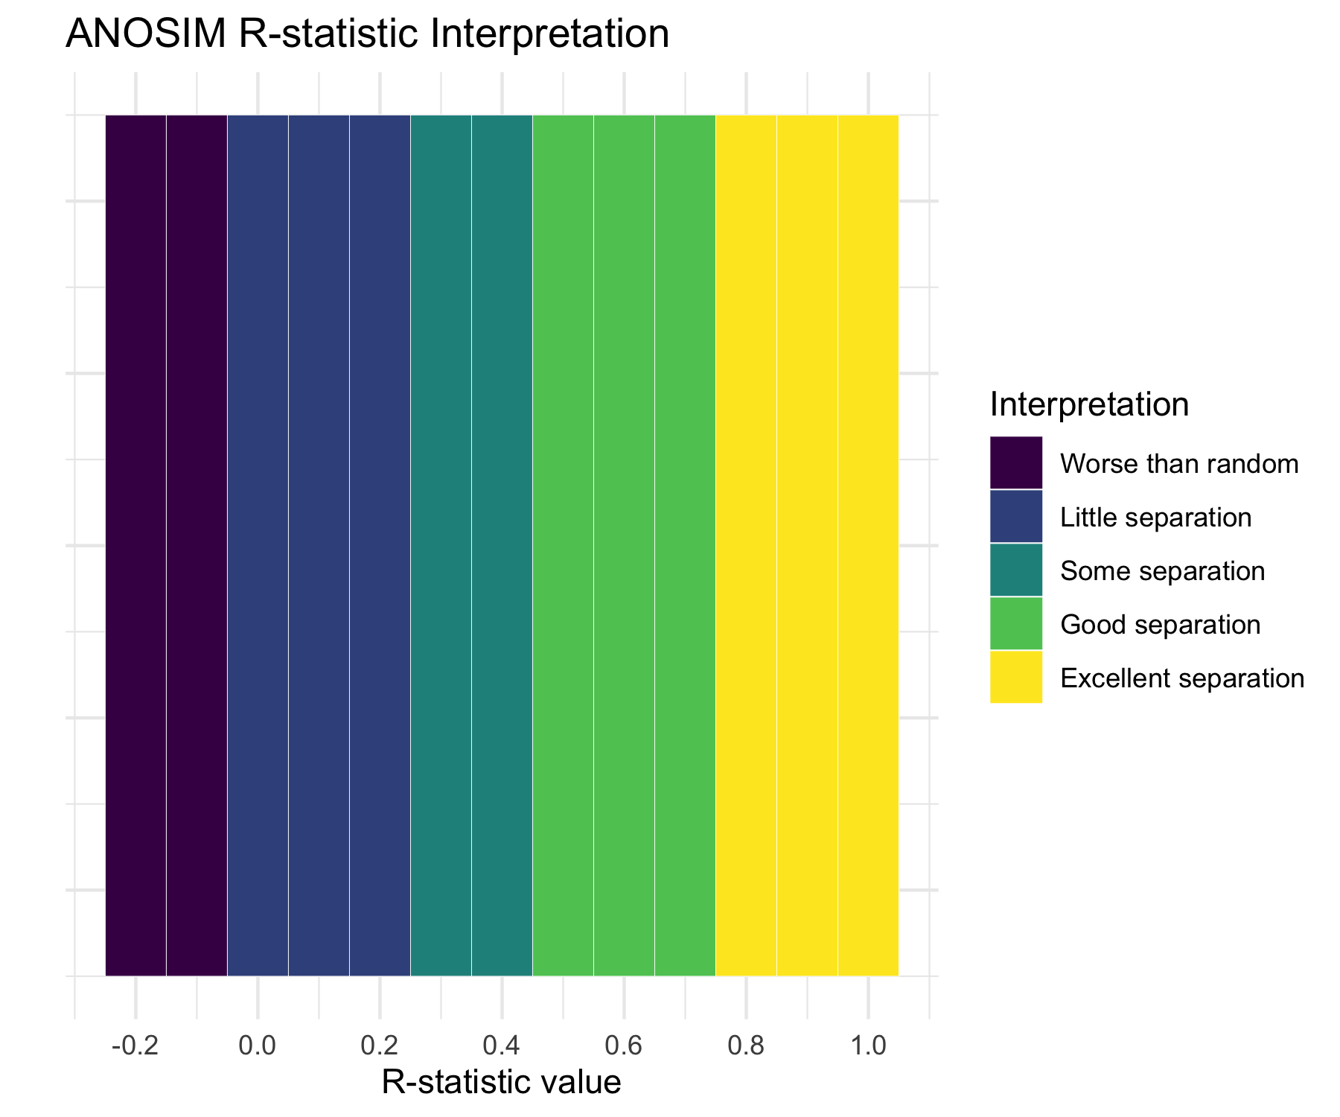
ANOSIM Algorithm:
Calculate dissimilarity matrix between all samples
Rank all dissimilarities from smallest to largest
Calculate mean rank of within-group dissimilarities (r̄w)
Calculate mean rank of between-group dissimilarities (r̄b)
Compute R-statistic: R = (r̄b - r̄w) / (N(N-1)/4) where N = total number of samples
Permute group labels and recalculate R many times
P-value = proportion of permuted R ≥ observed R
R-statistic interpretation:
R = 1: Perfect separation
R = 0: No separation
R = -1: More similar between groups than within
# Create interpretation guide for R-statistic
tibble(
R_value = seq(-0.2, 1, 0.1),
interpretation = case_when(
R_value < 0 ~ "Worse than random",
R_value < 0.25 ~ "Little separation",
R_value < 0.5 ~ "Some separation",
R_value < 0.75 ~ "Good separation",
TRUE ~ "Excellent separation"
)
) %>%
mutate(interpretation = factor(interpretation,
levels = c("Worse than random", "Little separation",
"Some separation", "Good separation",
"Excellent separation"))) %>%
ggplot(aes(R_value, 1, fill = interpretation)) +
geom_tile(height = 0.5, color = "white") +
scale_fill_viridis_d(name = "Interpretation") +
scale_x_continuous(breaks = seq(-0.2, 1, 0.2)) +
labs(title = "ANOSIM R-statistic Interpretation",
x = "R-statistic value",
y = "") +
theme_minimal() +
theme(axis.text.y = element_blank(),
axis.ticks.y = element_blank())

Slide 31
Running ANOSIM
# Run ANOSIM
anosim_result <- anosim(spe_matrix, doubs_env$reach,
distance = "bray", permutations = 999)
# Display results
anosim_result
Call:
anosim(x = spe_matrix, grouping = doubs_env$reach, permutations = 999, distance = "bray")
Dissimilarity: bray
ANOSIM statistic R: 0.119
Significance: 0.067
Permutation: free
Number of permutations: 999

Slide 32
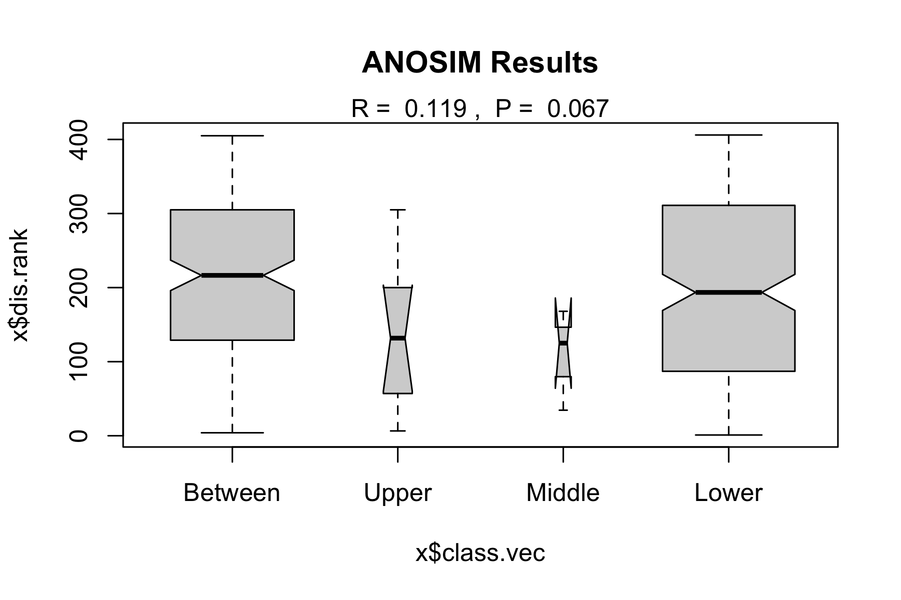
ANOSIM Results Interpretation:
R = 0.119: This indicates little separation between groups
p-value = 0.067: Highly significant result
Biological meaning: Fish communities are well-separated between river reaches, with communities within each reach being much more similar to each other than to communities in other reaches
# Plot ANOSIM results
plot(anosim_result, main = "ANOSIM Results")

Slide 33
ANOSIM vs PERMANOVA Comparison
# Compare results
comparison_table <- tibble(
Method = c("PERMANOVA", "ANOSIM"),
`Test Statistic` = c(paste("F =", round(perm_result$F[1], 2)),
paste("R =", round(anosim_result$statistic, 3))),
`P-value` = c(round(perm_result$Pr[1], 3),
round(anosim_result$signif, 3)),
`Interpretation` = c("Groups have different centroids",
"Excellent group separation"),
`What it tests` = c("Differences in group means",
"Overlap between groups"),
`Approach` = c("Uses actual distances", "Uses rank distances")
)
comparison_table
# A tibble: 2 × 6
Method `Test Statistic` `P-value` Interpretation `What it tests` Approach
<chr> <chr> <dbl> <chr> <chr> <chr>
1 PERMANOVA F = 2.95 0.012 Groups have dif… Differences in… Uses ac…
2 ANOSIM R = 0.119 0.067 Excellent group… Overlap betwee… Uses ra…

Slide 34
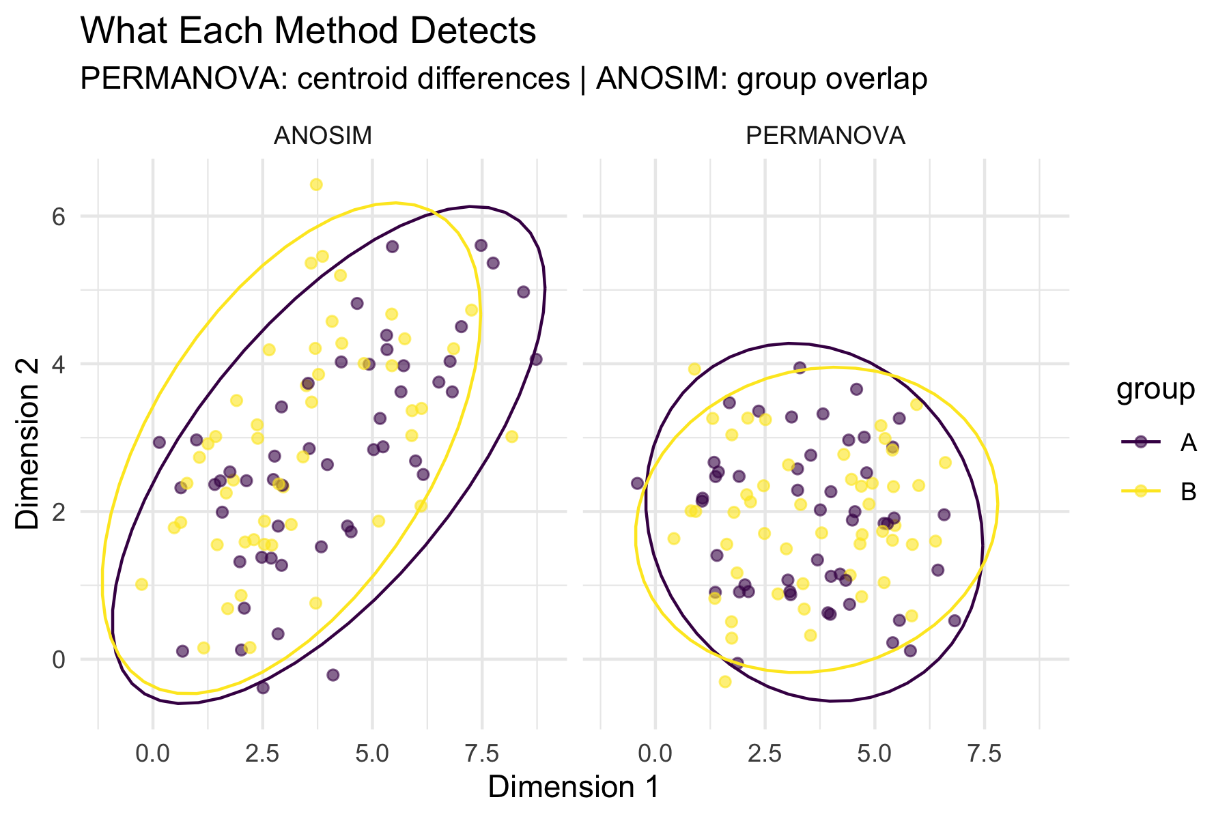
When to use which:
PERMANOVA:
More powerful for detecting differences
Better for complex experimental designs
Can handle interactions and covariates
Preferred for most applications
ANOSIM:
More robust to outliers
Simpler interpretation
Good for initial exploratory analysis
Useful when distributions are very non-normal
# Visualize the difference in what each method tests
tibble(
method = rep(c("PERMANOVA", "ANOSIM"), each = 100),
x = c(rnorm(50, 2, 1), rnorm(50, 5, 1), # PERMANOVA groups
rnorm(50, 2, 1), rnorm(50, 5, 1.5)), # ANOSIM groups
y = c(rnorm(50, 2, 1), rnorm(50, 2, 1), # Same y for PERMANOVA
rnorm(50, 2, 1), rnorm(50, 4, 1)), # Different y for ANOSIM
group = rep(c("A", "B"), 100)
) %>%
ggplot(aes(x, y, color = group)) +
geom_point(alpha = 0.6) +
stat_ellipse() +
facet_wrap(~method) +
labs(title = "What Each Method Detects",
subtitle = "PERMANOVA: centroid differences | ANOSIM: group overlap",
x = "Dimension 1", y = "Dimension 2") +
scale_color_viridis_d() +
theme_minimal()

Slide 35
Environmental Drivers
Which Environmental Variables Matter?
# Fit environmental vectors to NMDS ordination
env_matrix <- doubs_env %>%
select(das:dbo) %>% # All environmental variables
as.matrix()
# Fit environmental vectors
env_fit <- envfit(fish_nmds, env_matrix, permutations = 999)
env_fit
***VECTORS
NMDS1 NMDS2 r2 Pr(>r)
das 0.98098 0.19411 0.7284 0.001 ***
alt -1.00000 -0.00057 0.5650 0.001 ***
pen -0.61902 0.78538 0.2546 0.022 *
deb 0.99744 -0.07146 0.5701 0.001 ***
pH -0.09760 -0.99523 0.0746 0.368
dur 0.99967 -0.02575 0.2960 0.011 *
pho 0.22860 0.97352 0.5228 0.001 ***
nit 0.66665 0.74537 0.5200 0.001 ***
amm 0.19902 0.98000 0.5471 0.001 ***
oxy -0.46402 -0.88583 0.7826 0.001 ***
dbo 0.20211 0.97936 0.6883 0.001 ***
---
Signif. codes: 0 '***' 0.001 '**' 0.01 '*' 0.05 '.' 0.1 ' ' 1
Permutation: free
Number of permutations: 999

Slide 36
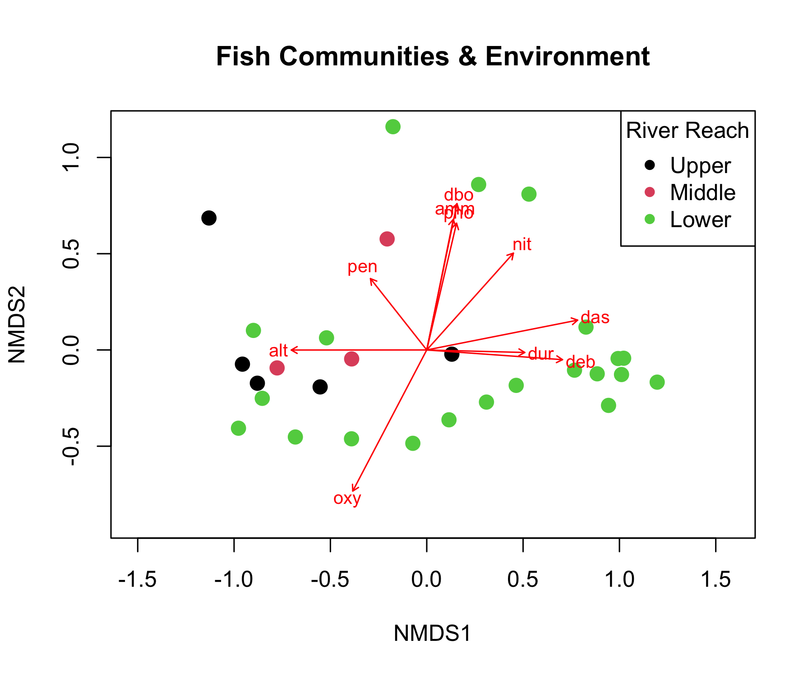
Environmental Vector Results:
Significant variables (p < 0.05):
# Extract significant variables
sig_vars <- env_fit$vectors$pvals < 0.05
sig_env <- names(env_fit$vectors$pvals)[sig_vars]
cat("Significant environmental drivers:\n")
Significant environmental drivers:
for(var in sig_env) {
p_val <- env_fit$vectors$pvals[var]
r2 <- env_fit$vectors$r[var]^2
cat(paste("-", var, ": R² =", round(r2, 3), ", p =", round(p_val, 3), "\n"))
}
- das : R² = 0.531 , p = 0.001
- alt : R² = 0.319 , p = 0.001
- pen : R² = 0.065 , p = 0.022
- deb : R² = 0.325 , p = 0.001
- dur : R² = 0.088 , p = 0.011
- pho : R² = 0.273 , p = 0.001
- nit : R² = 0.27 , p = 0.001
- amm : R² = 0.299 , p = 0.001
- oxy : R² = 0.612 , p = 0.001
- dbo : R² = 0.474 , p = 0.001
What this means:
These variables significantly correlate with community composition
They explain the spatial arrangement of sites in the NMDS
# Plot NMDS with environmental vectors
ordiplot(fish_nmds, type = "n", main = "Fish Communities & Environment")
points(fish_nmds, display = "sites", col = as.numeric(doubs_env$reach),
pch = 16, cex = 1.5)
plot(env_fit, p.max = 0.05, col = "red", cex = 0.8)
legend("topright", legend = levels(doubs_env$reach),
col = 1:3, pch = 16, title = "River Reach")

Slide 37
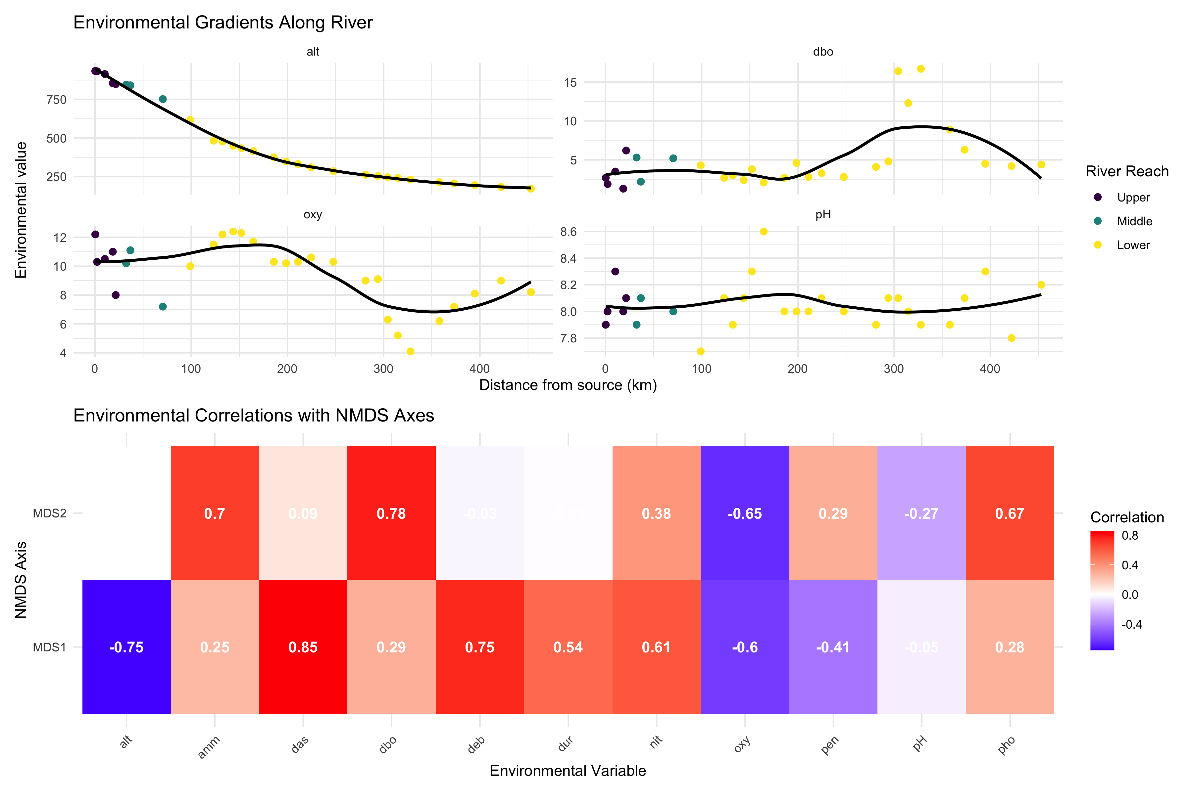
Environmental Gradient Analysis
# Create comprehensive environmental gradient plots
env_long <- doubs_env %>%
select(site, reach, das, pH, oxy, dbo, alt) %>%
pivot_longer(cols = c(pH, oxy, dbo, alt),
names_to = "variable", values_to = "value")
p1 <- env_long %>%
ggplot(aes(das, value, color = reach)) +
geom_point(size = 2) +
geom_smooth(method = "loess", se = FALSE, color = "black") +
facet_wrap(~variable, scales = "free_y") +
labs(title = "Environmental Gradients Along River",
x = "Distance from source (km)",
y = "Environmental value",
color = "River Reach") +
scale_color_viridis_d() +
theme_minimal()
# Show correlation with NMDS axes
nmds_env_cor <- cor(nmds_scores %>% select(MDS1, MDS2),
env_matrix, use = "complete.obs")
p2 <- nmds_env_cor %>%
as.data.frame() %>%
rownames_to_column("NMDS_axis") %>%
pivot_longer(cols = -NMDS_axis, names_to = "env_var", values_to = "correlation") %>%
ggplot(aes(env_var, NMDS_axis, fill = correlation)) +
geom_tile() +
geom_text(aes(label = round(correlation, 2)), color = "white", fontface = "bold") +
scale_fill_gradient2(low = "blue", mid = "white", high = "red",
midpoint = 0, name = "Correlation") +
labs(title = "Environmental Correlations with NMDS Axes",
x = "Environmental Variable", y = "NMDS Axis") +
theme_minimal() +
theme(axis.text.x = element_text(angle = 45, hjust = 1))
p1 / p2

Slide 38
Key Environmental Patterns:
Distance from source (das): Strong correlate with community change
Oxygen (oxy): Decreases downstream, affects fish communities
Biological oxygen demand (dbo): Increases downstream (pollution indicator)
Altitude (alt): Decreases downstream, associated with temperature changes

Slide 39
Summary and Conclusions
Key Findings from Today’s Analysis

Slide 40
NMDS Results:
Stress = 0.074: Excellent representation
Clear gradient from upper to lower river reaches
Within-reach similarity > between-reach similarity
PERMANOVA Results:
Highly significant differences between reaches (p < 0.001)
River reach explains substantial variance in community composition
All pairwise comparisons significant after correction
ANOSIM Results:
R = 0.119: Excellent separation
Confirms PERMANOVA findings with different approach
Strong within-group coherence
Environmental Drivers:
Distance from source: Primary gradient
Dissolved oxygen: Decreases downstream
Biological oxygen demand: Increases downstream
Multiple correlated factors drive community change
Biological Interpretation:
River continuum concept supported
Progressive community change from source to mouth
Environmental filtering shapes community assembly
Pollution gradient evident in lower reaches

Slide 41
Take-Home Messages

Slide 42
NMDS (Non-metric Multidimensional Scaling):
Visualizes community dissimilarity in 2D/3D
Preserves rank order of distances (non-metric)
No distributional assumptions
Stress < 0.2 for acceptable solutions
Great for exploring ecological gradients
PERMANOVA (Permutational MANOVA):
Tests for differences in group centroids
Uses distance matrices, not raw data
No distributional assumptions
Can handle complex designs
Check dispersion homogeneity assumption
ANOSIM (Analysis of Similarities):
Tests group separation using rank distances
R-statistic: -1 (no separation) to +1 (complete)
More robust to outliers than PERMANOVA
Simpler but less powerful
Good for exploratory analysis
Environmental Drivers:
Use envfit() to correlate environment with ordination
Identifies which variables explain community patterns
Helps understand ecological mechanisms
Essential for management implications

Slide 43
Best Practices Summary

Slide 44
Analysis Workflow:
Explore your data first
  Check for outliers and zeros
  Understand your sampling design
  Choose appropriate distance measure
Run NMDS for visualization
  Try multiple random starts
  Check stress values
  Interpret gradients carefully
Test hypotheses with PERMANOVA
  Check dispersion homogeneity first
  Include effect sizes in results
  Run pairwise tests if needed
Common Pitfalls to Avoid:
❌ Don’t:
Ignore stress values > 0.2
Forget to check PERMANOVA assumptions
Report only p-values without effect sizes
Over-interpret NMDS axes as meaningful
Use these methods on inappropriate data
✅ Do:
Use multiple random starts for NMDS
Check assumption violations
Include biological interpretation
Consider data transformations
Validate results with different methods

