Slide 1
Lecture 19 - Logistic Regression
Bill Perry

Slide 2
Lecture 19: Introduction to Logistic Regression
What is Logistic Regression?
Logistic regression is used when: - The response variable is binary (yes/no, 1/0, present/absent) - Data follows a binomial distribution (not normal) - We want to model the probability of an outcome
Today’s Example: Lizard Sexual Maturity
We’ll explore the relationship between body length and sexual maturity in female lizards - Response variable: Sexual maturity (mature: 1 = yes, 0 = no) - Predictor variable: Body length in cm - Question: Can we predict the probability of sexual maturity from body size?
Key Difference from Linear Regression
Linear regression: Models the actual values of Y
Logistic regression: Models the probability of Y = 1
Uses Generalized Linear Models (GLM) instead of General Linear Models

Slide 3
Step 1: Load and Explore the Data
# Load the lizard dataset
lizards_df <- read.csv("data/lizards.csv") %>%
clean_names()
# First few rows
head(lizards_df)
length mature
1 10.2 0
2 10.4 0
3 11.8 0
4 12.3 0
5 13.8 0
6 16.9 0

Slide 4
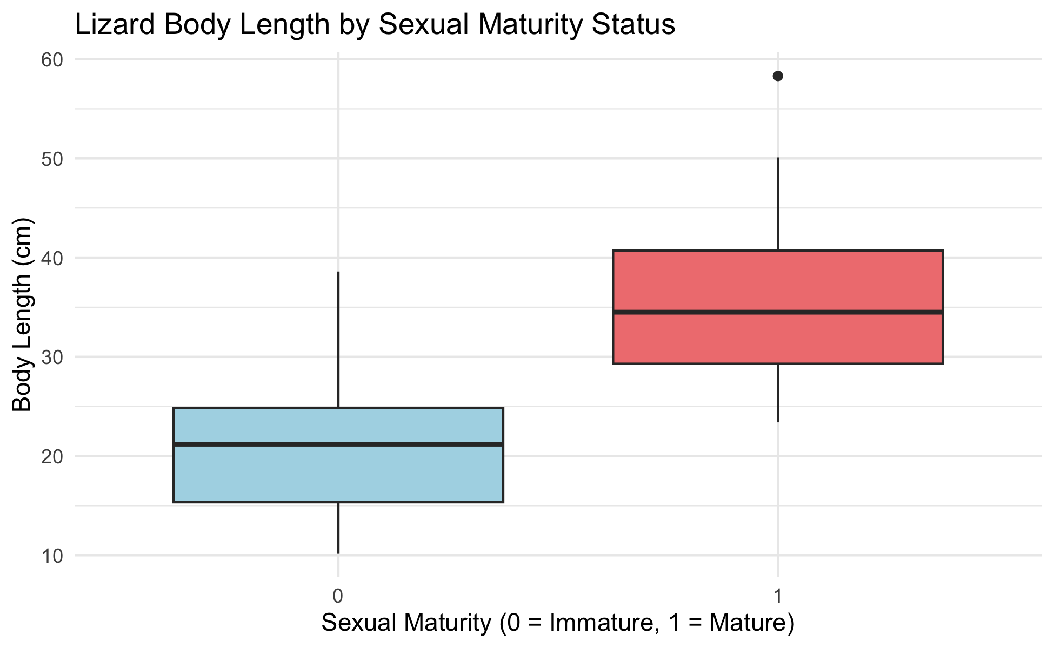
Step 2: Initial Data Visualization
Creating a Boxplot
Let’s visualize how body length differs between sexually mature and immature lizards:
# Create boxplot showing length by maturity status
maturity_boxplot <- ggplot(lizards_df, aes(x = factor(mature), y = length)) +
geom_boxplot(fill = c("lightblue", "lightcoral")) +
labs(title = "Lizard Body Length by Sexual Maturity Status",
x = "Sexual Maturity (0 = Immature, 1 = Mature)",
y = "Body Length (cm)") +
theme_minimal()
maturity_boxplot

Slide 5
What do we see?
There appears to be a relationship between size and sexual maturity
Mature lizards tend to be longer than immature ones
But there’s overlap - not a perfect separation
This suggests logistic regression might be appropriate

Slide 6
Step 3: Fit the Logistic Regression Model
Using glm() for Logistic Regression
The glm() function is similar to lm() but requires specifying the distribution family:
# Fit logistic regression model
# family = binomial tells R we have binary data
logistic_model <- glm(mature ~ length,
data = lizards_df,
family = binomial)
# Get model summary
summary(logistic_model)
Call:
glm(formula = mature ~ length, family = binomial, data = lizards_df)
Coefficients:
Estimate Std. Error z value Pr(>|z|)
(Intercept) -6.6899 2.1401 -3.126 0.00177 **
length 0.2503 0.0775 3.229 0.00124 **
---
Signif. codes: 0 '***' 0.001 '**' 0.01 '*' 0.05 '.' 0.1 ' ' 1
(Dispersion parameter for binomial family taken to be 1)
Null deviance: 60.176 on 43 degrees of freedom
Residual deviance: 34.041 on 42 degrees of freedom
AIC: 38.041
Number of Fisher Scoring iterations: 6
Interpreting the Model Output
Coefficients:
Intercept (β₀): -5.5847 - The log-odds when length = 0
Slope (β₁): 0.2503 - Change in log-odds for each 1 cm increase in length
P-values:
Both coefficients are significant (p < 0.05)
We reject the null hypothesis that β₁ = 0
There IS a relationship between length and sexual maturity
Understanding the Slope:
The positive slope (0.2503) indicates: - Longer lizards are more likely to be sexually mature - For each 1 cm increase in length, the log-odds of maturity increase by 0.2503

Slide 7
Step 4: Convert Log-Odds to Odds
Making the Results More Interpretable
Log-odds are hard to interpret. Let’s convert to odds:
# Extract the slope coefficient
slope_coefficient <- coef(logistic_model)[2]
# Convert log-odds to odds ratio
odds_ratio <- exp(slope_coefficient)
odds_ratio
length
1.284388
# Interpretation
# For every 1 cm increase in length, the odds of being sexually mature
# increase by a factor of 1.284 (or about 28.4%)

Slide 8
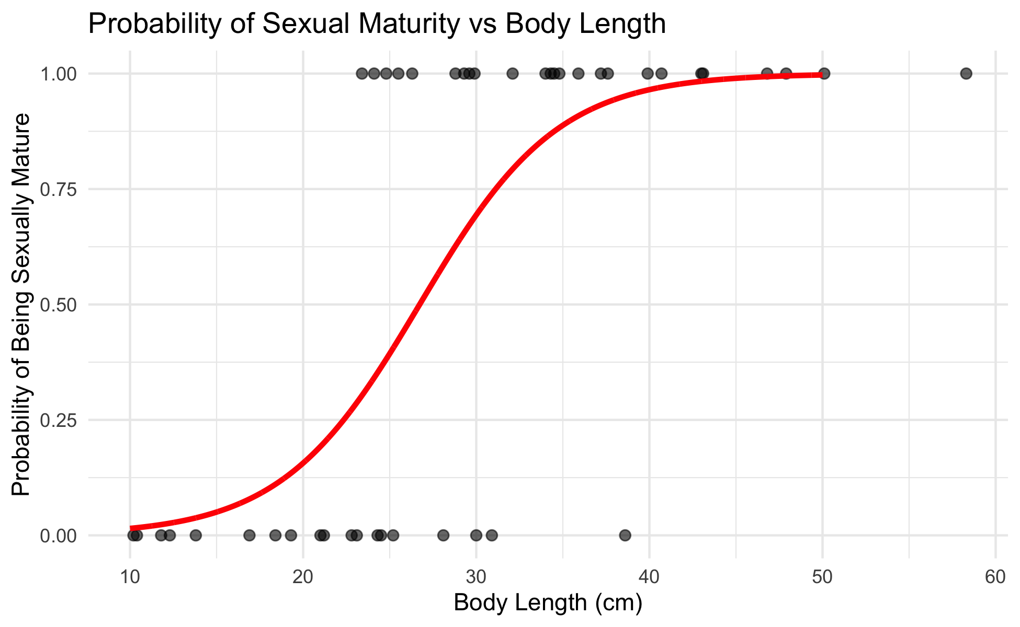
Step 5: Create the Logistic Regression Plot
Visualizing the Probability Curve
# Create sequence of x-values for prediction
xvals <- seq(from = 10, to = 50, by = 0.01)
# Get predicted probabilities
yvals <- predict(logistic_model,
list(length = xvals),
type = "response")
# Create prediction dataframe for plotting
prediction_df <- data.frame(length = xvals,
probability = yvals)
# Create the logistic regression plot
logistic_plot <- ggplot() +
# Add data points
geom_point(data = lizards_df,
aes(x = length, y = mature),
alpha = 0.6, size = 2) +
# Add logistic curve
geom_line(data = prediction_df,
aes(x = length, y = probability),
color = "red", size = 1.2) +
labs(title = "Probability of Sexual Maturity vs Body Length",
x = "Body Length (cm)",
y = "Probability of Being Sexually Mature") +
theme_minimal()
logistic_plot

Slide 9
What the S-curve tells us:
The red line shows how probability changes with length
Small lizards (<20 cm) have very low probability of being mature
Large lizards (>40 cm) have very high probability of being mature
The steepest change occurs around 25-30 cm

Slide 10
Step 6: Making Predictions
Using the Model for Prediction
Let’s predict the probability of sexual maturity for specific lizard sizes:
# Predict for a 20 cm lizard
prob_20cm <- predict(logistic_model,
list(length = 20),
type = "response")
prob_20cm
1
0.1565304
# Predict for a 30 cm lizard
prob_30cm <- predict(logistic_model,
list(length = 30),
type = "response")
prob_30cm
1
0.6939292
# Predict for a 40 cm lizard
prob_40cm <- predict(logistic_model,
list(length = 40),
type = "response")
prob_40cm
1
0.9651551
Interpretation:
A 20 cm lizard has about 14% probability of being sexually mature
A 30 cm lizard has about 70% probability of being sexually mature
A 40 cm lizard has about 96% probability of being sexually mature

Slide 11
Step 7: Model Fit Assessment
Calculating Pseudo-R2 Values
Unlike linear regression, logistic regression doesn’t have a traditional R². We use pseudo-R² instead:
# Calculate pseudo-R2 values using pscl package
pseudo_r2 <- pR2(logistic_model)
fitting null model for pseudo-r2
pseudo_r2
llh llhNull G2 McFadden r2ML r2CU
-17.0204762 -30.0881077 26.1352630 0.4343122 0.4478763 0.6009400
Interpreting Pseudo-R2 Values
The last three values are the pseudo-R² statistics:
McFadden: Compares model to null model
r2ML: Maximum likelihood based R²
r2CU: Cragg-Uhler (Nagelkerke) R²
Values around 0.4-0.5 indicate moderate to good fit. Our model explains approximately 40-50% of the variation in sexual maturity status.

Slide 12
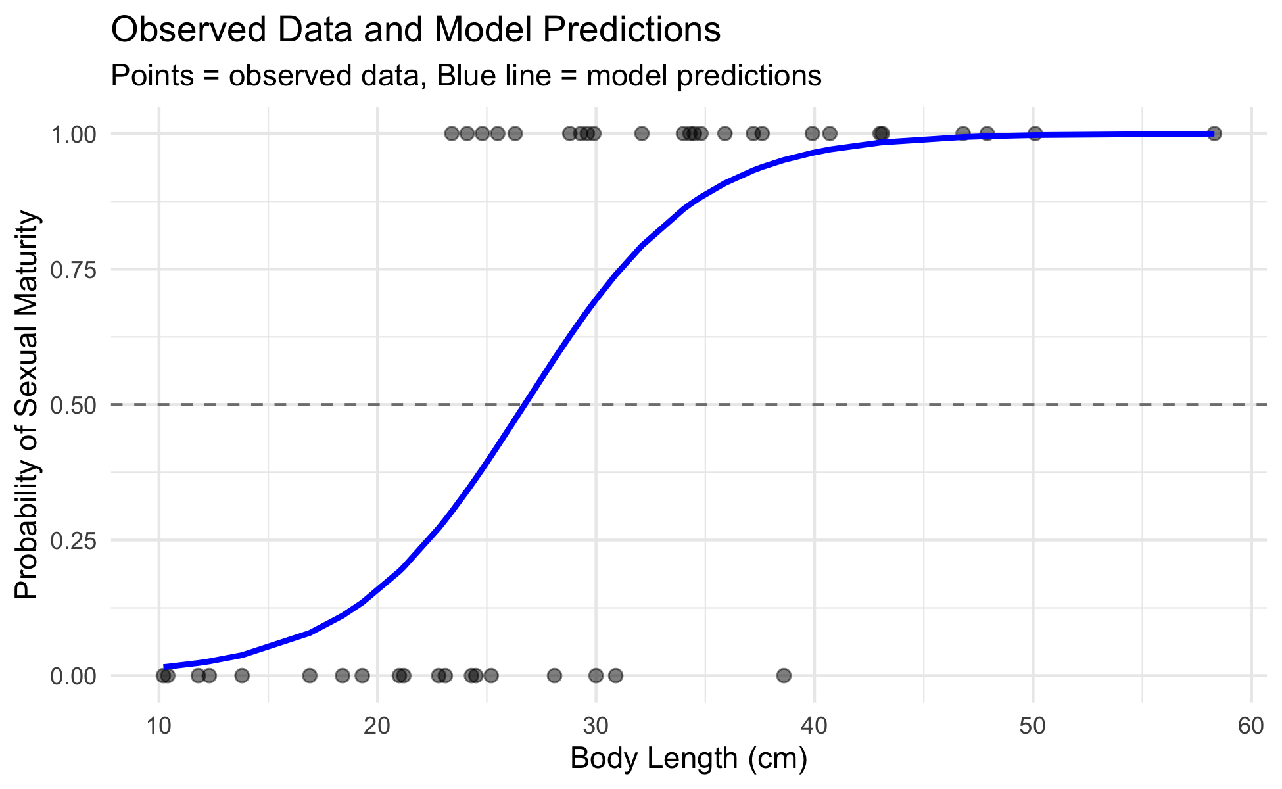
Step 8: Additional Diagnostics
Creating a More Detailed Summary Plot
# Create a plot showing observed vs predicted probabilities
lizards_df$predicted_prob <- predict(logistic_model, type = "response")
diagnostic_plot <- ggplot(lizards_df, aes(x = length)) +
# Add observed data as points
geom_point(aes(y = mature), alpha = 0.5, size = 2) +
# Add predicted probabilities
geom_line(aes(y = predicted_prob), color = "blue", size = 1) +
# Add 50% probability threshold
geom_hline(yintercept = 0.5, linetype = "dashed", color = "gray50") +
labs(title = "Observed Data and Model Predictions",
x = "Body Length (cm)",
y = "Probability of Sexual Maturity",
subtitle = "Points = observed data, Blue line = model predictions") +
theme_minimal()
diagnostic_plot

Slide 13
Summary: Key Takeaways
What We Learned:
Logistic regression models probability of binary outcomes
Uses glm() with family = binomial
Coefficients represent changes in log-odds
Convert to odds ratios for interpretation: exp(coefficient)
Creates S-shaped probability curves
Use pseudo-R² to assess model fit
Our Results:
Significant positive relationship between body length and sexual maturity
Each 1 cm increase in length increases odds of maturity by ~28%
Model explains ~40-50% of variation in maturity status
Can predict probability of maturity for any given length
When to Use Logistic Regression:
Binary response variable (0/1, yes/no, success/failure)
Want to predict probabilities
Relationships that follow S-shaped curves
When assumptions of linear regression are violated

