Slide 1
Lecture 11 — One-Way ANOVA: Comparing Many Groups
Partitioning variance, checking assumptions, and post-hoc tests with emmeans
Bill Perry

Slide 2
Where we left off (Lecture 10)
Factors — categorical variables with an ordered set of levels
fct_reorder() / fct_relevel() — set the order and the reference group
Cleaner, better-ordered plots for grouped data
Note
✅ Transition
The t-test (Lecture 04) compared two groups. But biology is full of three-or-more group questions — three species, four sites, five treatments. Now that you can control factor levels, today we learn the test for many groups: one-way ANOVA.

Slide 3
Goals for today
Understand why we don’t just run many t-tests
See how the F-statistic compares between- vs within-group variance
State ANOVA hypotheses (H₀: all means equal)
Check assumptions — normality of residuals, equal variance
Run it two ways: aov() and car::Anova()
Find which groups differ with emmeans post-hoc tests
Tools today:
palmerpenguins, tidyverse
car — Levene’s test, Anova()
emmeans, multcomp — post-hoc
Textbook:
📖 Whitlock & Schluter, Ch. 15 — ANOVA
📖 R4DS Ch. 16 — Factors
📖 R4DS Ch. 9 — Layers
Naming: models → _model, plots → _plot

Slide 4
How to Use These Slides — Predict · Type · Run
This lecture runs in four short chunks. After each chunk you switch to the activity and type the code yourself.
For every code block, do three things:
Predict — before it runs, say what you think the output will be
Type it out by hand — do not copy-paste
Run it and compare to your prediction
Note
✅ Why bother? (the evidence)
Predicting first forces you to retrieve what you know — the gap between guess and answer is what makes it stick.
Typing by hand builds the finger-memory and error-spotting that copy-paste skips.
Chunk → immediate practice keeps each idea in working memory long enough to form a lasting schema.

Slide 5
🧩 Chunk 1 of 4 · Why ANOVA & the F-Statistic
We will cover: why not many t-tests, what ANOVA asks, how F partitions variance, and a first look at the penguin data.
Tip
🖐 After this chunk: Activity Parts 1–3 (load the penguins, explore, state hypotheses).

Slide 6
Why Not Just Run Many t-Tests?
With 3 groups you’d need 3 t-tests (A–B, A–C, B–C). With 4 groups, 6 tests.
Every test at α = 0.05 has a 5% chance of a false positive. Run several and those risks stack up:
3 tests → ~14% chance of at least one false positive
6 tests → ~26%
ANOVA asks the question once, holding the overall error rate at 0.05.
Important
The multiple-comparisons problem
More tests = more chances to be fooled by noise. ANOVA is the single, honest test for “do any of these groups differ?”
📖 W&S §15.1 — why a single test

Slide 7
What One-Way ANOVA Asks
One numeric response (Y) across the levels of one categorical predictor (X).
Our question today:
Do the three penguin species differ in body mass?
Y = body_mass_g
X = species (Adelie, Chinstrap, Gentoo)
 | Hypothesis
H₀ — null | all group means are equal ($μ_{1}=μ_{2}=μ_{3}$)
Hₐ — alternate | at least one group mean differs
Note what Hₐ does not say: it does not tell you which group differs — that comes later, from the post-hoc test.

Slide 8
The F-Statistic — Between vs. Within
$$F=\frac{\text{variance BETWEEN groups}}{\text{variance WITHIN groups}}$$
Between — how far apart the group means are
Within — how much the individuals scatter inside each group
Big F → the groups are far apart relative to their internal noise → small p-value.
F ≈ 1 → the spread between groups is no bigger than the spread within them → no real difference.
Note
✅ Key idea
ANOVA is a signal-to-noise ratio. The “signal” is the gap between group means; the “noise” is the within-group scatter.
📖 W&S §15.1–15.2

Slide 9
Meet the Data — Palmer Penguins
# Load packages at the top — always -------------------
library(tidyverse) # wrangling + ggplot2
library(palmerpenguins) # the penguins data
library(car) # Levene's test, Anova()
library(emmeans) # post-hoc pairwise tests
# Drop rows missing mass or species -------------------
penguins_df <- penguins %>%
drop_na(body_mass_g, species)
penguins_df %>% count(species)
# A tibble: 3 × 2
species n
<fct> <int>
1 Adelie 151
2 Chinstrap 68
3 Gentoo 123
Three species, one lab: body mass (g) of penguins at Palmer Station, Antarctica.
drop_na() removes rows with missing mass
count(species) shows the sample size per group
Important
The groups are unbalanced (different n per species) — that matters when we pick our ANOVA type later.

Slide 10
Explore First — Boxplot by Species
Note
🔮 Predict first: Before the plot renders — do you expect all three species to differ, or just one? Which species do you think is heaviest?

Slide 11
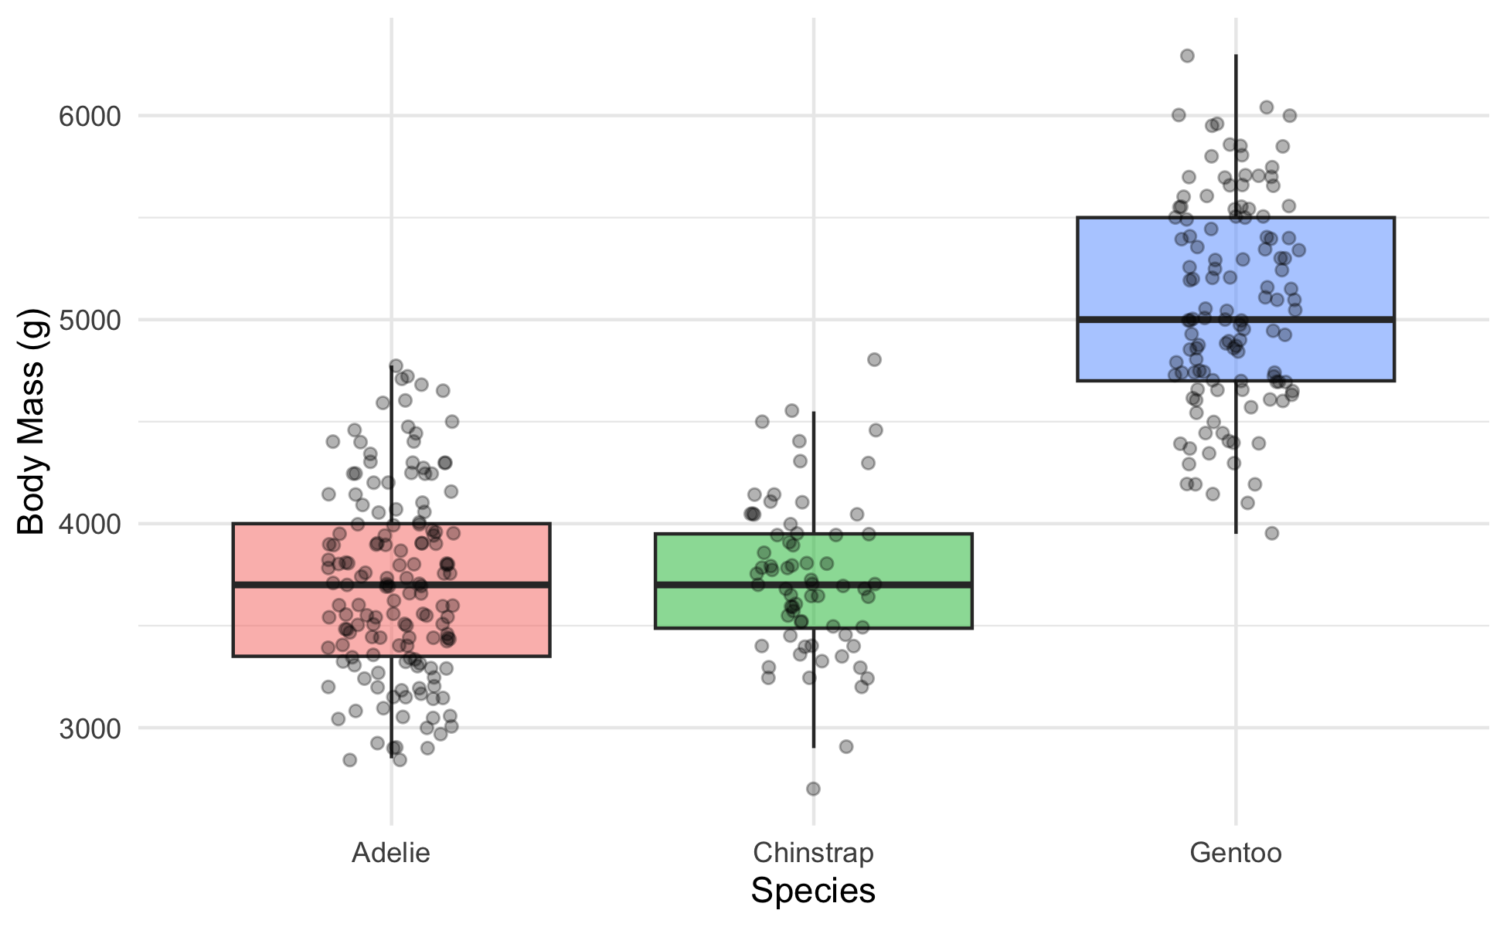
mass_box_plot <- penguins_df %>%
ggplot(aes(x = species, y = body_mass_g, fill = species)) +
geom_boxplot(alpha = 0.5, outlier.shape = NA) +
geom_point(
position = position_jitter(width = 0.15, seed = 42),
alpha = 0.3, size = 1.5
) +
labs(x = "Species", y = "Body Mass (g)") +
theme_minimal() +
theme(legend.position = "none")
mass_box_plot
Always plot before you test.
The picture usually tells the story before the p-value confirms it
Look for separation between boxes and roughly similar spread
📖 R4DS §9 — Layers

Slide 12
🛑 Pause — Do Activity Parts 1–3 Now
Load the penguins, plot body mass by species, and write your hypotheses. Predict which species differ before you run anything.

Slide 13
🧩 Chunk 2 of 4 · Fit the Model & Check Assumptions
We will cover: fitting the model, then checking normality of the residuals and equal variance across groups.
Tip
🖐 After this chunk: Activity Parts 4–6 (fit, QQ + Shapiro on residuals, Levene’s test).

Slide 14
Fit the Model
# ANOVA is a linear model with a categorical X ---------
mass_model <- lm(body_mass_g ~ species, data = penguins_df)
lm(Y ~ X) — the same syntax as regression (Lecture 06)
When X is categorical, that linear model is a one-way ANOVA
We check assumptions on this model before reading any p-value
Note
✅ Key idea
ANOVA and regression are the same machinery (lm). ANOVA just has a grouping variable instead of a numeric one.
📖 W&S §15.2

Slide 15
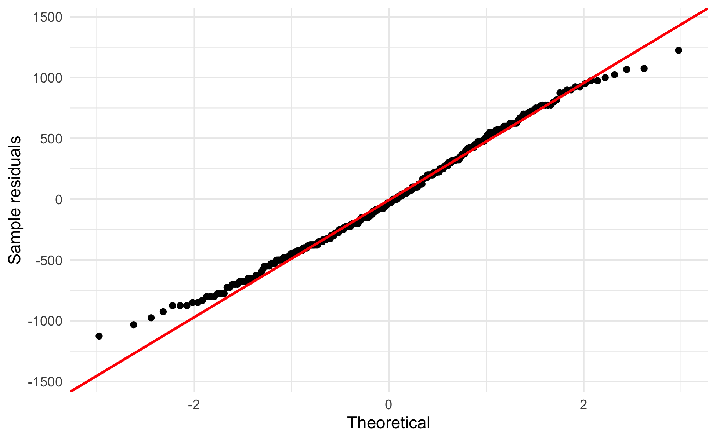
Assumption 1 — Normality of the Residuals
# QQ plot of residuals — points should track the line -
qq_mass_plot <- penguins_df %>%
mutate(resid = residuals(mass_model)) %>%
ggplot(aes(sample = resid)) +
stat_qq() +
stat_qq_line(color = "red", linewidth = 0.8) +
labs(x = "Theoretical", y = "Sample residuals") +
theme_minimal()
qq_mass_plot
Check normality of the residuals, not the raw masses
The QQ plot is the main tool; Shapiro-Wilk is a formal check
Important
Large-sample caution: with ~340 birds, Shapiro-Wilk flags tiny departures as “significant.” Trust the QQ plot — if points track the line, you’re fine.
shapiro.test(residuals(mass_model))
Shapiro-Wilk normality test
data: residuals(mass_model)
W = 0.99166, p-value = 0.05118

Slide 16
Assumption 2 — Equal Variance (Levene’s Test)
Note
🔮 Predict first: Look back at the boxplot spreads. Predict — will Levene’s test call the variances equal (p > 0.05) or unequal?

Slide 17
# Levene's test — H0: all groups have equal variance --
leveneTest(body_mass_g ~ species, data = penguins_df)
Levene's Test for Homogeneity of Variance (center = median)
Df F value Pr(>F)
group 2 5.1203 0.006445 **
339
---
Signif. codes: 0 '***' 0.001 '**' 0.01 '*' 0.05 '.' 0.1 ' ' 1
p > 0.05 → variances similar → classic ANOVA is fine
p < 0.05 → variances differ → use Welch’s ANOVA:
oneway.test(body_mass_g ~ species,
data = penguins_df,
var.equal = FALSE)
Same spirit as Welch’s t-test — robust when spreads differ.

Slide 18
🛑 Pause — Do Activity Parts 4–6 Now
Fit lm(body_mass_g ~ species), check the residual QQ plot + Shapiro, and run Levene’s test. Predict each result before you run it.

Slide 19
🧩 Chunk 3 of 4 · Run the ANOVA & Read the F Table
We will cover: the ANOVA table two ways — base aov() and car::Anova() — and why the difference matters for unbalanced data.
Tip
🖐 After this chunk: Activity Parts 7–8 (run both, read F / df / p).

Slide 20
Run the ANOVA — aov() and summary()
Note
🔮 Predict first: The boxplot looked very separated. Predict the p-value — closer to 0.5, 0.05, or far below 0.001?

Slide 21
# Classic ANOVA table (Type I sums of squares) --------
mass_aov <- aov(body_mass_g ~ species, data = penguins_df)
summary(mass_aov)
Df Sum Sq Mean Sq F value Pr(>F)
species 2 146864214 73432107 343.6 <2e-16 ***
Residuals 339 72443483 213698
---
Signif. codes: 0 '***' 0.001 '**' 0.01 '*' 0.05 '.' 0.1 ' ' 1
Reading the table:
Column | Meaning
Df | groups − 1, and residual df
F value | between ÷ within variance
Pr(>F) | the p-value for H₀
p < 0.05 → reject H₀ → at least one species differs. But which? Chunk 4.

Slide 22
Live Demo — Watch It Break (on purpose)
For unbalanced data we prefer car::Anova(). I’ll reach for it but type lowercase, and forget the package:
anova(mass_model) # base R — Type I, one model at a time
Anova(mass_model) # capital A — but car isn't loaded!
R stops:
Error in Anova(mass_model) :
could not find function "Anova"
The fix — load car, and mind the capital A:
library(car)
Anova(mass_model, type = "II")
Tip
✅ Why show a broken run?
anova() (base) and Anova() (car) are different functions — lowercase compares models with Type I sums of squares; capital-A gives the Type II/III table you want. “could not find function” almost always means a missing library().

Slide 23
car::Anova() — Type II for Unbalanced Data
# Type II sums of squares — the right call here -------
Anova(mass_model, type = "II")
Anova Table (Type II tests)
Response: body_mass_g
Sum Sq Df F value Pr(>F)
species 146864214 2 343.63 < 2.2e-16 ***
Residuals 72443483 339
---
Signif. codes: 0 '***' 0.001 '**' 0.01 '*' 0.05 '.' 0.1 ' ' 1
Why Type II?
Our groups have different n (unbalanced)
With one predictor the F is the same, but Type II is the habit you want before you meet two-way ANOVA, where the type genuinely changes the answer
Note
anova() = Type I (order-dependent). Anova(type = "II") = order-independent.

Slide 24
🛑 Pause — Do Activity Parts 7–8 Now
Run aov() + summary(), then car::Anova(type = "II"). Predict the F and p before you read them, and confirm both tables agree.

Slide 25
🧩 Chunk 4 of 4 · Which Groups Differ? Post-Hoc with emmeans
We will cover: ANOVA says “some differ” — emmeans says which, with the comparisons properly adjusted.
Tip
🖐 After this chunk: Activity Parts 9–11 (pairwise tests, letters, plot, report).

Slide 26
Post-Hoc — Pairwise Comparisons with emmeans
Note
🔮 Predict first: From the boxplot, predict — will all three species differ from each other, or will two be statistically tied?

Slide 27
# Estimated marginal means + Tukey-adjusted pairs -----
mass_emm <- emmeans(mass_model, pairwise ~ species)
mass_emm$contrasts
contrast estimate SE df t.ratio p.value
Adelie - Chinstrap -32.4 67.5 339 -0.480 0.8807
Adelie - Gentoo -1375.4 56.1 339 -24.495 <0.0001
Chinstrap - Gentoo -1342.9 69.9 339 -19.224 <0.0001
P value adjustment: tukey method for comparing a family of 3 estimates
Reading it:
emmeans(..., pairwise ~ species) gives each group’s mean and every pairwise comparison
The p-values are Tukey-adjusted — they already correct for multiple comparisons, so the family-wise error stays at 0.05
📖 W&S §15.4 — planned vs. unplanned comparisons

Slide 28
Compact Letter Display — Who Shares a Letter?
# Groups that SHARE a letter are NOT different --------
multcomp::cld(mass_emm$emmeans, Letters = letters)
species emmean SE df lower.CL upper.CL .group
Adelie 3701 37.6 339 3627 3775 a
Chinstrap 3733 56.1 339 3623 3843 a
Gentoo 5076 41.7 339 4994 5158 b
Confidence level used: 0.95
P value adjustment: tukey method for comparing a family of 3 estimates
significance level used: alpha = 0.05
NOTE: If two or more means share the same grouping symbol,
then we cannot show them to be different.
But we also did not show them to be the same.
How to read letters:
Same letter → not significantly different
Different letters → significantly different
This is the compact summary you see in published figures — one letter above each bar.
Tip
Install once: install.packages("multcomp")

Slide 29
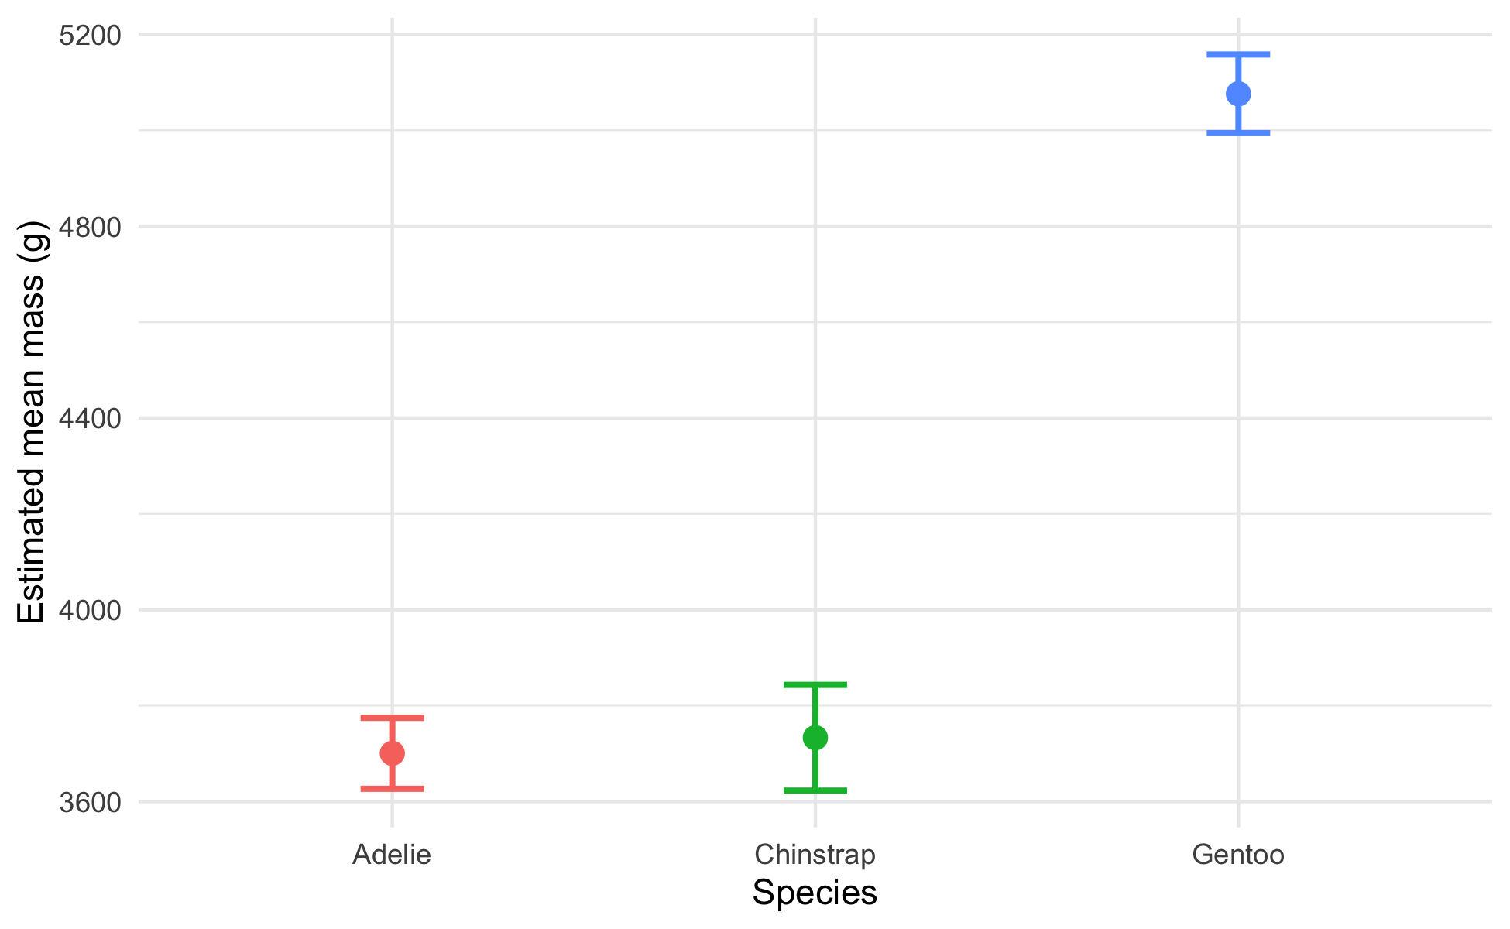
Plot the Result — Means ± CI
mass_emm_plot <- as.data.frame(mass_emm$emmeans) %>%
ggplot(aes(x = species, y = emmean, color = species)) +
geom_point(size = 3) +
geom_errorbar(
aes(ymin = lower.CL, ymax = upper.CL),
width = 0.15, linewidth = 0.9
) +
labs(x = "Species", y = "Estimated mean mass (g)") +
theme_minimal() +
theme(legend.position = "none")
mass_emm_plot
Estimated marginal means with 95% confidence intervals.
Non-overlapping intervals hint at real differences
Pair this plot with the letters for a publication-ready figure
The emmeans plot is the ANOVA cousin of Lecture 03’s mean ± SE plot.

Slide 30
How to Report an ANOVA
# Pull the F table values for reporting ---------------
mass_tab <- Anova(mass_model, type = "II")
mass_tab
Anova Table (Type II tests)
Response: body_mass_g
Sum Sq Df F value Pr(>F)
species 146864214 2 343.63 < 2.2e-16 ***
Residuals 72443483 339
---
Signif. codes: 0 '***' 0.001 '**' 0.01 '*' 0.05 '.' 0.1 ' ' 1
“Body mass differed significantly among the three penguin species (one-way ANOVA: F(2, 339) = 343.6, p < 0.001). Tukey-adjusted comparisons showed all three species differed, with Gentoo heaviest and Adelie lightest.”
Always include:
Test type (one-way ANOVA)
F, both df, and the p-value
The post-hoc result (which groups differ)
Group means ± SE or CI
Never write “p = 0.000” — use “p < 0.001”.

Slide 31
🛑 Pause — Do Activity Parts 9–11 Now
Run the emmeans pairwise test, get the letters, plot the means ± CI, and write your results sentence. Predict which species differ before you run the comparisons.

Slide 32
What We Learned Today
Concepts:
Many t-tests inflate the false-positive rate — ANOVA asks once
F = between-group ÷ within-group variance (signal ÷ noise)
Assumptions: normal residuals, equal variance (Levene)
ANOVA rejects H₀ for the group, but post-hoc finds which pairs differ
Tukey adjustment keeps the family-wise error at 0.05
R skills:
lm(Y ~ group) and aov() + summary()
car::Anova(model, type = "II")
leveneTest(), shapiro.test(residuals())
emmeans(model, pairwise ~ group) + multcomp::cld()
References:
📖 W&S Ch. 15 — ANOVA
📖 R4DS Ch. 16 — Factors
📖 emmeans vignettes
Up next — Lecture 12:
Joins — combine two tables on a shared key
The prerequisite for bigger datasets — and for maps

