Slide 1
Paper Calibration Curve: Predicting Leaf Area from Mass
The same analysis as regression_analysis_script.R — but as a report
Your Name Here

Slide 2
Introduction
To estimate leaf surface area without a leaf-area meter, we built a calibration curve. Paper of uniform stock has a constant area-per-gram, so the mass of a paper square is a near-perfect linear predictor of its area. Once we know that relationship, we can trace a leaf onto the same paper, weigh the tracing, and convert its mass to area.
Explanatory variable (X): paper mass (g) — easy to measure on a balance
Response variable (Y): paper area (cm²) — what we want to predict

Slide 3
Methods
We weighed 118 paper squares of known area (1–567 cm²) and fit a simple linear regression, area_cm2 ~ mass_g, with lm(). We checked the four regression assumptions using a residuals-vs-fitted plot and a normal Q–Q plot with a Shapiro–Wilk test on the residuals. All work was done in R with the tidyverse; this report was written in Quarto so every number and figure below is computed directly from the data.

Slide 4
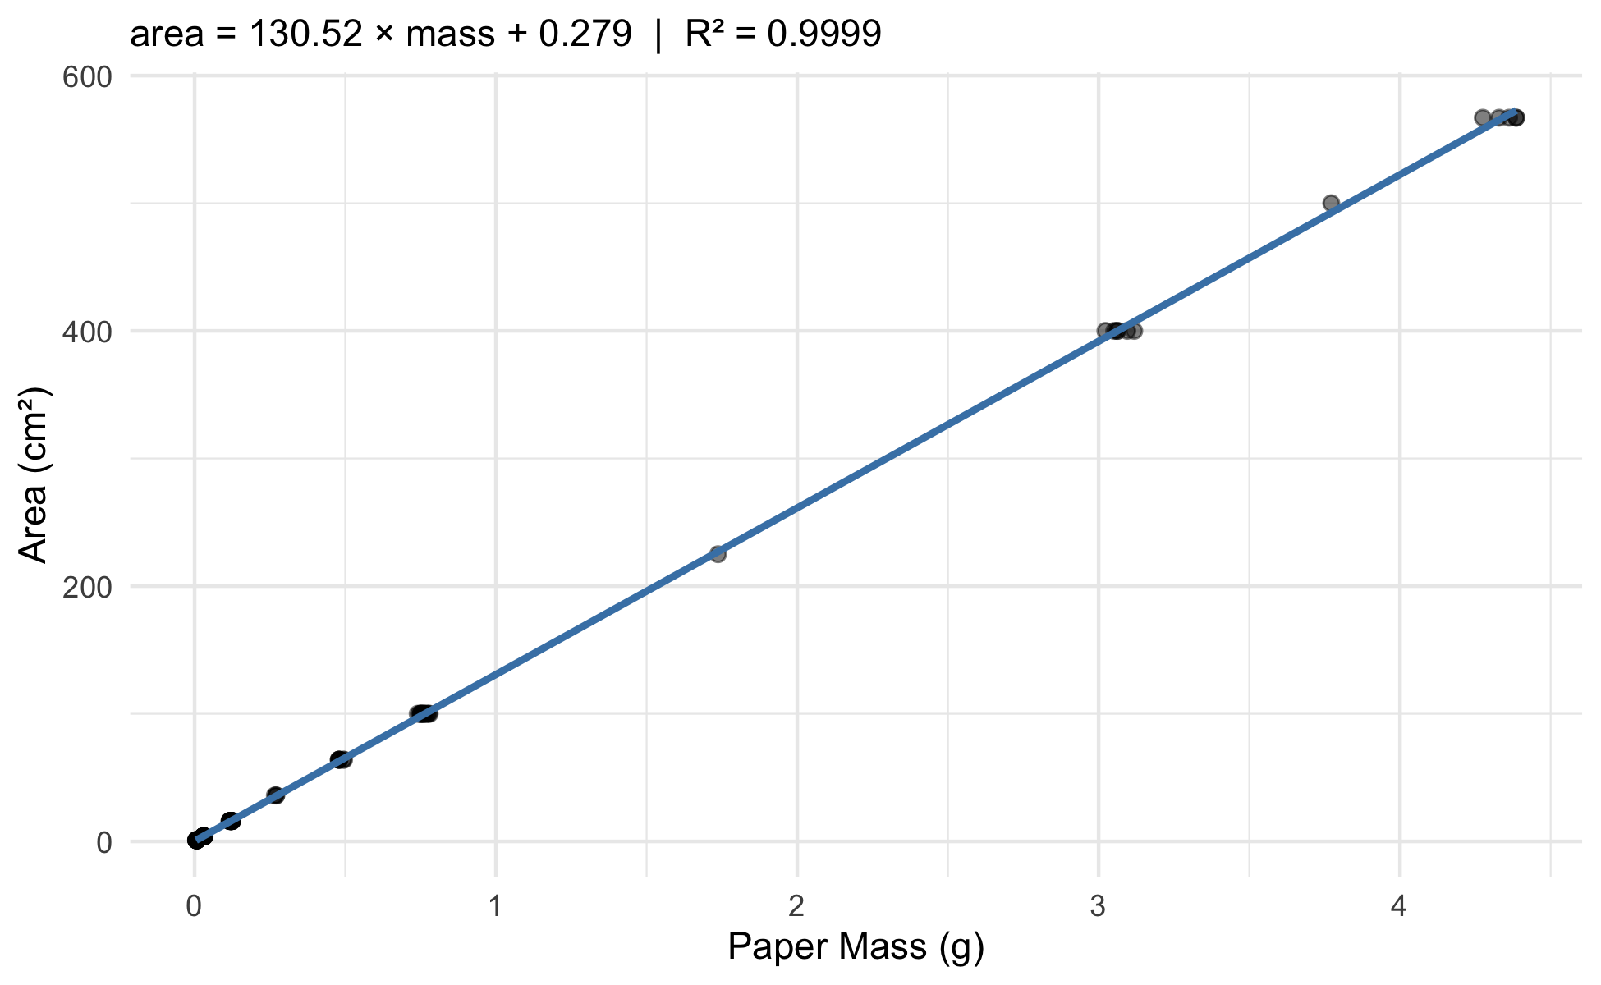
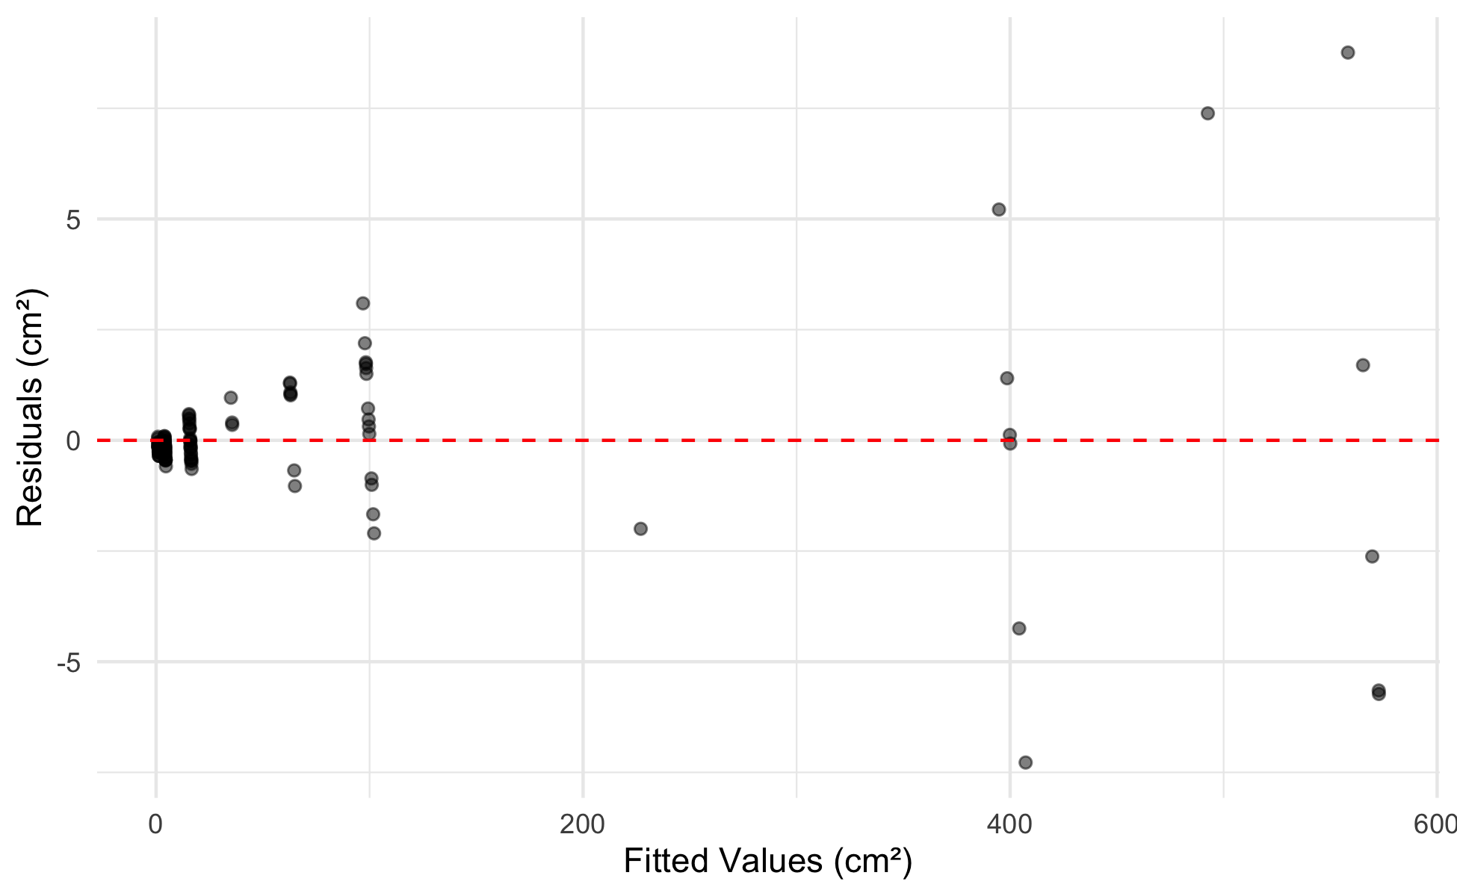
Results
Paper mass was an extremely strong predictor of paper area (linear regression: F(1, 116) = 7.849329^{5}, p < 5^{-224}, R² = 0.9999). The calibration equation was:
$$\hat{\text{area}}=130.52×\text{mass}+0.279$$
In words, every additional gram of paper corresponds to about 130.5 cm² of area.
Note
Notice that F, p, R², the slope, and the intercept above were never typed by hand — they are inserted with inline code like 130.52. Change the data file and re-render, and every one of these updates itself. That is the difference from the .R script, where you would copy each number into Word yourself.
The calibration curve
Assumption checks
A Shapiro–Wilk test on the residuals gave W = 0.677, p = 9.4^{-15}.
Predicting leaf area
Applying the equation to two example tracings, a sunny-side tracing of 0.092 g predicts an area of 12.3 cm², while a heavier shady-side tracing of 0.138 g predicts 18.3 cm² — consistent with our earlier finding that shady leaves are larger.
Figure 1. Paper area vs. mass with the least-squares line and 95% confidence band.
Figure 2. Residuals vs. fitted values — a random band with no funnel or curve supports linearity and equal variance.

Slide 5
Discussion
Write one short paragraph here. Did the calibration fit well (look at R² and Figure 1)? Did the residual plot and Shapiro–Wilk support the assumptions? Why is working in area (cm²) more biologically meaningful than raw mass (g) when comparing sunny and shady leaves? This is where you paste the results paragraph you drafted in the worksheet.

Slide 6
References
Whitlock, M. & Schluter, D. The Analysis of Biological Data (2nd ed.), Ch. 17.
Wickham, H. R for Data Science (2nd ed.) — https://r4ds.hadley.nz/

